Slide 1
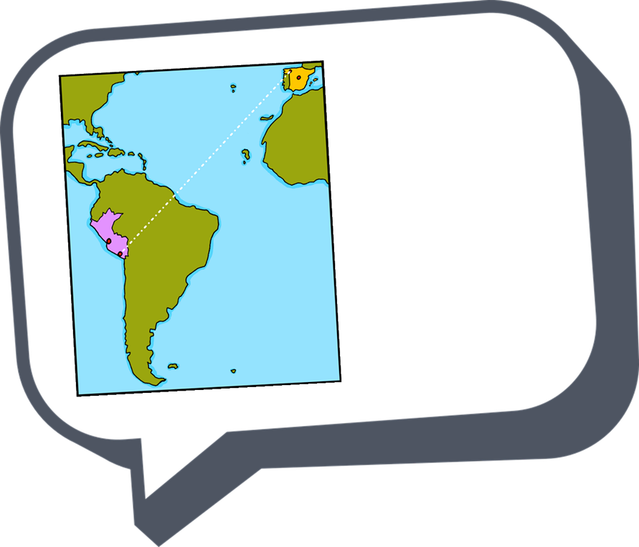
español - cover
Amarillo Term 2
¡hola!
español
Nombre : ……………………………………………….
Profesor (a) : ……………………………………..
Clase : ……………………………………………..

Slide 2
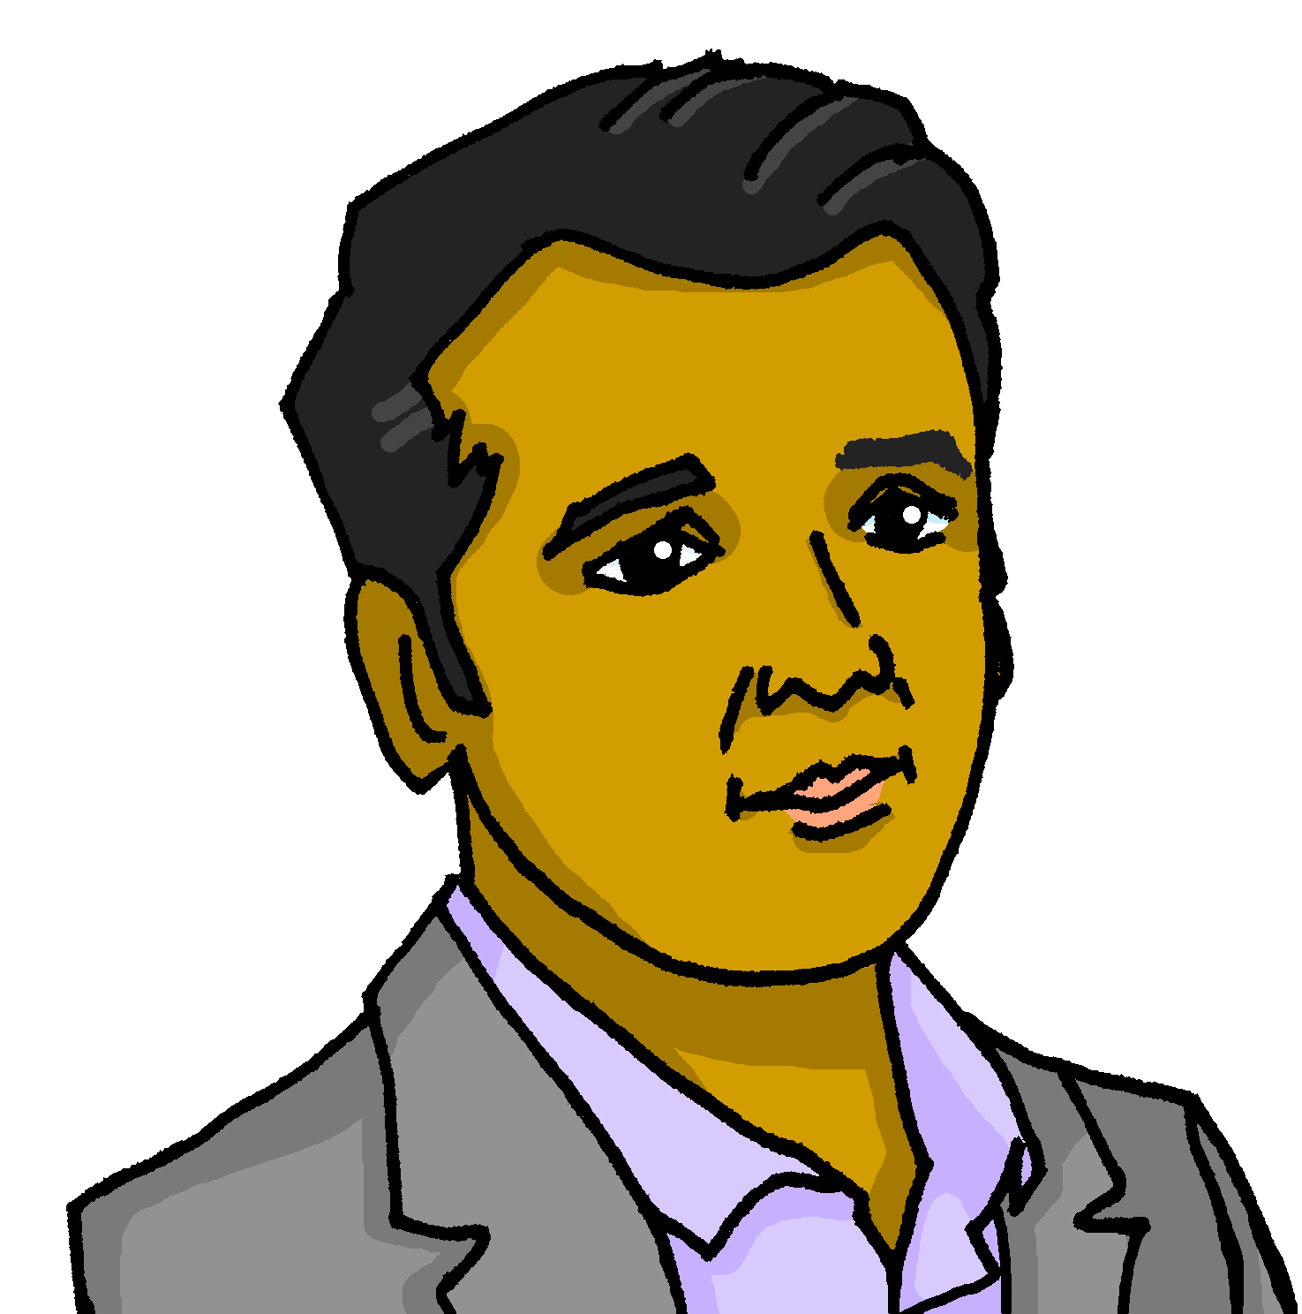
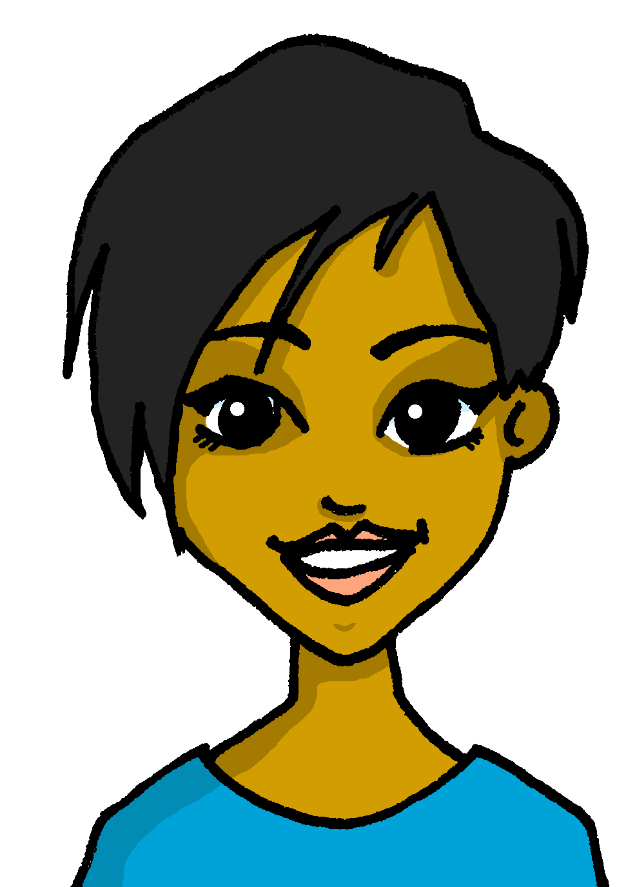
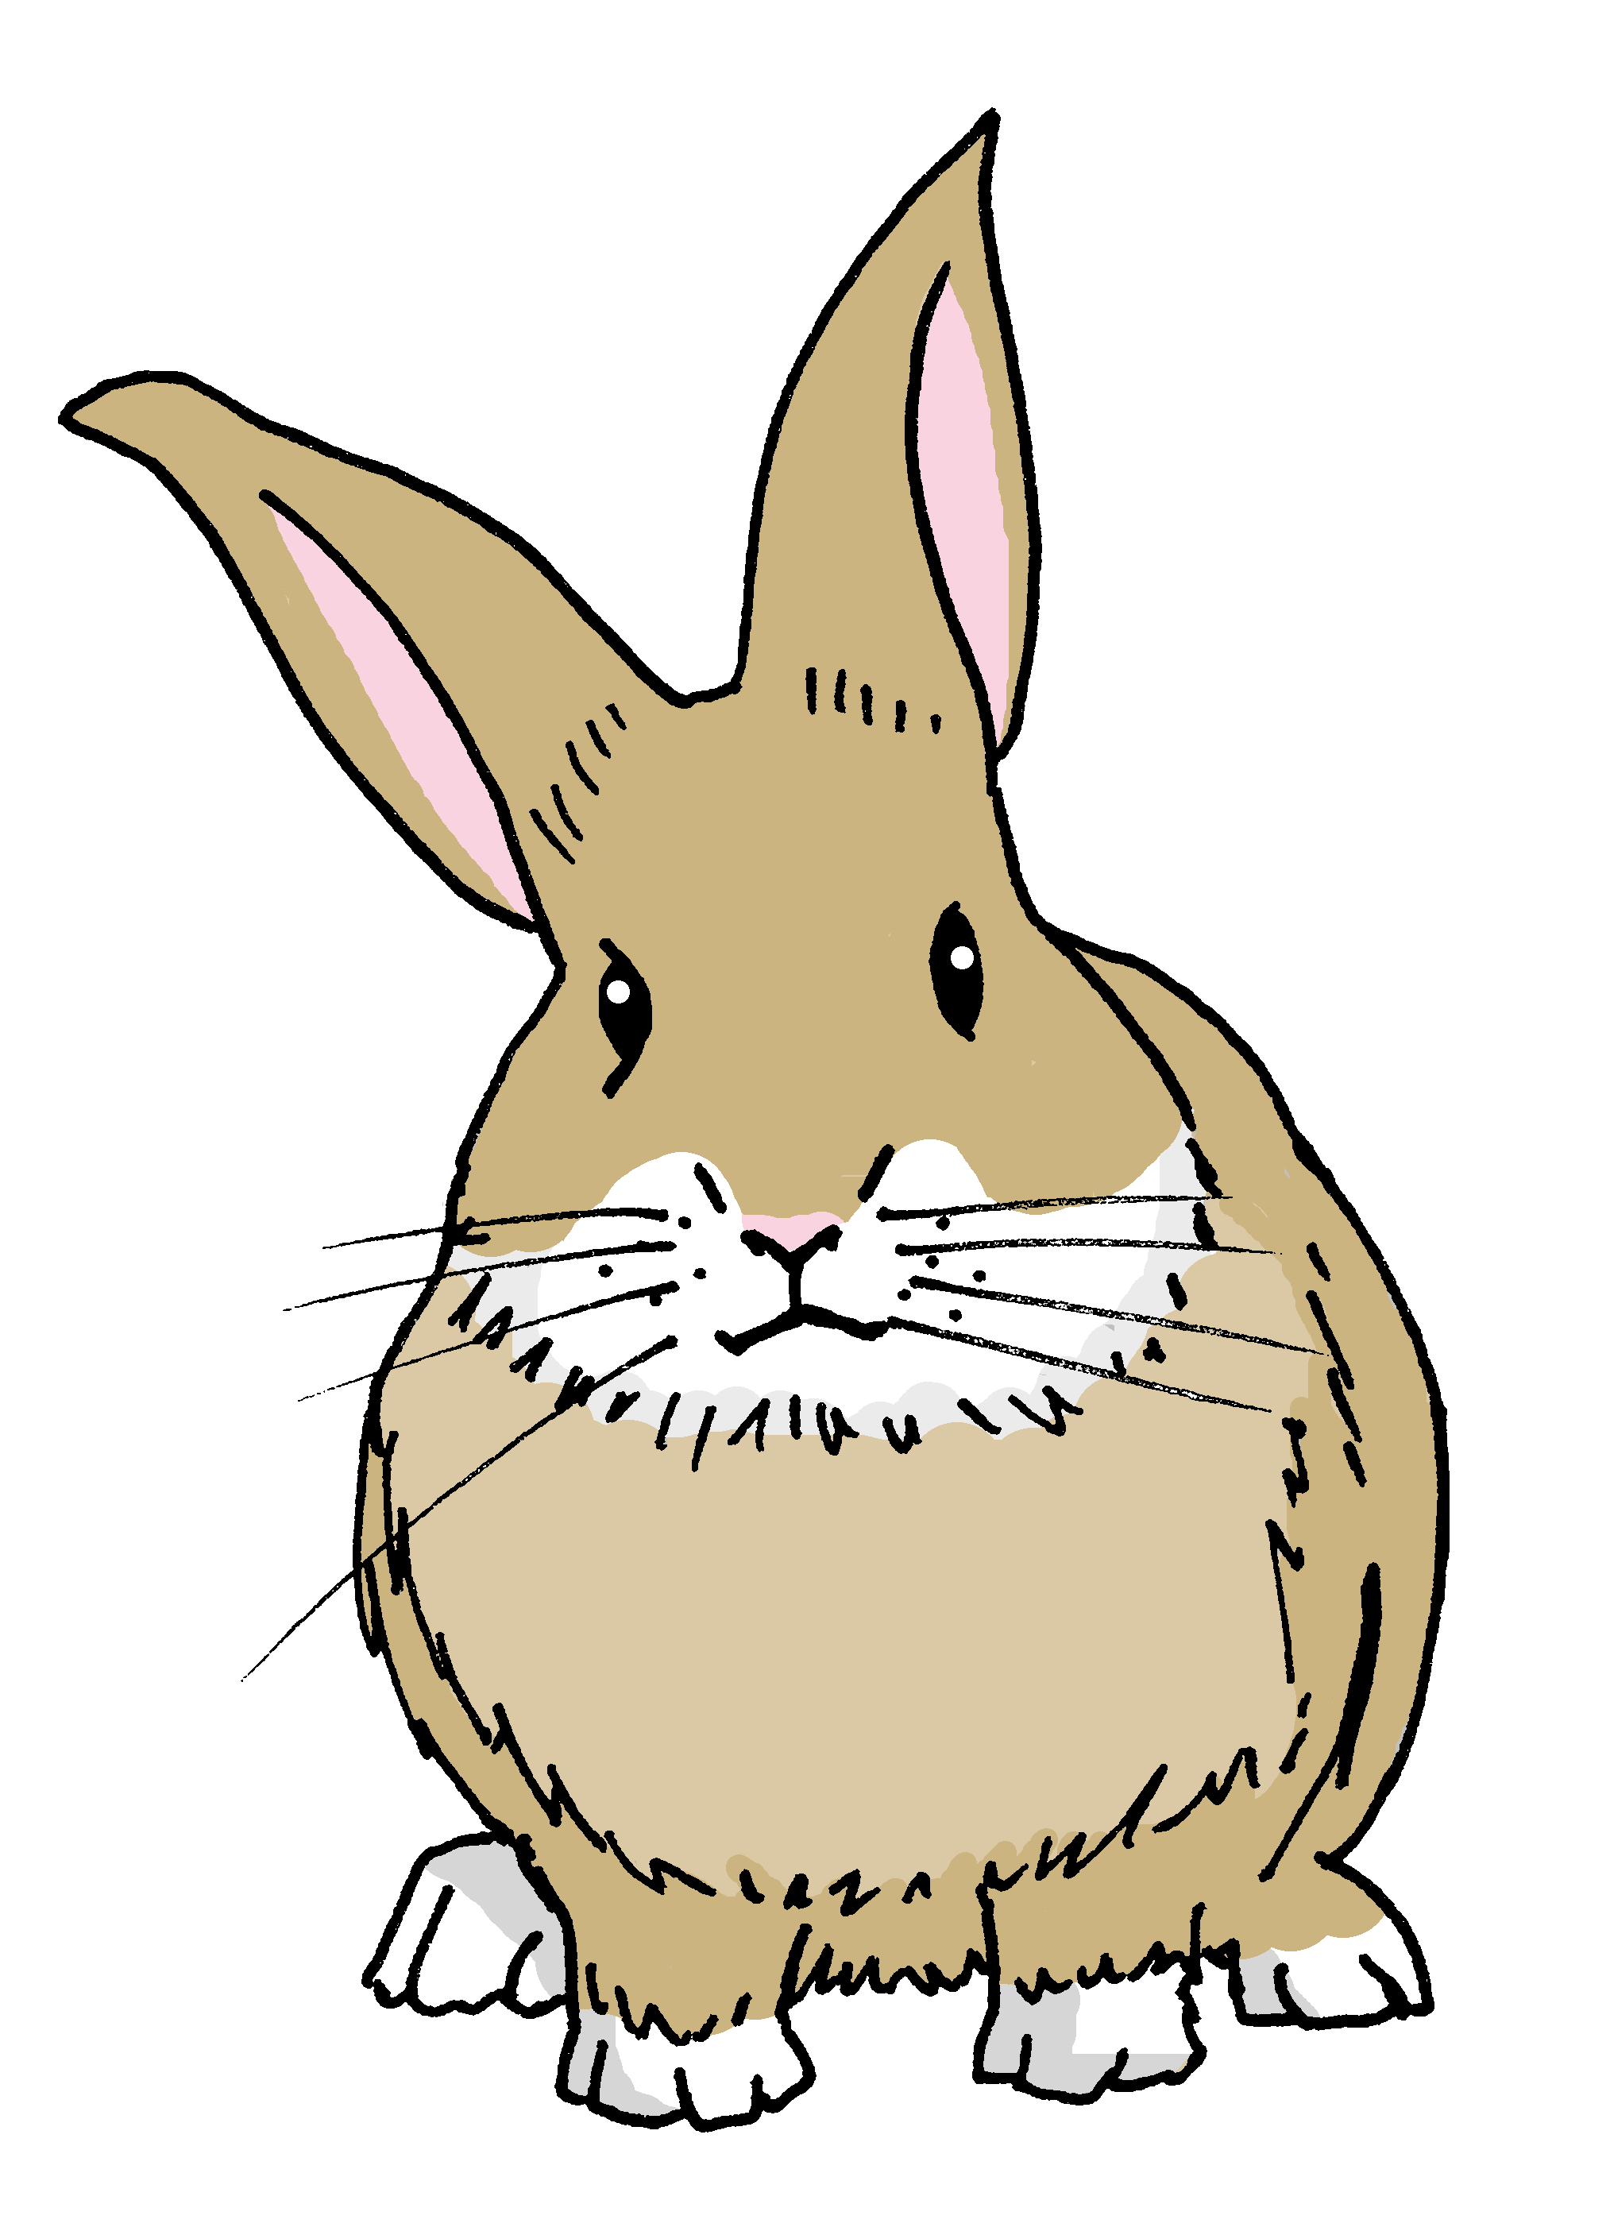
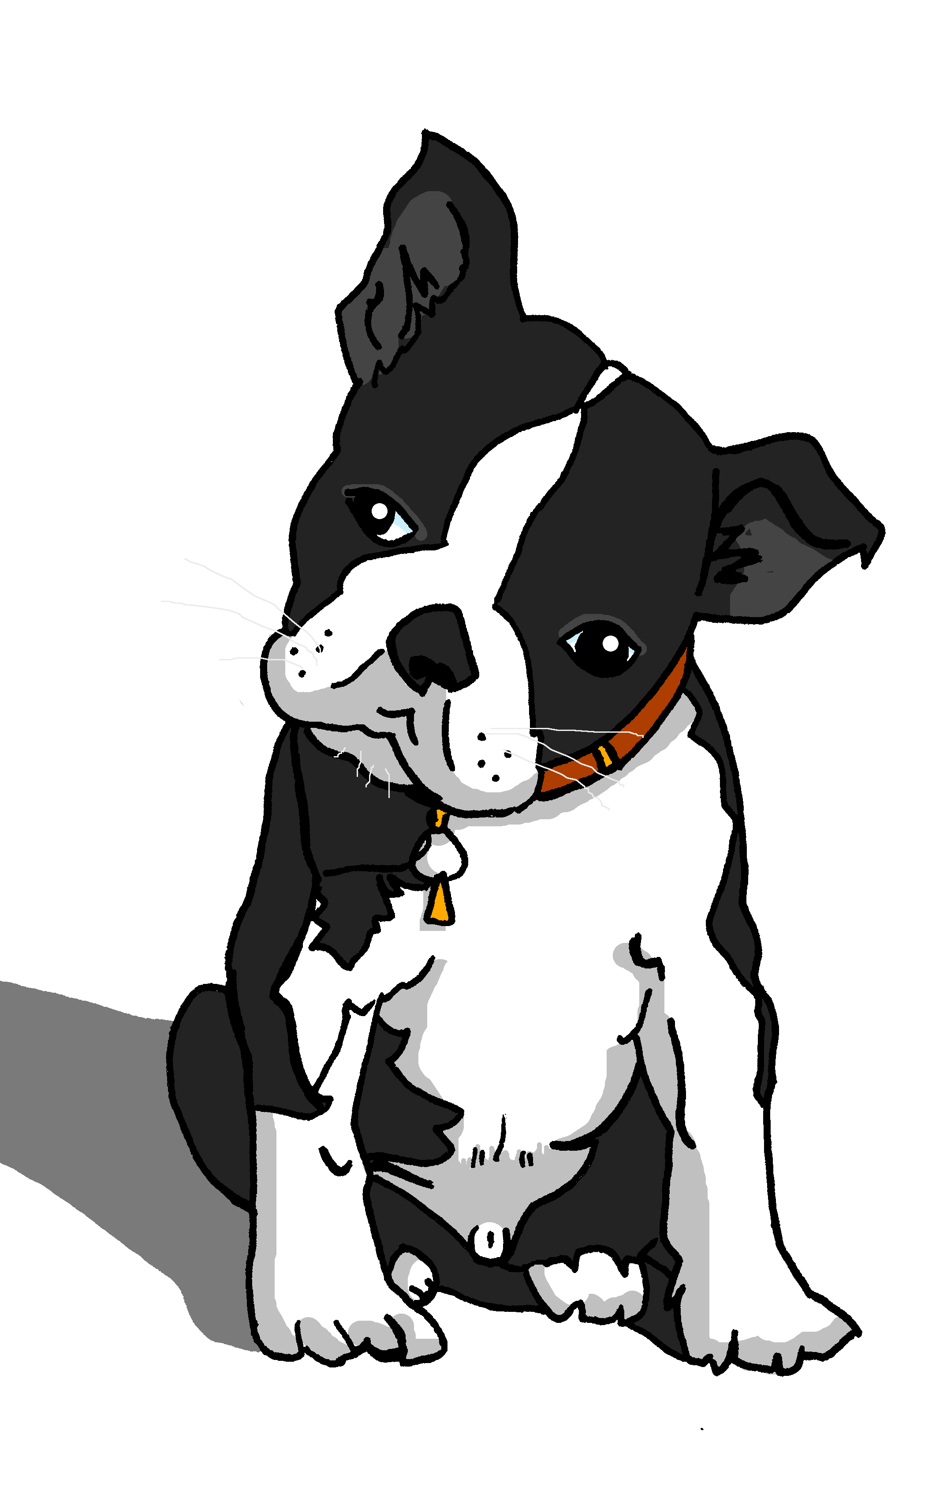
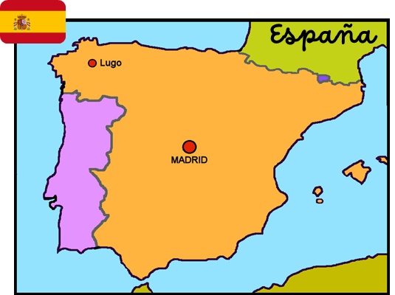
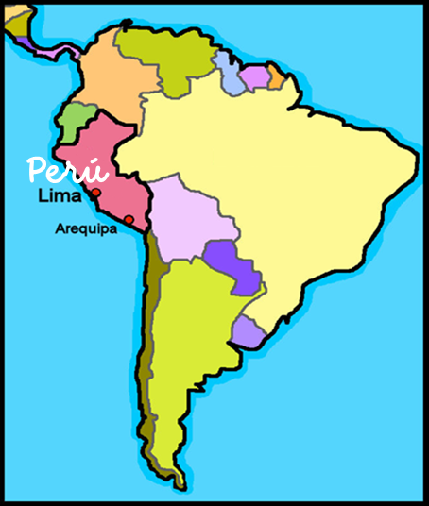
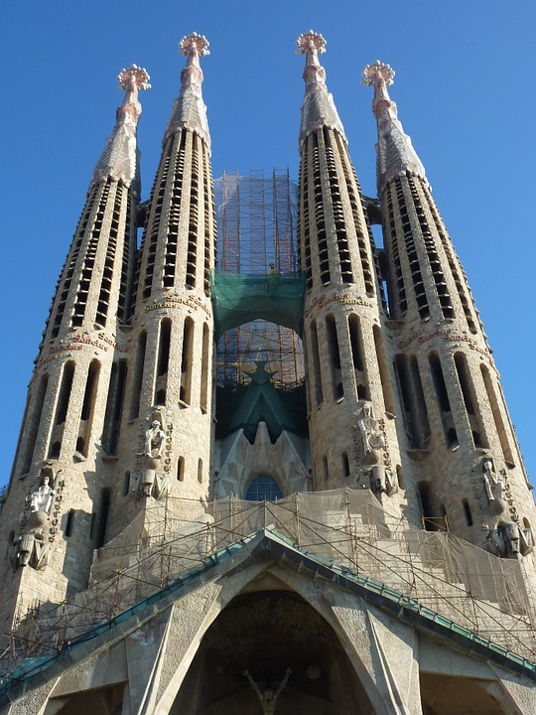
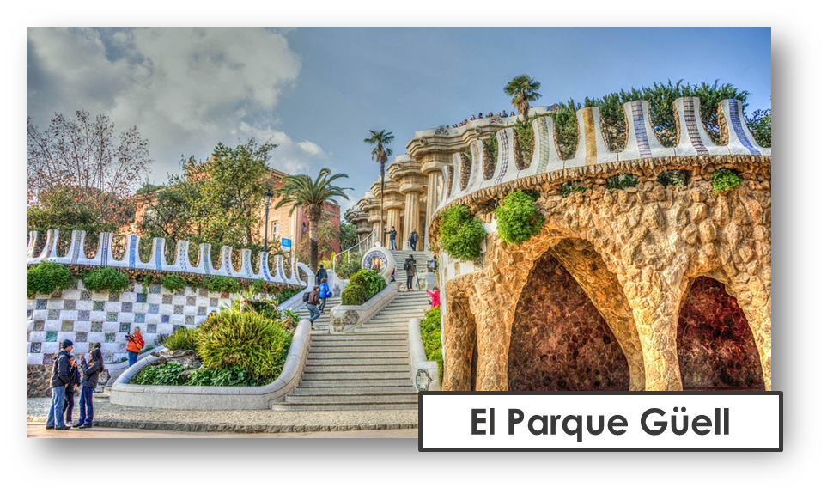
Characters
La familia Mamani Flores
Valeria
Miguel
Elena
Pedro
Hugo
Jorge
Ceci
Quique
Sofía
Luis
amigos
mascotas
Ángela
Pancho
Rubén
Manchita
Santi
Literatura
Manolito Gafotas
es un libro famoso en España.
Barcelona
Languages spoken in Spain
There are five official languages spoken in Spain? Spanish, Catalan, Basque (Euskera), Galician and Aranes.
Barcelona
español
catalán

Slide 3
Contents
Contents | page
Introduction: La familia Mamani Flores | 1
Fonética | 2
Term 1 Learning Overview | 3
1. Understanding and talking about activities in the Spanish club | 4-7
2. Talking about what activities you and others do at the weekend | 8-11
3. Talking about activities you and others do; Barcelona. | 12-16
4. Talking about activities you and others do; in the afternoon | 17-20
5. Talking about activities you and others do in school: reading club. | 21-26
6. Understanding and talking about activities I and others do at break time. | 27-30
7. Talking about how many things you and others have | 31-36
8. Saying how many things it has: describing a monster | 37-41
9. Saying how many things there is and there are. | 42-45
10. Progress checks
11. Pascua | 46

Slide 4
Term overview
Term 2 learning
UNIT | Context CommunicationCulture | Key ideas (GRAMMAR) | PHONICS | VOCABULARY
Unit 4a (W1-4) | Saying what I and others do at Spanish club at the weekend in Barcelona in the afternoon | Talking about doing Infinitive – regular AR verbs (singular) Definite articles – el, la | SSC [l] [ll] SSC [ga] [go] [gu] | Range of regular –AR verbs Family members Range of nouns, adjectives and adverbs
Unit 4b (W5-6) | Saying what I and others do break time reading club | Talking about doing (2) Infinitive – regular ER verbs (singular) Personal ‘a’ | SSC [ga] [go] [gu] SSC [ca] [co] [cu] SSC [que] | Range of regular –ER verbs Range of singular masculine and feminine nouns
Unit 5 (W7-9) | Saying how many, describing things my monster revision | Talking about more than one Essential verb: there is/are – hay Plural indefinite articles – unos, unas Regular plural marking on nouns [-s] | SSC [qui] Revisit [que] [qui] [ce] [ci] | Numbers 1-12 Parts of the body
Unit 6 (W10-11) | Revision Easter | Revisit key ideas | Revisit SSC | Revisit vocabulary

Slide 5
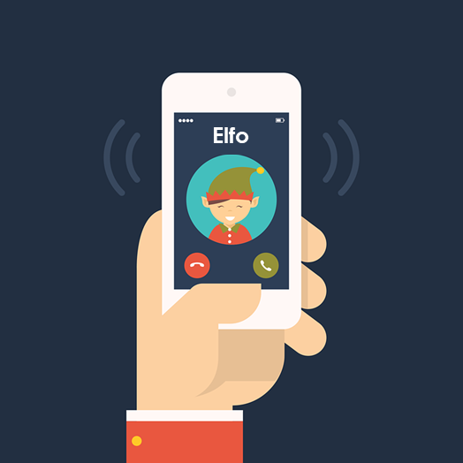
Phonics
Phonics
Spanish vowels are usually short and open!
[l]
[ll]
libro
llamar
[ga]
[go]
[gu]
ganar
lago
gusano
[que]
[qui]
These 3 sound like [k]
You know the SSC
[ca], [co], [cu].
paquete
quince
The same /k/ sound in front of ‘e’ and ‘i’. E.g. bicicleta & celebrar.

Slide 6
Rojo term 2 week 1
Saying what I and others do
1
Amarillo term 2
pronunciar
Understanding and talking about activities at Spanish club
[l]
El club de español
Describing activities
libro
Luis
Write down the key language for this week.
vocabulario
buscar |  | usar
crear |  | información
presentar |  | país
importante |  | divertido
interesante
Infinitives: -ar verbs
gramática
[to ____]
The infinitive often describes the general meaning of the verb.
In English, this is often written ‘to + verb’:
It’s important to listen.
In Spanish, many infinitives end in –ar:
Es importante escuchar.
You can also begin a Spanish sentence with the infinitive:
Escuchar es importante.
Listening is important.
Here we
translate the Spanish infinitive with the –ing form of the verb in English.
Translate the examples.
Crear es interesante. → _______________________________.
Es interesante crear. → ______________________________.
4

Slide 7
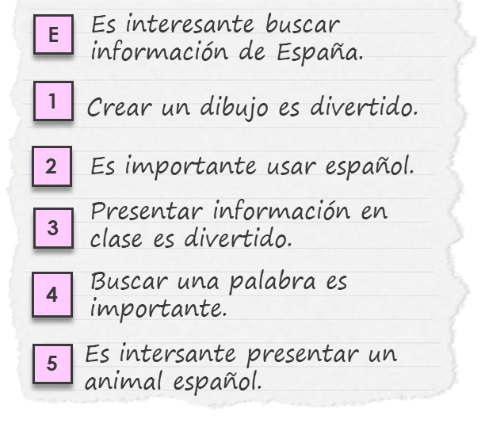
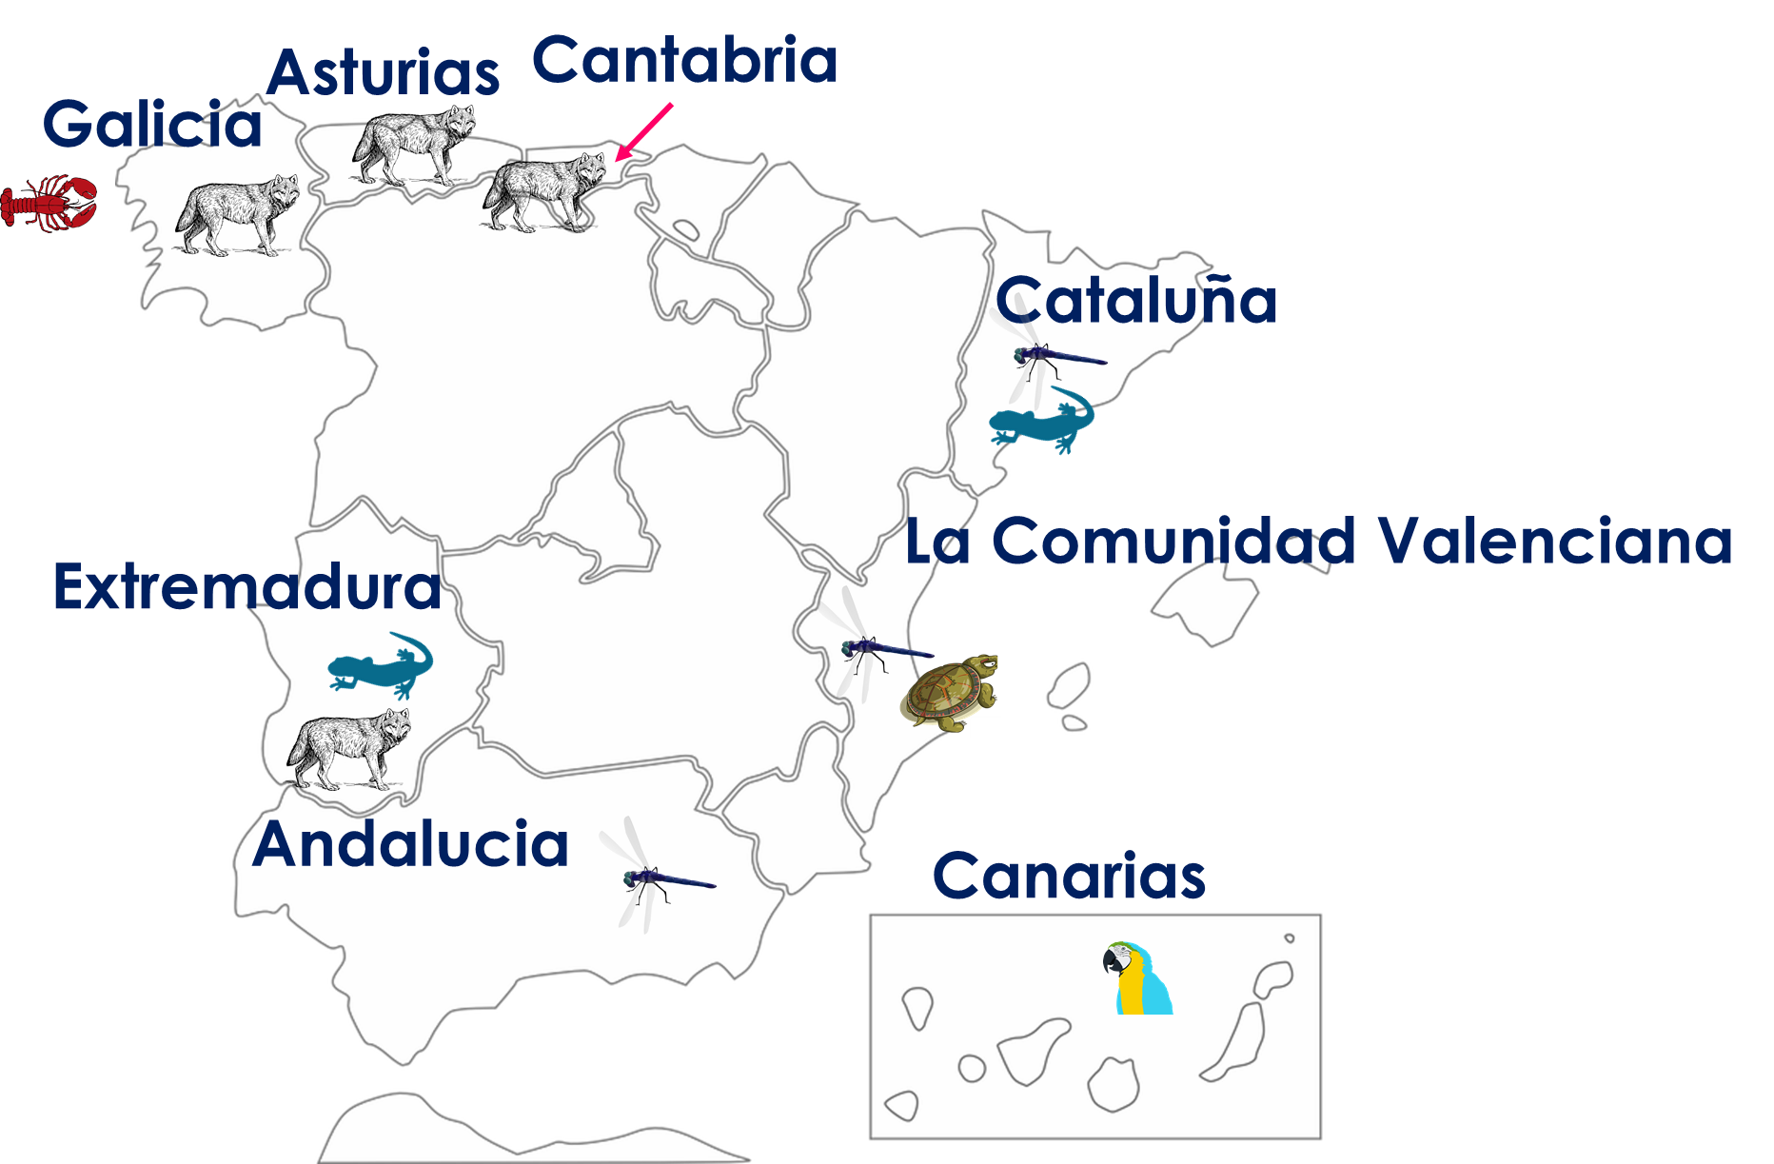
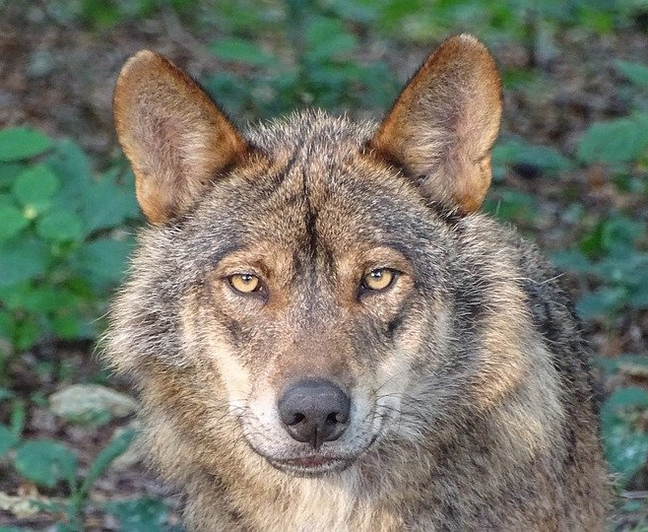
Rojo term 2 week 1
Saying what I and others do
1
Amarillo term 2
escuchar
El señor Valero habla. ¿Dónde está el infinitivo?
Escucha y marca .
El señor Valero =
Mr Valero
 | at the beginning | at the end
E
1
2
3
4
5
infinitivo en español | adjetivo en inglés
u _ _ _
leer
After a term in his school, Quique writes what he’s learned.
Quique escribe. Lee y completa las frases.
to
E
It is interesting ____ _________ information about Spain.
1
____________ a drawing is fun.
2
It is important ____ _____ Spanish.
3
_____________ information in class is _____________.
4
____________ a word is important.
5
It is _____________ to present a Spanish animal.
escuchar
Escucha. Escribe A-F en orden (1-6).
 | [A] un lobo ibérico
 | [B] una salamandra
 | [C] una libélula
 | [D] una langosta
 | [E] un loro
 | [F] un galápago
el = the (m) / la = the (f)
en peligro de extinción = endangered
El lobo ibérico está en peligro de extinción*.
5

Slide 8
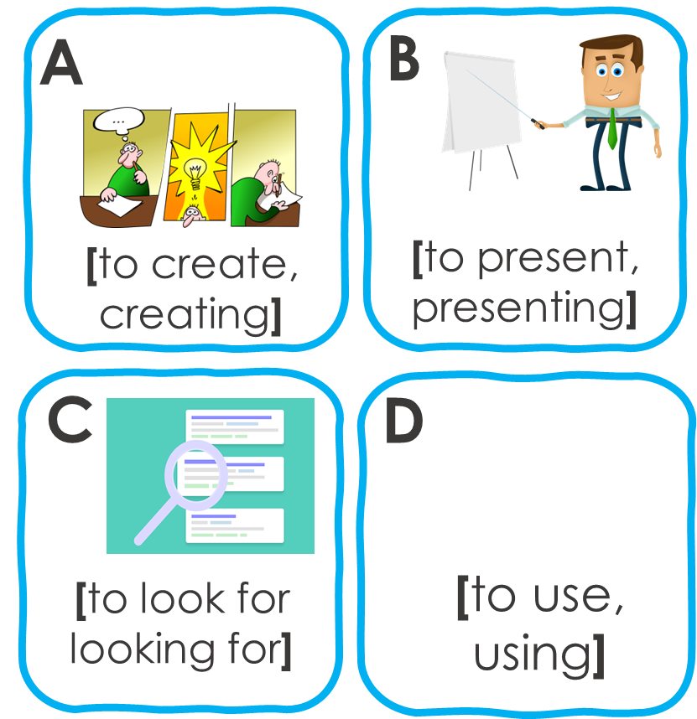
Rojo term 2 week 1
Saying what I and others do
1
Amarillo term 2
escuchar
Quique habla con su primo Luis. Escucha.
¿Qué infinitivo es?
Escribe la letra (A-D) y el adjetivo en inglés.
 | imagen | adjetivo | información extra
E
1
2
3
4
5
B
fan…
su = his/her | con = with
primo = male cousin
leer
[A] Lee las frases y marca la opción correcta.
 | Frase en español
E | Es importante usar vocabulario nuevo.
1 | Presentar información en español es increíble.
2 | Es divertido buscar una palabra.
3 | Buscar una respuesta es interesante.
4 | Crear en clase es importante.
5 | Es divertido buscar información de un país.
verbo en inglés
to use | using | to look for | looking for
to present | presenting | to create | creating
presenting | to present | to look for | looking for
to look for | looking for | to use | using
to create | creating | to look for | looking for
using | to use | looking for | to look for
[B] Escribe las frases en inglés .
E | It’s ______________ to use new _________________.
1
2
3
4
5
6

Slide 9
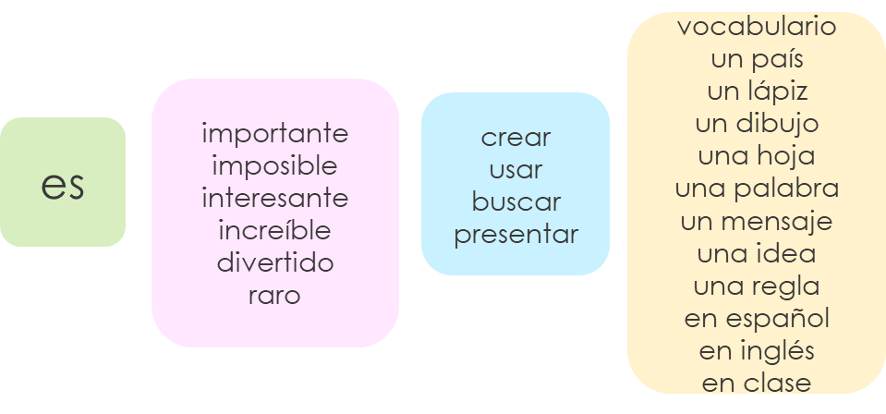
Rojo term 2 week 1
Saying what I and others do
1
Amarillo term 2
leer
Escribe en inglés. Can you get at least 15 points?
 | pesado | ahora | puerta
 | clase | cómodo | positivo
 | mesa | perro | profesora
 | tiene | dibujo | hermana
 | divertido | información | usar
 | buscar | crear | presentar
x3
x2
x1
escribir
Escribe 5 frases en español.
Not all
combinations
are possible so translate your sentences into English to ensure they make
sense!
1
2
3
4
5
7

Slide 10
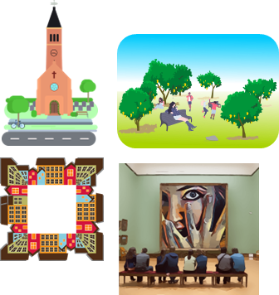
Rojo term 2 week 2
Saying what I and others do
2
Amarillo term 2
pronunciar
Talk about what activities you and others do at the weekend.
[l]
[ll]
Describing activities
libro
llamar
Write down the key language for this week.
vocabulario
visitar |  | museo
iglesia |  | papá
mamá |  | parque
plaza |  | con
Knowing who does what
[–ar verbs: ‘I’]
gramática
We have learned the infinitive form of a verb often describes the general meaning of a verb. In English, this is often written ‘to + verb’.
In Spanish, the infinitive of the verb often ends in –ar.
We don’t
To mean ‘I’ with a verb, the verb ending changes.
need pronouns because the verb ending tells us who is doing the action.
We remove –ar and add – o.
Ejemplo
General meaning
I
+ o
hablar
Es interesante visitar un museo.
Visito un museo.
It’s interesting to visit a museum.
I visit a museum.
Here we
translate the Spanish infinitive with the –ing form of the verb in English.
Translate the examples.
Usar español es importante. → ___________________________.
Hablo español. → ______________________________.
8

Slide 11
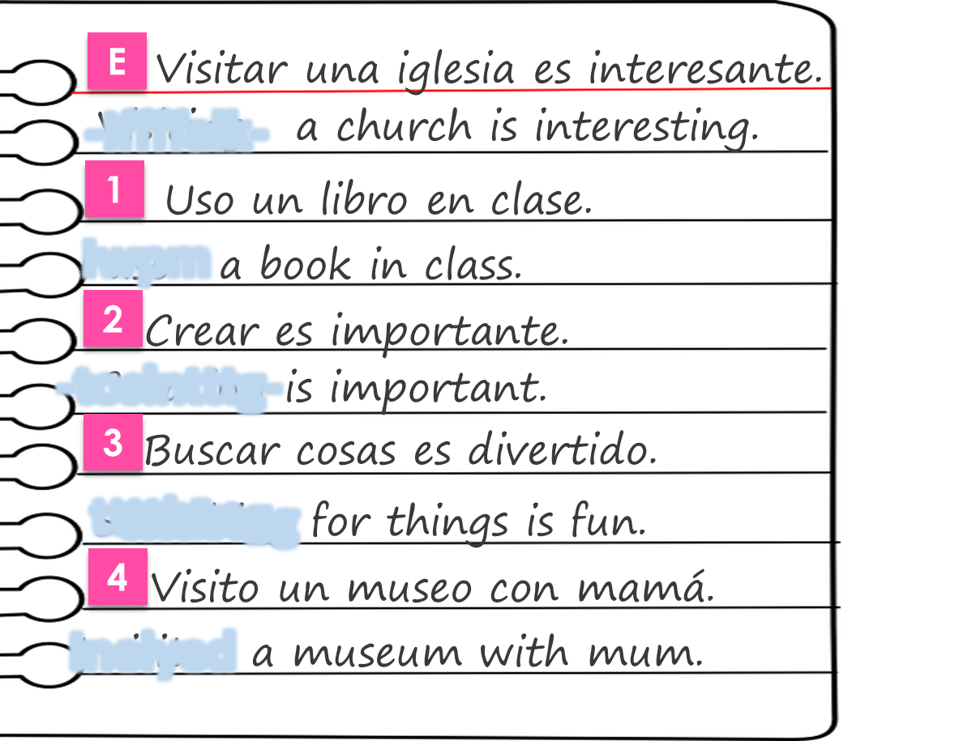
Rojo term 2 week 2
Saying what I and others do
2
Amarillo term 2
leer
Agua 💦 en los deberes de Sofía.
Lee las frases y marca .
Escribe en verbo en inglés.
 | general meaning | I
E
1
2
3
4
5
verbo
When the sentence
begins with the infinitive, we use the –ing form of the English verb.
Knowing who does what
[–ar verbs: ‘I’ vs. s/he, it]
gramática
In Spanish, the words for ‘I’ and ‘s/he’ (pronouns) are often unnecessary.
To mean ‘I’ with a verb, we remove –ar and add – o.
To mean ‘s/he, it’ with a verb, we remove –ar and add – a.
I
Ejemplo
s/he, it
Visito un museo.
visitar
Visita una iglesia.
I visit a museum.
S/he visits a church.
escuchar
Quique compara su fin de semana con mamá
Escucha, marca y escribe la Información.
 | Quique (I) | mamá (she)
E
1
2
3
4
5
verbo | información extra
compara = s/he compares
su = his/her
fin = end
(la) semana = week
9

Slide 12
Rojo term 2 week 2
Saying what I and others do
2
Amarillo term 2
pronunciar
Pronuncia las palabras y colecciona monedas .
Write your favourite words with the sound [l] and [ll] here.
leer
[A] Quique escribe 📝 sobre* el fin de semana.
¿Quién es? Marca .
 | Quique (I) | Mamá Elena (she)
1
2
3
4
5
6
7
1
Busco un libro en el parque.
Presenta información.
Uso mi barco en el parque.
Visito una plaza nueva.
Usa solo* inglés.
Visita un museo importante.
Busca ideas en un libro.
2
3
4
5
6
7
[B] Lee otra vez. ¿Es divertido, importante, interesante o rara? Escribe [D]. [Im], [In] o [R].
otra vez = again
escuchar
¿Quién es? Marca .
Escucha y escribe.
I
s/he, it
1 | _________ un animal con papel.
2
3
4
5
Cr_ _ _
10

Slide 13
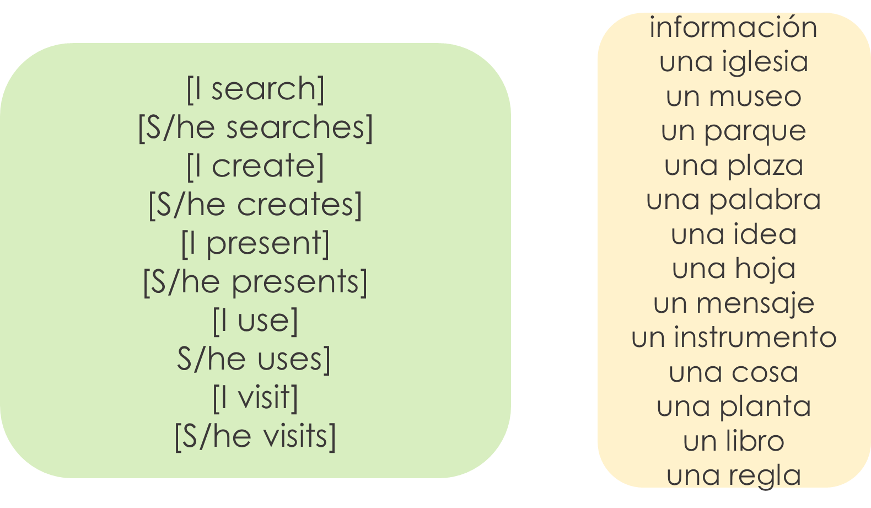
Rojo term 2 week 2
Saying what I and others do
2
Amarillo term 2
escribir
Escribe en español. Can you get at least 15 points?
 | happy | where? | impossible
 | a ruler | incredible | happy
 | a sheet, leaf | a pencil | an idea
 | you have | a message | a word
 | to visit | a church | un museum
 | a park | a square | with
x3
x2
x1
escribir
Escribe 5 frases en español.
Not all
combinations
are possible so translate your sentences into English to ensure they make
sense!
1
2
3
4
5
11

Slide 14
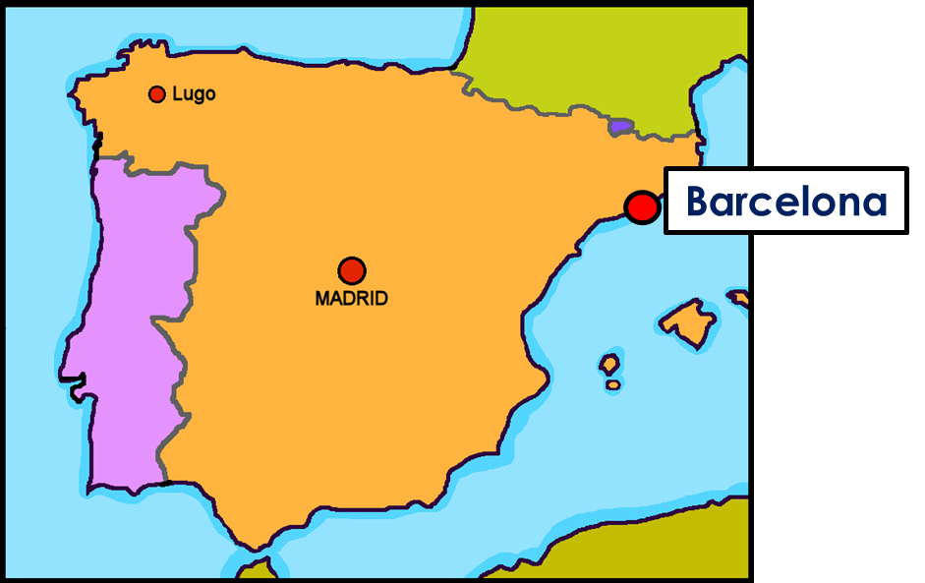
Rojo term 2 week 3
Saying what I and others do
3
Amarillo term 2
pronunciar
Barcelona
Talking about activities you and others do: Barcelona
[ga]
[go]
Outdoor activities
ganar
lago
Write down the key language for this week.
vocabulario
montar |  | pasear |  | la
bicicleta |  | estadio |  | el
madre |  | padre |  | por
ciudad |  | de
Definite articles: singular and plural
gramática
[the]
Remember! In Spanish, things, as well as people and animals, are either masculine or feminine. We say that they have gender.
This is
grammatical, not biological gender! A house (una casa) is not female, it is a feminine noun.
To say a (or an) in Spanish use un before a masculine noun and una before a feminine noun.
To say the before a singular noun, you use ‘el’ or ‘la’.
masculine |  | masculine
un museo | a museum | el museo | the museum
un parque | ___ park | el parque | ___ park
un estadio | ___ stadium | el estadio | ___ stadium
feminine |  | feminine
una iglesia | a church | la iglesia | the church
una ciudad | ___ city | la ciudad | ___ city
una bicicleta | ___ bicycle | la bicicleta | ___ bicycle
12

Slide 15
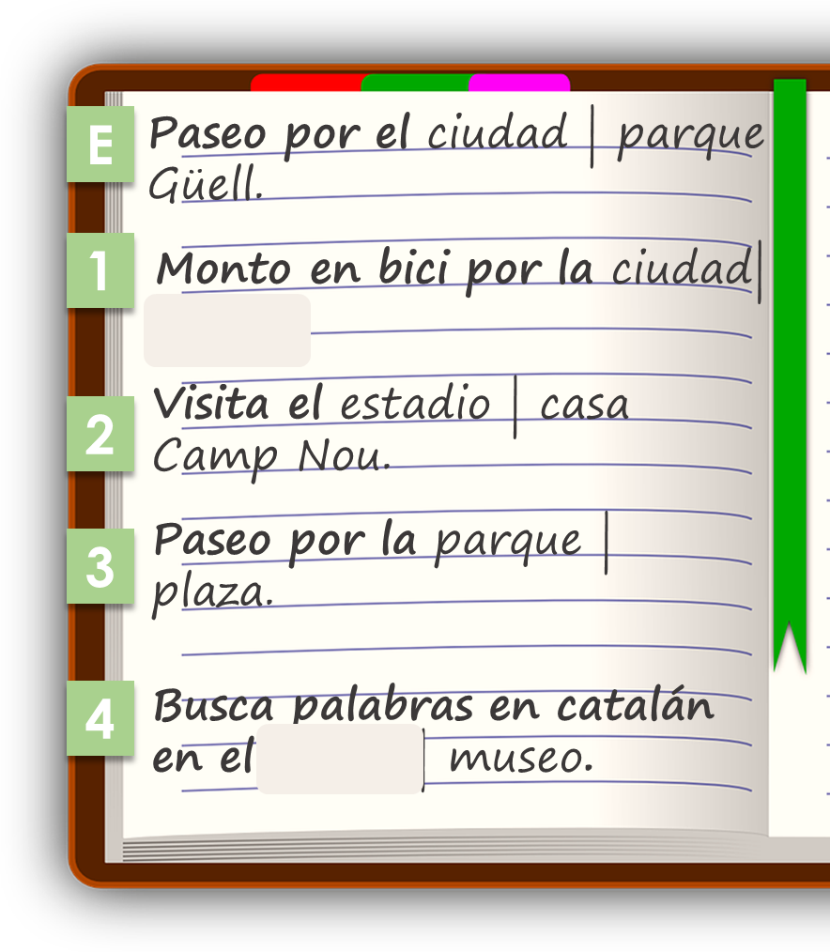
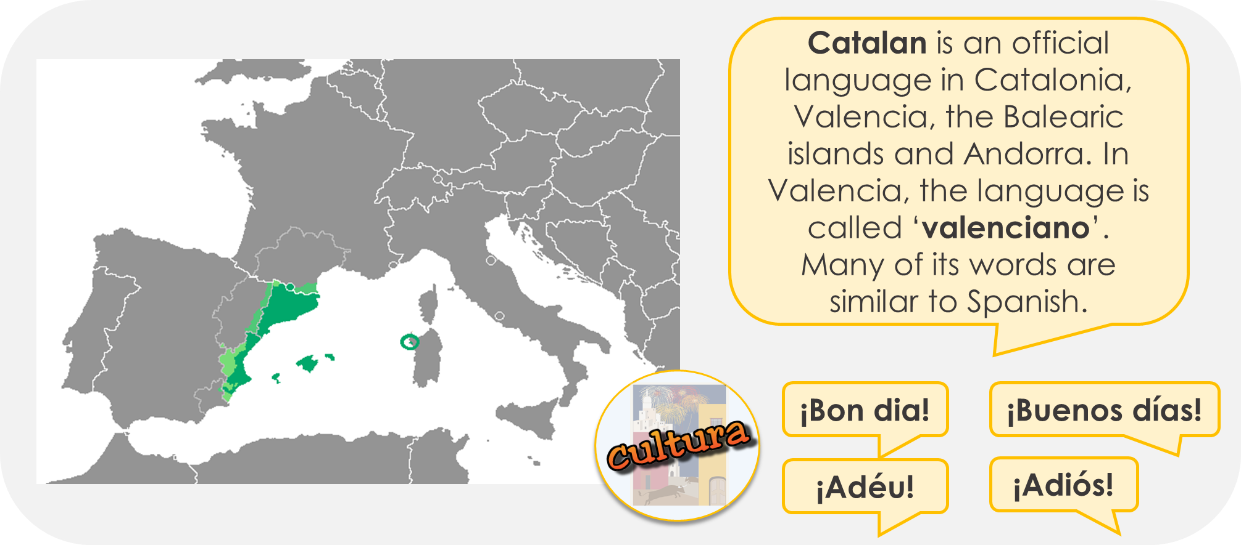
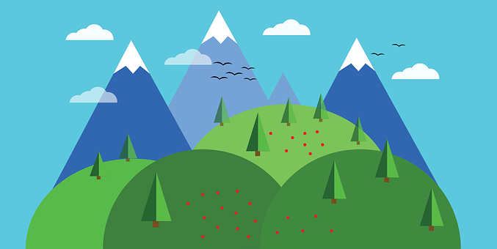
Rojo term 2 week 3
Saying what I and others do
3
Amarillo term 2
leer
Quique habla de actividades en Barcelona.
[A] ¿Es ‘I’ (Quique) o ‘she’ (Sofía)?
[B] Choose the correct noun.
Quique (I) | Sofía (she) | Where?
E
p _ _ _
1
2
3
4
(el) aire libre – the open air
escuchar
Quique habla de las actividades al aire libre.
Escucha.
¿Es ‘el’ o ‘la’?
¿Quién es?
¿Es al aire libre?
¿dónde?
playa | estadio
ciudad | museo
iglesia | casa
plaza | parque
bicicleta | estadio
plaza | parque
Quique (I) or Sofía (she) | ¿al aire libre?
E | el | la
1 | el | la
2 | el | la
3 | el | la
4 | el | la
5 | el | la
13

Slide 16
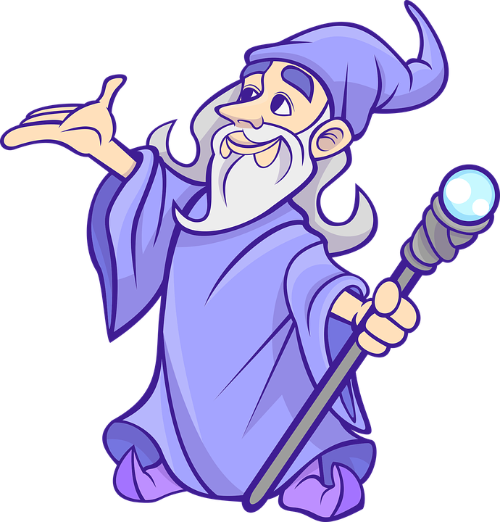
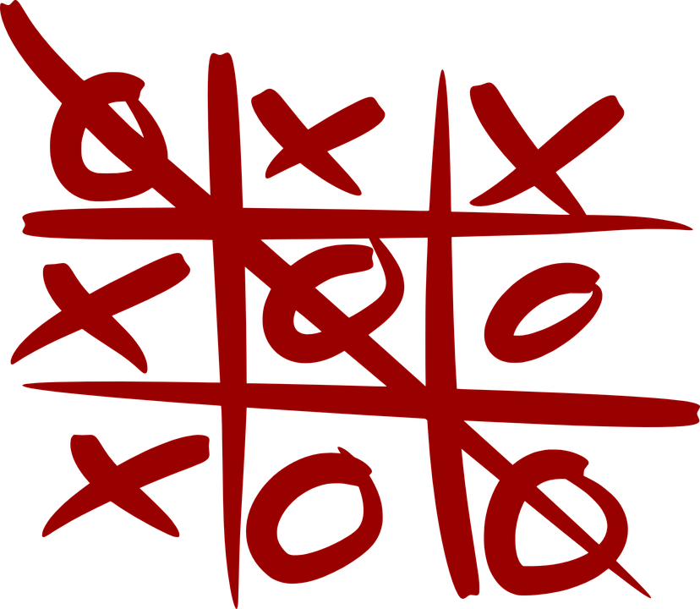
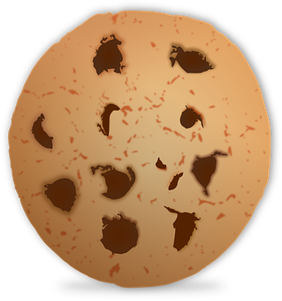
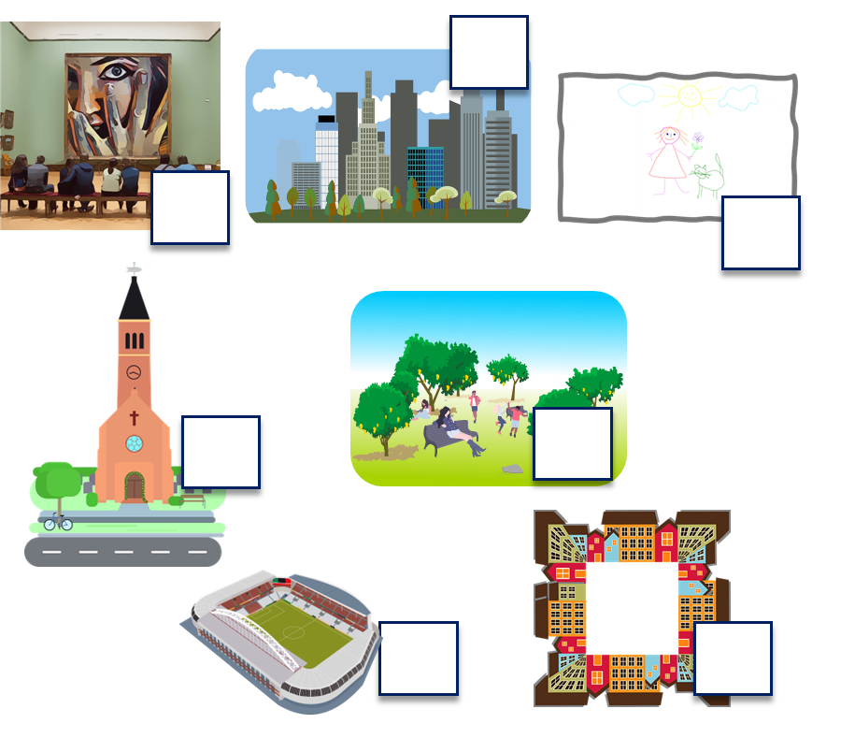
Rojo term 2 week 3
Saying what I and others do
3
Amarillo term 2
escuchar
Escucha y escribe las letras.
pronunciar
 | ga | go
 |  |  | _ _ ma
 |  |  | _ _ fas
 |  |  | pe _ _ r
 |  |  | al _ _
 |  |  | jue _ _
 |  |  | _ _ lleta
 |  |  | _ _ tas
Lee en orden alfabético.
E
ganar
1
domingo
gato
lago
2
negar
3
[something]
algo
tengo
mago
4
pegar
pagar
juego
5
fuego
6
a b ñ
vocabulario
[A] Escribe “un” / “una” o “el” / “la”.
 | definite (the) | indefinite (a/an)
E | ____ iglesia | ____ iglesia
1 | ____ dibujo | ____ dibujo
2 | ____ plaza | ____ plaza
3 | ____ museo | ____ museo
4 | ____ ciudad | ____ ciudad
5 | ____ estadio | ____ estadio
6 | ____ parque | ____ parque
[B] Escribe el número.
Yes/No questions
gramática
Turn a statement into a yes/no question by making your voice go up at the end.
I ride my bike.
Monta en bici.
Monto en bici.
She rides her bike.
¿Monto en bici?
Do I ride my bike?
Does s/he ride her bike?
Remember that there is no word for ‘do/does’ in Spanish questions.
¿Monta en bici?
14

Slide 17
Rojo term 2 week 3
Saying what I and others do
3
Amarillo term 2
hablar
Persona A: (Person B – turn to the next page.)
Round 2
Round 1
Your turn to ask!
Use your prompt card to ask questions.
Now listen to your partner and respond. Use your card to answer ‘yes’ or ‘no.
1) Pregunta y marca .
2) Escucha y responde.
leer
Escribe en inglés. Can you get at least 15 points?
 | normalmente | de | ser
 | soy | es | siempre
 | papel | cosa | viejo
 | instrumento | raro | nuevo
 | por | el | la
 | estadio | ciudad | bicicleta
 | pasear | montar | padre
x3
x2
x1
15

Slide 18
Rojo term 2 week 3
Saying what I and others do
3
Amarillo term 2
hablar
Persona B. (Person A – see previous page.)
Round 2
Your turn to ask!
Round 1
Your turn to respond!
Listen to your partner and respond. Use your card to answer ‘yes’ or ‘no’.
Now use your prompt card to ask questions.
1) Escucha y responde.
2) Pregunta y marca .
escribir
Escribe en español. Can you get at least 15 points?
 | s/he, it is (trait) | always | usually
 | from, of | to be, being (trait) | I am (trait)
 | (the) thing | (the) paper | (the) instrument
 | raro (m) | new (m) | old (f)
 | the (m) | the (f) | through, around, along
 | (the) stadium | (the) bicycle | (the) city
 | to go for a walk | to ride, riding | (the) father
x3
x2
x1
16

Slide 19
Rojo term 2 week 4
Saying what I and others do
4
Amarillo term 2
pronunciar
Por la tarde
Talking about activities you and others do
[gu]
Afternoon activities
gusano
La abuela Valeria
Write down the key language for this week.
vocabulario
descansar |  | (el) campo
(la) habitación |  | (la) tarde
por
Knowing who does what
gramática
[-ar verbs: ‘I’ vs. ‘you’]
In Spanish, the words for ‘I’ and ‘s/he’ (pronouns) are often unnecessary.
To mean ‘I’ with a verb, we remove –ar and add – o.
To mean ‘you’ with a verb, we remove –ar and add – as.
I
Ejemplo
you
Descanso en la habotación.
Descansas en la habitación.
I relax in the room
You relax in the room
Translate the examples.
Descanso en el campo. → ___________________________.
Descansas en el campo. → ____________________________.
17

Slide 20
Rojo term 2 week 4
Saying what I and others do
4
Amarillo term 2
escuchar
Quique habla con Sofía : ¿De quién habla?
Marca .
¿Qué información menciona? Marca .
Quique (I) | Sofía (you)
object | place | person
en inglés
E
with m_ s _ _ _ _ _
1
2
3
4
5
leer
Multiple meanings of ‘por’
Quique escribe 📝.
gramática
Lee. ¿Qué es en inglés?
You learnt ‘por’ is a preposition that is often used with verbs of
movement.
It can be translated in different ways in English.
Paseo por la ciudad.
I go for a walk around the city.
Paseo por el campo.
I go for a walk in the countryside.
We also use ‘por’ to indicate the time of the day (morning, evening). In this case, it is translated as ‘in’.
Visito el museo por la tarde.
I visit the museum in the afternoon.
 | in | around
E
1
2
3
4
5
18

Slide 21
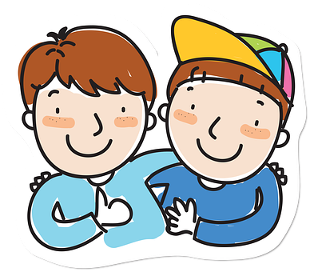
Rojo term 2 week 4
Saying what I and others do
4
Amarillo term 2
leer
Ahora traduce* las frases al inglés.
traduce = translate
You
 | ____ visit the church __ the __________.
 | ____ _____ your bike _______ the city.
 | ___ present ___________ in class.
 | ____ relax _____ my __________.
 | __ _____ ____ ______ ________ the park.
 | ___ __ __ _ ____ __ the countryside.
pronunciar
[A] Escucha. Escribe [ga] [go] or [gu].
[B] Practica el poema con tu pareja.
lo = it
su = his/her
el bigote – whiskers
alargado - long
Knowing who does what
gramática
[-ar verbs: ‘I’, ‘you’, s/he, it’]
Paseo - ____ I (go for a) walk
D _ _ c _ _ _ _ - I relax
Paseas - ____ (go for a) walk
D _ _ c _ _ _ _ _ - you relax
Pasea - ____ (goes for a) walk
D _ _ c _ _ _ _ - s/he relaxes
19

Slide 22
Rojo term 2 week 4
Saying what I and others do
4
Amarillo term 2
rojo (I)
amarillo (you)
azul (s/he).
leer
Lee. ¿Qué persona es? Colorea*.
colorea = colour in
leer
Quique y Sofía hacen* actividades por la tarde.
¿Quién es? Marca .
Quique (I) | Sofía (she)
¿Qué?
parque plaza
museo iglesia
mensaje palabra
bolsa instrumento
iglesia campo
tarde estadio
E
1
2
3
4
5
As part of his English homework, Quique has tried to translate his list into English, but he’s made some mistakes. Can you help him?
 | You go for a walk around the city .
 | She looks for the stadium .
 | She looks for the new word.
 | I create an important instrument .
 | I ride her bike in the bedroom.
 | She goes for walk in an afternoon.
I go, squ_ _ _
20

Slide 23
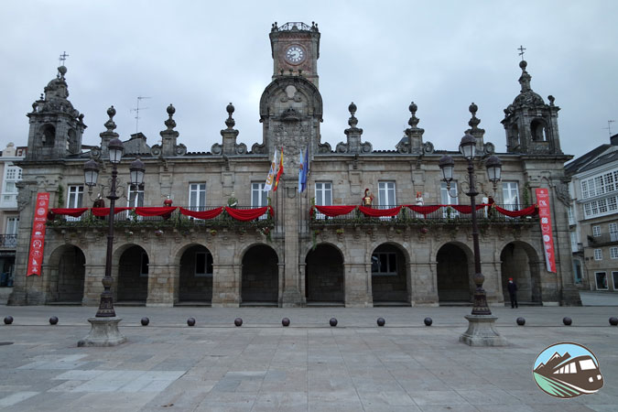
Rojo term 2 week 4
Saying what I and others do
4
Amarillo term 2
‘Plaza Mayor’ is the main square in many ] towns and cities in Spain. In Latin America, the main square is ‘Plaza de Armas’.
leer
Traduce la postal.
La Plaza Mayor de Lugo
traduce = translate
(la) postal = postcard
escribir
Escribe en español. Can you get at least 15 points?
 | you are (trait) | Spain | from
 | interesting (m/f) | important (m/f) | England
 | fun (m) | (the) information | (the) country
 | to create, creating | to look for, looking for | to use, using
 | countryside | around, in | to ride, riding
 | afternoon | in (with time) | the (f)
 | to relax, relaxing | room | the (m)
x3
x2
x1
20

Slide 24
Rojo term 2 week 5
Saying what I and others do
5
Amarillo term 2
pronunciar
El club de leer
Talking about activities you and others do.
Activities in school: the reading club
Write down the key language for this week.
vocabulario
aprender |  | (la) carta
leer |  | (la) noticia
español |  | (la) revista
inglés
Knowing who does what
gramática
[-er verbs: ‘I’ vs. ‘s/he, it’]
Some Spanish infinitives end in –er.
We know to mean ‘I’ & ‘s/he, it’ with a verb, the verb ending changes.
To mean ‘I’ with a verb, we remove –ar and add – o.
To mean ‘s/he, it’ with a verb, we remove –ar and add – e.
I
Ejemplo
s/he, it
Aprendo español en clase.
Aprende español en clase.
I learn Spanish in class.
S/he learns Spanish in class.
Translate the examples.
Aprendo inglés en clase. → ___________________________.
Aprende inglés en clase. → ___________________________.
21

Slide 25
Rojo term 2 week 5
Saying what I and others do
5
Amarillo term 2
escuchar
Quique habla del club de leer.
¿Quién es? Marca .
Rodea* la respuesta correcta.
Quique (I) | Rubén (she)
información extra
a book | a magazine
information about… England | Spain
in Spanish | English
a letter | a book
information about… England | Spain
an interesting book | piece of news
E
1
2
3
4
5
rodea = circle
leer
¡Mi gemela es diferente!
Personal ‘a’
gramática
Quique escribe de él* y Sofía.
[A] Lee. ¿Quién es? Marca .
In Spanish, after verbs such as ‘ver’ [to see, seeing] and ‘visitar’ [to visit, visiting], we need to use ‘a’ if what we see, or visit is a person or a pet.
This does not happen in English!
Place/object
person/pet
Visito el museo.
Visito a un amigo.
I visit the museum.
I visit a friend.
 | Quique | Sofía | ‘a’
E
1
2
3
4
5
Él = he
(la) gemela = twin sister
(la) oficina = office
[B] ¿Necesita ‘a’ o no?
22

Slide 26
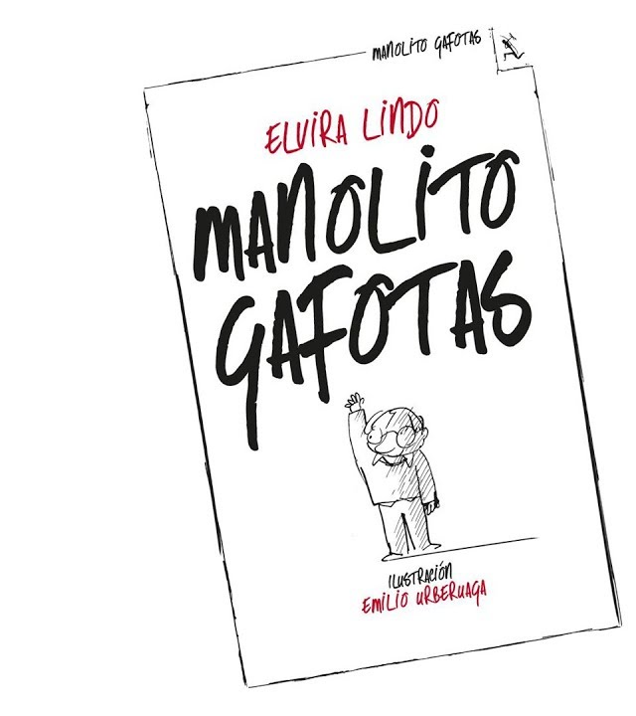
Rojo term 2 week 5
Saying what I and others do
5
Amarillo term 2
leer
[C] Ahora taduce las frases al inglés .
traduce = translate
learns
 | She __________ a word.
 | I _______ for my _____________.
 | He ________ a _______ in English.
 | ____ _________ information _______ an interesting country.
 | ___ ______ with ____ ______________.
 | ___ _________ ______ in the office.
pronunciar
escuchar
Escucha y completa.
Lee los nombres.
los= the (plural, masculine)
nombre = name | enemigo = enemy
‘Manolito Gafotas’ es un libro famoso* en España.
leer
Escribe en inglés .
Yes/No questions
gramática
1 |  | 6
2 |  | 7
3 |  | 8
4 |  | 9
5 |  | 10
Turn a statement into a yes/no question by making your voice go up at the end.
Leo un libro.
I read a book.
¿Leo un libro?
Do I read a book?
This works for any verb and any person (e.g., I, you, s/he).
¿Lee una revista?
Does she read a magazine?
23

Slide 27
Rojo term 2 week 5
Saying what I and others do
5
Amarillo term 2
escuchar
[A] Escucha. ¿Qué palabra es?
¿Es una pregunta (?) o una respuesta (.)?
I learn | s/he learns | I read
I learn | s/he learns | s/he rides
I visit | s/he reads | I read
I learn | s/he reads | I see
s/he learns | I learn | I see
I read | I use | s/he uses
[B] Escucha otra vez. Use the correct words to translate what you hear. ⚠️There are some extra ones!
otra vez = again
 | Spanish| English
 | (a piece of news| a letter| in Spanish | in English
 | with mum| with dad
 | in class | in the park
 | a book | a magazine| of | English | Spanish
 | on Monday | Tuesday | a piece of news
E
1
2
3
4
5
hablar
¿Does s/he…?
Escribe un nombre en secreto.
Tu compañero/a, adivina.
¡Sí! / ¡No!
24

Slide 28
Rojo term 2 week 5
Saying what I and others do
5
Amarillo term 2
leer
Escribe en inglés. Can you get at least 15 points?
 | día | sábado | domingo
 | qué | miércoles | jueves
 | la plaza | con | viernes
 | visitar | la iglesia | el museo
 | de | la noticia | inglés
 | la revista | el libro | español
 | aprender | leer | la carta
x3
x2
x1
escribir
¿Dónde está el oro*? Escribe frases.
el oro = gold
Write logical sentences to find gold and jewels!
= 5
= 10
1
2
3
4
5
25

Slide 29
Rojo term 2 week 5
Saying what I and others do
5
Amarillo term 2
escribir
Escribe en español. Can you get at least 15 points?
 | Saturday | day | Wednesday
 | Thursday | Sunday | What?
 | Thursday | to visit, visiting | with
 | museum | square | church
 | magazine | book | news
 | English | to learn, learning | to read, reading
 | Spanish | letter | of
x3
x2
x1
escribir
Escribe cinco frases lógicas en español.
I | learn(s) | a magazine | with my teacher (f)
 |  | a friend (m) | on the beach
 |  | an answer | in class
He | read(s) | a question | of Spain
 |  | a book | of Perú
 |  | a letter | in the afternoon
She | see(s) | a game | every day
 |  | a word | every week
 |  | a drawing | in English
26

Slide 30
Rojo term 2 week 6
Saying what I and others do
6
Amarillo term 2
El recreo
pronunciar
Understanding and talking about activities I and others do at break time.
[que]
You know the SSC
paquete
[ca], [co], [cu].
The same /k/ sound in front of ‘e’ is [que] because [ce] is always a soft ‘c’ sound. E.g. celebrar.
Write down the key language for this week.
vocabulario
comer |  | (la) actividad
responder |  | (el) ejercicio
(el) bocadillo |  | (la) naranja
(el) ordenador |  | hacer
hago |  | haces
Knowing who does what
gramática
[-er verbs: ‘I’ vs. ‘you’]
We know to mean ‘I’ & ‘you’ with a verb, the verb ending changes.
To mean ‘I’ with a verb, we remove –er and add – o.
To mean ‘you’ with a verb, we remove –er and add – es.
Ejemplo
I
comprender
you
Como un bocadillo.
Comes fruta.
I eat a sandwich.
You eat fruit.
Translate the examples.
Como una naranja. → _______________________________.
Comes un bocadillo. → _______________________________.
27

Slide 31
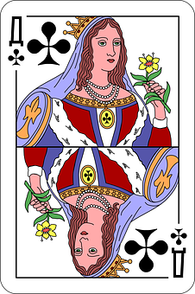
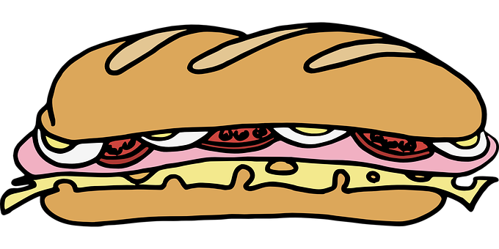
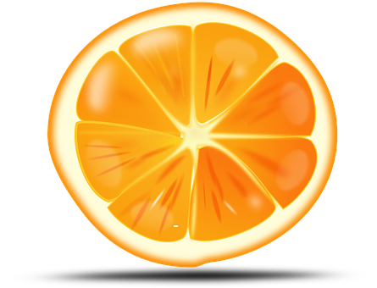
Rojo term 1 week 6
Saying what I and others do
6
Amarillo term 2
escuchar
Quique habla con Sofía. ¿Quién es? Escribe ‘A’ o ‘B’.
Escucha y escribe el verbo. ¿Qué imagen es correcta?
 | verbo | imagen
E
1
2
3
4
5
pronunciar
Pronuncia las palabras.
¿Pronuncias bien? Tu compañero marca .
1 |  |  | 6
2 |  |  | 7
3 |  |  | 8
4 |  |  | 9
5
Total:
[A] Escucha.
¿Qué palabra es?
[B] Escribe.
escuchar
the | a/an
___ ________ | una pelota
el ordenador | ___ ________
___ ________ | una cama
___ ________ | una madre
el campo | ___ ________
___ ________ | una país
E
a | the
horse | city
1
a | the
computer | room
2
a | the
bed | bike
3
a | the
mother | father
4
a | the
stadium | countryside
5
a | the
park | country
28

Slide 32
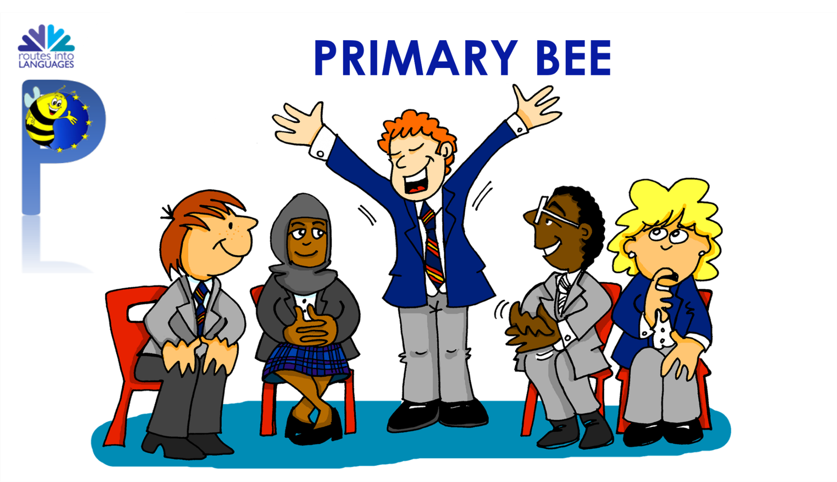
Rojo term 2 week 6
Saying what I and others do
6
Amarillo term 2
a b ñ
vocabulario
Practica en parejas.
Ask your partner how to say these words in Spanish.
Then swap roles.
1. to do, make
2. to eat, eating
3. to reply, replying
4. activity
5. exercise
6. sandwich
7. computer
8. orange
9. to go for a walk
10. to ride, riding
11. stadium
12. father
13. city
14. of, from
15. to have, having
16. a, an (f)
17. plant
18. bag
19. through, around
20. bed
¿Cómo se dice ____ en español?
¡Correcto!
If you don’t know, say ‘¡No sé!’
No sé!
Always say the words for ‘the’ (el, la) with nouns. E.g. el estadio.
practica = practise | pareja = partner
Knowing who does what
gramática
[-er verbs: ‘I’, ‘you’, s/he, it’]
Leo - ____ read
A _ _ _ _ d _ - I learn
Lees - ____ read
A _ _ _ _ d _ _ - you learn
Lee - ____ reads
A _ _ _ _ _ _ - s/he learns
You can do this
with any –er verb
Try writing the I, you & s/he form of ‘comprender’ and ‘ver’. This is call ‘conjugating’ a verb 😉 .
Knowing who does what: hacer
[hacer: to do, make; doing, making]
gramática
Note: ‘I do’ is different from the usual pattern.
Hago una actividad.
Haces una actividad.
Hace una actividad.
I do an activity.
You do an activity.
S/he does an activity.
29

Slide 33
Rojo term 2 week 6
Saying what I and others do
6
Amarillo term 2
leer
Escribe en inglés. Can you get at least 15 points?
 | un | (el) libro | (la) cama
 | tener | (la) bolsa | (el) barco
 | (la) ciudad | por | la
 | montar | pasear | (la) bicicleta
 | responder | (el) bocadillo | (la) naranja
 | (el) ejercicio | (el) ordenador | comer
 | (la) actividad | leer | aprender
x3
x2
x1
leer
Quique escribe a Sofía ¿Quién es?
¿Es Quique (I), Sofía (you), o la profesora* (she)?
Escribe el verbo y el número (1-5) de la frase.
1 | Haces un dibujo en papel.
2 | Aprendo el vocabulario con el profesor.
3 | Responde a un mensaje de mamá.
4 | Hago un ejercicio en inglés.
5 | Lee un libro en la clase.
[I]
[you]
[she]
1 haces
1
2
3
4
5
30

Slide 34
Rojo term 2 week 7
Saying what I and others do
7
Amarillo term 2
pronunciar
Use ‘tengo’, ‘tienes’ and ‘tiene’ to say how many things you and others have
[qui]
You know the SSC
quince
[ca], [co], [cu].
The same /k/ sound in front of ‘e’ is [que] because [ci] is always a soft ‘c’ sound. E.g. bicicleta.
Write down the key language for this week.
vocabulario
uno |  | siete
dos |  | ocho
tres |  | nueve
cuatro |  | diez
cinco |  | once
siete |  | doce
Tener: I have & s/he, it has
gramática
[to have, having]
To mean ‘I have’, use ‘tengo’.
To mean ‘you have’, use ‘tienes’.
I
you
Tengo una botella.
Tienes un juego.
I have a bottle.
You have a game.
💡 To talk about something in the plural (more than one), Spanish often adds an ‘s’ to the end of nouns ending in –o, -a or –e.
Tengo tres botellas.
Tienes cuatro juegos.
I have three bottles.
You have four games.
31

Slide 35
Rojo term 2 week 7
Saying what I and others do
7
Amarillo term 2
escuchar
Quique compite* con Sofía.
¿Quién tiene qué? ¿1 o +1? Marca .
Escribe el número.
Quiqe (I) | Sofía (she)
1 | +1
número
E
1
2
3
4
5
compite = competes
Tener: I, you, s/he
Translate the examples.
[to have, having]
tengo - ____ have
Ángela tiene un gato.
→ _______________________.
tienes - ____ have
Ángela tiene dos gatos.
tiene - ____ has
→ _______________________.
las = the (f., pl.)
(la) frase = phrase, sentence
decidir = to decide, deciding
leer
Lee las frases y decide.
Who has more items?
_____________________________
b. Who could play music?
______________________________
c. Who could go on a bike ride? ________________________
d. Who could read? ____________________________________
e. Who has more valuable items?
f. Whose items do you prefer?
32

Slide 36
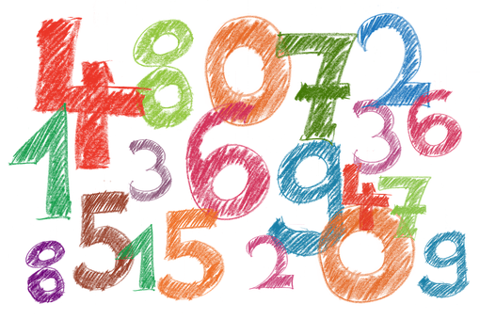
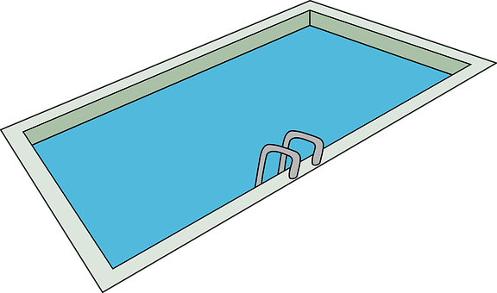
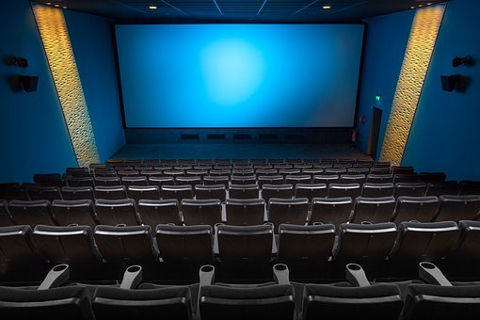
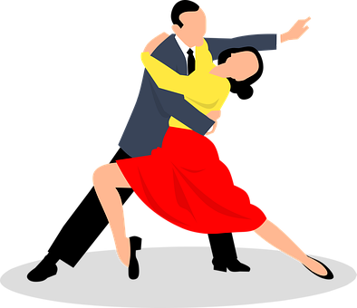
Rojo term 2 week 7
Saying what I and others do
7
Amarillo term 2
escuchar
¡Bingo! Escribe seis números.
escuchar
¿Qué sonido es?
pronunciar
Escribe una palabra.
Tu compañero/a adivina.
 | qui | ci
 |  |  | a ____
 |  |  | pis____na
 |  |  | ____ ne
 |  |  | po____to
 |  |  | mari____ta
 |  |  | tran____lo
E
cocina
bicicleta
aquí
1
equipo
2
cine
mariquita
3
[little bit]
quince
poquito
piscina
4
tranquilo
5
la palabra = word
adivina = guess
pronunciar
Escucha y canta.
Yo soy el uno, como yo no hay ninguno.
Yo soy el seis, siempre bailo ya lo ves.
(I am one, there’s no one like me.)
(I am six, I always dance as you can see.)
Yo soy el dos, ahora tengo mucha tos.
Yo soy el siete, remonto un barrilete.
(I am two, now I have a lot of cough.)
(I am seven, I make a kite)
Yo soy el tres, doy la vuelta al revés.
Yo soy el ocho, y me como un bizcocho.
(I am there, I flip around.)
(I am eight, I eat a sponge cake.)
Yo soy el cuatro, y me gusta el teatro.
Yo soy el nueve, cuando salgo siempre llueve.
(I am four, I like drama.)
(I am nine, when I go out it always rains.)
Yo soy el diez. ¿La cantamos otra vez?
Yo soy el cinco, los charquitos siempre brinco.
(I am five, I always jump over puddles.)
(I am ten. Shall we sing it again?)
33

Slide 37
Rojo term 2 week 7
Saying what I and others do
7
Amarillo term 2
leer
Completa la suma y escribe el número.
 | la suma | el resultado 📝
 | uno (+) tres =
 | cuatro (+) dos =
 | siete (+) tres =
 | cinco (+) cuatro =
 | doce (-) cuatro =
 | doce (-) nueve =
 | doce (-) siete =
E
1
2
3
4
5
6
escuchar
Escucha y escribe el número en español.
 | Número en español
¿Qué imagen es?
E
1
2
3
4
5
Nouns in plural
Translate the examples.
Tengo dos sombreros.
💡 To talk about something in the plural (more than one), Spanish often adds an ‘s’ to the end of the noun ending in
–o, -a or –e.
→ _______________________.
Tienes tres regalos.
→ ___________________.
34

Slide 38
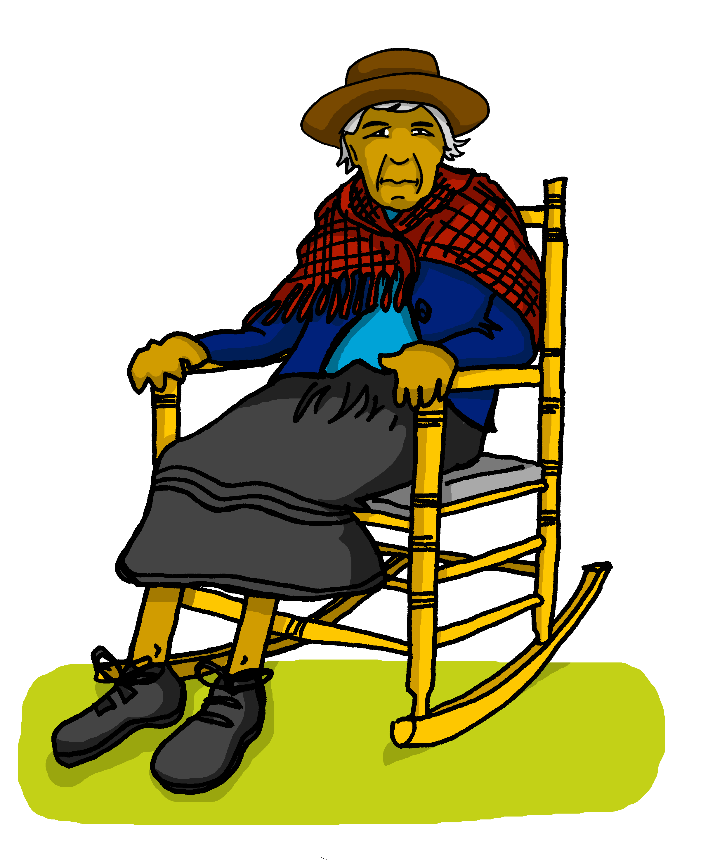
Rojo term 2 week 7
Saying what I and others do
7
Amarillo term 2
leer
Quique manda mensajes a la abuela. Lee las frases.
¿Quién es? Marca .
 | Quique (I) | Abuela Valeria (She)
E
1
2
3
4
5
leer
manda = he sends
Escribe en inglés. Can you get at least 15 points?
 | la puerta | la mesa | el dibujo
 | el profesor | por (la mañana) | la hermana
 | la mañana | la habitación | tiene
 | el campo | descansar | la tarde
 | tres | cinco | doce
 | cuatro | tienes | nueve
 | once | ocho | seis
x3
x2
x1
35

Slide 39
Rojo term 2 week 7
Saying what I and others do
7
Amarillo term 2
hablar
Escribe un número en secreto (1-8).
Tu compañero/a, adivina.
adivina = guess
¿Tienes [number] [item] ?
¡Sí…😊!
¡No…👎!
Remember
to make the nouns plural by adding an
‘s’ to the end of the noun ending in
–o, -a or –e.
escribir
Escribe en español. Can you get at least 15 points?
 | (the) door | (the) drawing | (the) table
 | teacher (m) | in (+ time) | (the) sister
 | (the) morning | (the) room | (the) afternoon
 | countryside | to relax, relaxing | s/he, it has
 | six | nine | eight
 | five | ten | eleven
 | four | seven | twelve
x3
x2
x1
36

Slide 40
Rojo term 2 week 8
Saying what I and others do
8
Amarillo term 2
Mi monstruo
pronunciar
Understand and create a description of a monster.
Use ‘unos’ and ‘unas.
Write down the key language for this week.
vocabulario
tiene |  | unos |  | (la) oreja
unas |  | (la) boca |  | (el) pie
(la) cabeza |  | (el) dedo |  | (el) ojo
Talking about things in the plural
gramática
[Indefinite articles: unos / unas]
To mean ‘a/an’, use either un or una.
un dedo
una boca
a finger
a mouth
To mean ‘some’ before a plural noun, use ‘unos’ or ‘unas’.
unos ojos
unas orejas
some eyes
some ears
To mean ‘some’ for masculine plural noun, use ‘unos’.
To mean ‘some’ for feminine plural noun, use ‘unas’.
37

Slide 41
Rojo term 2 week 8
Saying what I and others do
8
Amarillo term 2
leer
[A] Quique dibuja* unos monstruos. How many of each is he planning to draw? Escribe 1 o +1.
[B] Escribe el número.
escuchar
Quique tiene otro sueño. Escucha y marca .
There is | There are
Ahora escucha y lee. ¿Es posible?
Escribe la palabra 📝.
E
1
E
4
2
1
5
3
2
6
4
3
7
5
6
7
pronunciar
Escribe 📝 cinco palabras en secreto.
Tu compañero/a, adivina.
(el/la) compañero/a = male/female partner
adivina = guesses
38

Slide 42
Rojo term 2 week 8
Saying what I and others do
8
Amarillo term 2
hablar
Continúa la serie.
 | 4, ___, 8, ___, 12
 | 12, 11, 10, ___ ___ ___ ___
 | 1, 3, 5, ___ ___ ___
 | 11, 9, 7, ___ ___ ___
 | 1, 2, 3, 4, 5, ___ ___ ___ ___
 | 11, 10, 9, 8, ___ ___ ___ ___
 | 2, 1, 3, 1, 4, 1 ___ ___ ___ ___ ___ ___
3
E
4
1
5
2
6
escuchar
Mi monstruo tiene…
[B] Escucha y escribe en inglés.
 | It has _________ | eyes | ears .
 | It has _______ small | mouth | finger.
 | It has _______ | feet | eyes.
 | It has _______ | hats | feet.
 | It has _______ | fingers | feet.
E
1
2
3
4
hablar
(el) poema = poem redonda = round
para = in order to, to
veo = I watch, see
Completa el poema.
En mi cara redonda*
[I have] [eyes] y nariz ,
y también [I have] [a mouth]
para* [to eat, eating] y reír .
Con mis [eyes] veo* todo ,
con mi nariz hago ¡achís!
y con mi [mouth] [I eat]
palomitas de maíz.
39

Slide 43
Rojo term 2 week 8
Saying what I and others do
8
Amarillo term 2
leer
Escribe en inglés. Can you get at least 15 points?
 | la idea | la regla | tienes
 | el lápiz | el mensaje | la palabra
 | inglés | aprender | de
 | español | la noticia | leer
 | el pie | trece | la cabeza
 | el dedo | unos | la oreja
 | el ojo | la boca | tiene
x3
x2
x1
Don’t
escribir
Escribe en español.
You can use the words to help you.
forget capital letters and full stops!
unas
tiene
nueve
cinco
dedos
unos
una
1
It has some ears
_________________________________
2
It has five eyes.
_________________________________
orejas
2
It has a mouth.
_________________________________
3
It has nine fingers.
_________________________________
4
It has some feet.
_________________________________
tiene
tiene
boca
ojos
tiene
pies
tiene
40

Slide 44
Rojo term 2 week 8
Saying what I and others do
8
Amarillo term 2
escribir
Elige* un monstruo y escribe en español.
Mi monstruo tiene dos pies y una cabeza.
En la cabeza de mi monstruo hay una boca y siete ojos. No tiene orejas.
Add ‘no’
before the verb to make a sentence negative.
escribir
Escribe en español. Can you get at least 15 points?
 | message | word | pencil
 | ruler | You have | idea
 | to learn, learning | news | English
 | reading | Spanish | of
 | head | foot | twelve
 | some | finger | s/he, it has
 | ear | eye | mouth
x3
x2
x1
41

Slide 45
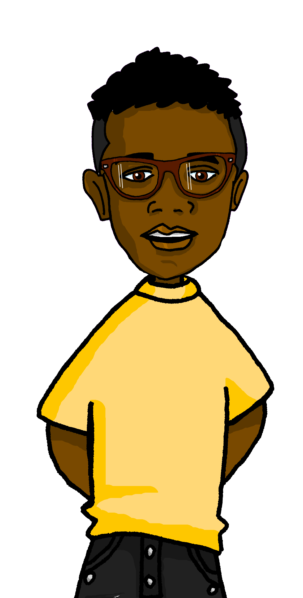
Rojo term 2 week 9
Saying what I and others do
9
Amarillo term 2
leer
Lee la información.
Use ‘hay’, to say how many things there are.
Max
Use ‘cuántos’ and ‘cuántas.
Max es amigo de Quique. Es de Inglaterra y aprende español en la escuela.
Write down the key language for this week.
vocabulario
¿cuántos? |  | ¿cuántos?
Hay
gramática
[there is; there are]
To mean ‘there is’ or ‘there are’ in Spanish, use ‘hay’.
Use ‘hay’ with both singular and plural nouns.
Hay unos estuches.
Hay una respuesta.
There are some pencil cases.
There is an answer.
escuchar
Max aprende sobre Lugo. Escucha y marca .
There is | There are
Ahora escucha y lee. ¿Es diferente?
Escribe la palabra 📝.
E
1
E
4
2
1
5
3
2
6
4
3
7
5
viaja = she travels
6
7
42

Slide 46
Rojo term 2 week 9
Saying what I and others do
9
Amarillo term 2
¿Cuántos? | ¿Cuántas?
gramática
[How many?]
The question word ‘¿cuántos?’ & ‘¿cuántas?’agrees with the gender and number of the noun it describes.
Use ‘¿cuántos?’ with masculine plural nouns, and ‘¿cuántas?’ with feminine plural nouns.
¿Cuántos museos hay?
¿Cuántas fiestlas hay?
How many museums are there?
How many festivals are there?
pronunciar
Pronuncia las palabras.
¿Pronuncias bien? Tu compañero marca .
1 |  |  | 6
2 |  |  | 7
3 |  |  | 8
4 |  |  | 9
5
Total:
escuchar
Escucha y escribe en inglés.
 | ____________ _________ | bikes | computers | words.
 | _________ _______ big | church | museum | square.
 | ___________ _______ | stadium |squares| parks.
 | _________ _______ | dogs| horses | bikes.
 | _________ _______ | classrooms | cities | rooms.
E
1
2
3
4
43

Slide 47
Rojo term 2 week 9
Saying what I and others do
9
Amarillo term 2
leer
[A] Max manda mensajes a Quique. Lee las frases. ¿Qué palabra es?
cuántos | cuántas
mandar = to send, sending
las = the (f., pl.)| (la) frase = sentence
leer
[B] Lee las frases y escribe en inglés.
H____ m________ s_________ _____ there?
H____ m________ c__________ _____ there i__ the _________?
There _____ ______ b___________ at home.
H____ m________ c_________ _____ there i___ ___________?
There _____ ______ m___________.
H____ m________ p_________ _____ there?
leer
Escribe en inglés. Can you get at least 15 points?
 | el papel | vieja | el instrumento
 | la cosa | raro | nueva
 | responder | el ordenador | hago
 | comer | el bocadillo | hacer
 | en | unos | ¿Cuántos?
 | hay | ¿Cuántas? | ocho
 | nueve | es | unas
x3
x2
x1
44

Slide 48
Rojo term 2 week 9
Saying what I and others do
9
Amarillo term 2
escribir
Escribe en español. Can you get at least 15 points?
 | old (m) | instrument | thing
 | paper | odd (f) | new (f)
 | To do, make | to eat,eating | Sandwich
 | computer | I do, make | to reply to, replying to
 | How many? (f) | some (f) | How many? (m)
 | seven | It is | some (m)
 | eleven | There is | eight
x3
x2
x1
Just have
a go! Write any of these English words in Spanish. You can add different words, too.
escribir
Escribe un mensaje a Max en español.
Write anything you like!
45

Slide 49
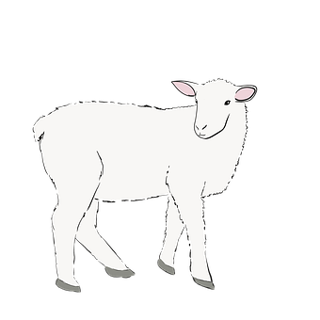
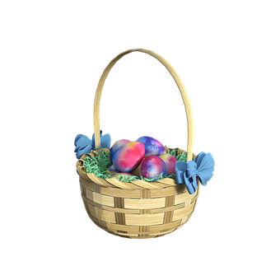
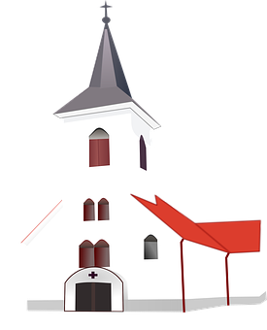
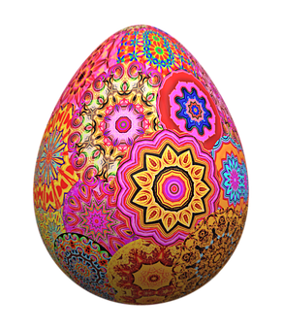
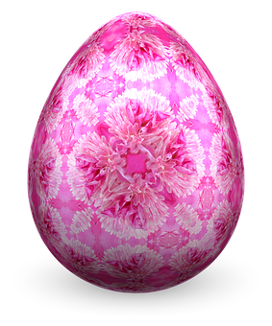
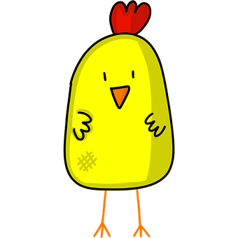
Rojo term 2 week 11
Pascua
11
Amarillo term 2
escribir
Busca 🔎 en la imagen y escribe el número..
Count the Easter pictures and write how many you see.
¿Qué? | ¿Cuántos?
pollitos
corderos
cestas
narcisos
conejos
iglesias
huevos
escribir
Fill in the missing numbers on the eggs.
uno
tres
cinco
siete
leer
Match each chick to an egg. Write the English translations below.
A
B
C
canta
canto
escucha
escuchas
hablas
dibujo
I
she
I
you
he
you
_____________
_____________
_____________
_____________
_____________
_____________
46

