Slide 1
Places and locations
Adverbs of position with ‘del’ and ‘de la’
SSC [cua] [cue] [cui]
Y7 Spanish Term 2.2 - Week 4 - Lesson 45 Amanda Izquierdo / Nick Avery / Rachel Hawkes Artwork: Mark Davies Date updated: 06.05.24
Notes:
Note: all words (new and revisited) in this week of the SOW appear on all three GCSE wordlists, with the following exception:
AQA list does not have balcón, dama, caballero.
Edexcel list does not have balcón, dama, caballero, torre.
Artwork by Mark Davies. All additional pictures selected are available under a Creative Commons license, no attribution required.
Learning outcomes (lesson 1):
Consolidation of SSCs [cue], [cua], [cui]
Introduction of ‘del’ and ‘de la’ (after adverbs of position)
Consolidation of ‘estoy’, ‘está’
Word frequency (1 is the most frequent word in Spanish):
7.2.2.4 (introduce) estamos [estar-21]; están [21]; oeste [2416]; este [>5000*]; estación [1404]; coche [1190]; tren [1488]; delante de [delante-1742]; fuera de [fuera-299]; debajo de [1366]; detrás de [2044]
7.2.2.1 (revisit) trabajar [174]; buscar [179]; descansar [1749]; preparar [570]; comida [906]; animal [322]; pasar [68]; tiempo [80]; campo [342]; junto[s] [149]; solo [181]
7.2.1.1 (revisit) balcón [3133]; dama [2062]; torre [2138]; caballero [2056]; saber [44]; pasar [68]; blanco [372]; flor [739]; plaza [806]; llevar [101]
Source: Davies, M. & Davies, K. (2018). A frequency dictionary of Spanish: Core vocabulary for learners (2nd ed.). Routledge: London
The frequency rankings for words that occur in this PowerPoint which have been previously introduced in NCELP resources are given in the NCELP SOW and in the resources that first introduced and formally re-visited those words.
For any other words that occur incidentally in this PowerPoint, frequency rankings will be provided in the notes field wherever possible.

Slide 2
Inicio
leer/escribir
2. pasar
1. el campo
3. el animal
to spend (time)
countryside
animal
to work, working
to spend (time)
4. solo, sola
countryside
alone
5. juntos, juntas
alone
together
food
to look for, looking for
6. buscar
together
to rest, resting
7. el tiempo
to look for, looking for
time
animal
time
8. descansar
9. la comida
10. trabajar
to rest, resting
food
to work, working
Notes:
Starter activity to settle students on arrival. Timing: 5 minutes
Aim: to revisit this week’s vocabulary (from 2.2.1).
Procedure:
Students read aloud all the words in Spanish and try to recall their meaning. Or they can write 1-10 and the answers.
Teacher elicits responses, prompting so that students say the Spanish. E.g. Entonces, número uno, ¿qué es en español y en inglés?
Teachers shows the answer with a further click.

Slide 3
Fonética
CUA
cuatro
Notes:
[1/3]
Timing: 3 minutes
Introduce and elicit the pronunciation of the individual SSC ‘cua’. Then present and elicit the pronunciation of the source words.
The source/cluster words have been chosen for their high-frequency, from a range of word classes, with the SSC (where possible) positioned within a variety of syllables within the words(e.g. initial, 2nd, final etc..) and additionally, we have tried to use words that build cumulatively on previously taught SSCs (see the Phonics Teaching Sequence document) and do not include new SSCs. Where new SSCs are used, they are often consonants which have a similar symbol-sound correspondence in English.

Slide 4
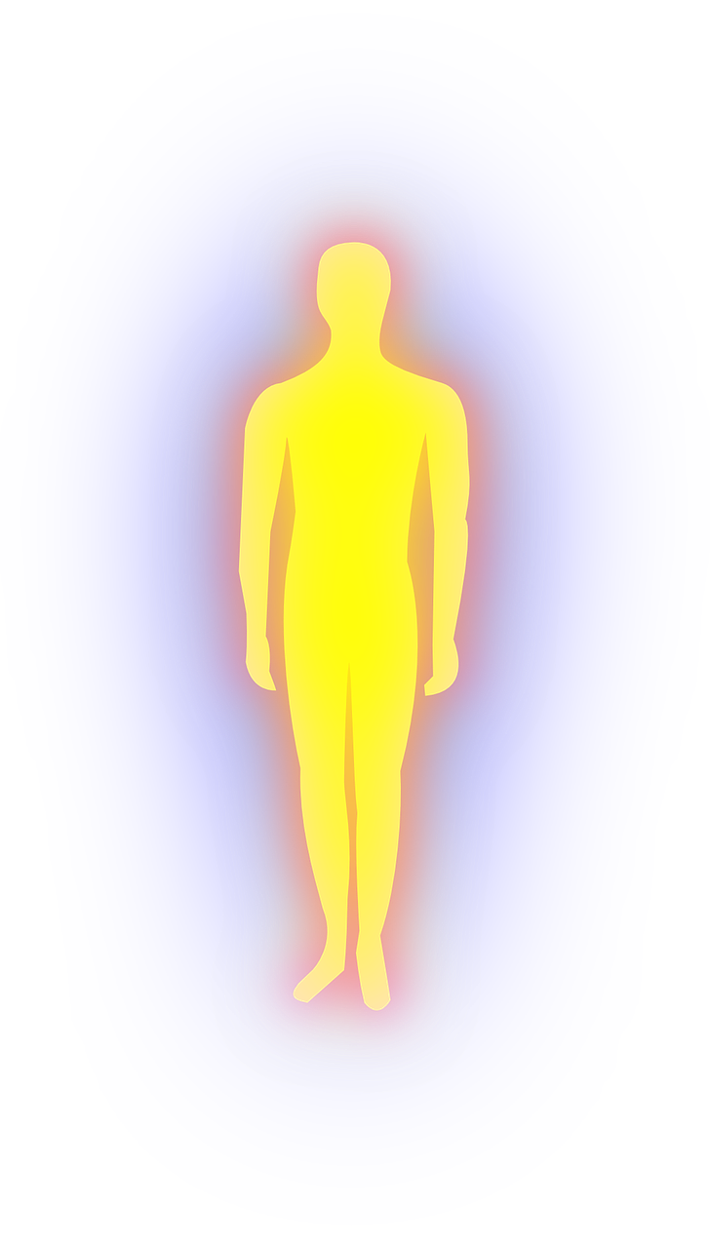
Fonética
CUE
cuerpo
[body]
Notes:
[2/3]
Introduce and elicit the pronunciation of the individual SSC ‘cue’.

Slide 5
Fonética
CUI
cuidar
to look after;
take care of
Notes:
[3/3]
Introduce and elicit the pronunciation of the individual SSC ‘cui’.

Slide 6
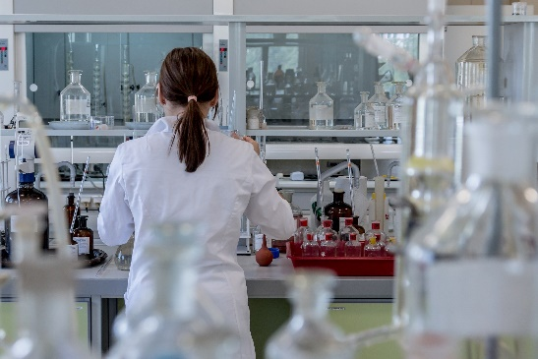
¿CE, CI, CUE o CUI?
escuchar / escribir
Escucha y escribe las letras.
decir
to say; tell
cuerpo
1
5
escuela
ciencias
2
6
sciences
necesario
¡cuidado!
3
necessary
7
cuidar
centro
4
to look after
8
centre
Notes:
Phonics and vocabulary Timing: 5 minutes.
Aim: To revisit SSCs [ce], [ci], [cue] and [cui].
Procedure:
1. Students listen to each recording and write the word including the missing letters.

Slide 7
¿CE, CI, CUE o CUI?
Escucha y escribe la palabra.
escuchar / escribir
decir
to say; tell
cuerpo
1
5
escuela
ciencias
2
6
sciences
necesario
¡cuidado!
3
necessary
7
cuidar
centro
4
to look after
8
centre
Notes:
OPTIONAL VERSION
Differentiation - more challenging version of previous activity: Timing: 5 minutes.
Aim: To revisit SSCs [ce], [ci], [cue] and [cui].
Procedure:
1. Students listen to each recording and write the whole word.

Slide 8
Vocabulario
el n_ _ _ _
el norte
el oeste
el este
el s_ _
el sur
Notes:
[1/7]
Timing: 8 minutes
Aim: to introduce vocabulary.
Procedure:
Teacher clicks on the compass to trigger the appearance of ‘norte’ and ‘sur’, which are revised here.
Teacher says each word out loud, students repeat.
Teacher clicks again to bring up and practise ‘este’ and ‘oeste’.
Continue with the next slides until all vocabulary introduced.

Slide 9
Vocabulario
delante
detrás
[in front]
[behind]
Notes:
[2/7]

Slide 10
Vocabulario
debajo
fuera
[under]
[outside]
Notes:
[3/7]

Slide 11
Vocabulario
cerca
lejos
1000 km
1 km
[near]
[far]
Notes:
[4/7]

Slide 12
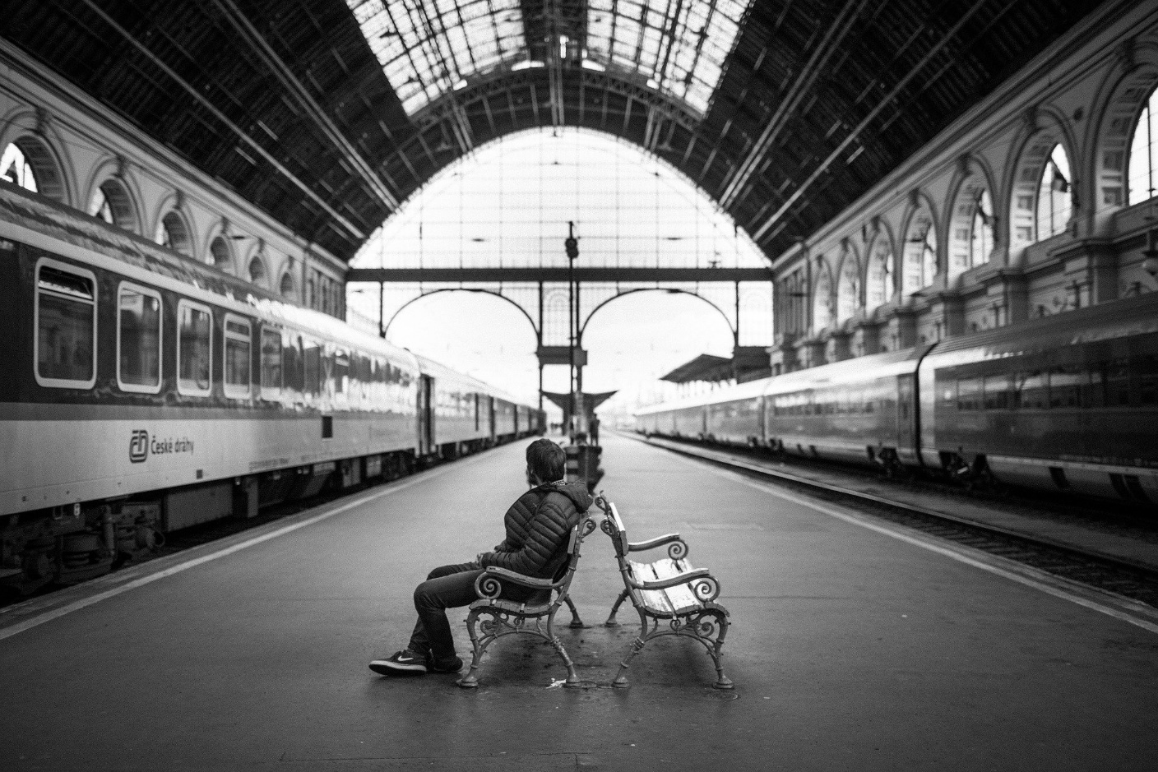
Vocabulario
la estación
Notes:
[5/7]

Slide 13
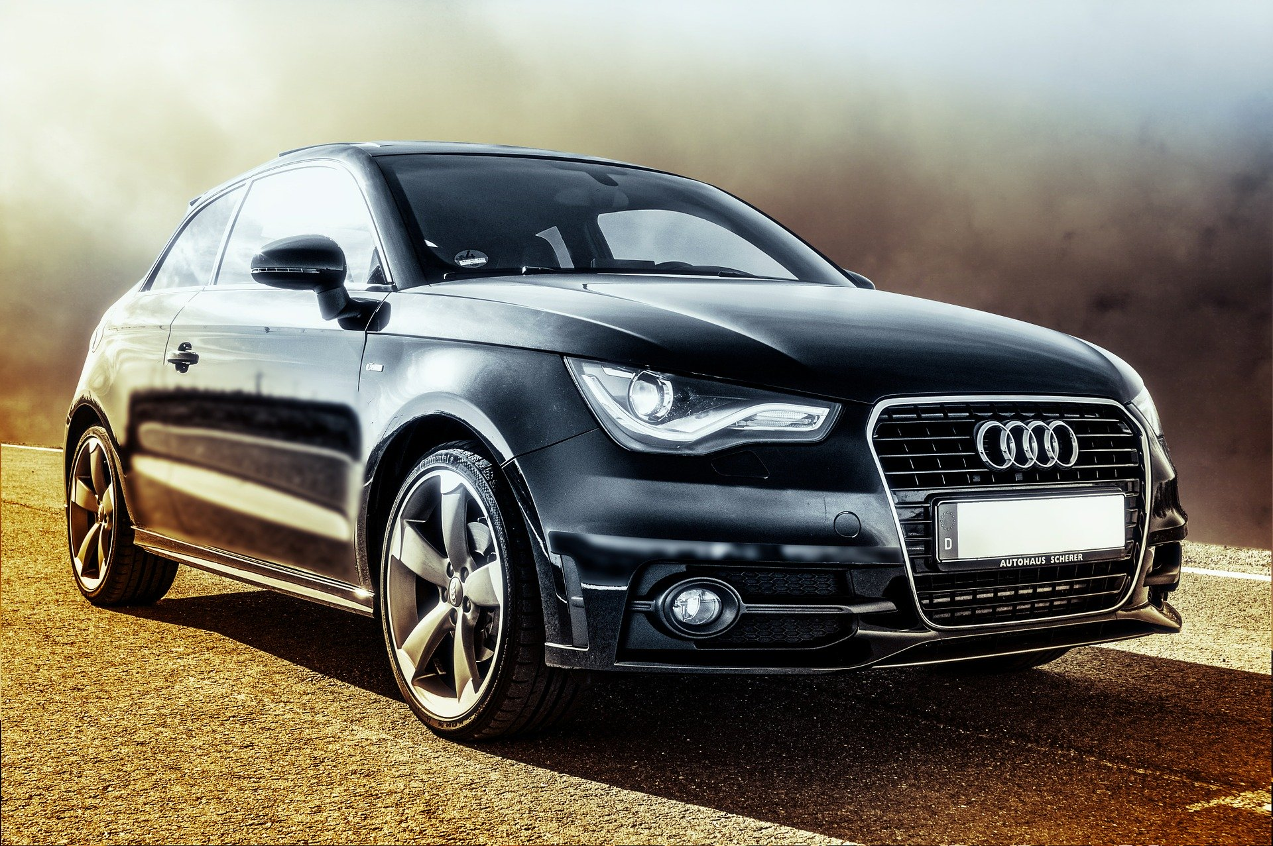
Vocabulario
el coche
Notes:
[6/7]

Slide 14
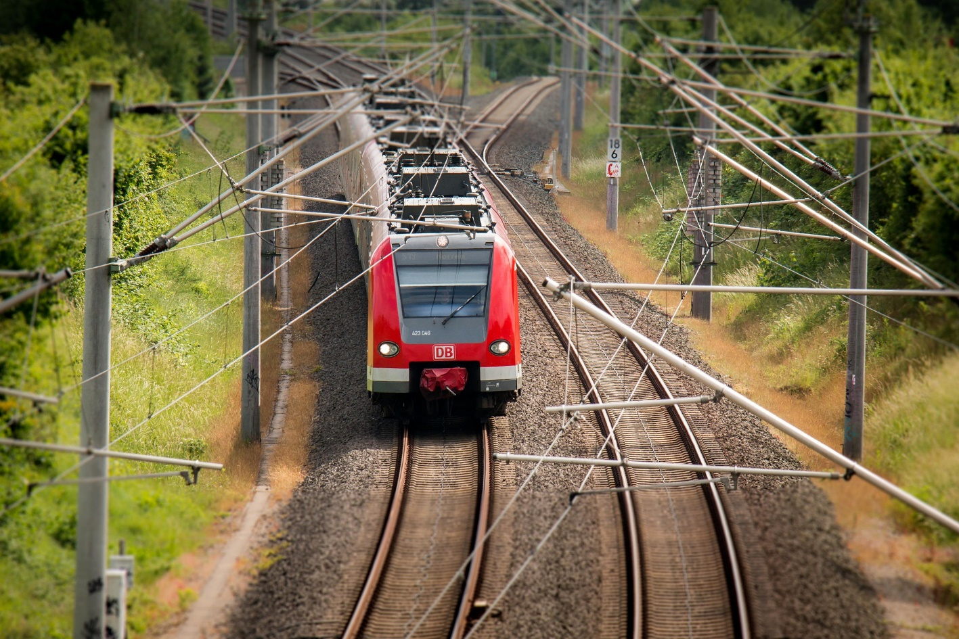
Vocabulario
el tren
Notes:
[7/7]

Slide 15
Talking about places and locations Using ‘del’ and ‘de la’ with adjectives
gramática
In Spanish, you can give locations using adverbs like ‘cerca’ or ‘lejos’.
You often use ‘de’ after them to refer to a person, place or thing.
Ana está cerca de Madrid.
Ana is near (to) Madrid.
Sara está cerca de Diego.
Sara is near (to) Diego.
Notes:
Timing: 3 minutes (two slides)
Aim: to introduce ‘del’ and ‘de la’ (after adverbs of position).
Procedure:
Go through the grammar explanation with students, revealing each new sentence on a mouse click.

Slide 16
Talking about places and locations Using ‘del’ and ‘de la’ with adjectives
gramática
To refer to a singular masculine noun (e.g. el museo), change de + el to ‘del’.
Ana está cerca del museo.
Ana is near (to) the museum.
To refer to a singular feminine noun (e.g. la plaza), use ‘de la’.
Ana está cerca de la plaza.
Ana is near (to) the square.
In English we use several words for this: near (to), far (from), in front (of). Or no word: under (-), behind (-), outside (-)
Notes:
Timing: 3 minutes (two slides)
Aim: to introduce ‘del’ and ‘de la’ (after adverbs of position).
Procedure:
Go through the grammar explanation with students, revealing each new sentence on a mouse click.

Slide 17
¿Es necesario ‘del’ o ‘de la’?
book = libro (m)
door = puerta (f)
bank = banco (m)
cerca (de)
c_ _ _ _ de
near (to)
station = estación (f)
shop = tienda (f)
lejos (de)
l_ _ _ _ de
far (from)
lejos de la tienda
lejos ____________
far from the shop
delante (de)
in front (of)
delante____________
in front of the bank
delante del banco
detrás de la puerta
detrás (de)
behind
detrás _____________
behind the door
outside
fuera de la estación
fuera (de)
fuera _____________
outside the station
debajo del libro
debajo (de)
under
debajo____________
under the book
Notes:
Timing: 5 minutes
Aim: to strengthen understanding of the need for ‘del/de la’ and gender agreement.
Procedure:
Students are prompted to recall the Spanish for ‘near’ and ‘far’.
Students translate each phrase on the right hand side into Spanish.
Teacher shows the answers one by one.
Note: it is sometimes thought that positional adverbs are prepositions, but the RAE lists the following as Spanish prepositions : a, ante, bajo, con, contra, de, desde, durante, en, entre, hacia, hasta, mediante, para, por, según, sin, sobre, tras. También son preposiciones, de uso más restringido, pro (asociación pro derechos humanos) y vía (Voló a Miami vía Londres). https://www.rae.es/diccionario-panhispanico-de-dudas/terminos-linguisticos

Slide 18
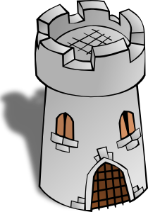
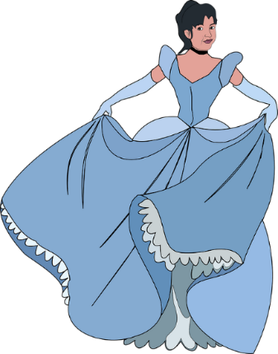
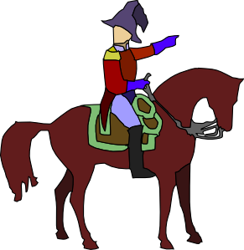
leer
¿Dónde está la persona/el lugar?
Marca la opción correcta.
La t_ _ _ _
la torre
leer
1 | La torre está lejos del | iglesia
 |  | oeste (m)
 |  | could be either
2 | La plaza está debajo del | edificio
 |  | balcón
 |  | could be either
3 | La dama está detrás de la | tienda
 |  | banco
 |  | could be either
4 | El caballero está delante del | casa
 |  | monumento
 |  | could be either
5 | El tren no está fuera de la | estación (f)
 |  | pueblo
 |  | could be either
La p_ _ _ _
la plaza
El b_ _ _ _ _
el balcón
La f_ _ _
la flor
La p_ _ _ _
La d_ _ _
la dama
El c_ _ _ _ _ _ _ _
el caballero
Notes:
Timing: 5 minutes
Aim: to revisit vocabulary (from 2.1.1); to improve understanding of the use of ‘del’ and ‘de la’.
Procedure:
Students are prompted to recall the Spanish word for the images on the right.
Students read each sentence and tick the correct answer depending on the use of ‘del’ (masculine) and ‘de la’ (feminine).
Teacher shows the answers one by one.
Note: the gender of new nouns is given because these don’t have gender marking (-o ending=masc; -a=fem) with which students are familiar.

Slide 19
¿Dónde está?
escuchar / leer
¿Qué escuchas? ¿‘del’ o ‘de la’?
Ahora, marca la palabra correcta y escribe la frase completa en inglés.
 | del | de la
la palabra correcta |  | ¿Cómo se dice en inglés?
oeste (m) | ciudad (f)
plaza | este (m)
estación (f) | museo
escuela | banco
tienda | teatro
coche (m) | mesa
1
The train is far from the city.
2
The white car is near the east.
3
The (male) teacher is in front of the station.
4
The (female) author is outside the bank.
5
The (female) director/headteacher is behind the shop.
6
The (male) classmate is under the table.
Notes:
Timing: 7 minutes
Aim: to consolidate the use of ’del’ and ‘de la’; to understand the sentences
Procedure:
Students listen to each recording and tick the correct column.
Students listen again and write the correct word.
Students write the sentence in English. (They may first need to transcribe it in order to think carefully about the language.)
Transcript
1. El tren está lejos de la [ciudad] 2. El coche blanco está cerca del [este] 3. El profesor está delante de la [estación] 4. La autora está fuera del [banco] 5. La directora está detrás de la [tienda de musica] 6. El compañero está debajo de la [mesa] 7. La estación está delante del [teatro] 8. El amigo está fuera del [edificio]
Note: the genders are mostly clear as most words end in –o and –a. However, students could also be told that even when the nouns don’t end in –o and –a, there are other helpful rules to determine the gender. For example, words ending in –dad (ciudad) and –ción (estación) are always feminine.
Previously taught vocabulary is recycled in this task:
1.2.6 – edificio
1.2.5 – ciudad, plaza, museo, escuela, banco, tienda, teatro, iglesia
1.2.3 – mesa
1.1.4 – casa

Slide 20
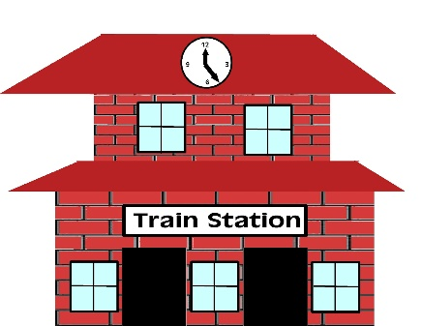
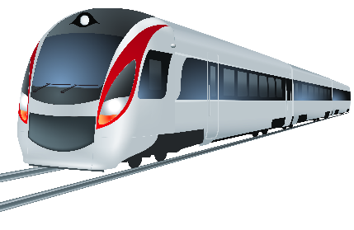
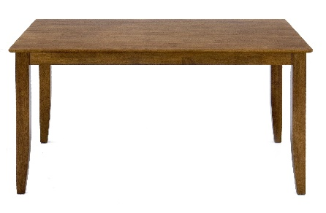
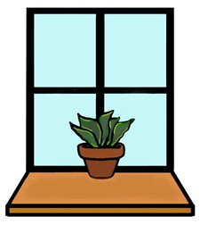
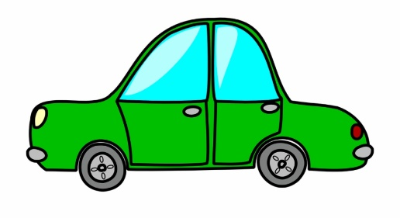
Describe las imágenes. Completa las seis frases en español.
escribir
[behind]
1
2
3
[far from]
1. La persona…
2. El periódico…
3. El chico…
4. La planta…
5. El tren…
6. El coche…
[outside]
[in front of]
4
5
6
[near]
[under]
Notes:
Note that some students will need to refer to the new locational adverb vocabulary to complete this activity. [1/2]
Time: 8 minutes
Aim: to produce sentences including ‘del’ and ‘de la’ and positional adverbs.
Procedure:
Students look at each image/English prompt and complete the sentences in the yellow box with ‘está’, a positional adverb, ‘del’ or ‘de la’ and the referential noun.
Teacher shows the answers on the next slide with further clicks.
Answers:
1) La persona está fuera del banco. 2) El chico está detrás del regalo. 3) El tren está lejos de la estación
4) El periódico está debajo de la mesa.
5) La planta está delante de la ventana.
6) El coche está cerca del oeste.

Slide 21
escribir
Respuestas
escribir
La persona está fuera del banco.
El chico está detrás del regalo.
El tren está lejos de la estación.
El periódico está debajo de la mesa.
La planta está delante de la ventana.
El coche está cerca del oeste.
Notes:
[2/2]
Answers:
1) La persona está fuera del banco. 2) El chico está detrás del regalo. 3) El tren está lejos de la estación
4) El periódico está debajo de la mesa.
5) La planta está delante de la ventana.
6) El coche está cerca del oeste.

Slide 22
Places and locations
Adverbs of position with ‘del’ and ‘de la’
Using estamos (we are) and están (they are) SSC [cua] [cue] [cui]
Y7 Spanish Term 2.2 - Week 4 - Lesson 46 Amanda Izquierdo / Nick Avery / Rachel Hawkes Artwork: Mark Davies Date updated: 06.05.24
Notes:
Note: all words (new and revisited) in this week of the SOW appear on all three GCSE wordlists, with the following exception:
AQA list does not have balcón, dama, caballero.
Edexcel list does not have balcón, dama, caballero, torre.
Artwork by Mark Davies. All additional pictures selected are available under a Creative Commons license, no attribution required.
Learning outcomes (lesson 2):
Consolidation of SSCs [cue], [cua], [cui]
Consolidation of ‘del’ and ‘de la’ (after adverbs of position)
Introduction of ‘estamos’, ‘están’
Consolidation of ‘estoy’, ‘está’
Word frequency (1 is the most frequent word in Spanish):
7.2.2.4 (introduce) estamos [estar-21]; están [21]; oeste [2416]; este [>5000*]; estación [1404]; coche [1190]; tren [1488]; delante de [delante-1742]; fuera de [fuera-299]; debajo de [1366]; detrás de [2044]
7.2.2.1 (revisit) trabajar [174]; buscar [179]; descansar [1749]; preparar [570]; comida [906]; animal [322]; pasar [68]; tiempo [80]; campo [342]; junto[s] [149]; solo [181]
7.2.1.1 (revisit) balcón [3133]; dama [2062]; torre [2138]; caballero [2056]; saber [44]; pasar [68]; blanco [372]; flor [739]; plaza [806]; llevar [101]
Source: Davies, M. & Davies, K. (2018). A frequency dictionary of Spanish: Core vocabulary for learners (2nd ed.). Routledge: London
The frequency rankings for words that occur in this PowerPoint which have been previously introduced in NCELP resources are given in the NCELP SOW and in the resources that first introduced and formally re-visited those words.
For any other words that occur incidentally in this PowerPoint, frequency rankings will be provided in the notes field wherever possible.

Slide 23
Identifica la palabra correcta.
puede
pedir
puedo
hablar
1 | 2 | 3
4 | 5 | 6
7 | 8 | 9
to be able to; can | to ask; asking | favour
you are able to; you can | to play; playing | I am able to; I can
to change; changing | to ask for; asking for | Can I go to the toilet?
s/he is able to; s/he can | to participate; participating | to wear; to carry/take
¿Puedo ir a los servicios?
poder
participar
jugar
llevar
10 11 12
el favor
puedes
preguntar
cambiar
Notes:
Inicio – starter activity to revisit vocabulary and settle students. Timing: 5 minutes
Aim: to revisit words from weeks 2.1.6 and 2.1.1 (revisited in the scheme of work this week) that haven’t already been incorporated into other lesson activities.
Procedure:
Students write 1-12 and the Spanish word.
When all students have arrived and 4 minutes have elapsed, the teacher says the number (either in numerical or random order, to challenge students more).
Students volunteer the answers in Spanish to practise pronunciation.
Teacher gives oral feedback.
Answers:
poder
preguntar
el favor
puedes
jugar
puedo
cambiar
pedir
¿Puedo ir a los servicios?
puede
participar
llevar

Slide 24
Daniel habla de la escuela. ¿Cuál es la palabra correcta?
hablar
En la clase es normal 1) [to be able to] 2) [to ask for]
3) [a favour] cuando necesitas ayuda o 4) [to ask]
5) [can I go to the toilet?] si necesitas ir.
El lunes 6) [I can] 7) [to play] con los compañeros y
8) [to take, to carry] material a casa. ¿También
9) [can you]? El profesor 10) [he can] 11) [to change] las actividades para grupos diferentes. 12) ¡[He participates] en muchas clases!
poder
pedir
un favor
preguntar
¿puedo ir a los servicios?
puedo
jugar
llevar
puedes
puede
cambiar
Participa
Notes:
Timing: 3-5 minutes
Aim: to produce the revisited vocabulary from 2.1.6 and 2.1.1 orally within a short text.
Procedure:
In pairs, students take turns to read the text aloud translating the English prompts into Spanish as they go.
The teacher asks students to read out the full text chorally.
To give feedback, the teacher shows each answer with further clicks.
Notes:
1. Teachers will make a judgement here about students’ readiness for oral productive recall. Ideally, as the target vocabulary here is all revisited (and also seen in the last activity) they would do this without looking at notes. However, if this is too much of a jump, they could write each number and the corresponding word in Spanish before speaking.
2. Students in pairs can divide the text in two: student A reads out the first paragraph and student B reads out the second paragraph.
Unknown words/cognates:
diferente [293]

Slide 25
Vocabulario
estamos
están
[we are] location, state
[they are] location, state
Notes:
Timing: 1 minute Aim: to introduce two new parts of estar and practise them. Procedure:
1. Present the words 2. Elicit repetition. 3. Check for understanding.

Slide 26
Talking about places and locations Using verb ‘estamos’ and ‘están’
gramática
Use the verb ‘estar’ to talk about locations.
To say ‘we are’ with a place or location, say ‘estamos’.
We are in a café.
Estamos en un café.
To say ‘they are’ with a place or location, say ‘están’.
Están en el centro.
They are in the centre.
Notes:
Timing: 2 minutes
Aim: to introduce the uses of ‘estamos’ and ‘están’.
Procedure:
1. Go through the grammar explanation with students, revealing each new sentence on a mouse click.
Note: ‘Estamos’ has the same –amos ending for that was previously taught for regular –ar verbs.

Slide 27
Talking about places and locations
hablar
Remember that in Spanish, to talk about locations you use ‘de’ after adverbs like ‘cerca’ o ‘lejos.
When you refer to a singular masculine noun (e.g. el campo), change de + el to ‘del’.
La casa está cerca del campo.
The house is near (to) the countryside.
To refer to a singular feminine noun (e.g. la estación), use ‘de la’.
El perro está cerca de la estación.
The dog is near (to) the station.
Notes:
Timing: 2 minutes
Aim: to recap ‘del’ and ‘de la’ (after adverbs of position), which was introduced last lesson.
Procedure:
Go through the grammar explanation with students, revealing each new sentence on a mouse click.

Slide 28
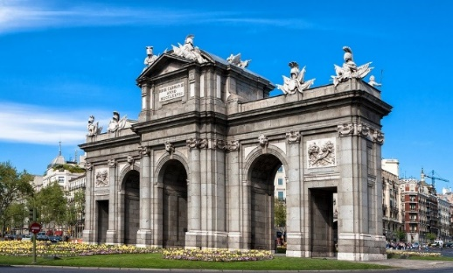
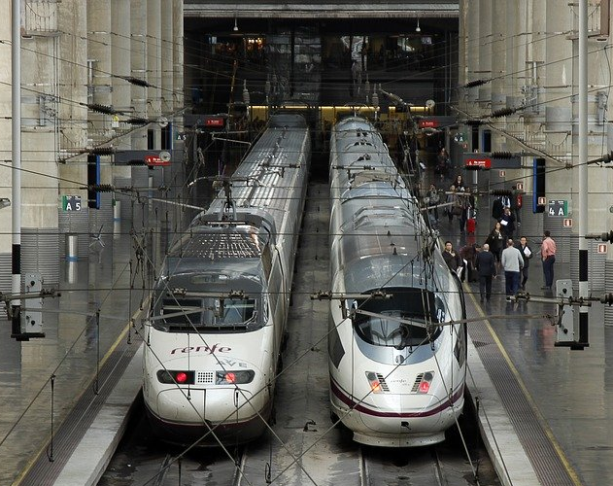
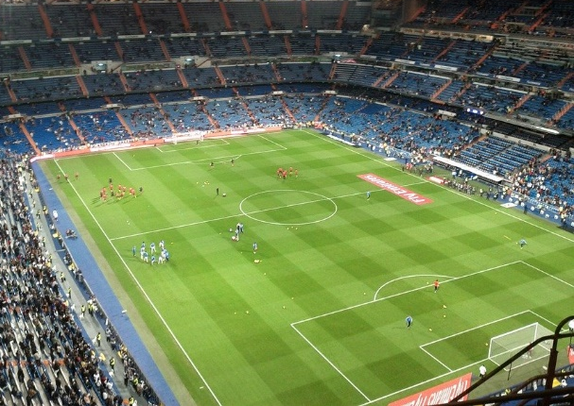
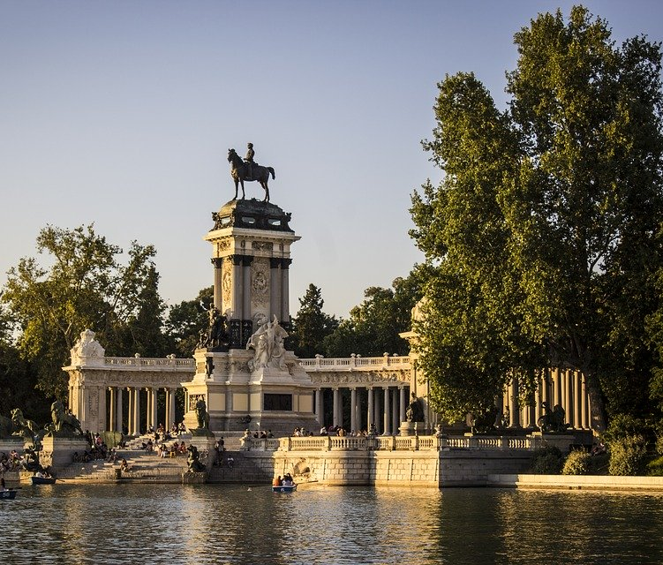
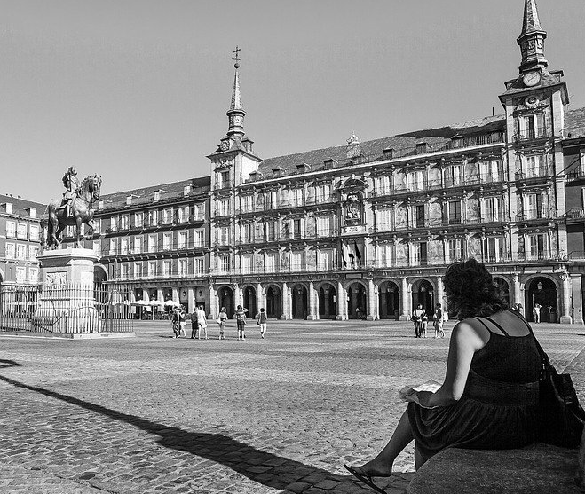
Pep is texting someone. He’s saying where he and his friends are in Madrid. He also says where other friends are.
leer
Puerta de Alcalá (f)
Marca ‘del’ o ‘de la’.
Luego, marca ‘we’ o ‘they’.
Estación Atocha (f)
Estadio Bernabéu (m)
 |  |  | ‘we’ | ‘they’
1. Estamos debajo | de la | Puerta de Alcalá.
 | del
2. Están cerca | del | Parque del Retiro.
 | de la
3. Estamos delante | de la | Estadio Bernabéu.
 | del
4. Están fuera | de la | Estación Atocha.
 | del
5. Estamos detrás | del | Plaza Mayor.
 | de la
Parque del Retiro (m)
Plaza Mayor (f)
Notes:
Timing: 8 minutes
Aim: to consolidate the use of ‘del’ and ‘de la’; to practise linking ‘estamos’ and ‘están’ to the meanings ‘we’ and ‘they’.
Procedure:
Students read each sentence and write ‘del’ or ‘de la’ depending on the gender of the following word.
Students tick the corresponding column, ‘we’ or ‘they’, depending on the verb.
Students translate the sentences to check understanding of the adverbs.
Notes:
The gender of all nouns is given to allow students to focus all their attention on connecting gender with the use of ‘del and ‘de la’. However, teachers could remove the (f) and (m) to increase the challenge for their students, as appropriate.
Teachers might like to prompt students to reflect on the gender of the nouns and to ask them, if needed. E.g., ‘parque, ¿es masculino o femenino?

Slide 29
¿Dónde está Wally?
You’re playing the Spanish ‘Where’s Wally?’. You get some hints! Is it Wally (‘he is’) or Wally and his Spanish twin, Waldito (‘they are’)?
escuchar
He is
They are
¿dónde? (Escribe en inglés)
You can also use indefinite articles (e.g. ‘un’, ‘una’) after ‘de’.
¿Cómo se dice en inglés?
a) Está cerca de un coche.
b) Está cerca del coche.
1
in front of a door.
2
in a river.
3
near a car.
4
outside a big building.
5
behind a tree in a park.
6
with some short people.
Notes:
Timing: 7 minutes.
Aim: to consolidate understanding of the difference between está (‘s/he is’) and están (‘they are’); to understand sentences with positional adverb + del/de la + place
Procedure:
Students listen to each recording and tick the corresponding column depending on the verb they hear.
Students listen again and write the information about where he is/they are in English.
Transcript
Está delante de una puerta.
Están en un río
Está cerca de un coche.
Está fuera de un edificio grande.
Están detrás de un árbol en un parque.
Está con unas personas bajas.
Están lejos de Inglaterra.
Están entre dos personas.
Note: Answers are animated to reflect this: 1-8 ticks and then 1-8 English. As always, teachers who want to run this activity differently can change the animation order.
Vocabulary in this task is recycled from
Term 2.1, week 3: río, ábol
Term 1.2, week 6: edificio, grande
Term 1.2, week 5: cerca, lejos, entre
Term 1.2, week 3: puerta, persona
Term 1.2, week 2: dos
Term 1.1, week 3: bajo
Term 1.1, week 1: Inglaterra
‘Parque’ was a previously taught phonics word

Slide 30
En Madrid
Students get lost in Madrid. Help them say where they are.
hablar
Estamos cerca del....
Persona A habla en español:
We are near to the …
A | B
Estación Antocha (f)
Estadio Bernabéu (m)
Don’t say the name of the place you chose. Your partner will get this from the del.
Estamos cerca del Estadio Bernabéu.
Persona B habla en español:
Notes:
NOTE: teachers could increase the challenge here, by adding different locational adverbs (we have used ‘near’ and ‘far’ only) to include outside, behind, in front as well. They could further increase the challenge by giving students the choice of saying I am/we are each time. Timing: 12 minutes (two rounds)
Aim: to practise the use of ‘estoy’ and ‘estamos’ , the use of adverbs and the use of ‘del’ or ‘de la’ in oral production.
Procedure:
Students work in pairs.
Student A quickly writes down 1-6 and A or B. S/he is going to say the sentence in Spanish from the top part of each box (including the del/de la) but must not say the name of the place.
2. Student B will listen and say the whole sentence, choosing between place A or B. Person A’s correct use of ‘del’ and ‘de la’ is needed in order to complete this part of the task. Emphasise with students that this is how their partner will know which place it is. 3. Student A confirms the answer.
4. Continue until all 6 items have been talked through. 4. Move onto slide 2 and swap roles.
Note: It is perfectly fine for student A to repeat the sentence, given that there are several pieces of information for Person B to write down.

Slide 31
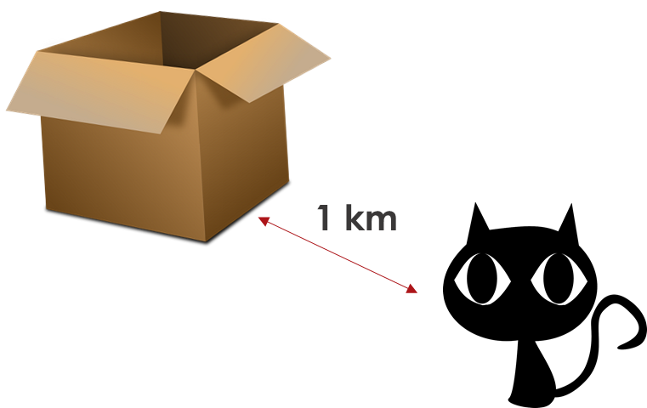
En Madrid (1/2)
near
hablar
We are near to the …
A | B
I am near to the …
A | B
I am near to the …
A | B
1
2
3
Plaza Mayor (f)
Parque del Retiro (m)
Museo del Prado (m)
Plaza Mayor (f)
Estadio Bernabéu (m)
Estación Antocha (f)
4
We are near to the …
A | B
5
We are near to the …
A | B
6
I am near to the …
A | B
Parque del Retiro (m)
Puerta de Alcalá (f)
Estación Antocha (f)
Estadio Bernabéu (m)
Museo del Prado (m)
Puerta de Alcalá (f)
Notes:
[1/2]

Slide 32
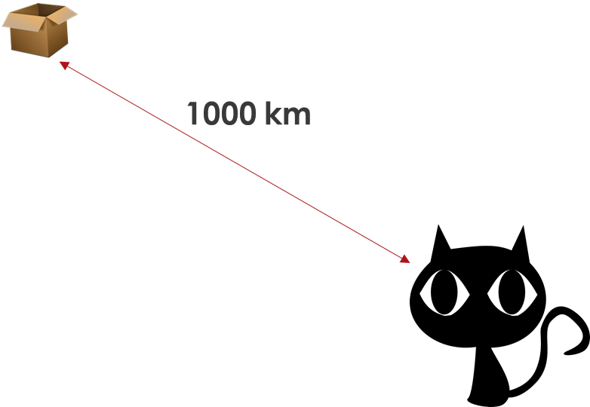
En Madrid (2/2)
far
hablar
I am far from the …
A | B
I am far from the …
A | B
We are far from the …
A | B
1
2
3
Plaza Mayor (f)
Parque del Retiro (m)
Museo del Prado (m)
Plaza Mayor (f)
Estadio Bernabéu (m)
Estación Antocha (f)
4
We are far from the …
A | B
5
I am far from the …
A | B
6
We are far from the …
A | B
Parque del Retiro (m)
Puerta de Alcalá (f)
Estación Antocha (f)
Estadio Bernabéu (m)
Museo del Prado (m)
Puerta de Alcalá (f)
Notes:
[2/2]

Slide 33
En Madrid
Students are still lost! Translate these texts to the Spanish teacher. Escribe las seis frases en español.
escribir
escribir
Estamos fuera de la ciudad.
Estoy delante de la estación.
Está detrás del tren.
1. We are outside the city!
2. He is behind the train.
3. I am in front of the station.
Están lejos de la escuela.
Está cerca del este.
Estoy debajo del coche verde.
4. They are far from the school.
5. She is near the east.
6. I am under the green car!
Notes:
Timing: 8 minutes.
Aim: to bring together the grammar and vocabulary taught (and revisited) this week in written production.
Procedure:
1. Students translate each sentence into Spanish.
2. The teacher shows the answers one by one.
Note: At this stage, we are expecting students to recall the gender of the noun.

Slide 34
Deberes
New vocabulary for 7.2.2.5:
Audio file
Student worksheet
In addition, revisit: Term 2.2.2 Term 2.1.2
Notes:
Use this slide to set the homework.
For Y7, the typical homework will be to pre-learn vocabulary for the next lesson. There is an audio file to accompany the student worksheet.
Notes:
i) Teachers may, in addition, want to recommend use of a particular online app for the pre-learning of each week’s words. ii) Quizlet now requires parental involvement / registration / permissions for users below the age of 13, so it is perhaps most suitable for Y9 – 11 students. iii) Language Nut hosts LDP vocabulary lists and these are free for schools to use, though there is a registration process. One benefit is that all of the student tracking data that Language Nut offers are also available to schools that use the LDP lists for practice. Perhaps this makes it a good option for Y7/8.
iv) There are other free apps, and new ones are always appearing. Teachers have told us that they are currently using: Flippity, Wordwall (where using previously-created activities is free).
v) Gaming Grammar has been acquired by Language Nut. Its original content should still be available to teachers and much of it is appropriate for Y7 learners. Verbs (present): 1st person singular/plural in the ‘Verb agreement (present)’ menu practices aspects of this week’s lessons.

