Slide 1
¿Te gusta la música española?
¿Por qué (no)?
Notes:
Two questions to set the scene for the lesson.
Click on the text to hear the audio.

Slide 2
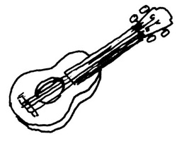
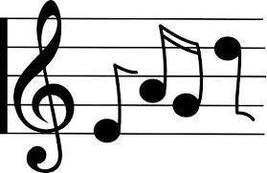
2
3
6
2
4
2
1
7
3
1
2
1
6
4
2
3
1
3
7
1
9
2
5
9
Notes:
Puntos This is a variation on treasure hunt. Pupils volunteer a sentence, producing co-ordinates e.g. Me encanta la música clásica is the first square. Click on the blue square and it reveals the number of points that square is worth to the team. Keep playing, taking turns, until all the squares are revealed. There is a point scored behind each one, but it is not the same each time, so the suspense is there till the end.
Have two volunteers at the front, one to keep score for each team.

Slide 3
¿Te gusta la música española?
¿Qué número prefieres?
Prefiero número …
1
2
3
4
5
Notes:
¿Te gusta la música española? = Do you like Spanish music? Pupils are invited to give their opinions about each musical extract to allow them to practise the language they are learning. Elicit the two opinion phrases first. Then click on the pink sound file icons to hear the audio.
Do some whole class question and answer – Te gusta número uno? etc… Introduce the question – what number do you prefer? ¿Qué número prefieres? = What number do you prefer? Prefiero número … = I prefer number … Click again to see the second question about preference and how to begin the answer.

Slide 4
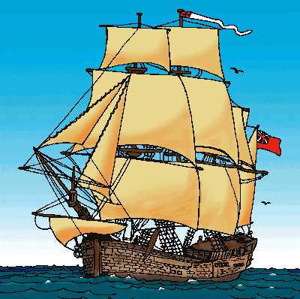
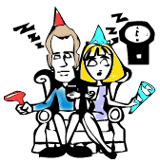
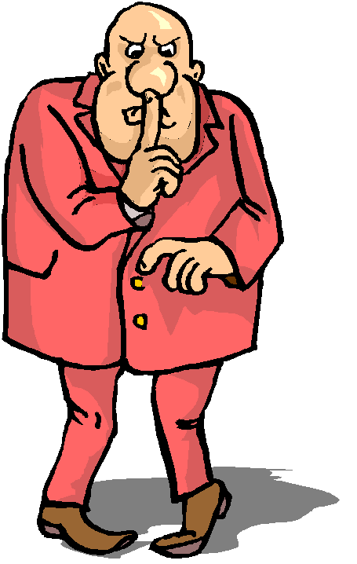
divertida
tradicional
ruidosa
aburrida
moderna
tranquila
Notes:
Before asking pupils to give reasons, bring back the most useful adjectives for describing music preferences from the those learnt in the previous lesson. Bring them up one by one and then elicit the meanings ‘Como se dice en inglés?’ using the pictures if necessary to support.

Slide 5
¿Te gusta la música española?
¿Por qué (no)?
¡Sí! Me gusta la música española porque me parece __________.
1
¡No! No me gusta la música española porque me parece __________.
2
¿Qué número te gusta?
¿Por qué?
3
Me gusta número … porque creo que es __________.
4
¿Qué número no te gusta?
¿Por qué no?
No me gusta número … porque creo que es __________.
5
Notes:
¿Te gusta la música española? = Do you like Spanish music? Pupils have just practised the feminine form of the adjectives, in anticipation of describing ‘la musica espanola’. ¿Qué número te gusta? = What number do you like? ¿Por qué? = Why? Before doing questions 2 and 3, which need the masculine form of the adjective, go to Slide 5 to elicit these, before returning to this slide to give reasons using masculine forms of the adjectives.
Me gusta número … porque creo que es … = I like number … because it seems … to me. (The adjective pupils choose to use must be in the masculine form as it is describing a blue/masculine noun [número]). Click again to see the second and third question. Pupils should give a reason using ‘me parece …’ (plus adjective) or ‘creo que es …’ (plus adjective).

Slide 6
divertida
tradicional
ruidosa
divertido
tradicional
ruidoso
aburrida
moderna
tranquila
aburrido
moderno
tranquilo
Notes:
Elicit the masculine forms of the adjectives for each of the feminine forms.
Drill these.

Slide 7
¿Qué tipos de música te gustan?
Me encanta el Hip Hop y me gusta el reggae.
¿Por qué?
porque el Hip Hop es ruidoso y el reggae es divertido.
¿Qué tipos de música no te gustan?
I don’t like folk music and I hate jazz music.
No me gusta la música folclórica y odio el jazz.
¿Por qué no?
Because folk music is traditional and jazz music is boring.
porque la música folclórica es tradicional y el jazz es aburrido.
Notes:
Try to elicit with the whole class the Spanish for the first two sentences, picture by picture. Then reveal the sentences. Then ask them to try to translate the next two sentences from Spanish into English, and take their answers.

