Slide 1
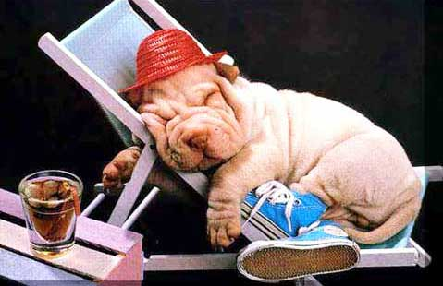
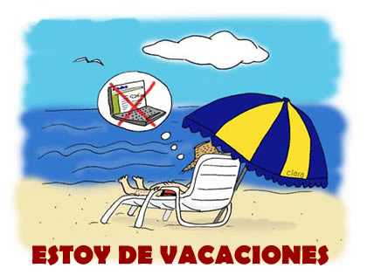
Las vacaciones

Slide 2
Most popular learning activities
Competitive Games
Pairs
Groups
Trans Sp/En
Computer
Speaking pairs
Whiteboards
Notes:
Slides 2-3 show the results from a survey I did with my Y10 class at the end of the previous unit. I shared the results with them and told them I would be adding as many of these elements to this term’s Holidays module as possible.

Slide 3
Most popular - holidays
Dream holidays
Sports
Food & Drink
Weather
Transport

Slide 4
4 x equipos de 4 personas

Slide 5
Encuentra 5 palabras/expressions para cada categoría (pp.20-21):
1 | Country names
2 | Weather words / expressions
3 | Holiday activities (verbs)
4 | Describing words
5 | General holiday words (beach, coast, weather, people, food, views, countryside, facilities, hotel, campsite, staff, shops)

Slide 6
Rules: To win…
Each word must be spelt correctly and be written in Spanish AND English by ALL group members
If you think you have finished, tell me and I will check your words. Any that are not right I will underline and you will need to put them right OR choose another word
If it’s a noun, you must put EL or LA in front
If it’s a verb, you must translate exactly e.g. ir = to go BUT voy = I go and fui = I went so BE PRECISE!

Slide 7
Strip bingo
Practise the words in pairs (Spanish → English) until you know them. Choose 8 words/phrases from this selection of holidays words. Fold your strip of paper into 8 sections and write the English word for one of the holidays words on each (OR draw a picture if you prefer). When the words are called out by the caller, you can only tear it off if it is at either end. The winner is the one who gets rid of all of their ‘strip’ first.

Slide 8
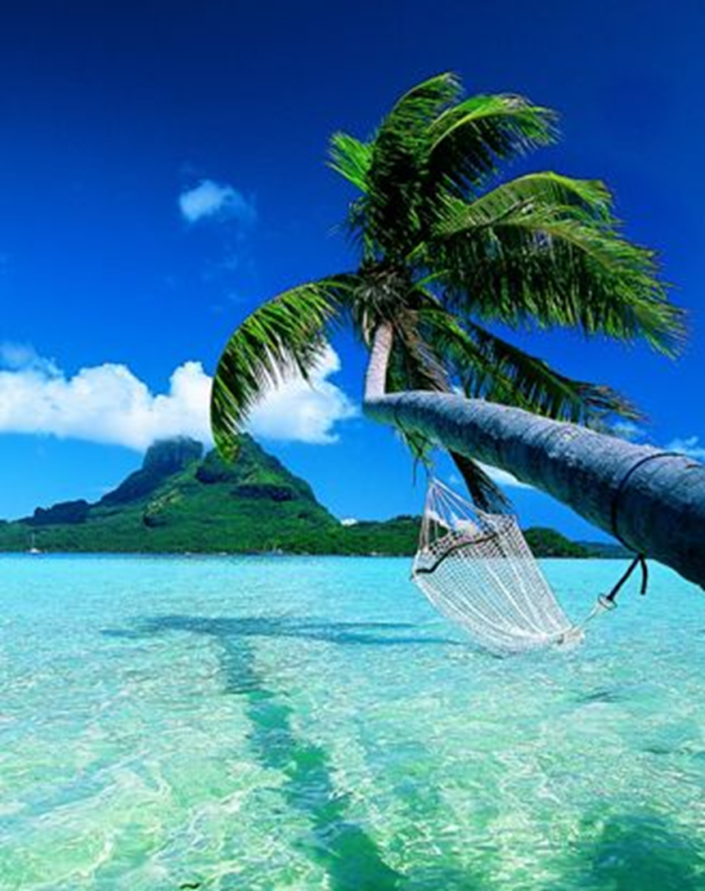
Persona 1: Para mí lo más importante es la playa Persona 2: ¡la playa! Pues, para mí es la comida. Persona 1: Sí, la comida también es importante.
Notes:
Final activity to introduce language for lesson 3.

