Slide 1





Bishop Burton College,
East Riding
Title: Developing all skills at KS4
Wednesday 9 May
Notes:
Language learning at its best is cumulative and gently yet powerfully progressive. Successful outcomes at GCSE have their source in strategic planning, careful teaching and motivational learning at KS3. This session explores how we can achieve this in practice!
Rachel works across the seven schools in the CAM Academy Trust. Director of International Education and Research, and SLE for languages, she is also a former President of ALL, the Association for Language Learning. Co-author of several textbooks, including the new Pearson textbook for GCSE Spanish (¡Viva!), she has a PhD from Cambridge University, focusing on teacher and learner interaction in the secondary languages classroom.

Slide 2

Listening and Reading
- Build comprehension skills from Y7
- Use authentic and/or non-text book resources as well
- Develop an analytical understanding of the question types used at GCSE and the implicated skills

Slide 3

Listening strategies and skills
A good knowledge of vocabulary, high frequency words and synonyms
Prediction
Ability to spot opinions and changes of opinion
Avoidance of distractors and sustained concentration
Infer and make associations from synonymous phrases
Ability to cope with unfamiliar language / manage the panic!
Ability to recognise and decode cognates

Slide 4


GCSE Spanish
Listening strategies & exam questions [1]
multiple choice (in English)

Slide 5

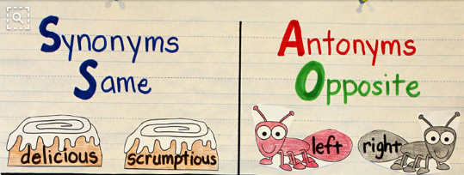
Prediction = using the information available to make an educated guess about what we might hear and what the answers might be.
Synonyms / synonymous phrases = words and phrases that suggest the same idea or share an association. E.g. abuela = familia
(often specific examples of a more general category)

Slide 6
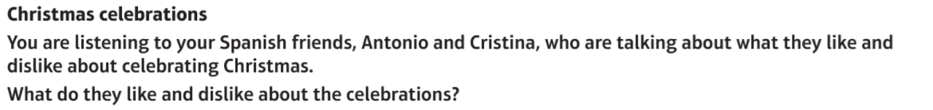
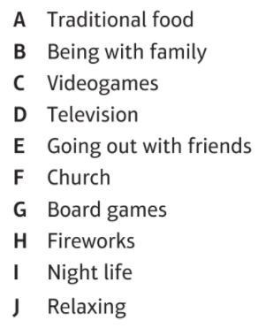
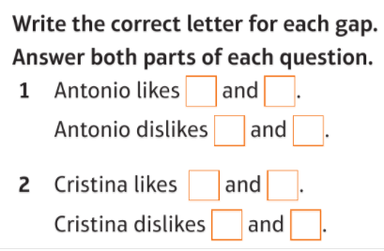
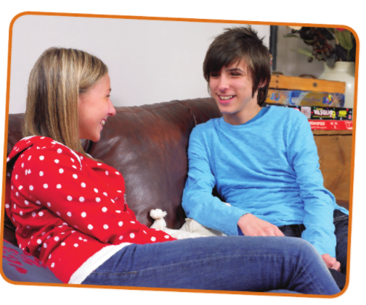

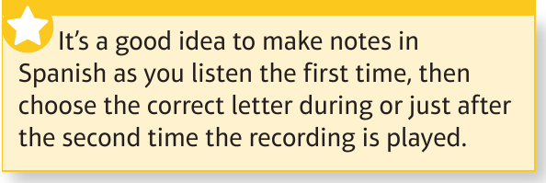
1
B
C
abuela
I
D
videojuegos
discotecas
E
A
tele
amigos
F
G
cena-mariscos
iglesia
ajedrez
Notes:
p.188 Module 9 Repaso
With multiple choice questions in English, prediction is a key strategy. You are given a lot of information on the page but it is in English, so brainstorm the words in Spanish (write them on) – not only the exact words but think of any synonyms / any related words you can.
When you listen the first time, note down key words in Spanish (with ☺ and ☹ faces as you need to spot the opinions, too).
Listen out for opinion phrases and also change of opinion phrases (pero / aunque) and ‘demasiado’ is a negative indicator…
Be prepared for the opinions to be jumbled – i.e. like / dislike / like / dislike
Model this one with students – As you listen to Antonio, bring up ‘abuela’ and ‘videojuegos’ next to smilie and then ‘discotecas’ and finally ‘tele’ next to sad face.
Explain to them then all four things were mentioned, and these were the only four things from the list mentioned, so we need to infer by Antonio’s mention of preferring videogames to tele that he doesn’t like tele, even though he doesn’t clearly state I don’t like TV.
For Cristina, we bring up ‘amigos’ and ‘cena’ next to positive and ‘iglesia’ and ajedrez’ next to negative.
Then we go back through all the categories and add in the matching letters.
Make the point that not only prediction is necessary here, but also openness to synonyms as ‘familia’ is not mentioned but ‘abuela’ is, and similarly ‘board games’ are not said but ‘ajedrez’ is…
1
− Iremos a casa de mi abuela. Siempre me divierto cuando estamos juntos, aunque mis primos siempre quieren ver la tele, pero yo prefiero jugar a los videojuegos. Las discotecas en Nochevieja son demasiado caras.
2
− Tengo suerte porque suelo salir con mis amigos antes de ir a misa. Me fastidia ir a la iglesia aunque vale la pena porque siempre cenamos marisco antes de la misa. No juego nunca al ajedrez ¡Qué va!

Slide 7

As well as prediction and synonym recognition, another very important listening strategy for multiple choice questions is avoiding distractors.
Often, all or most of the items in the list will be mentioned, but won’t be relevant answers, because the opinion is wrong/opposite, they apply to other people, or they are negated.

Slide 8

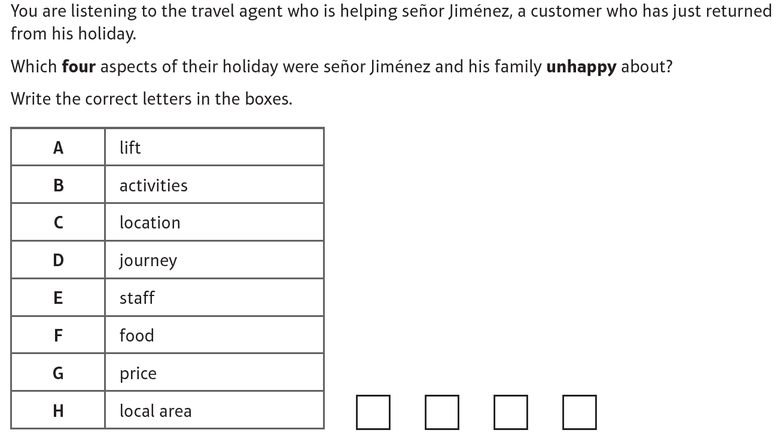
2
In this question, predict the Spanish first, then anticipate the synonyms AND finally listen out for distractions.
A
D
E
G
With this type of question, there are no separate question numbers, so be prepared for the audio to be one, continuous passage.
Notes:
End of Year assessment Listening F/H Q3
– Hola, quiero quejarme. ¡Nuestras vacaciones
fueron desastrosas!
– Buenas tardes, señor Jiménez. ¿Cuál fue el
problema?
– Primero, el ascensor del hotel estuvo estropeado
durante toda la semana y además, en el viaje al
aeropuerto, el autobús tuvo una avería y tuvimos
que esperar a un mecánico.
– ¡Lo siento, señor Jiménez! ¿Y qué tal las
actividades?
– Eh…lo pasamos bomba en el acuario…
– ¿Y el restaurante?
– Nunca lo visitamos, siempre comimos en el
barrio ya que la zona era muy bonita y tenía
lugares pintorescos. Sin embargo, ¡el director
del hotel no hizo nada para resolver nuestros
problemas! Pagamos demasiado, por lo
tanto, creo que se debería hacer algo como
reembolsarme el dinero, por ejemplo.
– Ay, señor. ¡Claro qué sí!

Slide 9
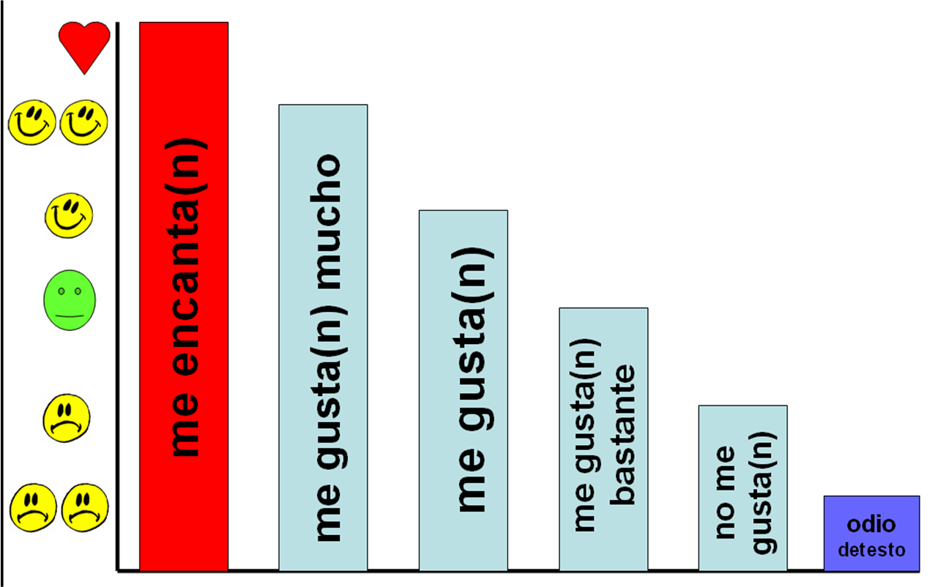
Opinions can be expressed in many different ways, and often without using the familiar verbs of opinion..
Changes of opinion can often be signalled by conjunctions or adverbs: pero, sin embargo, aunque, des(afortunadamente), por otro lado, mientras que

Slide 10
GCSE Spanish
Listening strategies & exam questions [2]
P/N/P+N
Write the questions
TL multiple choice
TL fill in table

Slide 11
Multiple choice in Spanish
Inverse prediction (translate into English – pay particular attention to negatives)
Expect synonyms/antonyms – don’t expect to hear the exact word/phrase that is listed in the question
Listen out for distractors, just as in English multiple choice questions
Audio will not necessarily be in order of the options listed

Slide 12
GCSE Spanish
Listening strategies & exam questions [3]
Open questions in English

Slide 13
Open questions in English
Read the question really carefully
Think about the context – e.g. public announcements are often about health issues (diet, exercise, smoking etc…)
Use prediction wherever you can
Add as much detail as you understand (often marks are given away because details are missed out)
Keep revising vocabulary – as with all types of listening and reading question, knowledge of key vocabulary is crucial

Slide 14


COGNATES: At higher tier, you are expected to cope with some unfamiliar vocabulary. Often key words heard are cognates. If you can write down what you hear with correct spelling, you can often recognise the meaning more easily, especially words with ‘ci’,’ce’ and silent ‘h’ sounds.
Write these words down as you hear them and try to work out their meaning.
Spanish word heard | possible meaning
1
2
3
4
5
6
7
8
Spanish word heard | possible meaning
9
10
11
12
13
14
15
16
cancelar
vida nocturna
inicio
sentido común
cómplice
objetos de valor
contribución
coincide con
servicio educativo
malísimo
zona
carísimo
huracanes
pasado mañana
contacto humano
anteayer

Slide 15

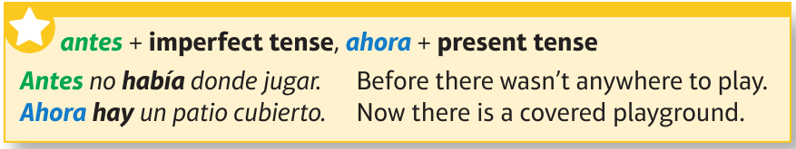

Escucha. Copia y completa la tabla en inglés.
 | my primary school | my secondary school
Camilo | [5] | [6]
Noa | [5] | [6]
Notes:
10 minutes
Draw students attention to the number of details they should listen out for.
This will justify the 2nd full time of listening, even for brighter students.
After 2nd time of listening, get students into groups of 4 to pool their answers and see how close they can get to the full number of details.
[transcript]
¿Cómo era tu escuela primaria, Camilo?
[M] Bueno, era muy pequeña y no había uniforme. Tampoco había muchas instalaciones para el deporte pero había más tiempo libre para jugar. Nunca teníamos deberes.
¿Y cómo es tu instituto?
Es enorme. Hay más alumnos y más profes. Me chifla el edificio porque es moderno y colorido. También hay más oportunidades para hacer deporte. Las clases no son tan fáciles como en primaria pero es normal, en mi opinión.
Noa, ¿cómo era tu escuela primaria?
[F] Era muy grande porque estaba en la ciudad. No tenía ningún espacio verde pero había una piscina al aire libre y un polideportivo. Tenía una sola profesora para todas mis clases, que era bastante antipática.
¿Y cómo es tu instituto ahora?
Totalmente distinto. Tengo que ir dos horas a pie para llegar a mi insti, así que mi día es mucho más largo. Pero mis profes enseñan bien porque son inteligentes y están bien preparados para las clases. Hay un gran salón de actos para hacer obras de teatro. ¡Me encanta! Lo malo es que no hay biblioteca.

Slide 16
my primary school
my secondary school
Camilo
1 Enormous, 2 more pupils and
1 Was small, 2 didn’t have
teachers. 3 Likes the building
uniform. 3 Didn’t have many
4 because it’s modern and
sports facilities, 4 but there
colourful. 5 More
was more time to play.
opportunities to do sport.
5 Never
had
.
homework
6 Classes aren’t as easy as in
primary school.
Noa
1 Very big because it was in
1 Completely different. 2 Has to
the city. 2 No green spaces,
walk two hours on foot to
3 but it had a swimming pool
get to school. 3 Teachers
and a sports centre. 4 Had all
teach well 4 as they are
his classes with one
intelligent and well
teacher, 5 who wasn’t nice.
prepared. 5 Big hall for doing
plays.
6 Only bad thing is that it
doesn’t have a library.
Notes:
5 minutes
Students correct their own work or that of their peers (green pen!)

Slide 17
¿Cómo era tu escuela primaria, Camilo?
Noa, ¿cómo era tu escuela primaria?
¿Y cómo es tu instituto?
¿Y cómo es tu instituto ahora?
Notes:
20 minutes
Students in pairs now use their English notes / answers to the listening to try to reconstruct in Spanish either the conversation with Camilo OR the one with Noa.
(Teachers could allocate Camilo OR Noa to each pair, if preferred, rather than letting them choose).
This is a dictogloss activity, which is very good for developing writing skills and understanding of grammar, following a listening task.
Teachers may wish to return to displaying the previous slide to support students in this task.
Encourage them to use the KL boxes in their textbook and not dictionaries, although any words they need to look up in dictionaries just need highlighting so that students commit them to memory.
This will really develop their use of negatives and imperfect / present tenses.
Teachers should find they have time to offer feedback to individuals as they are working.

Slide 18





https://www.audio-lingua.eu
http://www.phschool.com/atschool/realidades/program_page.html
http://es.maryglasgowplus.com/teachers
http://www.spanishlistening.org/

Slide 19


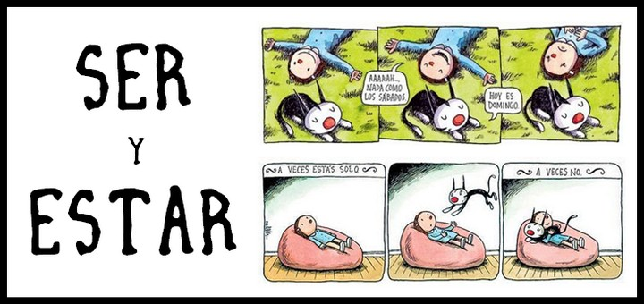



http://www.veintemundos.com/en/
http://es.maryglasgowplus.com/teachers
http://www.google.es
http://zachary-jones.com
https://hablacultura.com/cultura-textos-aprender-espanol/
http://noticiasmuycuriosasverparacreer.blogspot.co.uk/
http://www.practicaespanol.com/

Slide 20

Higher Reading 1
Literary text questions

Slide 21
Reading – literary text questions
Read the English title and task carefully for any clues about the text.
Next, read the example and the questions carefully. If you know any of the key words in the questions, make a note of them.
Read the text through – don’t try to translate it word for word in your head – this will take too long, and you may get stuck when you come across unknown words. Keep going, trying to identify the parts of the text where the answers are.
When you think you have isolated the relevant portion of text for question 1, read-re-read this part, trying to make sense of it in relation to what the question is asking. You may need to do some deduction / inference.
Complete the same steps for all questions. Watch out for answers being before the key phrase, as well as after it.
Notes:
Read through this with students, and then apply it together to the first text & questions.
Correct this one together.
Then ask students to apply these steps to the remaining questions.
Almost all are questions in English, but the final question is a True/False/Not mentioned format.

Slide 22
Higher Reading 2
Multiple choice questions

Slide 23

What the examiners say…
To get more points…
Read the rubric (instructions) carefully
Answer in the correct language
Make final answers absolutely clear
Learn and test yourself on vocabulary to prepare
Don’t jump to conclusions – read the text to the end
Pay attention to the negative
Expect ‘distractors’ and don’t fall for them
Look out for synonym / synonym phrases

Slide 24
Higher Reading 3
Tense, TL, Gap-fill, Survey response & Translation questions

Slide 25

TENSES: Overlap questions often test students’ ability to differentiate between three time frames.
To get these questions right, make sure you:
1) read the tense of the question VERY CAREFULLY
2) use time phrase clues
3) pay close attention to the verb forms
Question: “Who has recently been swimming?”
Ania: Mis amigos y yo nadamos ayer.
Ignacio: Nunca hago natación.
Elena: Vamos a ir a la piscina mañana.

Slide 26

Past | Present | Future
compré
bailo
volveré
estudiaba
vamos
irá
tenía
tiene
tendré
había
hago
estaré
estaba
trabaja
trabajaré
hacía
estudio
compraré
fui
voy
iré
hice
trabajé
estudié
fuimos
volveré | compré | bailo | irá | vamos
estudiaba | tenía | tiene | tendré | había
estaré | estaba | hacía | fui | hice
hago | trabaja | trabajé | trabajaré | compraré
estudio | estudié | iré | voy | fuimos

Slide 27
Reading – Target language Answers
Read the TL questions very carefully, and work out what they mean
Pay particular attention to the question word – qué, cuándo, cuál, quién, por qué
Scan the text for the answer
Wherever possible, lift the answer directly from the text – you do not need to write full sentence answers
Make sure you only lift the words you need, not more
If it is not possible to lift the answer exactly, see if you can use the words in the question to form your answer
Watch out for changes from 1st – 3rd person – e.g. my → his/her (mi → su)

Slide 28
Reading – Gap fill questions
Read each sentence
Work out the meaning and come up with a plausible missing word in English.
Try to match it to one of the options in the box.
Be careful not to leap to conclusions – they will often give you different versions of a verb, for example, and you must choose the correct tense and person.
The word just before the gap is often helpful – i.e. before gap 1 it is ‘last night’ so likely to be a past verb. Gap 2 is ‘los’ so it must be a plural noun.

Slide 29
Reading – Survey response
It looks like there is a lot to read here, but each question can be done separately
Read the question title, instructions and example very carefully
Then read Q1, and the survey question and response for Q1.
The reason usually comes from your understanding of the chosen survey response

Slide 30
Reading – Translation
Pay special attention to the verbs. Several tenses are always included in this task.

Slide 31
Writing
Core repertoire in three time frames
Decode the question
Use known language creatively to answer the question
Use QL checklist (e.g. LOVE IT! or similar)
Check carefully for mistakes (VAN)

Slide 32
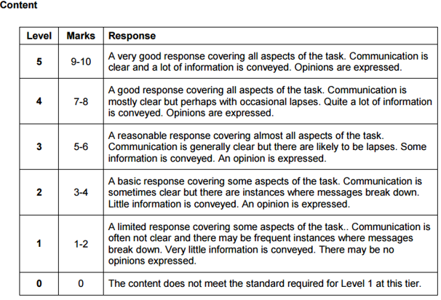
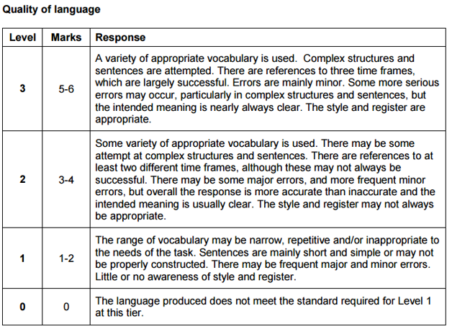
relevant to question - all bullets covered (but can be uneven)
average 20-25 words per bullet (2-3 sentences)
almost all messages communicate clearly (despite minor errors) – i.e. it will be pleasant to read, coherent, logically sequenced
opinions
variety of vocabulary (not too much repetition of basics)
past, present, future references
complex structures
complex sentences

Slide 33
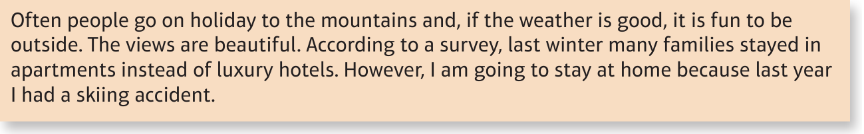

Translation 1/8
One strategy you might want to consider is doing the translation task first, before the 90-word and 150-word tasks.
Do this translation without referring to your resources.
Allow a maximum of 15 minutes.
Then click the link before and listen/watch the ‘think aloud’ model version and correct your own work.
Note any mistakes you made, to avoid next time.
http://www.showme.com/sh/?h=cUlz74a
Notes:
Students should have a go at this translation by themselves, allowing 15 MINUTES to finish it.
If they are in a computer room (or doing this individually at home) they can then click the ShowMe link to do a ‘talk/walk through’ version, which serves as correction as well.
https://www.google.co.uk/search?q=15+minute+timer&rlz=1C1CHBD_en-GBGB704GB704&oq=15+minute+timer&aqs=chrome..69i57j0l5.8250j0j8&sourceid=chrome&ie=UTF-8

Slide 34
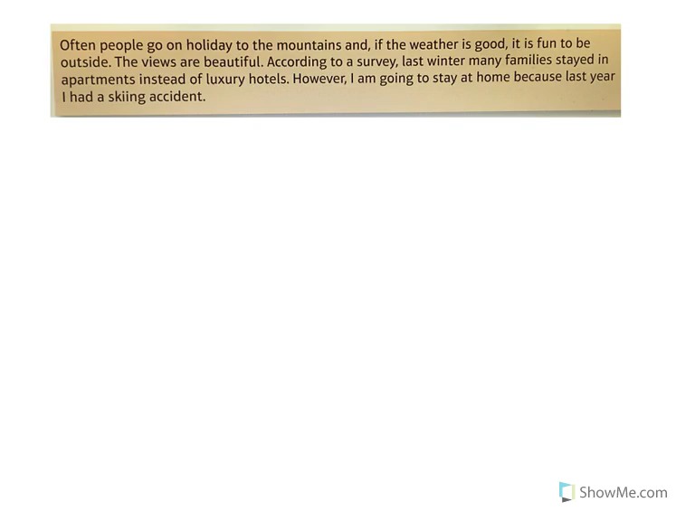

Slide 35
Teaching and learning strategies for teachers
Sentence-building tasks
Translation (including regular sentence-level vocabulary tests)
Developing accuracy
Developing range and variety

Slide 36

1 Sentence-building
Simple sentence (one main verb, one main idea)
Compound sentence (two simple sentences and two equal ideas joined together by ‘and’, ‘but’, ‘or’ etc.)
Complex sentence (two joined clauses, but only one is a simple sentence. The other is a dependent clause, which can’t stand on its own.)
NB: Awarding bodies define ‘complex structures’ as the successful use of elements from the Higher Grammar list, and complex sentences as those which include subordination.

Slide 37
¡Con poco alcanza! (a little goes a long way!)
es | muy | al tenis | no | aburrido | pero | lo
juego | jugar | mucho | a menudo | porque | me gusta
1. no es aburrido | it is not boring
2.
3.
4.
5.
6.
7.
8.
9.
10.
A. Escribe tantas frases cortas como puedas en 6 minutos.
B. Haz una frase larga que usa todas las 13 palabras/frases.
Me gusta jugar al tenis pero no lo juego muy a menudo porque es aburrido.
Notes:
If students are struggling with this, give them some ideas to start them off.

Slide 38
Module 2 Questions (From Theme 3)
My studies and Life at school / college
1 ¿Cómo es tu insti? ¿Qué instalaciones tiene / no tiene?
2 ¿Qué asignaturas te gustan y no te gustan? ¿Por qué?
3 ¿Qué opinas del uniforme escolar?
4 ¿Qué piensas de las normas de tu insti?
5 ¿Qué es lo bueno / malo de tu insti?
6 Describe un día escolar típico.
7 ¿Qué actividades extraescolares haces?
8 ¿Qué actividades extraescolares hiciste el año pasado?
9 ¿Qué planes tienes para este trimestre?
10 ¿Te gustaría participar en un intercambio o viaje escolar en el futuro? ¿Por qué (no)?
Notes:
Quite a few of these questions were revised in the previous session (2,3,4,5 could all have been answered with language that was practised for photo card, role play and 40-word writing tasks).
This lesson picks out a few that were not covered as thoroughly or at all. (1,6,7,8,9) and revises them through a series of sentence-building slides.

Slide 39


Start with the purple word and finish with the orange word.
Write the translation if you have time.
This format was minimally adapted from a resource posted on FB page: Secondary MFL Matters. Join this! ☺

Slide 40
Comberton
se
College.
Mi
Village
colegio
llama

Slide 41
Mi colegio se llama Comberton Village College.
My school is called Comberton Village College.

Slide 42
este
en
Mi
colegio
el
está
cerca de
de Inglaterra.
Cambridge

Slide 43
Mi colegio está cerca de Cambridge en el este de Inglaterra.
My school is near to Cambridge in the east of England.

Slide 44
hay
ochocientos
mi
mil
insti
o menos
En
alumnos.
más

Slide 45
En mi insti hay más o menos mil ochocientos alumnos.
In my school there are more or less 1,800 pupils.

Slide 46
profesores
cincuenta
hay
Creo
en mi
colegio.
aproximadamente
ciento
que

Slide 47
Creo que hay aproximadamente ciento cincuenta profesores en mi colegio.
I believe that there are approximately 150 teachers in my school.

Slide 48
mi
opinión
mi
En
insti
es
muy
grande.

Slide 49
En mi opinión mi insti es muy grande.
In my opinion my school is very big.

Slide 50
es
moderno
También
bastante
y
diría que
tiene
buenas
instalaciones.

Slide 51
También diría que es bastante moderno y tiene buenas instalaciones.
Also I would say that it is quite modern and it has good facilities.

Slide 52
Teaching and learning strategies for teachers
Sentence-building tasks
Translation (including regular sentence-level vocabulary tests)
Developing accuracy
Developing range and variety

Slide 53

1a C’est un _________ de science-fiction.[film]
1b Je vais _________una conversation avec Johnny Depp.[film]
2a On doit __________ souvent de l’eau.[drink]
2b La lemonade c’est ma _____________ préfèrée. [drink]
3a Je fais mes devoirs dans le __________ .[study]
3b Je dois __________ beaucoup au collège. [study]
4a On va réduire la _______ de l’éléctricité. [use]
4b Il faut ________ les transports en commun. [use]
5a On va _________ la télé. [watch]
5b Quelle heure est-il? Tu as une _________? [watch]
6a Je vais__________demain. [phone]
6b Je peux utilizer ton __________ ? [phone]

Slide 54


¡A traducir!
https://www.wordclouds.com/
¡Hazlo ahora!
On Monday after break I have drama | On Wednesday we start with RPE
On Friday the first subject is French | On Tuesday the last classes are English and maths
http://www.tagxedo.com/
http://www.wordle.net

Slide 55
¡A traducir!
¡Hazlo ahora!
On Monday after break I have drama | On Wednesday we start with RPE
On Friday the first subject is French | On Tuesday the last classes are English and maths
El lunes después del recreo tengo arte dramático
El miércoles empezamos con religión
El viernes la primera asignatura es francés
El martes las últimas clases son inglés y matemáticas
Notes:
1 El lunes a primera hora tengo biología y luego tengo matemáticas. [pause]. Después del recreo tengo lengua y luego inglés. Por último tengo dos horas de ciencias, química y física.
2 El martes empezamos con música. A segunda hora tenemos religión. Luego hay empresariales y biología. Después del segundo recreo tengo geografía e inglés.
3 El miércoles la primera asignatura es el inglés y en la segunda clase tengo matemáticas. Luego tengo lengua y francés. Las últimas clases son la física y las matemáticas.
4 El jueves primero tengo inglés y biología. Después tengo historia y lengua. Luego tengo arte dramático e informática.
5 El viernes por la mañana tengo informática y dibujo. Después del recreo tenemos una lección doble de educación física. Por fin tengo clases de matemáticas y tecnología.

Slide 56

The good thing is that I have lots of friends there.
Lo bueno es que tengo muchos amigos allí.
Notes:
www.tagxedo.com

Slide 57
Me presento [A]
Completa las frases en español con las palabras apropiadas.
1 ¡Hola! ¿_____ _________? [How are you?]
2 Me llamo Cara y ________ en Murcia. [I live]
3 Soy ________ seria pero muy _____________. [quite, nice]
4 ______ cuatro personas ____ mi familia; mis padres, mi abuela y yo. [there are, in]
5 ___ _________ hermanos _____ tengo tres ___________; [I don’t have, but, pets]
6 tengo dos _______ y ___ tortuga. [dogs, a]
7 Mi pasión _______ el fútbol. [is]
8 __ héroe es Cristiano Ronaldo. ¡Es genial! [my]
Notes:
Gap-fill

Slide 58
Me presento [B]
Completa la traducción en español y en inglés.
1 ¡Hola! ¿_____ _________? | 1 _________ ! How are you?
2 Me llamo Cara y ________ en Murcia. | 2 ________________________ I live ________________.
3 Soy ________ seria pero muy _____________. | 3 _____ quite ______________ nice.
4 ______ cuatro personas ____ mi familia; mis padres, mi abuela y yo. | 4 There are ____________ in _______________;__________.
5 ___ _________ hermanos _____ tengo tres ___________; | 5 I don’t have _____________ but _____________ pets.
6 tengo dos _______ y __ tortuga. | 6 ____________ dogs ____ a ________.
7 Mi pasión _______ el fútbol. | 7 __________ is ____________.
8 __ héroe es Cristiano Ronaldo. ¡Es genial! | 8 My ___________________. _______________!
Notes:
Parallel translation format

Slide 59
Me presento [C]
Completa el texto en español con las palabras apropiadas.
¡Hola! ¿_____ _________? Me llamo Maya y ________ en Mallorca. Soy ________ pero _____ simpática. ______ tres personas ____ mi familia. ___ _________ hermanos _____ tengo tres ___________; tengo dos _______ y __ gato. Mi pasión _______ el fútbol. __ héroe es Lionel Messi. ¡Es fenomenal!
Hello! How are you? I am called Maya and I live in Mallorca. I am serious but very nice. There are three people in my family. I don’t have brothers and sisters but I have three pets; I have two dogs and a cat. My passion is football. My hero is Lionel Messi. He’s amazing!

Slide 60
Me presento [D]
Traduce las frases al español.
1 Hello! How are you?
2 I am called Maya and I live in Mallorca.
3 I am serious but very nice.
4 There are three people in my family.
5 I don’t have brothers and sisters but I have three pets;
6 I have two dogs and a cat.
7 My passion is football.
8 My hero is Lionel Messi. He’s amazing!
Notes:
It can be extremely valuable for students to repeat tasks, after a time interval, and at a different level. With four different task formats, students can see their progression over time, if they attempt a more challenging version of the task the second time around.
Markscheme – 3 – 2 – 1 – 0

Slide 61


A
Un crayon, du papier, un dé
First player who rolls a 6 grabs the pencil and starts translating. Other player rolls the die until s/he rolls a 3 and shouts “TROIS”. This player now has the pencil and starts translating. First player has the die and needs a 3 to steal the pencil. The winner is the player who has translated all sentences correctly, first.
1. Lady Gaga est très sportive et elle n’est pas très timide. Elle est un peu bavarde. | L_____ G_______ i___ v_____ s________ a___ s____ i__ n___ v____ s____. S___ i__ a b____ c____________.
2. J’adore Lionel Messi. Il est intelligent et patient. Il est fort en foot. | I l_____ L_______ M_______. H____ i____ i___________ a____ p_______. H___ i__ g_____ a__ f_________.
3. Je déteste ma cousine parce qu’elle est pénible. | I h_____ m___ c_________ b__________ s____ i___ a______________.
4.Mon meilleur ami s’appelle Julien. Il est drôle mais un peu égoïste. | M__ b_____ f______ i___ c________J_______. H__ i__ f______ b___ a b___ s_________.
5. Je ne suis pas de tout paresseux. J’aime le sport! | I a__ n___ a__ a____ l_________. I l______ s________!
6. Je parle français et allemand. Je passe des heures à surfer sur Internet. J’ai beaucoup de copains en ligne. | I s________ F_______ a____ G__________. I ________ h______ s________ t___ i_________. I h____ l___ o_ f______ o______.
This idea was posted recently on FB page: Secondary MFL Matters. Join this! ☺

Slide 62
B
Un crayon, du papier, un dé
First player who rolls a 6 grabs the pencil and starts translating. Other player rolls the die until s/he rolls a 3 and shouts “TROIS”. This player now has the pencil and starts translating. First player has the die and needs a 3 to steal the pencil. The winner is the player who has translated all sentences correctly, first.
1. Justin Bieber est assez sociable mais il est aussi égoïste. Il est très riche! | J_____ B_______ i__ q______ s________ b___ h__ i___ a______ s_____. H_ i__ v_____ r____!
2. Usain Bolt est très intelligent mais il n’est pas de tout patient! | U______ B_______ i_ v_____ i__________ b___ h___ i__ n___ a__ a_____ p___________!
3. J’adore mon oncle parce qu’il est très drôle. | I l_____ m____ u_______ b___________ h___ i__ v_____ f___________.
4.Ma meilleure amie s’appelle Léa. Elle est gentille mais un peu maladroite. | M__ b_______ f________ i____ c_______ L____. S___ i___ n_____ b____ a b____ c___________
5. J’ai beaucoup d’amis. On parle de musique ensemble. | I h_______ l______ o__ f_________. W__ t_____ a_______ m________ t______________.
6. Je parle anglais et français. Je passe des heures à jouer au foot avec mes copains. | I s_______ E______ a____ F_________. I s_____ h________ p___________ f__________ w__________m____ f________________.
This idea was posted recently on FB page: Secondary MFL Matters. Join this! ☺

Slide 63
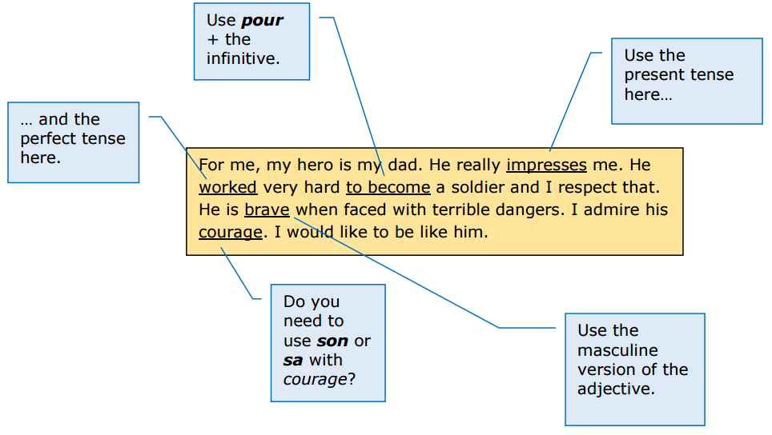
Tip: Browse all awarding body websites for their free resources, not just the one your school is doing.
http://qualifications.pearson.com/content/dam/pdf/GCSE/French/2016/teaching-and-learning/Approaches_to_translation.pdf

Slide 64
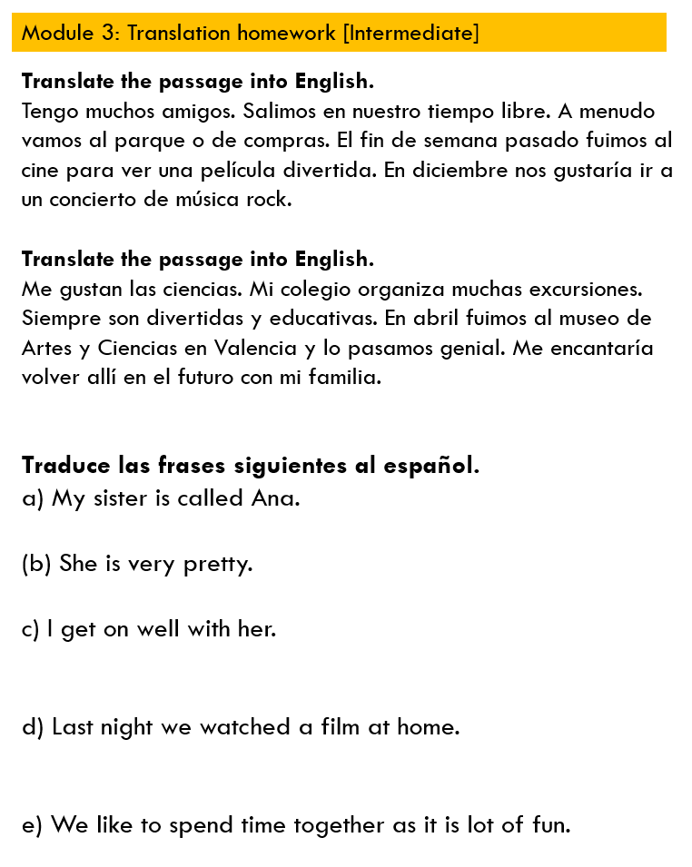
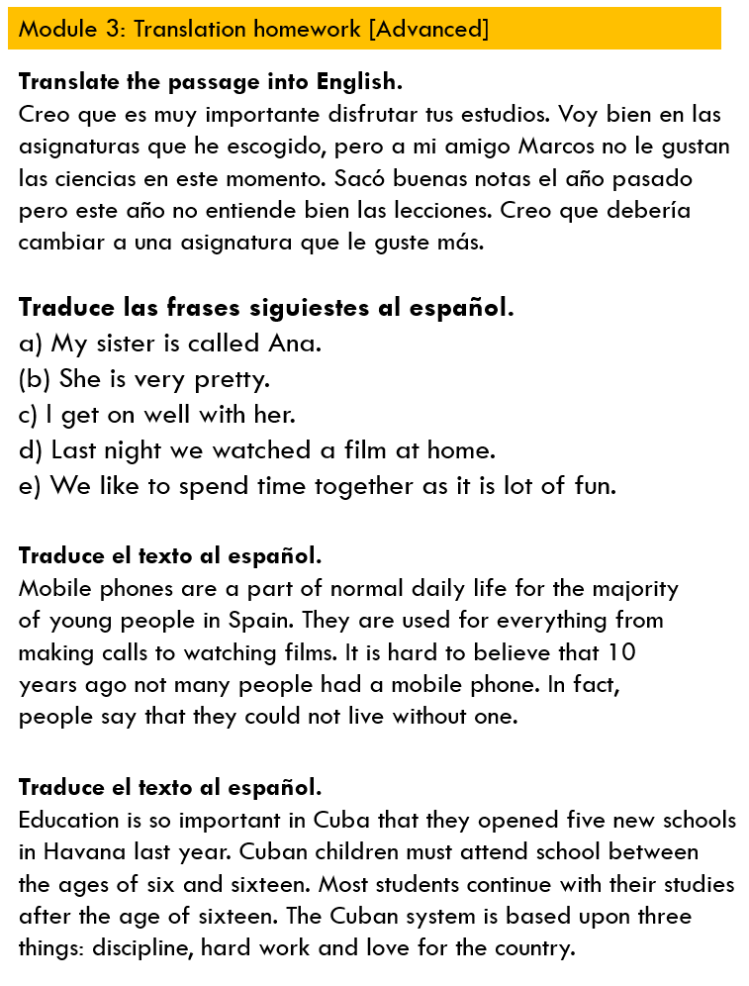

Slide 65
Teaching and learning strategies for teachers
Sentence-building tasks
Translation (including regular sentence-level vocabulary tests)
Developing accuracy
Developing range and variety

Slide 66
3 Develop accuracy
Cues and prompts
Txt Spk
Sentence auction
Tick grids and peer assessment
Reference resources
VAN checklist

Slide 67

VAN checklist
Verbs
Subject – Verb agreement (Who is doing what?)
Tense (When?)
Position in the sentence
Adjectives
Noun – Adjective agreement
Position
Nouns
Masculine / Feminine
Singular / Plural
Definite / Indefinite article

Slide 68
Teaching and learning strategies for teachers
Sentence-building tasks
Translation (including regular sentence-level vocabulary tests)
Developing accuracy
Developing range and variety

Slide 69
4 Develop range and variety
ASL (Average Sentence Length)
Antonyms / synonyms
Harvesting
Function and themes
Using reading as a springboard

Slide 70
1 Soy bastante pesimista pero mi hermano es siempre _______________.
2 Mi profesora de español es _________ pero mi profe de historia es muy serio.
3 Por lo general, mi mejor amigo Santi es generoso, aunque de vez en cuando es ________.
4 Un buen amigo es _________; nunca es infiel.
5 Mi perro es muy travieso, pero a veces también puede ser ________.
6 Normalmente mi padre es ___________ pero los fines de semana es un poco perezoso.
simpático | hablador | bueno
divertido | optimista | tacaño
trabajador | inteligente | fiel

Slide 71
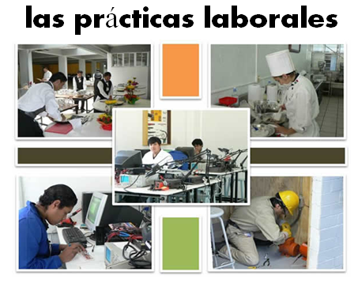
En el presente…
Opiniones y preferencias
Voy (a menudo a Francia)
Lo más importante para mí es (la playa) porque
Suelo ir (con mi familia)
Prefiero (las vacaciones del verano )porque…
Es (un sitio bonito y turístico)
Me gusta(n) (tomar el sol)
Está (en el sur del país)
Tiene (unos 8.000 habitantes)
No me gusta(n) (visitar monumentos)
El hotel tiene
(muy buenas instalaciones)
A mi madre le encanta(n) (los museos) Dice siempre.. “Vamos al museo”
En el futuro…
El año pasado …
En el pasado
Fui a…… con…
El año que viene…
Voy a ir a…
El hotel estaba (cerca del mar)
(el hotel) era… (la gente) era…
Quiero ver…
Hice muchas cosas, por ejemplo…
Tengo pensado …
Cada día iba (a la playa)
Cuando sea mayor…
Me lo pasé bomba / fatal/ bien
Tengo la intención de
Lo que más me gustó fue….
Me gustaría…
Fue una experiencia (inolvidable)

Slide 72
Functions |  | Themes
A | Questions | 1 | Future plans
B | Opinions | 2 | Work experience
C | Suggestions | 3 | Uniform
D | What others say | 4 | Primary school
E | Likes & dislikes (not ‘aimer’) | 5 | Subjects and teachers
F | Habits | 6 | Extra-curricular
G | Comparisons | 7 | Problems
H | Past events | 8 | School rules
Notes:
A bit of a wordy one to explain but essentially it’s about getting students to think outside the box and use their language creatively. On the right are the main sub-themes from a topic, school in this case. On the left are various language ‘functions’. By mixing up the combinations some creative sentences can be written that are not usually found within textbooks.
For example – comparisions are often drawn between subjects (G5) but not so often between future plans (G1) or school rules (G8) and yet, with a little bit of thinking, students can come up with content and language that fulfills on these new combinations and makes for more interesting work.
With one class I put them into groups and gave combinations. We collated all responses electronically and after oral feedback, all students got all of the work, not just theirs, sent out to them.

Slide 73
Speaking
Use of TL
Photo card
Role play
General conversation

Slide 74
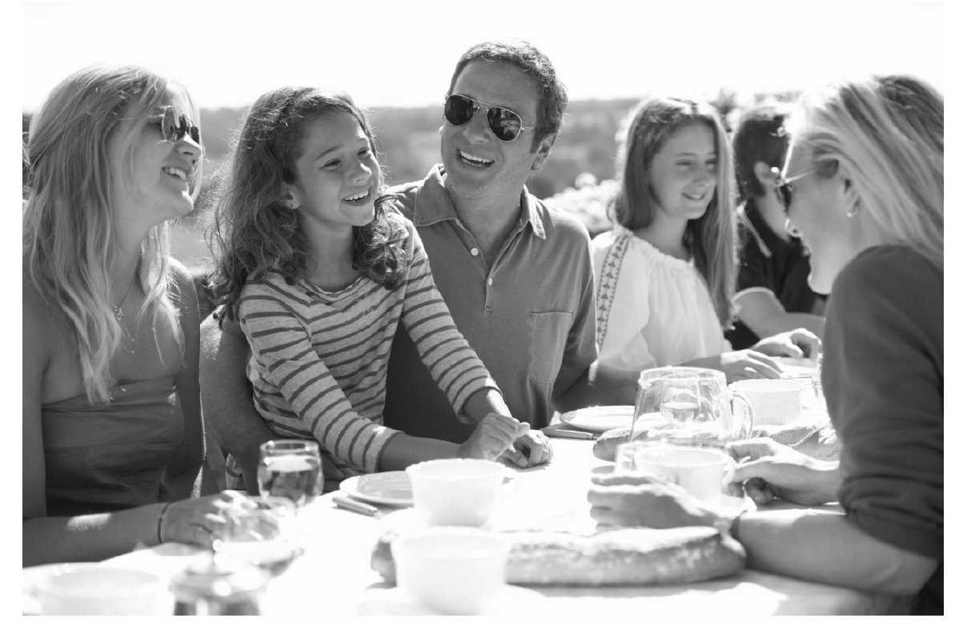

Qu’est-ce qu’il y a sur la photo?
¿Qué hay en la foto?
Was gibt es auf dem Foto?
People
Action
Location
Mood
(Weather)

Slide 75
Language functions/structures | Examples from the model answer
Physical description | tiene el pelo largo y marrón
Action | están comiendo y charlando, todos están sonriendo
Location | en la foto hay…, en el centro, a la derecha, al lado del (padre), en el fondo, están sentados, en una mesa, fuera,
Mood | están contentos, están sonriendo
Weather | hace mucho sol y calor
Speculation / Hypothesis | A lo mejor, podría ser, quizás, a mi parecer, en mi opinión, podrían estar, pienso que, parece, posiblemente, por lo visto, parecen, creo que
Reasons / Justifications | porque, pero, aunque, porque
Negation – i.e. Saying what isn’t there | no es un picnic, no se puede ver mucho en el fondo, no hay regalos ni tarta
General → specific vocabulary | un grupo de personas → una familia → el padre, la madre, una chica un event especial / una celebración → un cumpleaños

Slide 76
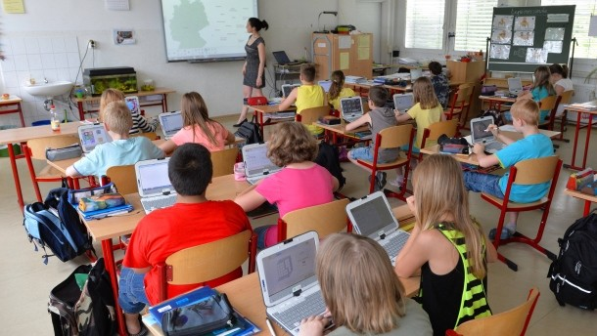


Look at the photo during the preparation period.
Make any notes you wish to on an Additional Answer Sheet.
Your teacher will then ask you questions about the photo and about topics related to school and further education.
People
Action
Location
Mood
(Weather)
¿Qué hay en la foto?
Describe tu colegio.
¿Qué asignatura te gusta? ¿Por qué?
Notes:
Remind students they already did the first part of this photo card task last week.
Give out the ‘keep talking’ sheet to students and share the ‘model’ answers for the first two questions, which students are to translate into Spanish.

Slide 77
el instituto / la comida
el inglés
mi profesor de inglés
el dibujo
la historia
la geografía
la música
la tecnología
la informática
la educación física
mi profesora de inglés
los profesores
las ciencias
las matemáticas
hay…
muchas instalaciones / muchos ordenadores
comida buena / laboratorios modernos
una piscina, una biblioteca buena, un césped artificial
me gusta
me encanta
no me gusta
odio
prefiero
me gustan
me encantan
no me gustan
porque
ya que
aunque
es…
son…
aburrido
práctico
divertido
estricto
simpático
incómodo
delicioso
relevante (s)
interesante (s)
difícil (difíciles)
fácil (fáciles)
útil (útiles)
muy
bastante
un poco
demasiado
más… _____ que
menos ____ que
tan ______ como
mejor que…
peor que…
y
pero
por ejemplo
porque
ya que
sobre todo si
pero a veces
y a menudo
y normalmente
por ejemplo…
pero…
ayer
hoy
el lunes
el martes
el miércoles
el jueves
el viernes
resolver problemas estudiar las montañas y los ríos
trabajar sólo/con mis amigos memorizar las fechas
trabajar en silencio hablar
trabajar duro hacer experimentos / deporte
llevar uniforme ir de vacaciones / ser piloto
dibujar y pintar cantar y tocar un instrumento
utilizar el ordenador comer chicle / usar el móvil
copiar el trabajo estudiar psicología / ciencias
(no) puedo
(no) podemos
tengo que
tenemos que
(no) se debe
hay que
si quiero
tuve que
no pude
decidí
en el futuro
el próximo año
en septiembre
después de mis exámenes
voy a …
espero…
quiero…
me gustaría..
y
pero
cuando
entonces
(no) estaba contento
me gritó
me regañó
llamó a mis padres
mi profesor
mi profesora
Check out Vincent Everett’s Keep Talking resources on TES

Slide 78
Utiliza la hoja para traducir la respuesta al español:
Describe tu colegio.
I like school although it is a bit boring. There are lots of facilities and there is a pool and a good library.

Slide 79
Utiliza la hoja para traducir la respuesta al español:
¿Qué asignatura te gusta? ¿Por qué?
I like geography because it is quite practical and relevant, and usually I can work with my friends. (But today I had to work in silence, but I decided to talk to Josh and my teacher wasn’t happy).

Slide 80

Look at the photo during the preparation period.
Make any notes you wish to on an Additional Answer Sheet.
Your teacher will then ask you questions about the photo and about topics related to school and further education.
People
Action
Location
Mood
(Weather)
¿Qué hay en la foto?
¿Cuál es tu profesor/a favorito/a?
Describe tu colegio.
¿Qué planes tienes para el próximo año?
¿Qué asignatura te gusta? ¿Por qué?
Notes:
Now bring up the other two questions and get students to use the keep talking sheet to form answers to these questions (these only need to be one sentence long).

Slide 81
Utiliza la hoja para traducir la respuesta al español:
¿Cuál es tu profesor/a favorito/a?
I really like my English teacher because she is very nice, (but I don’t like my teacher of history because he is too strict).

Slide 82
Utiliza la hoja para traducir la respuesta al español:
¿Qué planes tienes para el próximo año?
In September I want to study maths and science in the sixth form, (and then I want to go to university, if I can).

Slide 83
Speaking
Use of TL
Photo card
Role play
General conversation

Slide 84
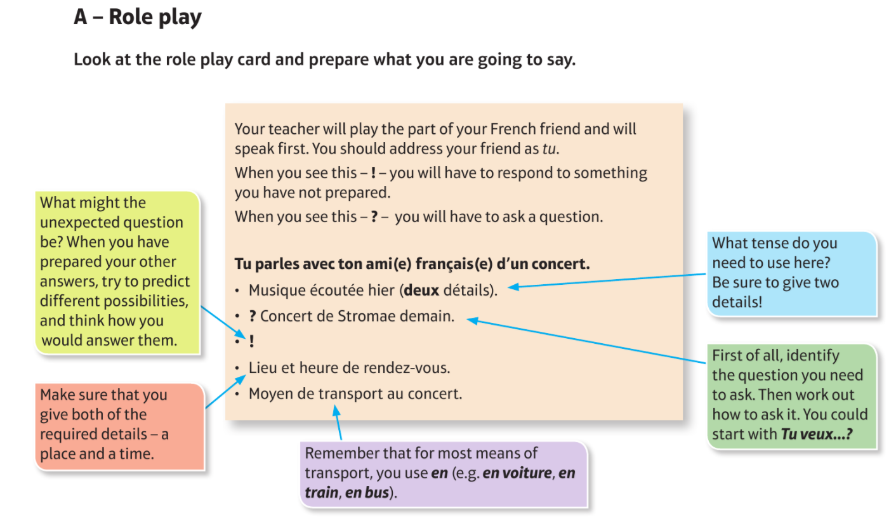

Slide 85
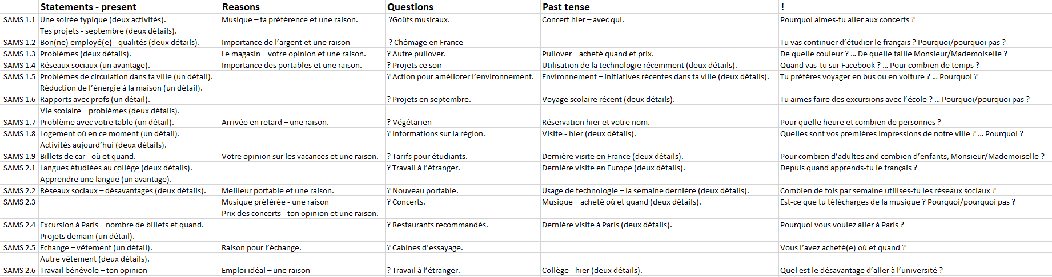
Database of RP prompts from the SAMS

Slide 86
Role play
Votre opinion sur les vacances et une raison.
Dernière visite en France (deux détails).
Projets en septembre?
J’adore les vacances parce que je peux me détendre.
L’année dernière je suis allé(e) à Paris avec ma famille.
Qu’est-ce que tu vas faire en septembre?
Notes:
¿Qué piensas de las instalaciones en tu colegio?

Slide 87
Role play
Une soirée typique (deux activités).
Tes projets - septembre (deux détails).
?Goûts musicaux.
D’habitude je sors avec mes copains et on va en ville.
Je vais aller au club de judo et faire de la danse aussi.
Tu aimes quelle sorte de musique?
Notes:
¿Qué sitios de interés hay en su región?

Slide 88
Role play
Tu profesor/profesora ideal (dos detalles)
Importancia de aprender español (una razón)
?Actividades extraescolares?
Mi profe ideal es mi profe de matemáticas porque es muy paciente
Para mí es importante aprender español porque me encanta España
¿Qué actividades extraescolares haces?
Notes:
¿Qué piensas de las instalaciones en tu colegio?

Slide 89
Role play
Tu pueblo – situación y tamaño
Tu pueblo – tu opinión y una razón
?Casa
Mi pueblo está en el este de Inglaterra y es bastante grande
Me gusta mi pueblo porque es tranquilo
¿Cómo es tu casa?
Notes:
¿Qué sitios de interés hay en su región?

Slide 90
Speaking
Use of TL
Photo card
Role play
General conversation

Slide 91

General conversation
Prepare developed answers to topic questions for homework (1++++ answers = 5 clauses) – length and complexity
Practise those in class (to confident mastery) in speaking lines
Recycle the topics from time to time (e.g. Y11 now recycling questions from the start of Y10)
Ensure that students curate their best work together in one place for the general conversation (either in paper booklet OR on Quizlet)
Use FLA time to practise previous topics with students

Slide 92
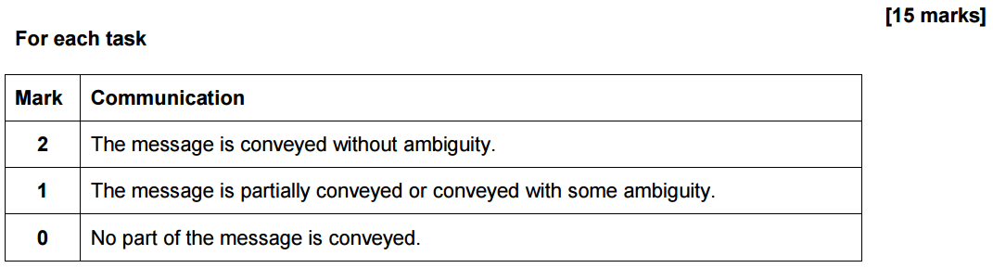
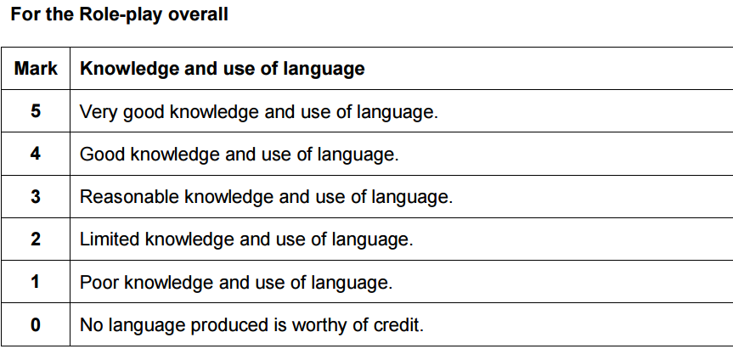
Mark scheme: Role Play - HIGHER
Mark scheme: Photo card - HIGHER
Name:
Indicative Grade | Mark | AQA criteria | additional notes
8/9 | 14-15 | The speaker replies to all questions clearly and develops most answers. He/she gives and explains an opinion. | clearly means no ambiguity – needed for 14 or 15. Three of five questions developed. Both unprepared questions need to be answered clearly (with an unambiguous verb).
7 | 13 | The speaker replies to all (or nearly all) questions clearly and develops most answers. He/she gives and explains an opinion. | There could be one minor moment of ambiguity. Three of five questions developed. Answer both unprepared questions (although one could contain ambiguity)
6 | 10-12 | The speaker replies to all or nearly all questions clearly and develops some answers. He/she gives and explains an opinion. | Minor ambiguity allowed. 2 prepared Qs need 1++ development. At least 1 unprepared question need to be answered.
5 | 7-9 | The speaker gives understandable replies to most questions and develops at least one answer. He/she gives an opinion. | Permits 1/5 bullets not to be answered. 1+ development needed at least once. At least one opinion.
4 | 4-6 | The speaker gives understandable replies to most questions but they may be short and/or repetitive. | Permits 1/5 bullets not to be answered. All answers can be short / undeveloped / repetitive.
3- | 1-3 | The speaker replies to some questions but the answers are likely to be short and/or repetitive. | 3/5 questions answered with short, repetitive utterances.
Part 2
Indicative Grade | Mark
8/9 | 14-15
7 | 13
6 | 10-12
5 | 7-9
4 | 4-6
3- | 1-3
The 5 utterances are marked separately for communication = 5 x 2 points.
Knowledge / use of language (up to 5 points) is awarded overall.
Role play
1 | 2 | 3 | 4 | 5
Photo card
1 | 2 | 3 | 4 | 5 | Opinion | Reason
Notes:
Pupil feedback sheet

Slide 93
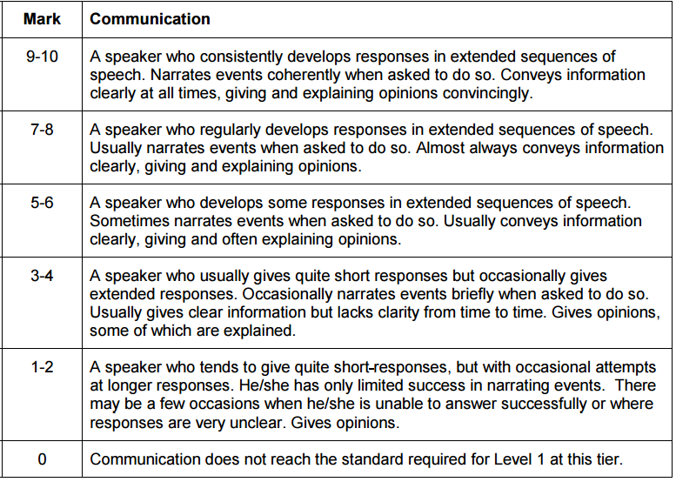
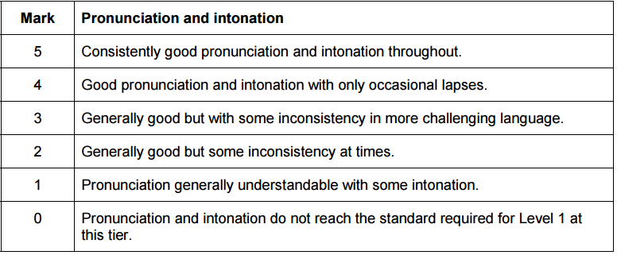
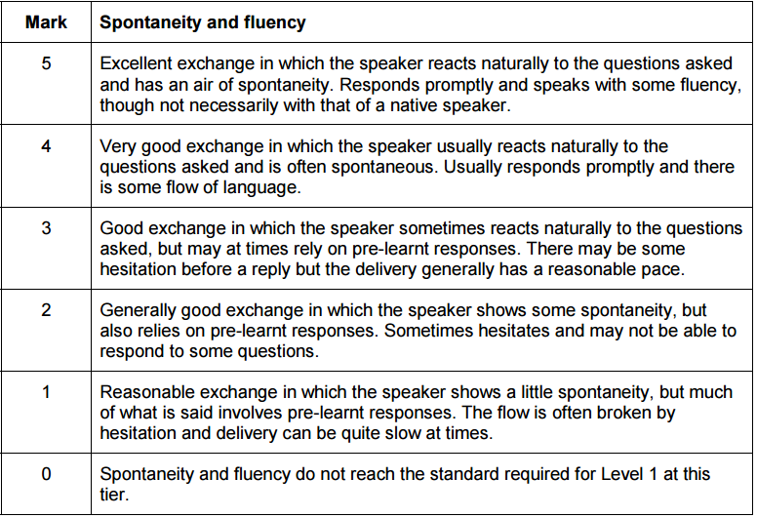
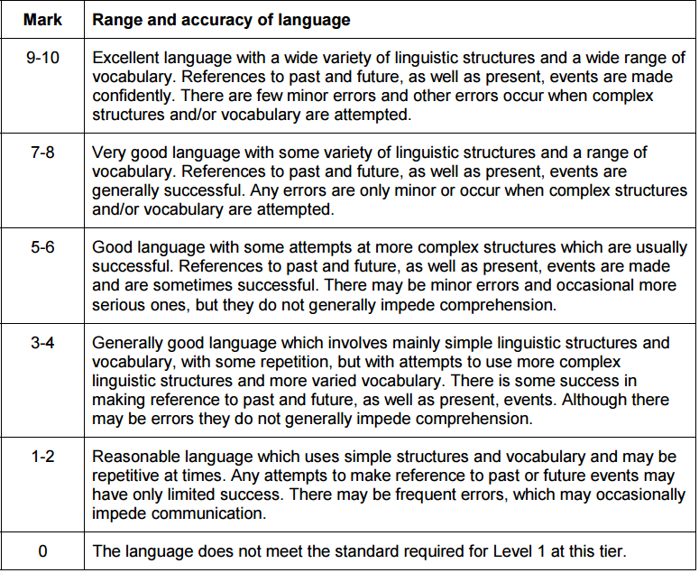
Part 3: General conversation – Assessment criteria (Higher)
Total speaking mark:
Present | Future | Past | Opinion | Reason | Question

Slide 94

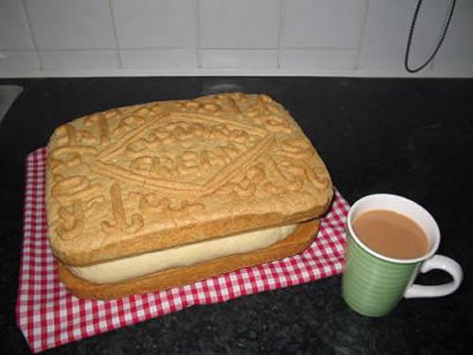
Developing answers
Grade 5
Links | y, también, pero, o, además, sin embargo, por eso, así que, primero, luego, después, por último, a menudo, a veces
Opinions and reasons | Creo que / Pienso que / Me parece que / En mi opinión / Para mí un poco, bastante, muy, demasiado
Variety of structures | Verb + infinitive: se puede / se debe / me gusta (etc.) / me gustaría / tengo que /quiero /espero / tengo la intención de /se debería Comparatives – más que / menos que Superlatives – el/la mejor, el/la peor
Extended sentences | Clauses with: porque, ya que, aunque, cuando, donde, que, si
Interesting vocabulary | don’t repeat interesante / aburrido!
Tenses | present, preterite, near future

Slide 95
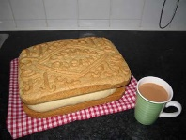
Developing answers
Grade 8/9
Links | y, también, pero, o, además, sin embargo, por eso, así que, por lo tanto, primero, luego, después, por último, a menudo, la última vez que…, por desgracia, sobre todo, incluso, en cambio, a causa de, gracias a, a pesar de
Opinions and reasons | Creo que/Pienso que / Me parece que / En mi opinión / Para mí / A mi modo de ver / Desde mi punto de vista / A mi juicio Verbs of opinions referring to others: A mi madre le encanta… Verbs of opinion in the past: me gustó… Lo que más/menos me gusta/gustó es que/fue que… para + infinitive – to explain something you do/did un poco, poco, bastante, muy, demasiado Exclamations: ¡Qué miedo! ¡Ni hablar!
Variety of structures | Verb + infinitive: se puede / se debe / me gusta (etc.) / me gustaría / tengo que /querer /poder / esperar / tener la intención de /se debería / quisiera / hay que / está prohibido/permitido / soler / acabar de / volver a/ empezar a / dejar de / terminar de / decidir Comparatives – más/menos que, tan…como, tanto/a/os/as + noun + como Superlatives – el/la menos…/más, el/la mejor/peor Absolute superlatives: muchísimo / importantísimo Range of negatives: no…nada, nunca, nadie, ningún/ninguna, ni…ni… Direct and indirect object pronouns, desde hace, desde que, no solo…sino también..
Extended sentences | 1. Sentences with more than one tense (e.g. antes..pero ahora…) 2. Comparing/referring to self and others 3. Contrasting two points of view – por un lado…por otro lado, una ventaja…otra ventaja 4. Complex sentences with: porque, ya que, dado que, aunque, cuando, donde, que, si (& some that need the subjunctive: para que, antes de que, con tal de que, siempre que, hasta que) 5. Phrases which introduce the subjunctive, e.g. Es importante que … (It is important that …) Es probable que … (It is likely that …) Espero que … (I hope that …) Quiero que … (I want …) No creo que … (I don’t believe that …), Me molesta que…, No es justo que… 6. Antes de / Después de + infinitive,…
Interesting vocabulary | A range of more unusual verbs and adjectives, and idioms
Tenses | present, present continuous, preterite, near future, future, imperfect, imperfect continuous, perfect, pluperfect, impersonal verbs, present subjunctive, imperfect subjunctive ®, passive ®

Slide 96
Grade 5
Links | et, aussi, mais, ou, en plus, qui plus est, cependant, pour cette raison, donc, d’abord, ensuite, et puis, après, enfin, souvent, quelque fois, de temps en temps, rarement, toujours
Opinions and reasons | je crois que / je pense que / il me semble que / il me paraît que / A mon avis / selon moi un peu, assez, très, trop, peu
Variety of structures | Verb + infinitive: on peut / on doit / il faut/ j’aime (etc.) / je voudrais / j’ai envie de / il me faut /je veux /j’espère / j’ai l’intention de / je devrais / je compte Comparatives – plus… que / moins… que / meilleur / pire Superlatives – le/la/les plus…/moins… / le meilleur, le pire
Extended sentences | Clauses with: parce que, puisque, car, quand, où, qui / que, si + present, future, si + imperf + conditional (set phrases only)
Interesting vocabulary | don’t repeat intéressant / ennuyeux / super
Tenses and moods | present, passé composé, near future, conditional (voudrais)

Slide 97
Grade 8/9
Links | et, aussi, mais, ou, en plus, qui plus est, cependant, pour cette raison, donc, d’abord, ensuite, et puis, après, enfin, souvent, quelque fois, de temps en temps, rarement, toujours, ce qui fait que, d’où il résulte que, par conséquent, heureusement, malheureusement, par contre, néanmoins, surtout, en ce qui concerne, malgré (le fait que), à cause de, à cause du fait que
Opinions and reasons | Je pense que/ je crois que / il me paraît que / il me semble que/ Selon moi/ à mon avis/ selon mon point de vue/ Verbs of opinions referring to others: il y en a qui pensent que / certains disent que / la plupart des gens aiment, etc. Verbs of opinion in the past: j’ai apprécié / il m’a plu / j’ai bien aimé…Ce que j’ai aimé le plus/ Ce qui m’a plu, c’était …/ pour + infinitive quantifiers: un peu, peu, assez, très, trop Exclamations: quelle horreur! Quel désastre!
Variety of structures | Verb + infinitive: on peut / on doit / il faut/ j’aime (etc.) / je voudrais / j’ai envie de / il me faut /je veux /j’espère / j’ai l’intention de / je devrais / je compte / il est interdit de / il est permis de / Verb + à / de: commencer à / réussir à / finir de / décider de / venir de / êre en train de Comparatives – plus… que / moins… que / meilleur / pire Superlatives – le/la/les plus…/moins… / le meilleur, le pire depuis / depuis que / Range of negatives: ne…pas /ne...plus/ne…jamais/ne…que/ne…ni..ni / ne… aucun / Direct and indirect object pronouns, y, en
Extended sentences | 1. Sentences with more than one tense (e.g. avant…mais maintenant…) 2. Comparing/referring to self and others 3. Contrasting two points of view – d’une part…d’autre part, un avantage est que, un inconvenient est que 4. Complex sentences with: parce que, puisque, car, étant donné que, quand, , où, qui/que, (& some that need the subjunctive: pour que, avant que, bien que 5. Phrases which introduce the subjunctive, e.g. il faut que … (one must…) il est probable que … (It is likely that …) je veux que … (I want …) je ne pense pas que … (I don’t believe that …), ce n’est pas juste que…, je doute que... (I doubt that …), il est possible que (it is possible that …), il se peut que (Maybe/It’s possible that…) 6. avant de + infinitive / en…...ant / après avoir + pp / après être + pp + agreement / ayant + pp
Interesting vocabulary | A range of more unusual verbs and adjectives, and idioms: Vouloir, c’est pouvoir! tout est bien qui finit bien!
Tenses and moods | present, passé composé, near future, future, conditional, imperfect, pluperfect, conditional perfect, impersonal verbs, present subjunctive, imperfect subjunctive ®, passive ®

Slide 98

Grade 5
Links | und, aber, oder, denn, entweder ... oder ... (+WO1) außerdem, deshalb, jedoch, ab und zu, manchmal, oft, dann, danach, früher, später, natürlich, im Großen und Ganzen, neulich, letzte Woche, nächstes Wochenende/Jahr (+WO2)
Opinions and reasons | ich denke, ich glaube, ich finde, ich mag, ich hasse, ich [snap verb] gern/lieber/am liebsten, ich liebe, meiner Meinung nach ein bisschen, ziemlich, sehr, echt, wirklich, viel, zu, total, völlig
Variety of structures | Present tense modal verbs (+ inf): ich darf, kann, muss, will… Past tense modal verbs (+ inf): ich durfte, konnte, musste, wollte… ich möchte, es gibt, es gab, ich/es hatte, ich/es war Comparatives - e.g. einfacher, schwieriger, besser als … Superlatives – e.g. am einfachsten, am schwierigsten, am besten
Extended sentences | denn (+WO1) weil/da, dass, obwohl, wenn, als (+WO3) um... zu + infinitive
Interesting vocabulary | Try to avoid gut, nicht gut, toll, interessant, langweilig!
Tenses | present, perfect, simple past (haben, sein, modal verbs), future

Slide 99
Grade 8/9
Links | ohne Zweifel, sonst, trotzdem, leider, deswegen, eigentlich, zufällig etc.
Opinions and reasons | Ich interessiere mich für …, Am liebsten …, Es macht Spaß/hat Spaß gemacht, … + infinitive, Ich kann … nicht leiden, Das Beste/Schlechteste/Wichstigste daran ist …, Mir ist klar, dass …, ein großer Vorteil/Nachteil ist, Es wäre viel besser, wenn … (+ conditional), Es geht mir auf die Nerven, Mir gefällt/gefallen …, Ich freue mich darauf, Das kann zu (Problemen) führen, Das finde ich schade, Es kommt darauf an, ob … relativ, besonders, irrsinnig, bestimmt, vielleicht, wahrscheinlich
Variety of structures | verbs used with zu + infinitive: Ich plane, … zu + inf, ich hoffe, … zu + inf, ich habe Lust, … zu + inf, ich habe vor, … zu + inf, ich versuche, … zu + inf weder… noch …, nicht nur… sondern auch … seit, statt, trotz, während, wegen (+ R4) nichts Besonderes, viel Neues, etwas Schreckliches, wenig Interessantes separable verbs, e.g. teilnehmen, vorbereiten, zurückkommen, stattfinden, einladen, auswählen impersonal verbs, e.g. es tut mir Leid, es tut weh, es schmeckt, es stimmt, es lohnt sich, es ist mir egal, es gefällt mir [es hat mir gefallen] reflexive verbs, e.g. ich langweilige mich, wir streiten uns, er freut sich (auf), wo treffen wir uns? adjective endings, e.g. es war ein lehrreiches Erlebnis
Extended sentences | two+ tenses in one sentence, e.g. Früher hat mein Vater es gemacht, aber jetzt muss ich es machen. relative pronouns, e.g. Es gibt Leute, die mich inspirieren. Er ist ein Mann, den ich bewundere. use of question words as WO3 conjunctions, e.g. Ich wohne in Berlin, wo es viel zu tun gibt. ohne... zu + infinitive, statt… zu + infinitive conjunctions als ob, bevor, bis, damit, nachdem, ob, während, sobald (+WO3) Einerseits …, andererseits …
Interesting vocabulary | Choose a range of more unusual verbs and adjectives (e.g. ähnlich, unterschiedlich, entsetzlich) & idioms (e.g. Ich habe die Nase voll) Weak nouns, e.g. der Junge, Herr, Mensch, Nachbar, Tourist, Student, Polizist
Tenses | Simple past of common verbs (e.g. ich ging, kam, blieb, aß, trank, las, gab, nahm, sprach, traf, schreib), conditional würde + infinitive (and hätte, wäre, könnte), pluperfect

Slide 100
Bishop Burton College,
East Riding
Title: Developing all skills at KS4
Wednesday 9 May
Notes:
Language learning at its best is cumulative and gently yet powerfully progressive. Successful outcomes at GCSE have their source in strategic planning, careful teaching and motivational learning at KS3. This session explores how we can achieve this in practice!
Rachel works across the seven schools in the CAM Academy Trust. Director of International Education and Research, and SLE for languages, she is also a former President of ALL, the Association for Language Learning. Co-author of several textbooks, including the new Pearson textbook for GCSE Spanish (¡Viva!), she has a PhD from Cambridge University, focusing on teacher and learner interaction in the secondary languages classroom.

