Slide 1

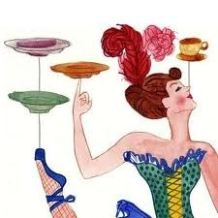
Comberton Village College
Keeping the plates spinning!
Rachel Hawkes
ALL London Event – 16 June 2012
Notes:
'Keeping the plates spinning’ Teachers need something of the 'acrobatic' about them to press all the right buttons with students. Not every idea needs to be rocket science, but it's the right combination of tasks at the right time for the right students that creates an effective combination for learning. This session will combine ideas old and new

Slide 2

Comberton Village College
Keeping the plates spinning!
Rachel Hawkes
Essentially teachers are artisans working primarily alone, with a variety of new and cobbled-together materials, in a personally designed work environment. They gradually develop a repertoire of instructional skills and strategies ...through a somewhat haphazard process of trial and error, usually when one or other segment of the repertoire does not work repeatedly. Somewhere in that cycle they may reach out to peers or even to professional trainers, but they will typically transform those inputs into a more private, personally congenial form...
[This] makes technical communication between teachers a very difficult exercise because the repertoire under discussion is a wholly personal invention and because so much of it has been automatized. The information is unique and, in important ways, inarticulate ... One finds, of course, the same phenomenon among superior artists, athletes, craftspeople, mechanics and even surgeons ...
(Huberman, 1993, p. 136)
Notes:
As well as being acrobatic, someone else has made a very interesting attempt at describing what it is that we do. I am going to be ‘teacher’ and read it out to you. Just by way of sharing a first idea as well – not rocket science but none the less something that had slipped off the radar but is firmly back for me – that is ‘reading out loud’ to students.
I remember clearly when I was learning that just by having the teacher read aloud whilst I read along silently made the meaning of the text jump out at me. It really helped comprehension. Now I’m teaching A level again for the first time in a decade, there were several times when students requested this, as we tackled more complex texts.
Not just A level students but also Y10 have requested it this year.
OK – so here goes…
There are so many things I like about this description of what we do. I like the imagery of the language – cobbled – together materials, personally designed environment, haphazard process of trial and error– it makes us sound like inventors, creators, craftsmen. That definitely speaks to me.
Somewhere in the cycle… - the collaboration elements – peers and trainers
But the 2nd paragraph – describes how difficult it is to share knowledge in this job. As everything is so personal and individual and the more it becomes second nature the more likely it is that you don’t know what you do in given situations, it just works, this is not so positive. It reminds me of the 4 states of competence, only 2 of which are ‘learning states’ – unconscious incompetence, conscious incompetence, conscious competence, unconscious competence. There’s no point being competent if you are not conscious of it as you cannot improve yourself or share productively with others.
At this point it makes me feel slightly better that I feel so often aware of being incompetent, as at least it means I’m still learning! And it’s a good reminder of the importance of reflecting as often as we can about what we do and why.
So this is by way of setting the scene for this session today. Facing the particular challenges of my classes this year, I’ve found some things that work (eventually) that I want to share. I’ve also come found some gems from other people’s work and I’ve also had the privilege of working on some projects that have been really positive.

Slide 3
Comberton Village College
Lessons from a Y10 class
Controlled Assessments Vocabulary learning Mastering a core repertoire Listening Speaking
Rachel Hawkes
Notes:
Controlled Assessments – if we’re not careful they decide how we teach.
However much I resisted the pressure at the start of the year and tried to build confidence, skills and motivation, I succumbed to the CA pressure in Term 2 and they did a speaking and a writing. The speaking was probably well-timed, but the writing was a step too far and as always, when this happens, they were trying to memorise things they had only half mastered.
By the end of the Easter term, they were beginning to flag and what was more important was that they sensed the hollowness of just trying to pass an exam with knowledge they would not retain 2 minutes after it was finished.
These students are B-D grade students in the main.

Slide 4
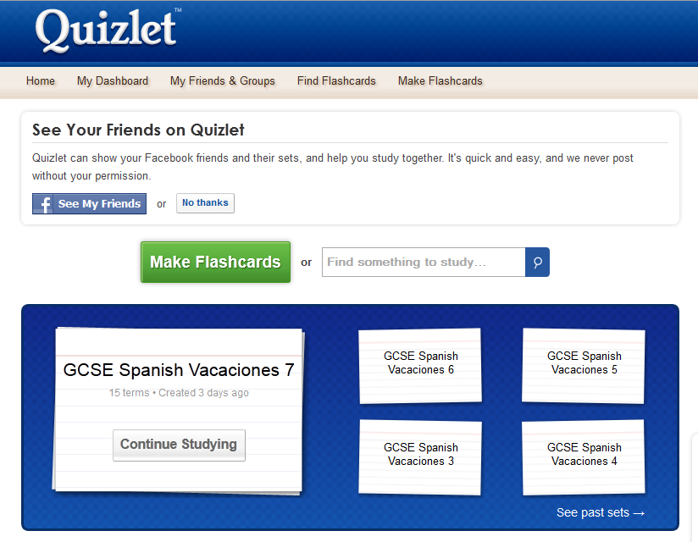
Comberton Village College
Lessons from a Y10 class
Rachel Hawkes
www.quizlet.com
Notes:
www.quizlet.com
So I felt we would have to change things for the summer term. The other Y10 classes are doing another speaking and writing this term so I’ve taken a bit of a risk but I just felt determined that I would have a go at seeing if we could work some things into their longer term memories so that they can approach the next assessments with a core repertoire that is in their heads.
In this attempt, one of the things that I wanted to be more systematic about was vocabulary learning.
Clearly in this ability and motivation range, they have to work harder to retain the words that some very bright groups just need to see or write down once.
So, I tried to think very clearly up front about the core language they would need for the topic of holidays – the words I wanted them to know actively to be able to use in their own speaking and writing.
I came up with half a term’s worth of 15 x word sets and set one each week. I also built them into the lessons as much as possible.
I then emailed them a link with the words electronically. With recalcitrant cases, I also took the liberty of emailing their parents with the links.
Students can use other learning methods if they prefer. The class is ¾ boys and this makes a homework with outcomes – that they feel they have done.
Slowly but surely this is paying off. Not with every student. But there has been steady improvement for most and a couple of remarkable turn-arounds. One student in particular has had a eureka moment during this process and has discovered self-belief. His active vocabulary has improved so much that he answers most vocabulary questions asked by other students before I can. He voluntarily stayed at the end of the day to record a mini speaking clip last week.

Slide 5
De vacaciones…
dije = I said / dijo = s/he said
me gusta… | ir a la playa | con mi familia
prefiero… | ir a Francia / España… | con mis amigos
puedo… | tomar el sol | en el mar
quiero… | nadar | en la playa
tengo que… | descansar | en una discoteca
lo más importante (para mí) es | bailar | en un club
me encanta… | jugar al tenis / al fútbol… | en la piscina
lo mejor es… | viajar… | en un hotel / una granja…
lo peor es… | alojarme… | en tren / en avión
 | ir de compras
decidí… | visitar monumentos
iba a… | sacar fotos
 | alquilar (una bici/un barco)
voy a… | hacer surf /el esquí
me gustaría… | comer
espero… | beber
present
normalmente
siempre
a veces
a menudo
todos los años / días
ayer
el año pasado
el año que viene
past
future
y | pero | porque | también | entonces | cuando | aunque | por ejemplo | sobre todo si
fui = I went / fuimos = we went
hace sol / frío / calor = it’s sunny / cold / hot
Notes:
Using fewer words with more confidence and as many as possible from memory.
This is not rocket science either, but it is easy, particularly if using a text book to turn the page, go on to the new double spread and forget about the language from the previous page. If we can do it, how much more likely is it that the students will. Returning to the same core time and time again helps students to feel a bit more in control of what they’re in the process of trying to store in their long term memory.

Slide 6
Comberton Village College
Listening
Causes most anxiety Always feels like a test Most challenging for lower ability But…certain top set students also fear it
Rachel Hawkes
Notes:
Listening is vital for language learning. It is a source of language input, the decoding of which is believed by most to account to a large extent for language acquisition. But for learners it is often the activity that causes most anxiety. You can often detect a powerful change in the atmosphere in a languages classroom when a listening activity is announced and then in progress. So often students ask ‘is it a test?’ when you start a listening activity, presumably because this is how it feels to them. I’ve never been asked that about a reading activity. It is true that it’s most often the lower ability that find it the most scary and demotivating but there are a significant number of students in top sets that struggle with listening.

Slide 7
Comberton Village College
Listening – whole class
Listening (with confidence and perseverance) 1. In pairs 2. Answers first 3. Ordering cards ‘Running listening comprehension’ 5. Visual listening (YouTube, BBC online clips, adverts) 6. Songs 7. Listening → speaking 8. Produce own listening assessment
Rachel Hawkes
9. All speaking (when spontaneous) is listening
10. Pre-teach key language
11. Repeat listening tasks
Notes:
In whole class teaching situations I think there are lots of things we can do to make listening more effective and more enjoyable. By more effective I really mean less scary, because fear is not positively correlated with either motivation or progress! Some favourite ideas for this involve a slight twist on the usual format of playing a CD, individual work answering questions.
1. Learners work in pairs and listen for alternate number answers and then share their answers before listening a second time. On feedback their approach is “we think that no. 1 is.....”
2. Give the answers first and ask learners to anticipate (written or orally) what language they will hear (even scripting a suggested dialogue/monologue). When they listen, they compare what they’ve anticipated with the audio material.
3. Learners respond to material heard by ordering cards. The focus can be the on structures, where learners sort the activity cards into columns to denote present, past or future or opinions, where the categorising is into positive and negatives or simply on the order in which the items on the cards are mentioned in the passage.
4. Learners are the source of listening themselves. A text is posted on the wall – learners read and memorise as much as they can and run back to their group and repeat it. Learners have to respond to the text by answering questions or filling in a grid or completing a multiple choice activity. (if learners write down what is said, this is called ‘running dictation’).
5. Move away from the ‘disembodied voices’ of CD by using video extracts for listening tasks (Youtube, foreign television channels, short tv adverts, bbc online clips)
6. Use songs. Gap fill and or responding using a simple proforma to identify key features, key language and elicit opinions.
7. Use listening as a stimulus for speaking as often as you can, rather than an end in its own right.
8. Learners make their own listening material in groups (as a revision activity at the end of a module) and the whole class completes the different activities. Can use video for this (webcam & effects)
9. Think of all speaking activities as listening activities too and let this influence your planning. For example, verbal tennis, speaking lines, role plays are as much about listening as they are about speaking.
10. Pre-teach some key language. Teacher selects some key language crucial to the listening passage and flags this up, defining it in the foreign language for learners before listening. This activity is a listening task in itself and can greatly enhance learners’ comprehension of the text when they come to listen to it.
11. Repeat listening exam papers a couple of lessons later or the following week (after you have gone through and marked it. This really improves confidence which in turn impacts on performance.

Slide 8
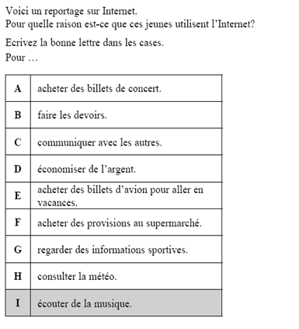
2
Exemple | I
Gérard | B
(b) Margot | C
(c) Philippe | D
(d) Dorothée | A
(e) Guillaume | E
(f) Elise | H
C Grade
Notes:
This doesn’t work with every type of question, but it does work well with certain types. If you give them the answers first, and then ask them to image what each person might say. Tell them (where this is the case i.e. in GCSE/AS listenings) that the person will not say the exact same words as that would be too easy, but that s/he will either use synonyms or circumlocute or give examples or all 3.
So, in number 1 for example, Gérard says: Je cherche des informations quand je fais mon travail scolaire. C’est indispensable quand on fait du travail pour l’histoire ou pour les sciences.
In number 2, Margot says: J’aime bien parler avec mes copines. Je me suis fait de nouveaux amis grace au chatroom.

Slide 9
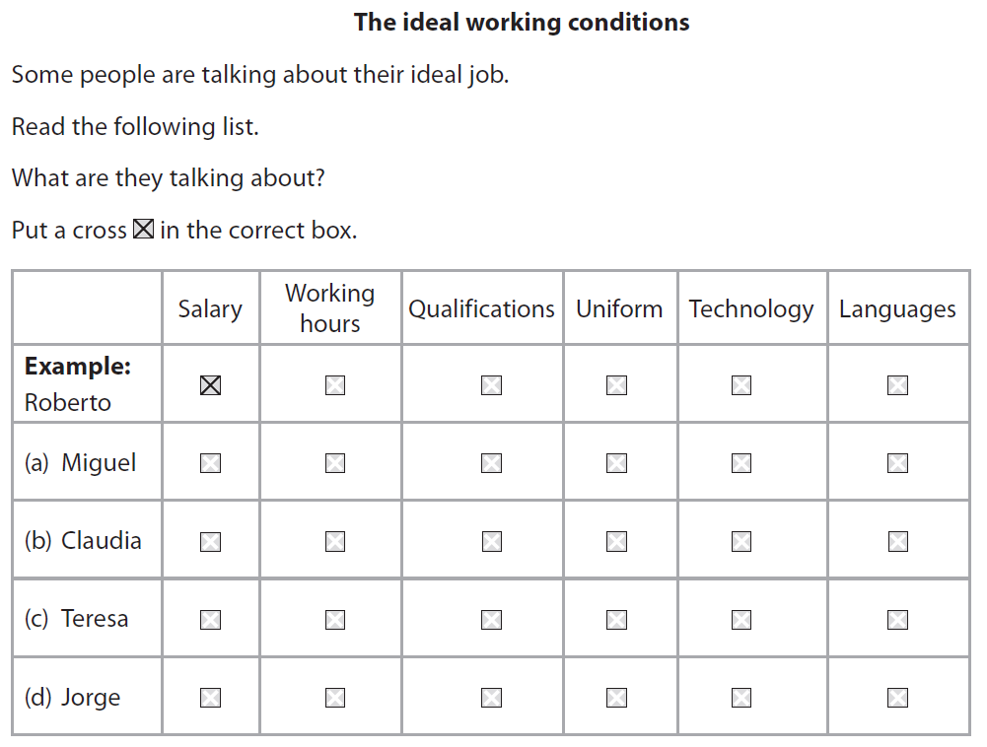
3
Notes:
2010 Edexcel Higher Q7
Sometimes it’s the layout / format of the questions that contributes to making them feel inaccessible and/or intimidating. Using past papers but creating a different (more appealing) activity can be useful. The 2nd or 3rd time of listening they can answer the exam question layout.
It’s also a good way to get them to listen to the same passage several times.

Slide 10


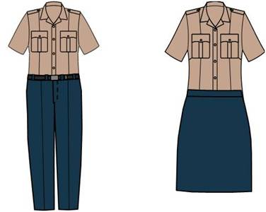





Slide 11
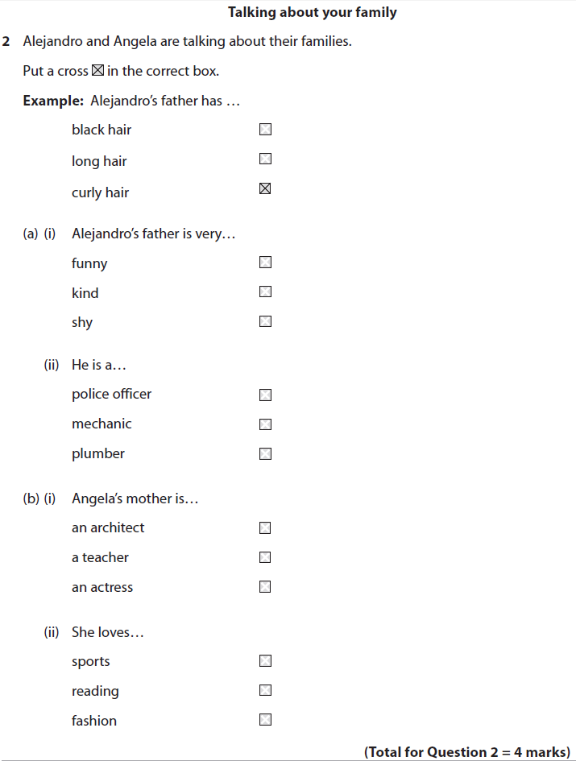

4
¿Y cómo es su carácter?
Es una persona muy simpática.
¿Y en qué trabaja tu padre?
Es agente de policía y trabaja muchas horas.
¿Y tu madre?
Mi madre es actriz. Es muy famosa.
¡Qué interesante!
Si, pero siempre está leyendo. Es un poco aburrida.
Notes:
2010 Edexcel Higher Q2
Various different models – could do running dictation (read text, run back, say it all and others choose correct answer) – if it’s a dialogue, could send two people (attempt to do intonation). OR they could run and listen (I have this on computers with just the part of the question they need, for them to click on ), then run back and try to say it from memory (better for intonation, pronunciation skills). Both are good for working memory, which is what listening relies on.
Or, you could also do ‘chinese whispers style’. Only 1 in each group has the questions to answer. One hears the text (or reads it) and has to whisper it to the next person, down the line.
¿Y cómo es su carácter?
Es una persona muy simpática.
¿Y en qué trabaja tu padre?
Es agente de policía y trabaja muchas horas.
¿Y tu madre?
Mi madre es actriz. Es muy famosa.
¡Qué interesante!
Si, pero siempre está leyendo. Es un poco aburrida.

Slide 12

Une publicité française
5
merci à Morag Gillings

Slide 13
Le petit garçon :
C’est Maurice qui a _______ la mousse.
Répète Coco ! C’est Maurice qui a ______ la mousse !
C’est _________ Coco ! Répète ! C’est Maurice qui a _______ la mousse.
La voix de femme:
Si la mousse au ________ de Nestlé est si ________, c’est parce qu’elle est préparée avec ___ chocolat Nestlé.
Le petit garçon :
Vas y! Répète !
Coco :
Vas y! Répèèèèèète !!
Le petit garçon :
Je te remercie Coco…
La voix de femme :
La mousse __ Nestlé… la _____ mousse au chocolat Nestlé !
merci à Morag Gillings

Slide 14
Questions sur la publicité.
Qui a mangé toutes les mousses au chocolat ?
Comment est la mousse au chocolat ?
Coco est quelle sorte d’animal ?
Maurice est un a) un poisson rouge b) un chat c)un lapin ?
Vrai ou faux ? Le petit garçon veut que sa mère pense que Maurice avait mangé toutes les mousses ?
Discussion
Aimes-tu les mousses au chocolat ?
Quels autres parfums de mousse aimes-tu ?
Les mousses sont bonnes pour la santé ?
Quand manges-tu les mousses ?
Les mousses sont croquantes ?
merci à Morag Gillings

Slide 15
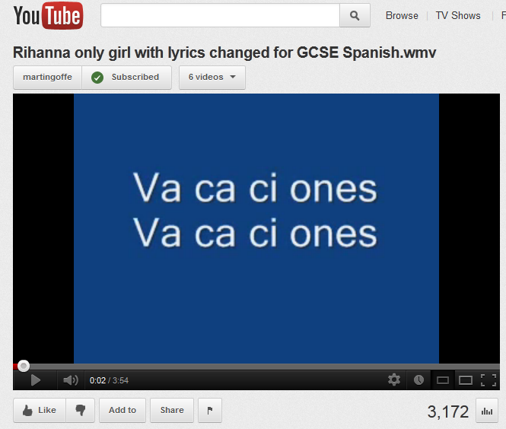
Comberton Village College
Listening
Rachel Hawkes
6
Notes:
http://www.youtube.com/watch?v=605hlfZ-9_U&feature=related

Slide 16
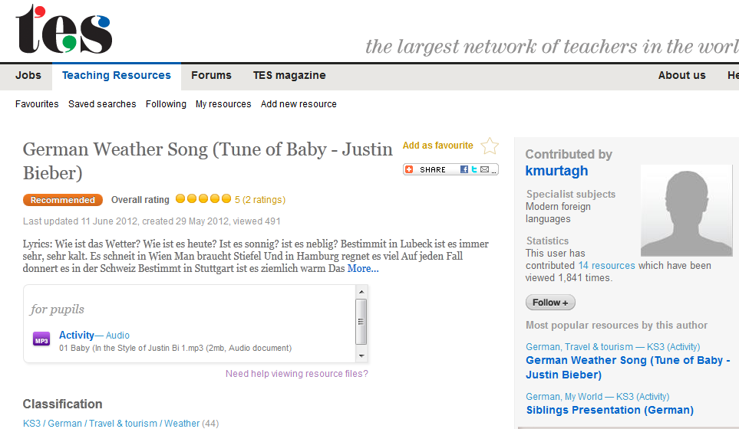
Comberton Village College
Listening
Rachel Hawkes
6
Notes:
http://www.tes.co.uk/ResourceDetail.aspx?storyCode=6242555

Slide 17
Comberton Village College
Listening
Rachel Hawkes
6
http://www.tv5.org/TV5Site/enseigner-apprendre-francais/rubrique-4-Paroles_de_clip.htm?id_col=40&artiste=&chanson=&keywords=
Julien Loko : Encore
Notes:
Pdf and suggested activities to go with these are brilliant.
This is a particular nice one for descriptions – with the Twilight trilogy of books/films very popular with teenagers, this is an idea song/context for them too.

Slide 18
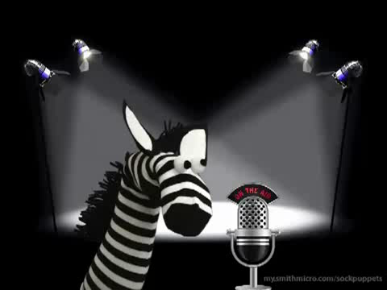
Comberton Village College
Listening
Rachel Hawkes
6
Notes:
http://www.youtube.com/watch?v=gF7omKhq-8Y&feature=plcp

Slide 19


Comberton Village College
Speaking
Whole class (spontaneous) speaking activities Spontaneous speaking = speaking + listening
Rachel Hawkes
Notes:
Overview of speaking section.

Slide 20

Comberton Village College
What is the teacher role in (spontaneous) classroom talk ?
Source of high quality language input for acquisition Contingent feedback Sensitive co-construction Creation of a ‘safe place’ for trial and error Inclusion of humour
Rachel Hawkes

Slide 21
Comberton Village College
Tips for target language
Plan to use the TL yourself – anticipate the language you will use for setting up activities, explaining, disciplining, joking… Predict the words they will not know and plan how to explain / pre-teach them using the TL Make it 100% clear that you value every TL contribution Overtly encourage and reward TL risk-taking Praise ‘thinking’ questions – whatever language they come in Make them feel safe to experiment and make mistakes Use humour!
Rachel Hawkes

Slide 22

Los deportes
Hoy vamos a
repasar deportes
describir y definir deportes

Slide 23

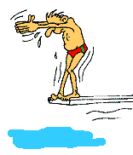
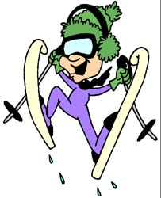
¿Qué deportes les gustan más?
Escribe el porcentaje (%) correcto.
18%
A | nadar | 56%
B | hacer el ciclismo | 35%
C | jugar al baloncesto | 27%
D | hacer la vela | 20%
E | esquiar | 12%
F | jugar al tenis de mesa | 18%
20%
¿Cuál es el deporte más popular?
56%
¿Cuál es el deporte menos popular?
¿Cuáles son deportes de pelota?
¿Cuáles son deportes acuáticos?
12%
¿Cuáles son deportes de equipo?
¿Cuáles son deportes olímpicos?
Notes:
Questioning here is to bring out key words for classifying sports and defining them – students need to know actively how to use these terms themselves. It would be useful here to draw out their own preferences for these and other sports. See if they can use ‘Me gusta’ and ‘no me gusta’ and ‘prefiero’ and push for opinions/justifications ‘porque’ + rápido / emocionante / peligroso / divertido / exigente

Slide 24


Pon los números en el orden correcto.
1. el bádminton
6. el tenis
2. el fútbol
7. el voleibol
3. el taekwondo
8. el tenis de mesa
4. el atletismo
9. la gimnasia
5. el ciclismo
10. la natación
Notes:
Watch the video twice and ask pupils to write down the order Berni does the sports in. Only 8 are used. The answers are 4,5,2,9,3,6,8,10.

Slide 25
¿De qué deporte se habla aquí?
1. Es el deporte más popular en Inglaterra y en España.
2. Es un deporte individual que es popular en Inglaterra, que se hace cerca del agua. En mi opinión es despacio y aburrido.
3. Es un deporte de equipo que se juega con una pelota y se puede jugarlo en la playa. Es un deporte olímpico y de verano.
4. Es un deporte acuático y olímpico. Rebecca Adlington ganó una medalla de oro en este deporte en Beijing en 2008.
5. Es un deporte de equipo que originó en Inglaterra. Es bastante agresivo y no es un deporte olímpico.
6. Es un deporte que es como una mezcla entre el fútbol y el baloncesto.
el rugby | el voleibol | la natación
la pesca | el fútbol | el balonmano
Notes:
After students have completed this activity in pairs, correct it, but then use the text to pull out key vocabulary and perhaps also elicit from them simple sentences that they build by adapting words from the text.
E.g. como se dice…
1. It is an olympic sport.
2. It is a popular sport.
3. It is a team sport.
4. It is not an olympic sport.
5. It’s an individual sport.
6. It’s a boring sport.
7. It’s a water sport.
8. It’s an aggressive sport.
Try to slot in ‘de invierno’ and ‘de verano’ too to keep these fresh.
The idea is that students should see how easy it is to create very different meanings by varying the adjective, and that they reinforce the pattern of adjective position after the noun. This primes them for the listening activity that follows.

Slide 26
Escucha las frases y apunta el orden correcto (1-9)
A It’s a water sport.
B It’s a team sport.
C It’s a ball sport.
D It’s an individual sport.
E It’s an olympic sport.
F It’s a sport. | 1
G It’s a fun sport.
H It’s not an olympic sport.
I It’s an exciting sport.
Notes:
Read these in this order:
1. Es un deporte.
2. Es un deporte olímpico.
3. Es un deporte divertido.
4. Es un deporte acuático.
5. Es un deporte individual.
6. No es un deporte olímpico.
7. Es un deporte de equipo.
8. Es un deporte emocionante.
9. Es un deporte de pelota.

Slide 27


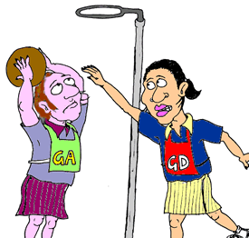

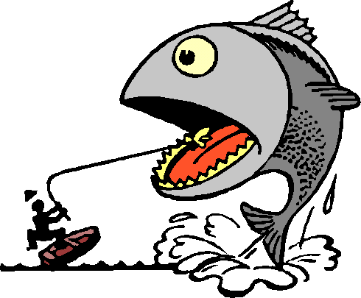
Describe estos deportes.
Notes:
Elicit as many phrases from students as you can. Try to use follow up questions to get them to say more about the sports, giving their own opinions etc..

Slide 28
Mi deporte preferido o un deporte que me gusta mucho
Un deporte que no me gusta nada
Un deporte olímpico que me gustaría ver o probar en el futuro
Un deporte que le gusta a mi madre
Notes:
This will need differentiating by different levels of support with different groups, but keep it in the TL or the learning is minimal.
Explain the prompts in the TL with gestures, examples etc..
Idea of the activity is to give 5 seconds only for students to draw something on their paper – bring up the categories one by one and give 5 x seconds only. The drawing will be rubbish but that is the point! At the end they will know what it is but it won’t be obvious to anyone else.
From this point they should be in pairs and present their ‘mini flashcards to each other’ – lower ability might only manage single words/short phrases but more able students should try to explain what the sport is to them – i.e. un deporte que me gusta mucho es el tenis…

Slide 29
Mi deporte preferido o un deporte que me gusta mucho | Un deporte que no me gusta nada
Un deporte olímpico que me gustaría ver o probar en el futuro | Un deporte que le gusta a mi madre

Slide 30
1. Es un deporte de verano.
2. Es un deporte olímpico.
3. Es un deporte divertido.
4. Es un deporte acuático.
5. Es un deporte individual.
6. No es un deporte olímpico.
7. Es un deporte de equipo.
8. Es un deporte emocionante.
9. Es un deporte de pelota.
Notes:
Reminder of the key language – NOT to translate although perhaps students could test each other on the phrases to make sure they know them.

Slide 31
Repaso: Termina la frase…
El fútbol es…
La pesca es…
Un deporte que me gusta mucho es…
Un deporte que no me gusta nada es…
Dos deportes olímpicos son…y…
Un deporte rápido es…
Un deporte despacio es…

Slide 32

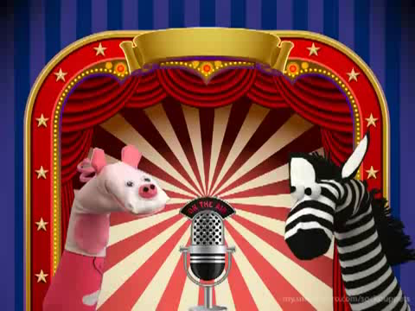


Comberton Village College
Speaking
Rachel Hawkes

Slide 33

Sing to the future: Language Beatz Competition
The aim’ is for students in Year 8 to practise and improve their foreign language skills by transferring language from the Key Stage 3 curriculum into catchy, memorable song lyrics.
You can find out more from the Routes into Languages website: http://www.routesintolanguages.ac.uk/east/activity/2378
It will also soon appear on the Speak to the Future campaign website:
http://www.speaktothefuture.org/
Notes:
This is where I share something about learning beyond the classroom. Another project – in line with Spanglovision, Language on Film, Language Leaders, this is another idea that took root and is bearing fruit.
Here’s one of the 12 finalist entries for the Eastern region finals on Thursday 28 June.
Using music creatively in groups for language learning can prove both motivating and effective. The project is being piloted from this autumn term in the East of England –

Slide 34

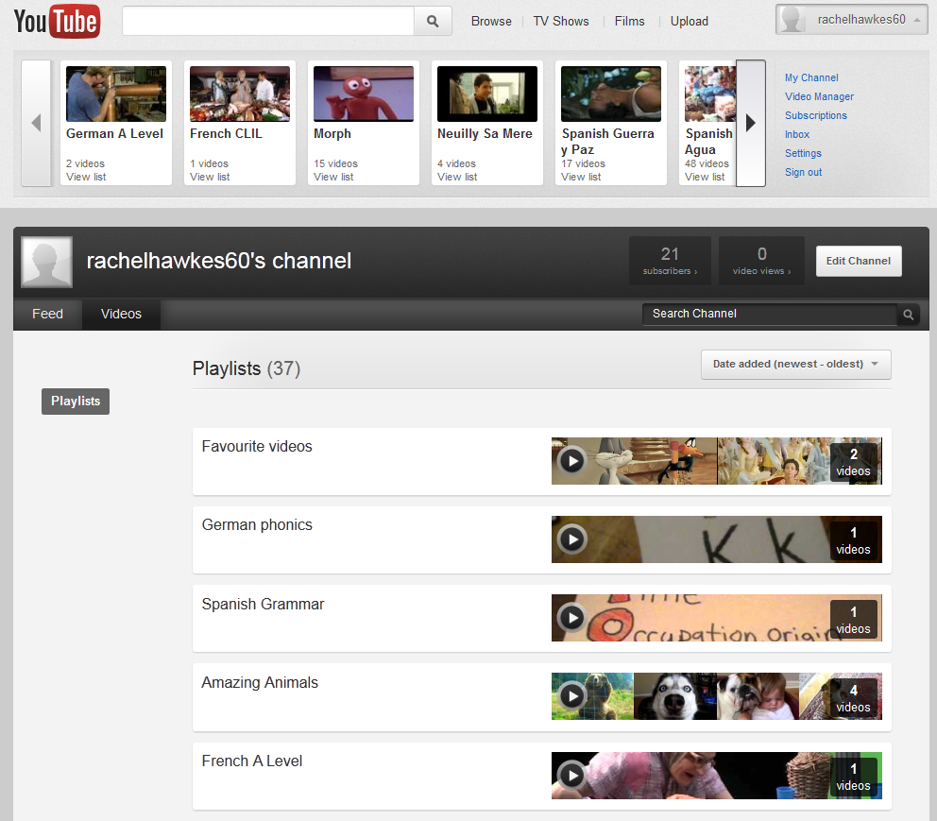
http://www.youtube.com/user/rachelhawkes60

Slide 35

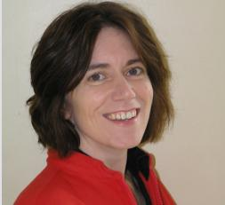
Comberton Village College
My contact details and links to resources
www.tes.co.uk (type ‘rhawkes’ into search to pull up all resources) www.rachelhawkes.com Spontaneous talk sessions Resources (Y7, 9,GCSE, AS Level Spanish) Using music http://www.rachelhawkes.com/RPP/Song/SongContests.php
Rachel Hawkes
www.rachelhawkes.com
rhawkes@comberton.cambs.sch.uk
01223 262503 ext.222
http://viewer.zmags.com/publication/bc43d4ae#/bc43d4ae/8
Notes:
There are obviously a lot more ideas – limit is only time to explore them, create them, try them out! And today, the time is limited to share the ideas, but I hope that’s been a useful session and you’ve taken at least one thought away to explore in your own practice.

Slide 36
Comberton Village College
Keeping the plates spinning!
Rachel Hawkes
ALL London Event – 16 June 2012
Notes:
'Keeping the plates spinning’ Teachers need something of the 'acrobatic' about them to press all the right buttons with students. Not every idea needs to be rocket science, but it's the right combination of tasks at the right time for the right students that creates an effective combination for learning. This session will combine ideas old and new

Slide 37
Best sources of video
Comberton Village College
http://www.bbc.co.uk/learningzone/clips/
www.youtube.com
www.dailymotion.com
Just using Google works for finding most things!
Bookmarking
http://www.youtube.com/rachelhawkes60
http://www.delicious.com/rachelhawkes/videos
Rachel Hawkes

Slide 38


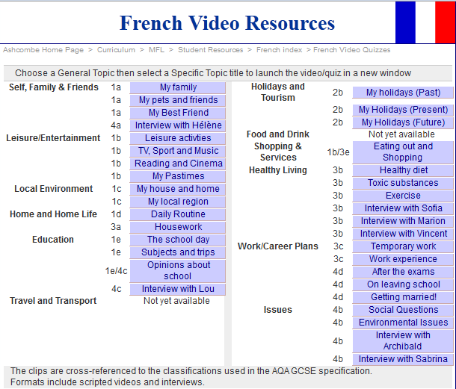


http://c-est-pas-sorcier.france3.fr/
http://agriculture.gouv.fr/vinzetlou/alimentation/episode13.html
http://www.pubstv.com/
http://www.ashcombe.surrey.sch.uk/Curriculum/modlang/french/index_fr_video.htm
http://les-gosses-du-mercredi.blogspot.com/
Notes:
Some more sites for video.

Slide 39

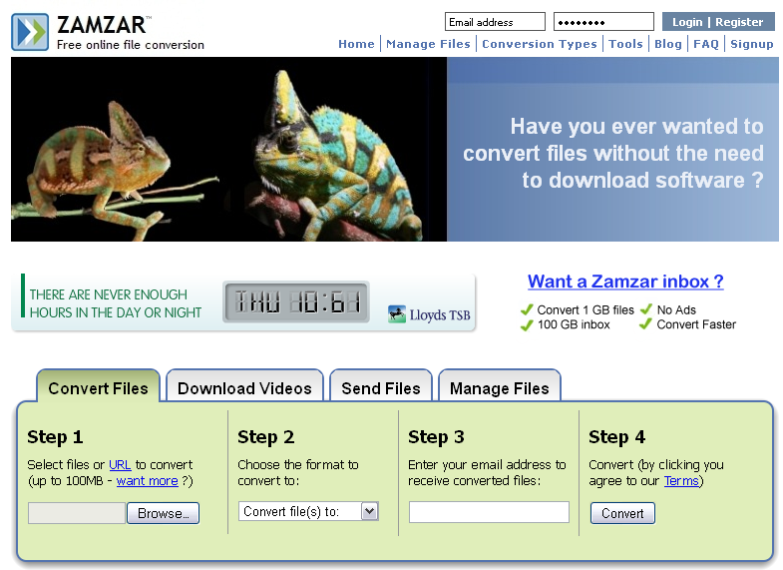
Downloading video clips
Comberton Village College
RealPlayer
(Zamzar)
www.zamzar.com
http://uk.real.com/realplayer/
Rachel Hawkes

Slide 40
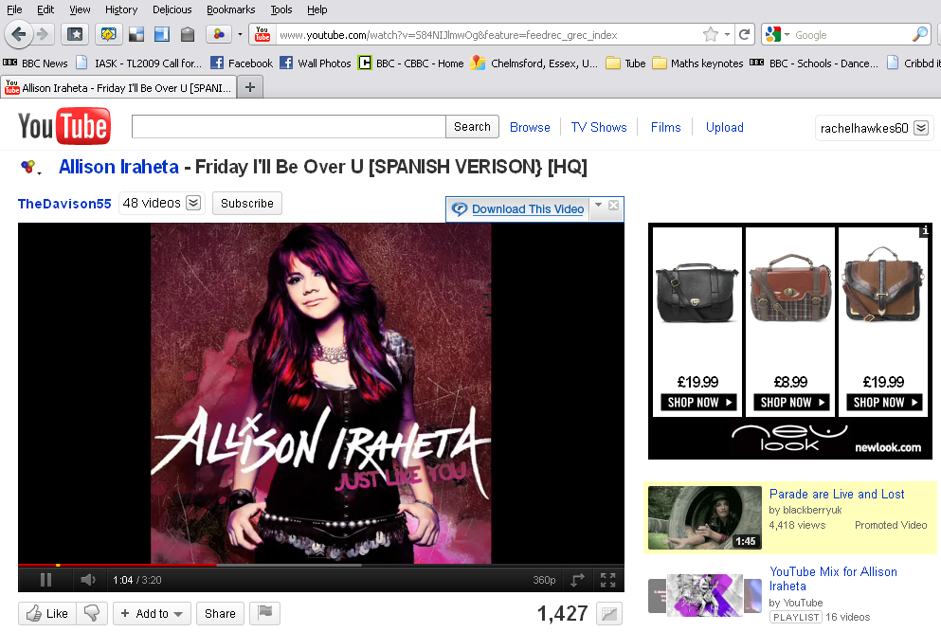
RealPlayer
1. Find your clip. Hover mouse over the clip and the RealPlayer download prompt appears. Just click this!

Slide 41
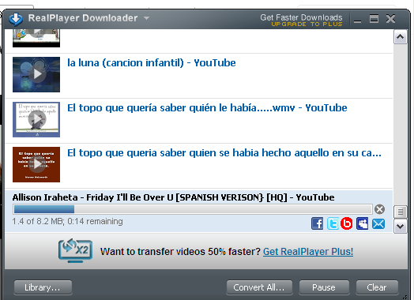
RealPlayer
2. This RP Downloader window appears and shows the download.
3. The files save by default to ‘My videos’ within ‘My documents’.
4. They are .flv format.
5. To download RealPlayer to your computer, go to: http://uk.real.com/realplayer/

Slide 42
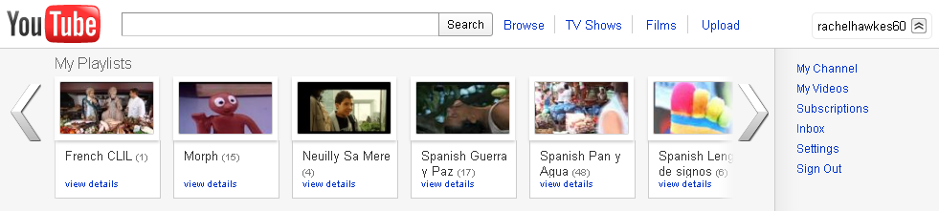
YouTube
1. If you create your own account (channel) on YouTube you can keep the video clips you like in one place and organise them into categories.
2. You can also share them more easily with others this way.
3. Appropriately enough, here’s a link to a YouTube clip taking you through how to do this.
http://www.youtube.com/watch?v=p_IZ6CAlxG8
4. If you Google almost anything, it will bring up a YouTube link to a clip showing you how to do it.

Slide 43
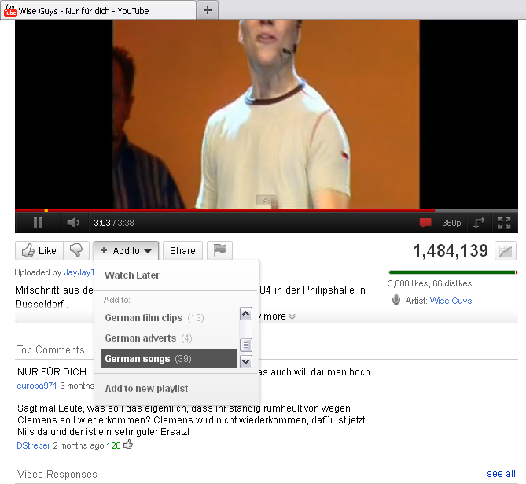
5. Then when you find clips you like, just do ‘Add to’ and put them into a category (or playlist).
6. It’s easy to create a new playlist for a new category whenever you need to.

