Slide 1


Comberton Village College
Talk to me! Crystal clear ideas to get students talking
Spontaneous talk Role of the teacher Practical examples from one KS4 Y10 class
Rachel Hawkes

Slide 2
Comberton Village College
Spontaneous talk: What is it?
Spontaneous contributions in the TL as part of the language of the classroom Unplanned / unscripted talk as part of a lesson task or activity Whole-class teacher-led interactions (that may prime for subsequent pair work)
Rachel Hawkes

Slide 3
Comberton Village College
Why is it important?
Students equate the ability to speak in the TL with learning the language (it is the subject to them) Students believe that what the can produce in unrehearsed situations is what they really know Spontaneous TL use (or lack of it) has been highlighted in every Ofsted report since records began Secondary Curriculum, KS3 Framework and GCSE specifications (not all) highlight its importance
Rachel Hawkes

Slide 4
Comberton Village College
What is the teacher role in spontaneous talk?
Source of high quality language input for acquisition Contingent feedback Sensitive co-construction Creation of a ‘safe place’ for trial and error Inclusion of humour
Rachel Hawkes

Slide 5
Comberton Village College
What about the rest of the class?
Source of high quality language input for acquisition a) The unpredictability and humour of these interactions encourage active listening for comprehension. The stability and continuity of the theme/topic of the talk enable learners to understand longer stretches of interaction (teacher talk and visual stimulus are the scaffolding) ‘Off line’ opportunities for reflection and planning Comparing the talk of teacher and peer Using the time to plan next contribution
Rachel Hawkes

Slide 6

Hoy vamos a hacer preguntas

Slide 7

Comberton Village College
Increasing interactivity (spontaneity, sustaining the flow, intonation) Questioning
WHAT ARE THE QUESTIONS
Idea 1

Slide 8

¿Cuáles son las preguntas?
7. Sí, pero es un poco aburrido.
1. Me llamo Adam.
2. Tengo 15 años.
6. Sí, por supuesto. ¿Y tú?
3. En Cambourne.
5. Sí, me gusta mucho.
4. Sí.
Notes:
8

Slide 9
¿Cuáles son las preguntas?
1. Sí, me gusta mucho.
6. Fui de compras en Cambridge.
2. Sí, porque me hacen reír.
5. Voy a ir al cine.
3. Le gusta jugar al fútbol.
4. Me gusta salir con mis amigos.
Notes:
9
I will do the questions the first time around here and that will give a lead to the stronger ones to do likewise when we change roles.

Slide 10
Comberton Village College
Increasing interactivity (spontaneity, sustaining the flow, intonation) Questioning
Rachel Hawkes
FIND SOMEONE WHO
Idea 2

Slide 11
Busca a la persona que …
juega al fútbol los sábados.
va al cine a menudo.
lee todos los días.
ve la tele cada día.
nunca descarga música del Internet.

Slide 12
Busca a la persona a quién…
le gusta Come Dine with Me.
no le gusta Top Gear.
le gusta Factor X.

Slide 13
Comberton Village College
Manipulating language (Sentence-building, creativity, improvisation)
Rachel Hawkes
TARGET TALK
Idea 3

Slide 14

¿Qué deportes te gustan?
Your answer must contain EXACTLY 7 words!
¿Qué programas te gustan?
Your answer must contain more than 9 words!
Notes:
The conditions or ‘targets’ can be many and varied. It ALMOST doesn’t matter as the point of putting a condition there is to cause students to think their sentences through carefully as they build them. It makes them much more aware of what they’re saying. And making a sentence of exactly 8 words will involve usually a very short clause with ‘weil’ or two clauses linked with ‘und’ or additional details like when and where. So they focus on different ways to make their sentences longer. It also works well to set >9 words or <5 words at times too.
14

Slide 15
Comberton Village College
Increasing interactivity (spontaneity, sustaining the flow, intonation) Questioning
Rachel Hawkes
GROUP TALK
Idea 4

Slide 16

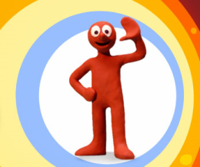
http://www.youtube.com/watch?v=VNktrq3w6pE - Morph short episode 4

Slide 17
¡Vamos a mirar algo!
Título del programa/de la película: ………………………………….
1. ¿Qué tipo de programa es?
3. ¿Dónde tiene lugar?
5. ¡Añade tu opinión!
 | película
 | dibujos animados
 | telenovela
 | noticias
 | programa de deporte
 | telecomedia
 | concurso
 | programa de música
 | afuera
 | me gustó
 | no me gustó
 | en la ciudad
 | en el campo
 | adentro
Escribe en español lo que ves en el programa.
 | en el estudio
 | en un edificio
____________________________________________________________________________________________________________________________________________________________________________________________________________________________________________________________________________________________________________________________________________________________
4. ¿Cómo es?
2. ¿Para quién es ?
 | divertido
 | cómico
 | triste
 | informativo
 | serio
 | interesante
 | emocionante
 | aburrido
 | adultos
 | niños
 | todos
Notes:
Students should use this sheet from last lesson to write a short intro paragraph about their Morph episode. In lesson 3 they are going to work on narrating the story in the past to add to this. If necessary there is more structured guidance given on Slide 8 for this task.

Slide 18




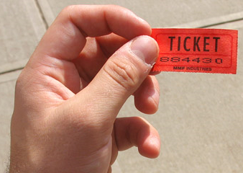
Comberton Village College
Increasing interactivity (spontaneity, sustaining the flow, intonation) Questioning
Rachel Hawkes
REWARDING SPONTANEITY
Idea 5

Slide 19
Comberton Village College
Manipulating language (Sentence-building, creativity, improvisation)
Rachel Hawkes
ODD ONE OUT
Idea 6

Slide 20
1908
1992
2012
1948
Notes:
Pilla al intruso. Students may say anything from ‘2012 porque es futuro y los otros son pasados’ or ‘2012’ porque son ‘dos mil’ y los otros son ‘mil novecientos’. My answer is ‘1992’ porque los juegos olimpicos tuvieron lugar en Barcelona y los otros en Londres.

Slide 21

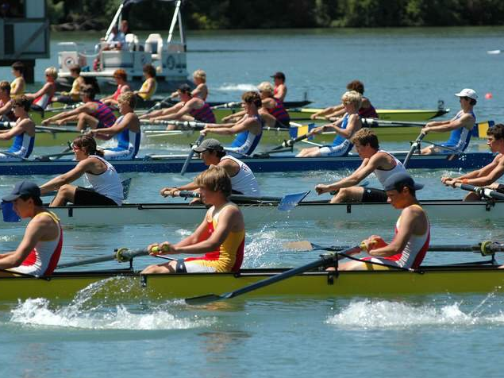
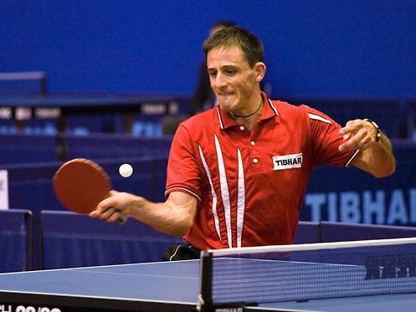
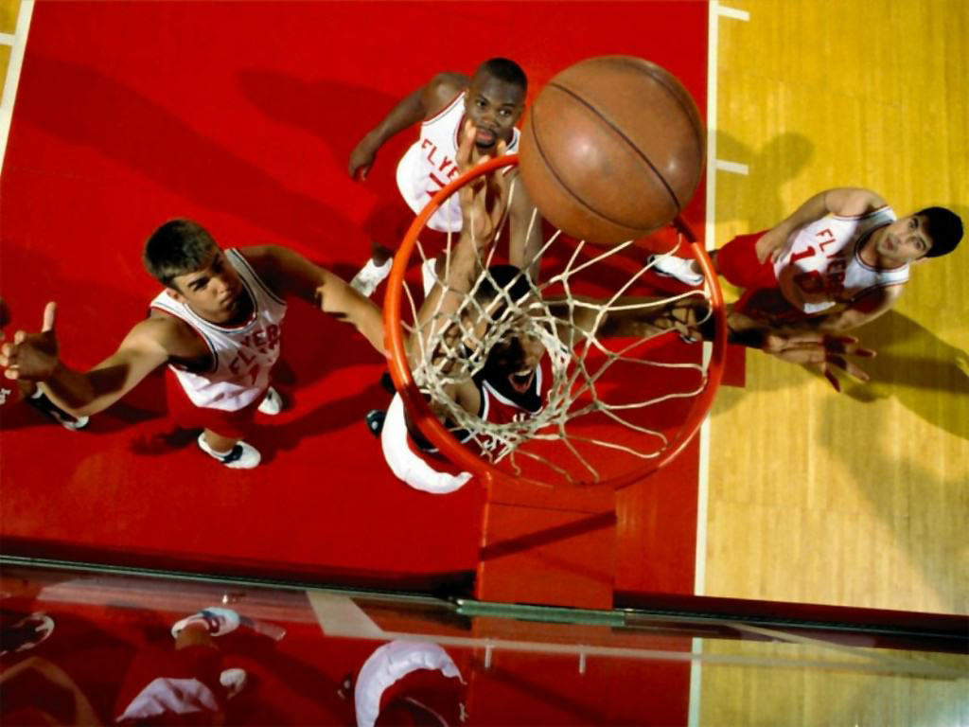
Notes:
Pilla al intruso. El hockey, el remo, el tenis de mesa o el baloncesto. El remo porque es el unico que necesita agua? El remo porque los otros tienen pelotas? El tenis de mesa porque es el unico deporte individual – los otros son deportes de equipo?

Slide 22
Comberton Village College
Increasing interactivity (spontaneity, sustaining the flow, intonation) Questioning
Rachel Hawkes
SPEND THE WORDS
Idea 7

Slide 23

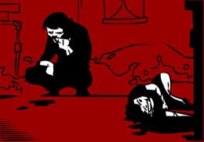
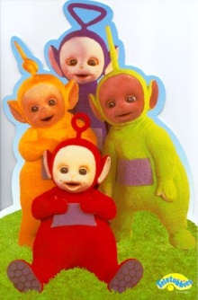



Me gustan mucho | tiene lugar en | Mi programa preferido
entretenido (a/os/as) | son | Prefiero
porque | trata de | No me gustan tanto
A mi madre | una telenovela | tonto (a/os/as)

Slide 24
Comberton Village College
Increasing interactivity (spontaneity, sustaining the flow, intonation) Questioning
Rachel Hawkes
JUST A MINUTE! (GROUPS)
Idea 8

Slide 25
Me gustan las telenovelas
Me gustan las telenovelas como Eastenders que trata de la vida de familias que viven en el este de Londres
Slide from Neil Jones (with thanks!)

Slide 26

Son____________que tienen lugar en _____________. Tratan de un personaje hecho de _______ que se llama ________. Es un programa para _______ pero pienso que es también para _______. El programa es muy _______ y los episodios son cortos. El episodio 4 me _______ mucho porque era muy __________.
unos dibujos animados | divertido | todos
niños | un estudio | gracioso
plastilina | gustó | Morph

Slide 27
1
2
3
Opinión
Presente
Pasado
Futuro
Razón
Pregunta
4
5
6
Notes:
This is a whole class version of this activity, designed particularly with KS4 classes in mind. The idea would be that a general question is asked on a topic recently covered:
e.g. Que te gusta ver en la tele or Que deportes te gustan and a student would try to answer building in an example from each category – the teacher awards the ‘pieces of pie’ by clicking on the relevant sections according to the colour key as the student talks to involve all other students in what is essentially ‘modelling’ of extended answers. Students 2 – 6 who volunteer would also get to give their answers.
As a starter activity in whole teaching it takes approx 5 mins – obviously not all 6 x students need to be asked if a shorter activity is wanted.

Slide 28
Comberton Village College
Manipulating language (Sentence-building, creativity, improvisation)
Rachel Hawkes
SAY SOMETHING ELSE
Idea 9

Slide 29
Comberton Village College
Say something else
Rachel Hawkes
Me gustan las comedias.
Un programa que me gusta mucho se llama Educating Essex.
Es un programa de tele-realidad.
Tiene lugar en Essex.
Trata de la vida en un instituto.
Me gusta porque es muy informativo y divertido.
Idea 9

Slide 30
Comberton Village College
Manipulating language (Sentence-building, creativity, improvisation)
Rachel Hawkes
PIMP MY SENTENCE
Idea 10

Slide 31
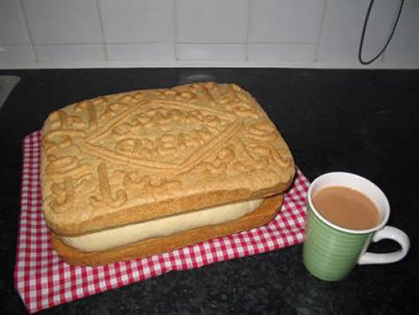
Pimp my sentence!
Je joue au tennis.
J’habite au nord de l’Angleterre.
Mon chien s’appelle Bob.

Slide 32


HAVE I GOT NEWS
FOR YOU
Jamie, 14años, va a jugar para……
Chloe dice: En mi opinión fumar es…..
Según Adam, Alex ha comprado …
Factor X es muy ………… dice James.

Slide 33
Meine Schule ist eine gemischte Schule.
Meine Schule ist eine Schule,die sich in Naturwissenschaften spezialisiert.
Meiner Meinung nach sind die Schulregeln nicht zu streng.
Die besten Schulen haben eine Uniform.
Mein Lieblingsfach ist Englisch, weil ich gern Geschichten schreibe.
Um meine Schule zu verbessern, muß man mit den Strafen aufhören.
Nächstes Jahr möchte ich Spanisch studieren.
Notes:
Students have to change something in the sentence – it could be one detail, it could be the whole thing, it could be adding an additional detail to ‘grow’ the sentence.

Slide 34
Comberton Village College
Increasing interactivity (spontaneity, sustaining the flow, intonation) Questioning
Rachel Hawkes
STARTER ACTIVITIES (KS4-5)
Idea 11

Slide 35
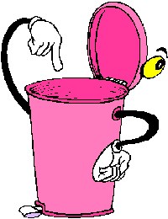
Cubo de basura
¿Qué vas a tirar?
¿Por qué?
Notes:
http://www.muchosgifs.com/1a1a1a/hogar/cubos/basura25.gif

Slide 36
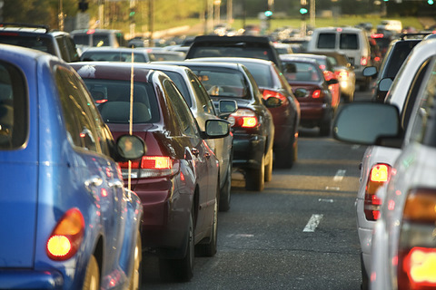
¡Atasco!
¿Adónde ibas?
¿A qué hora saliste de casa?
¿Cuánto tiempo llevas esperando?
¿Qué harás mientras sigues esperando?
Notes:
http://www.cosasdemotor.es/images/novedades_ley_de_trafico.jpg

Slide 37
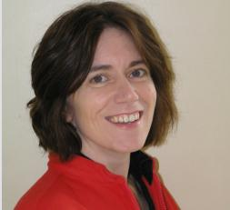
Comberton Village College
My contact details and links to resources
www.rachelhawkes.com 1. This and other presentations 2. Speaking resources 3. KS3, KS4 and KS5 Spanish resources www.tes.co.uk (type ‘rhawkes’ into search to pull up all resources) Spanish, French and German resources
Rachel Hawkes
rhawkes@comberton.cambs.sch.uk
01223 262503 ext.222
Notes:
There are obviously a lot more ideas – limit is only time to explore them, create them, try them out! And today, the time is limited to share the ideas, but I hope that’s been a useful session and you’ve taken at least one thought away to explore in your own practice.

