Slide 1


R
d
t
e
a
y
o
l
t
a
k
?
Notes:
Presentation Title: Introduction Curriculum 2014

Slide 2
National curriculum aims
The National Curriculum for languages aims to ensure that all pupils:
understand and respond to spoken and written language from a variety of authentic sources
speak with increasing confidence, fluency and spontaneity, finding ways of communicating what they want to say, including through discussion and asking questions, and continually improving the accuracy of their pronunciation and intonation
can write at varying length, for different purposes and audiences, using the variety of grammatical structures that they have learnt
discover and develop an appreciation of a range of writing in the language studied.

Slide 3
GCSE Speaking 2018
unpredictability
“ the awarding organisation must take all reasonable steps to minimise the predictability of each such assessment.”
preparation time (between 10 and 12 minutes)
teacher-conducted, audio-recorded, awarding body-assessed
conversation (more than one topic, only one of which may be chosen by the learner in advance of the assessment)
two further tasks, from the following: (role play, response to visual stimulus, response to textual stimulus, response to stimulus with visuals and text)
no dictionaries
Foundation – 7-9 minutes Higher – 10-12 minutes
Notes:
GCSE Subject Level Conditions and Requirements for Modern Foreign Languages (French, German, Spanish)
February 2015
www.gov.uk/government/publications/gcse-9-to-1-subject-level-conditions-and-requirements-for-modern-foreign-languages
p.18-19

Slide 4
 | KS2 Programme of Study 2014 | Common European Framework of Reference
Speaking | End of KS2 Outcomes | A1
 | engage in conversations; ask and answer questions; express opinions and respond to those of others; seek clarification and help* speak in sentences, using familiar vocabulary, phrases and basic language structures develop accurate pronunciation and intonation so that others understand when they are reading aloud or using familiar words and phrases* present ideas and information orally to a range of audiences* | Spoken Interaction I can interact in a simple way provided the other person is prepared to repeat or rephrase things at a slower rate of speech and help me formulate what I'm trying to say. I can ask and answer simple questions in areas of immediate need or on very familiar topics. Spoken production I can use simple phrases and sentences to describe where I live and people I know.
Speaking | End of KS3 Outcomes | A2
 | initiate and develop conversations, coping with unfamiliar language and unexpected responses, making use of important social conventions such as formal modes of address express and develop ideas clearly and with increasing accuracy, both orally and in writing speak coherently and confidently, with increasingly accurate pronunciation and intonation | Spoken Interaction I can communicate in simple and routine tasks requiring a simple and direct exchange of information on familiar topics and activities. I can handle very short social exchanges, even though I can't usually understand enough to keep the conversation going myself. Spoken production I can use a series of phrases and sentences to describe in simple terms my family and other people, living conditions, my educational background and my present or most recent job.
Speaking |  | B1
 |  | Spoken Interaction I can deal with most situations likely to arise whilst travelling in an area where the language is spoken. I can enter unprepared into conversation on topics that are familiar, of personal interest or pertinent to everyday life (e.g. family, hobbies, work, travel and current events). Spoken production I can connect phrases in a simple way in order to describe experiences and events, my dreams, hopes and ambitions. I can briefly give reasons and explanations for opinions and plans. I can narrate a story or relate the plot of a book or film and describe my reactions.

Slide 5
Progression and Guided Learning Hours
Year | Hours of tuition | Cumulative hours | CEFR Level
3 | 19* | 19
4 | 19* | 38
5 | 38* | 76
6 | 38* | 114 | A1
7 | 95 | 209 | A2
8 | 95 | 304 | A2+
9 | 95 | 399
10 | 95 | 494 | B1
11 | 95 | 589
12 | 190 | 779 | B2
13 | 190 | 969 | C1
*Figures based on 30 minutes per week at Y3 and Y4, 60 minutes at Y5 and Y6
Notes:
The GLH were helpful in deciding the approximate progress we can expect during each key stage. All primary and secondary schools vary in their allocation of curriculum time for language learning, but here I have taken as a starting point 30 minutes per week in Years 3 and 4, 60 minutes in Years 5 & 6, and 150 minutes per week across KS3 and KS4. (This equates to 3 x 50 minute lessons across KS3 and KS4. This is a rough average. In fact, our dual linguists have less and our single linguist classes have slightly more than this.)
We can see from the table that, with this number of GLH, we might reasonably expect learners to achieve at least A1 competence by the end of KS2, and at least A2 by the end of Y8 (assuming the curriculum allocation hours given), making significant progress towards B1 but not reaching it by the end of Y9. I used this information to peg the key progression points A1 and A2 within the new framework.
A1 = Step 4 on my framework

Slide 6
What is spontaneous talk?
unrehearsed (conversational) exchanges, in which teachers will not know exactly what language the students will produce in the interactions.
interactions in which the speaker, whether teacher or learner, only has something to say as a result of having heard and understood what has been said previously, and this will involve listening and understanding.

Slide 7
What is spontaneous talk?
Planned speaking
Spontaneous talking
focus on production (S)
rehearsal
prepared
focus on form
learner knows what teacher will ask
teacher knows what learner will say
closed questions are closed
focus on interaction (L + S)
use
improvised
focus on meaning
learner doesn’t know in advance what teacher will ask
teacher doesn’t know what learner will say
closed questions are open

Slide 8

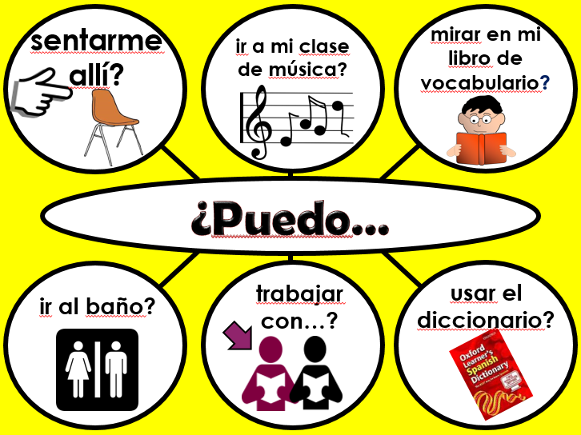
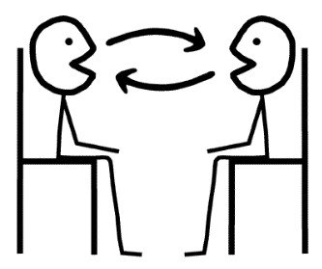

Aspects of spontaneous talk
Questions
Classroom language
Pair tasks
Group tasks

Slide 9

¿Quién?
¿Cómo?
¿Por qué?
¿Qué?
¿Cuánto?
¿Dónde?
¿Cuántos?
¿Cuándo?
¿Cuál?
Notes:
Teach the key question words with gestures. See this video for suggested gestures.
http://www.youtube.com/watch?v=iqCvE258vY0

Slide 10
¿Qué pregunta es?
Juego al fútbol.
?
en Comberton.
¿Dónde?
Notes:
Using the Q words in context to reinforce their meaning. Lines 1 – 3 are there. Students supply the question word orally. Do a couple first to model, then give each pair 20 seconds to say each dialogue first before taking the answer whole class for the rest of the slides.

Slide 11
¿Qué pregunta es?
Juego al fútbol.
?
el sábado.
¿Cuándo?
Notes:
Using the Q words in context to reinforce their meaning. Lines 1 – 3 are there. Students supply the question word orally. Do a couple first to model, then give each pair 20 seconds to say each dialogue first before taking the answer whole class for the rest of the slides.

Slide 12

¿Qué pregunta es?
Juego al fútbol.
?
¡JUEGO AL FÚTBOL!
¿Cómo?
¿Qué?
Notes:
Using the Q words in context to reinforce their meaning. Lines 1 – 3 are there. Students supply the question word orally. Do a couple first to model, then give each pair 20 seconds to say each dialogue first before taking the answer whole class for the rest of the slides.

Slide 13
¿Qué pregunta es?
Juego al fútbol.
?
¡Es fenomenal!
¿Por qué?
Notes:
Using the Q words in context to reinforce their meaning. Lines 1 – 3 are there. Students supply the question word orally. Do a couple first to model, then give each pair 20 seconds to say each dialogue first before taking the answer whole class for the rest of the slides.

Slide 14
¿Qué pregunta es?
Juego al fútbol.
?
con mis amigos.
¿Con quién?
Notes:
Using the Q words in context to reinforce their meaning. Lines 1 – 3 are there. Students supply the question word orally. Do a couple first to model, then give each pair 20 seconds to say each dialogue first before taking the answer whole class for the rest of the slides.

Slide 15
¡Vamos a conversar!
Aprendo el español.
?
¿Con quién?
¿Cómo?
¿Dónde?
¿Cuándo?
¿Por qué?
con mi clase | ¡APRENDO EL ESPAÑOL! | el viernes
en el colegio |  | ¡Es muy importante!
Notes:
Pair work
Question words are spontaneous
Responses are then supported.

Slide 16

Español
El viernes
en el aula ML6
con la señora Hawkes
Si, me gusta → es fantástico
Hablo, escucho, leo y escribo…y juego.
¡Genial!
¡Qué guay!
¡Fenomenal!
¡Buen acento!
¡Bien hecho!
Notes:
Variation in pairs of one of my favourites ‘What is the question’
Thanks again to Louise Crossley for adaptation of Kagan here, with additional praise in TL.

Slide 17
???????
El ………..
en el aula ………..
con ………………..
Si, me gusta → es ………….. (No, no me gusta → es…)
……………….. y ………….
¡Genial!
¡Qué guay!
¡Fenomenal!
¡Buen acento!
¡Bien hecho!
Notes:
Continue on to freer conversation where student chooses a different subject to talk about, and the other students asks the same sequence of questions as before. Both can use these prompts to help them keep the conversation on track.

Slide 18
Aspects of spontaneous talk
Questions
Classroom language
Pair tasks
Group tasks

Slide 19







sentarme allí?
mirar en mi libro de vocabulario?
ir a mi clase de música?
¿Puedo…
trabajar con…?
usar el diccionario?
ir al baño?

Slide 20






¿Puedo sentarme allí?
¿Puedo ir al baño?
¿Puedo ir a mi clase de música?
¿Puedo trabajar con…?
¿Puedo mirar en mi libro de vocabulario?
¿Puedo usar el diccionario…?

Slide 21












































[1]
[2]
[3]
[4]
[5]
¿Cómo estás? Estoy… fenomenal. bien. confundido/a. cansado/a. enfermo/a. fatal. | Tengo… todo correcto. un problema. una idea. hambre. sed. dolor de cabeza. un perro. | ¿Cómo? ¿Qué? ¿Dónde? ¿Cuándo? ¿Quién? ¿Con quién? ¿Por qué? ¿Cuánto? ¿Cuántos? (¿Cuántas?) ¿Cuál? ¿Qué tipo de? ¿A qué hora? | ¿Cómo fue? Fue… fácil. difícil. así así. divertido. aburrido. fatal. (muy, bastante, un poco) | ¿Puedo..? sentarme allí? ir a mi clase de música? mirar en mi libro de vocabulario? ir al baño? trabajar con..? usar el diccionario?
He / No he … terminado. ganado. perdido. entendido. olvidado. hecho mis deberes. | ¿Tenemos que…? trabajar en pareja? escribir? hablar? memorizarlo? pegarlo? entregar los cuadernos? |  |  | Señor(a), ¿puede…? repetir? hablar más despacio? dar un ejemplo? ayudarme? firmar mi merit? leer esto?
Ha ha ha!
[6]
[7]
[8]
[9]
[10]
¿Cómo se dice..?
¿Qué piensas? | ¡Vamos!
Pienso que …es… | ¡Venga!
Sí, es verdad | Tú empiezas.
No, no es verdad. | ¡Tira el dado!
Yo también / Yo tampoco | Me toca (a mí).
No lo sé. | Te toca (a tí).
No me importa. | ¡Tramposo!
¿Y tú? | ¡No hagas eso!
¿Te gusta…?
¿Estás loco/a?!
¡Hola!
¡Hola!
Buenos
días
e.j. Me gusta
la música!

Slide 22
Aspects of spontaneous talk
Questions
Classroom language
Pair tasks
Group tasks

Slide 23






1 | 2 | 3
4 | 5 | 6
una pera
un limón
una manzana
una naranja
una fresa
un plátano
Notes:
1 Draw from the sound what you think it is
2 Confirm from the written word (allow time to change mind/picture)
3 Show the pictures (learners change their pictures to reflect the meaning, if they got any wrong)
From here:
1 speed listening
2 taboo
3 Q & A (i.e. put all the cards together – each learner picks 3) Tienes una naranja Si / No – make pairs this way. Always have 3 x cards so have to pick up when you’ve got rid
4 Say as many things as you can about one of the items
5 Ask as many questions as you can about one of the items

Slide 24
Exploiting self-made cards
speed listening
say something else
taboo
Q & A (e.g. put all the cards together – each learner picks 3) ¿Tienes una naranja? Sí / No – make pairs this way.
say as many things as you can about one of the items
ask as many questions as you can about one of the items

Slide 25





Notes:
Way to add spontaneous utterances to any new vocabulary –
When pupils draw one of these cards, they have to say:
1 a question
2 an exclamation
3 a positive opinion
4 a negative opinion
5 something in the future
6 something in the past

Slide 26
Against the clock, in pairs ..
Think about (language) you know
  Questions
  Statements
  Negative statements
  Other sorts of sentence
Notes:
There is of course a connection between spontaneity and time pressure which requires some training and support. An activity like this one – for pairs - aims to :
Give a challenge in a playful context
Remind learners of language they already know
Be repeatable in another context (by changing the vocabulary)
Be flexible (in terms of the discourse types)
Explain that this screen reminds the class of some of the language they have previously encountered / been taught, so that they can activate their memory
Explain that participants are going to work in pairs on this brief activity
0.47-0.49

Slide 27
Apples
You have 60 seconds
In the target language
Take it in turns
Say as many sentences about an apple, or apples as you can – from any of the categories - to your neighbour
E.g. I like .. , How much is ..?
Notes:
Take feedback on the activity and draw out:
That pupils will get better at the activity if they do it again fairly soon
That you can change the (core!) topic very easily
That they might well have requests for language they wanted to say (useful for forward planning)
That there is an opportunity to remind them of constructions they could have used but may have forgotten
0.49-0.51

Slide 28

Target talk
¿Qué estudias?
Your answer must contain EXACTLY 7 words!
¿Cuál es tu asignatura preferida?
Your answer must contain more than 9 words!

Slide 29

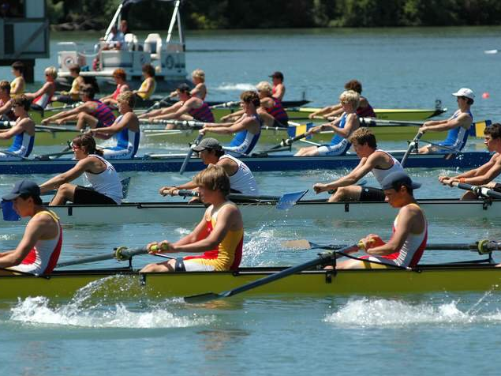
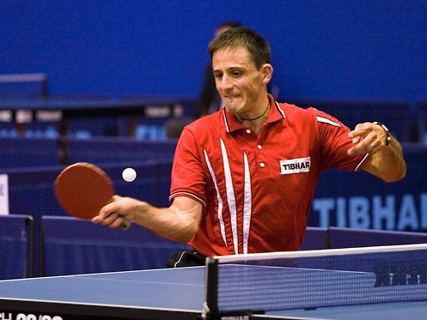
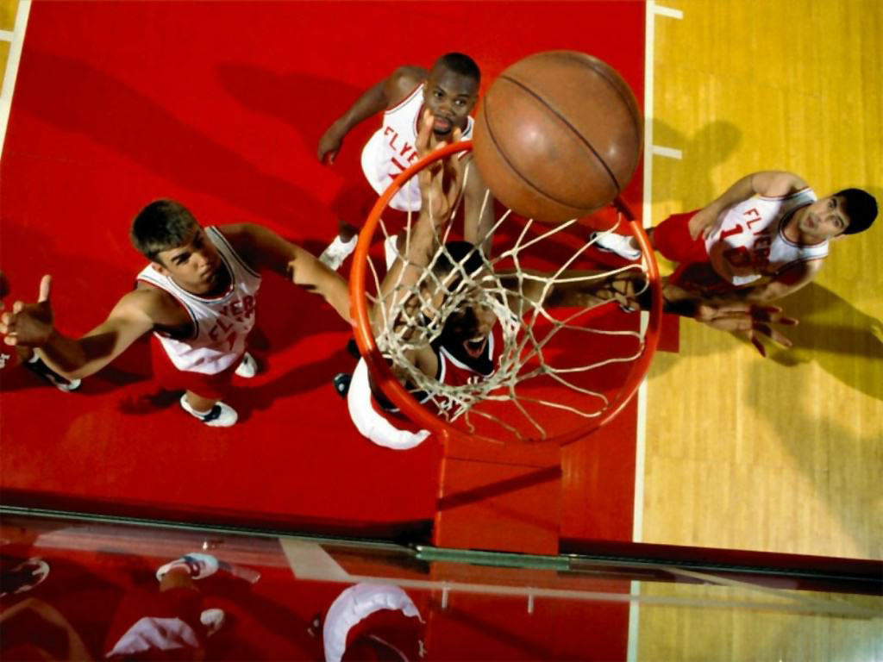
Odd one out
Notes:
Pilla al intruso. El hockey, el remo, el tenis de mesa o el baloncesto. El remo porque es el unico que necesita agua? El remo porque los otros tienen pelotas? El tenis de mesa porque es el unico deporte individual – los otros son deportes de equipo?

Slide 30
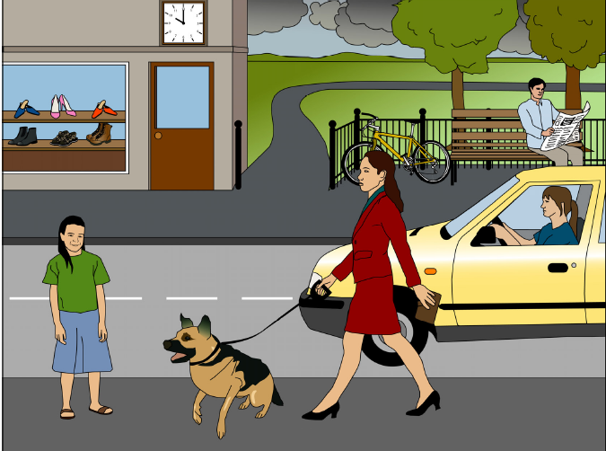
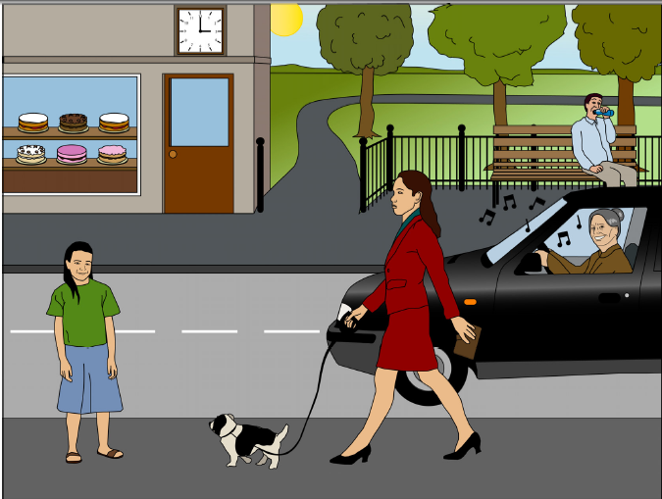
A
B
1) Menciona dos diferencias
2) Responde a dos preguntas
3) Haz dos preguntas
Picture tasks
Notes:
Pictures and task taken from ASSET Breakthrough speaking task – grade 3

Slide 31
Aspects of spontaneous talk
Questions
Classroom language
Pair tasks
Group tasks

Slide 32

la música

Slide 33
Número | Ejemplo | Clase de música
1
2
3
4
5
6
7
8
Reggae
Hip Hop
Clásica
Folclórica
Rock
Jazz
Pop
Tradicional
Hip Hop | Reggae | Clásica | Folclórica
Jazz | Rock | Tradicional | Pop
Notes:
There are 30 secs of each type of music to play to the students. Use the talking frames on the next 3 slides (Year 7,8,9) to get students to discuss the types of music after you have played the first 3 examples. If this routine works well you might want to repeat it after you’ve played the next 5 excerpts.

Slide 34

¡Es fenomenal!
¡Es fatal!
¡(No) me gusta!
¿Qué piensas?

¡Sí, es verdad!
¡No, no es verdad!
¡Yo también!
¡Yo tampoco!
X
X
X
¡Estás loco/a!
Pienso que...
Notes:
Year 7 Talking frame

Slide 35


Brainstorming
¿Cómo se dice … en inglés / español?
Pienso que …es…
¿Qué piensas?
¡No lo sé!
¡Sí!
¡No!
Notes:
Teaching the language of working together – asking for each other’s prior knowledge, but also encouraging hypothesising, risk-taking.
Group speaking - ¿Cómo se dice?
This activity is primarily to be used at the start of a new topic / theme. The aims are to:
Retrieve prior knowledge and share it
Identify gaps in current knowledge
Use TL for routine communication
Ask / answer questions in TL
Start with a text and see what students know first.
Give them some time to interrogate each other’s knowledge and make some hypotheses about words they might know, using this routine in the TL
When they have finished talking they could record their group knowledge in a couple of different ways:
They could have red / yellow / green post-it notes for unknown / think we know / know words
They could shade their own large copy of the text with these colours, as appropriate.

Slide 36

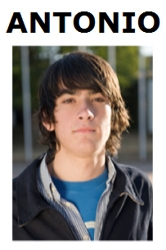

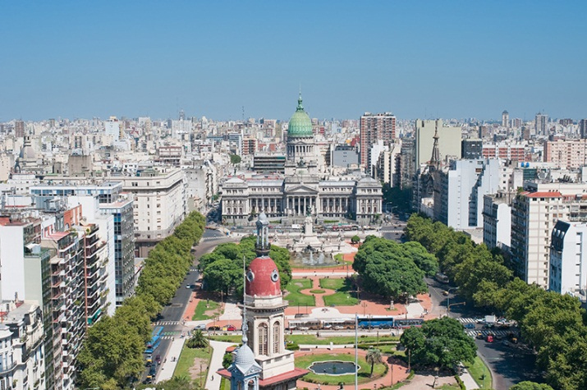
Hotseating
❶
Argentina, el uno de enero, 2015
¡Hola! ¿Qué tal? Me llamo Antonio y vivo en Argentina, en Buenos Aires.
Tengo trece años y mi cumpleaños es el quince de mayo.
Soy bastante sincero. También soy generoso, pero no soy tímido.
Tengo una hermana que se llama Rosa. Tiene catorce años. En mi opinión, es un poco tonta.
Tengo un ratón y dos peces. Mi ratón es blanco y muy divertido.
Mis peces son azules y amarillos y son estupendos, pero no son muy listos.
Mi color favorito es el amarillo.
Mi pasión es el rugby y mi héroe es Felipe Contepomi. ¡Es genial!
Mi cantante favorita es Beyoncé porque es fenomenal.
Mi programa favorito es ‘Factor X’.
¿Y tú? ¿Qué tipo de persona eres?
¿Tienes mascotas?
¿Tienes hermanos?
¿Cuándo es tu cumpleaños?
❷
❸
❹

Slide 37
Hacer trampa
A way to revise key language from each topic
A way to increase spontaneity and fluency in oral responses
How it works
Share out the cards (the object is to get rid of all your cards).
In turns, pick up a card (no-one must see each other’s cards!)
If it has a statement, read it out as if it were your opinion (with conviction, good intonation) and place the card in the centre face down
If it says ‘¡Estás haciendo trampa! you have to invent your own statement on the topic, deliver it convincingly as if it were just a regular card and place it in the centre face down.
If someone suspects you are ‘cheating’ s/he will say ‘trampa’. If you were, you have to pick up all the cards from the centre. If no, the accuser has to pick them all up.
The winner is the one to get rid of all his/her cards first.

Slide 38
El fútbol es un deporte de equipo. | El tenis es un deporte individual. | El balonmano es un deporte rápido y emocionante. | El ciclismo es un deporte olímpico. | el remo es un deporte acuático.
Un deporte que me gusta mucho es la natación. | Un deporte que no me gusta nada es el judo. | La esgrima es un deporte individual. | La gimnasia es un deporte individual. | la halterofilia es un deporte muy aburrido.
El rugby no es un deporte olímpico. | La pesca es un deporte despacio pero interesante. | La vela es un deporte olímpico y de verano. | El voleibol es un deporte de equipo y de pelota. | El esquí es un deporte de invierno.
El tenis de mesa es un deporte individual. | el piragüismo es un deporte interesante y rápido . | El netball no es un deporte olímpico. | Un deporte que me gusta mucho es el atletismo. | Un deporte que odio es la gimnasia.

Slide 39
Un deporte que me encanta es la natación. | No me gusta el rugby porque es demasiado agresivo. | Me gusta el tiro con arco porque es exigente. | Me encanta el balonmano porque es muy rápido. | No me gusta la natación sincronizada porque es aburrida.
¡Estás haciendo trampa! | ¡Estás haciendo trampa! | ¡Estás haciendo trampa! | ¡Estás haciendo trampa! | ¡Estás haciendo trampa!
¡Estás haciendo trampa! | ¡Estás haciendo trampa! | ¡Estás haciendo trampa! | ¡Estás haciendo trampa! | ¡Estás haciendo trampa!
¡Estás haciendo trampa! | ¡Estás haciendo trampa! | ¡Estás haciendo trampa! | ¡Estás haciendo trampa! | ¡Estás haciendo trampa!

Slide 40
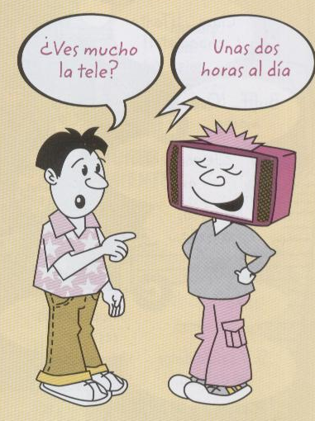
Discussion
Objetivos
Hablar sin preparación
Dar opiniones con razones
Conversar sobre la tele

Slide 41
Speaking Peer assessment
Nombre:
Preguntas
Opiniones:
- Me encanta
- Me gusta mucho
- No me gusta nada
- Odio
Razones: (e.g. aburrido, gracioso …)
Enlaces:
- porque
- también… y …
- tampoco … ni…
- pero

Slide 42



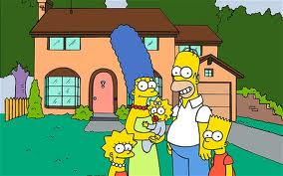

¡Vamos a conversar!
¡A mí también/ tampoco!
¿Qué piensas de…?
¿Por qué?
¿Y tú, qué piensas?
¡Vaya!
¿Te gusta…?
¿Cuánto ves…?
¡Es muchísimo!

Slide 43
Peer or group tasks?
Peer
Group
flashcard routines
speaking line
target talk
tandem (peer testing)
give one, get one
fortune tellers
bingo
say something else
taboo
discussion (opinions, reasons, preferences, voting, explaining choices)
spend the words / golden cards
triangles (observer/reporter)
simultaneous translating
open conversation
game playing (e.g. cheat)
Notes:
Peer – often practice tasks which lead to more spontaneous open conversation

Slide 44





Rock, paper, scissors
evolution!
Share one idea that you want to try in your teaching.
Rock paper scissors!
You lose – you stay the same. You win – you evolve!

Slide 45
Inspection findings 1993 - …
“Overall there is insufficient emphasis on helping students to use the language spontaneously for real situations. Consequently too few students could speak creatively, or beyond the topic they were studying, by making up their own sentences in an unrehearsed situation.”
(OFSTED, 2008, p.12)
“In many of the secondary schools visited, opportunities for students to listen to and communicate in the target language were often limited by many teachers’ unpreparedness to use it. Too often, students were not taught how to respond to everyday requests and thus routine work in the target language and opportunities to use it spontaneously were too few.” (OFSTED, 2011, p.6).
Notes:
We can buck this trend…

Slide 46
R
d
t
e
a
y
o
l
t
a
k
?
My website: www.rachelhawkes.com
My email: rhawkes@comberton.cambs.sch.uk
This presentation and handouts: http://www.rachelhawkes.com/PandT/Speaking/Speaking.php
Notes:
Presentation Title: Introduction Curriculum 2014

