Slide 1

Queen Mary’s High School, Walsall
Motivating talk in the languages classroom
Wednesday 9 May
Notes:
Language learning at its best is cumulative and gently yet powerfully progressive. Successful outcomes at GCSE have their source in strategic planning, careful teaching and motivational learning at KS3. This session explores how we can achieve this in practice!
Rachel works across the seven schools in the CAM Academy Trust. Director of International Education and Research, and SLE for languages, she is also a former President of ALL, the Association for Language Learning. Co-author of several textbooks, including the new Pearson textbook for GCSE Spanish (¡Viva!), she has a PhD from Cambridge University, focusing on teacher and learner interaction in the secondary languages classroom.

Slide 2
The new GCSE speaking exam
What strategies can a teacher conducting the test use to ensure the student demonstrates spontaneity?
It is important to follow up on students’ replies to develop a natural conversation. This will demonstrate a student’s ability to use language spontaneously.

Slide 3
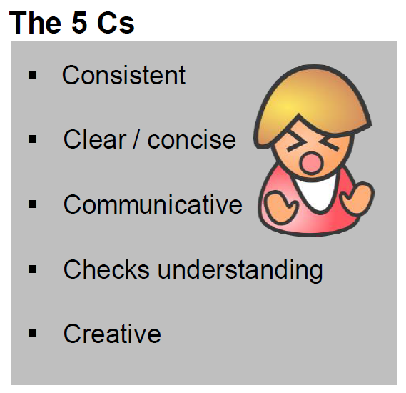
Using the target language
If teachers don’t, students don’t
If teachers do, that’s not in itself a guarantee that students will!
Consistency is what counts, and also…
Careful planning and routines
Openness to interruptions / asides
Clarity of purpose (spontaneous / prepared)
Notes:
1. Consistent
Absolutely vital. If you use the TL one day and not the next, you erode its effectiveness. If you use the TL and then translate yourself, you reduce its effectiveness. Consistency in TL use by the teacher involves planning, even scripting, and certainly thinking through each task / each explanation / each feedback and anticipating the language that you can use to communicate the meaning effectively to learners without resorting to English. If, at the planning stage, you realise that the message you need to give is vital but that you cannot conceive of how to do it in TL (or that doing it would take 20 minutes instead of 1) then you are justifying the use of English for that explanation / message. This is not the same for each teacher and it should be something we can all make progress in, such that we grow our use of TL and get more able to use it for a greater range of teaching activities. One teacher in my department, who has been working on this hard for 6 years, is currently challenging herself to 100% TL with a beginner Y8 German class. I observed and videoed several lessons at the start of the year and I’ve only seen her use English once for the word ‘exception’ which came up unexpectedly and she couldn’t immediately think how to convey its meaning clearly in the TL.
2. Clear / concise
Using the TL makes us consider v carefully the words we use to explain things and the bring in additional non-verbal support mechanisms too, such as visuals, mimes, props, gestures. At the very beginning we will need to be very concise indeed. And the words that we do need to teach as TL in the course of our explanations will be incredibly useful language and should be flagged up in the lesson. One method for this that works effectively is to arrive at a class understanding of the word through teacher TL explanation, example, miming etc.. and then to ask a class member to provide the English meaning orally. The teacher only writes down the German and the students write down both (but still having to think rather than just copy down the English). On the next slide I have an example of the words that have come up in this way over the first half-term of German lessons (2 x lessons per week).
3. Checks understanding
Of course we all use expressions to check understanding in our classrooms. But sometimes we don’t perhaps put enough emphasis on the expectation for a reply! I’ve often heard ‘Alles klar?’ by the teacher or ‘Entendéis?’ said almost as a rhetorical utterance. When there is barely a murmur in response, the teacher has not followed this up. if we think of the purpose of saying ‘ Is that clear?’ it seems really important that we accompany it with an expectation that students will either say confidently ‘Ja’ or will have questions because they are not clear about it. We have a couple of legendary stories in our department about this. In one class of lower ability learners one Y11 student, who had had the same teacher throughout Y10 too, and was used to his teacher saying to the class ‘Entendéis?’ suddenly asked her at Easter of Y11 – Miss, what is this about 10 days? What is going to happen in 10 days? You’ve been saying that since the start of Y10! So it’s a salient lesson that we need to ensure that we check understanding, of crucial terms and also of our teacher talk, especially key terms that we are going to repeat and repeat. Having said that, checking understanding also involves seeing how students respond. If they do what we ask readily, if the work produced matches expectations, then we can also be confident that they have understood.
4. Creative
With the still limited language of our learners, teachers have to be creative about TL use. We will need to use cognates at the start (but also withdraw them as soon as we can if there is a better TL word) – I can think particularly of Moglichkeit in German rather than Possibilitat. If we first teach Possibilitat and then we introduce them to Moglichkeit we can then stop using possibilitat fairly soon. To get meanings across we will also need our ingenuity. Getting into the habit of using examples to get meanings across is invaluable, especially if they involve the immediate setting of the classroom. Referring to things that are too far removed from the classroom can lose beginner students. I watched a teacher come up with a very good way to tell her learners in lesson one that she wanted to know their preferred names, not just their register names, by using a member of the class who she imagined would prefer Kate rather than Kathryn. In this, as in other aspects of teacher talk, we can grow our ability.
5. Communicative
Keeping it real. This doesn’t necessarily mean having a conversation with learners that is ‘off-topic’ although it can be nice to do this occasionally. It means responding to unplanned talk or learner questions in terms of the message rather than slipping into accuracy mode and correcting every utterance. This is very much about clarity of purpose for each activity. If you are practising pronunciation in a given task, then correct pronunciation errors. If you are practising producing correct forms e.g. perfect tense, then correct errors. But in every lesson there must be a decent chunk of time allocated to communicating through the TL. In these sorts of activities, where communication of the message is dominant, correction of errors is an unhelpful addition, because it blurs the purpose and demotivates the learner who is actually trying to really tell you about his/her pet. That doesn’t mean that as the teacher you don’t recognise that when Jimmy is talking he still hasn’t got the idea of where to put the adjective in French when he speaks spontaneously, but that doesn’t mean he wouldn’t know if he had time to plan to write or plan to speak. What we can do accurately in an unplanned situation is different to what we can do when we have time to reflect. And research is unclear at best about what a learner can take from explicit accuracy feedback while they’re in the act of talking. So if you notice in spontaneous speaking that there are fundamental errors, make a note that some more practice activities are needed down the line, but don’t stop him mid-flow. Only signal problems if they are genuine communication problems – i.e. you don’t know what he means. Then ask follow up questions to try to get to the meaning. Smile as you do this and encourage further communication. Offer alternatives to see if you can arrive at what he wanted to say.

Slide 4
The big ‘five’ strategies: from rehearsal to spontaneity
Phonics
Questions
Pictures
Routines
Pair / Group work

Slide 5



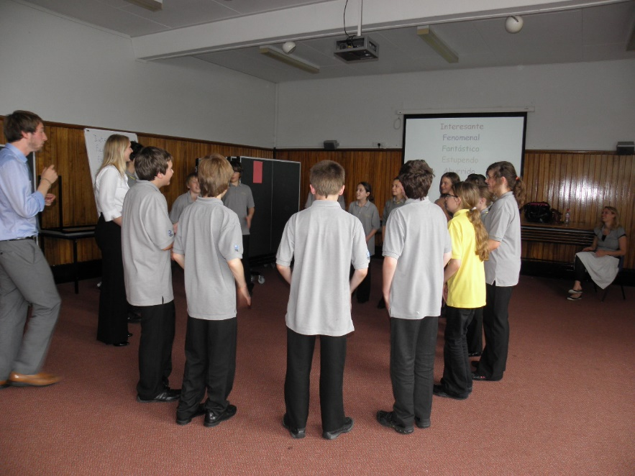
Warm up
1,2,3,4, fizz, 6,7,8,9,buzz, 11,12,13,14,fizz,
16,17,18,19, buzz
Con-cen-tra-tion, Con-cen-tra-tion now begins!
My name is Susan and I like sealions…
What’s that? It’s a spider!
Last Saturday I bought a banana…

Slide 6

1 Students will be more confident at speaking in the target language if they have a secure grasp of the sound/writing relationship.
Not to mention the fact that they need to be able to read aloud accurately, with good pronunciation and intonation, what they have prepared to say for the role play and the photo card later at GCSE.

Slide 7

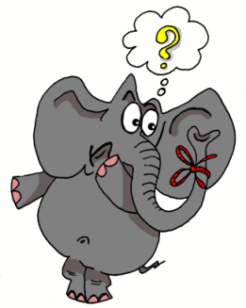




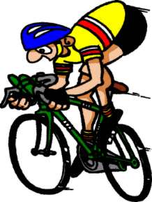

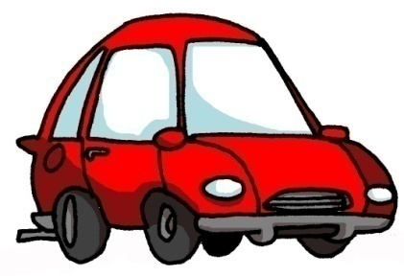



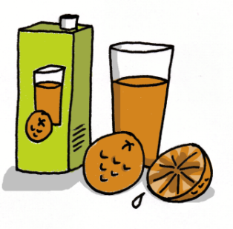



1 | 2 | 3 | 4
5 | 6 | 7 | 8
9 | 10 | 11 | 12
13 | 14 | 15 | 16
idea
araña
elefante
olvidar
universo
cerdo
ciclista
casa
coche
cucaracha
gimnasia
hamburguesa
España
zumo
gusano
llave
Notes:
7
Layering memory of the key phonics sounds – iconic word, image, gesture to represent each key sound, chosen for its difference to English pronunciation.

Slide 8

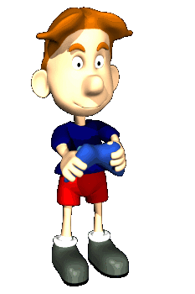


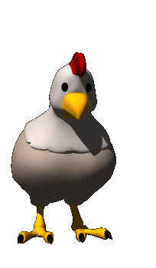


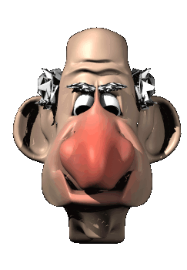




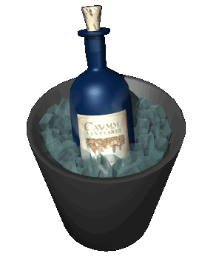


oi
ui
eu
au
le poisson
Oui!
le jeu-vidéo
les ciseaux
ou
i
u
é
la poule
le midi
les lunettes
le bébé
ez
er
qu
gn
le nez
danser
la question
la montagne
in
en
on
tion
le vin
le serpent
le pont
la pollution
Notes:
New version of Francophoniques – reduced to 16 key sounds.

Slide 9
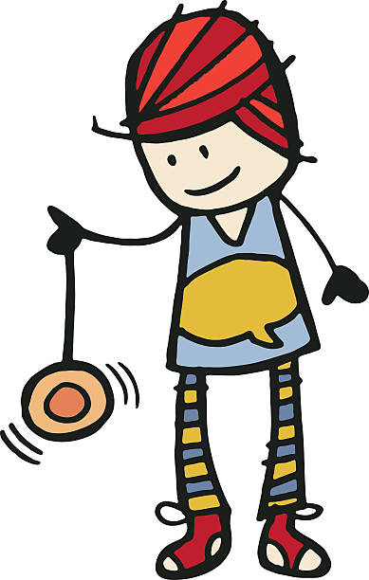












1 | 2 | 3 | 4 | 5
6 | 7 | 8 | 9 | 10
Jo-jo
Buch
Zug
Vogel
Wildwassersport
ein Ei
Hi Hai!
die Biene
Haus
Deutschland
11 | 12 | 13 | 14
Mäuse
Mr Löwe Löwe
küssen
Bär

Slide 10




Role Play
When pupils are confident at pronouncing from text, they have a useful way in to many tasks, including role play.
Characters
Choral response
Props
Apps

Slide 11
1 | 2 | 3 | 4
5 | 6 | 7 | 8
Personnage 1
un peu bête
rit beaucoup plus jeune que les autres
Personnage 2
sûr de soi parle très fort
Personnage 3
timide, évite le contact visuel
parle doucement
Personnage 4
très energique bouge souvent
Left hand side: be the character no. 2
Right hand side: be the character no.3
Personnage 5
aime dominer
interrompt souvent
Personnage 6
de mauvaise humeur
impatient
Personnage 7
enthousiaste, excitable
frappe les mains souvent
Personnage 8
pensif, sérieux
se gratte la tête
regarde dans la distance

Slide 12
Person A: Salut. Es-tu libre le samedi?
Person B: Oui. Pourquoi?
Person A: Tu veux aller au cinéma?
Person B: Qu’est-ce qu’il y a comme film?
Person A: Avengers – Infinity War
Person B: Oui, je voudrais bien. À quelle heure on se rencontre?
Person A: À sept heures. Et où?
Person B: Chez moi?
Person A: Génial. À plus tard. Au revoir…
Person B: Au revoir

Slide 13

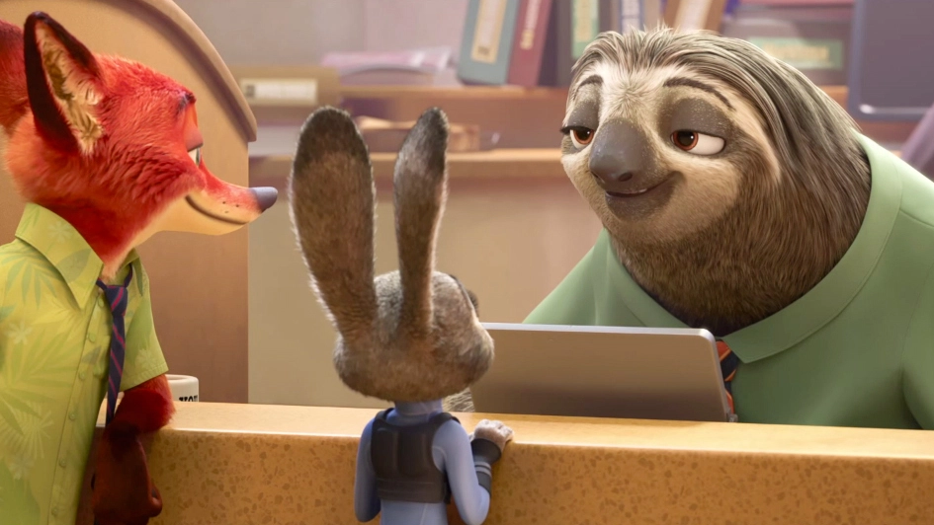
Arrange to go out.
Be either the rabbit or the sloth.
Notes:
Sloth or rabbit?
Faultier oder Hase?

Slide 14
Sock puppets
Notes:
Drama techniques reduce the anxiety associated with speaking a foreign language because they allow students to take on different identities – it is play.
They are not being themselves therefore the shame associated with making spoken mistakes is reduced.
It is a distancing technique.
It improves accent and intonation – they are playing the role of a Britsh / American person so they try to sound more authentic
Props and puppets serve to help this process – diffusing tension / anxiety and increasing the fun factor.

Slide 15



Using poetry (and other texts)
It’s more important to maximise the amount of talking time for all students than it is to hear every student answer individually.
Group recitation (with actions!)
Physical theatre
Small group performance

Slide 16
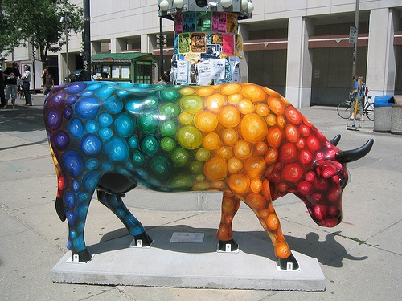
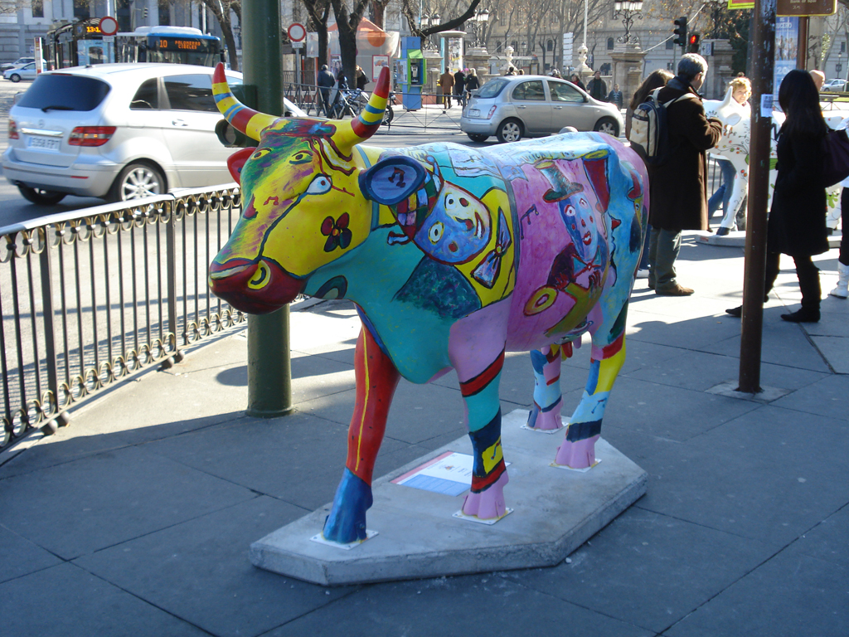
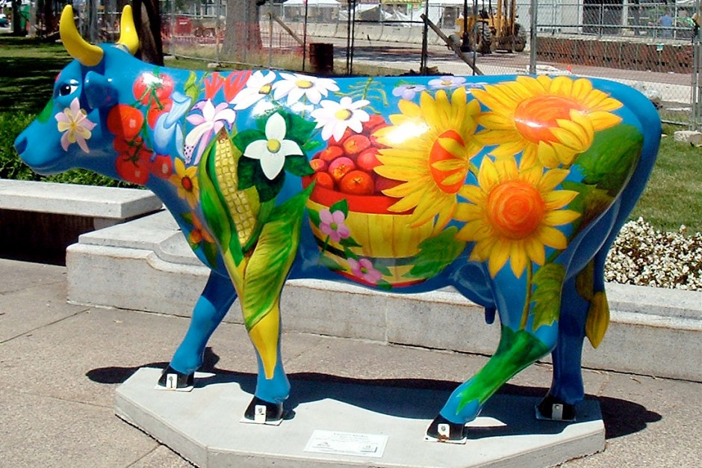
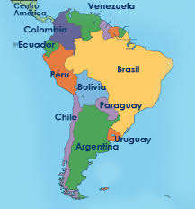
Quiero ver una vaca
Quiero ver una vaca colorada
Quiero ver una vaca colorada
A las tres de la tarde
Quiero ver una vaca colorada
A las tres de la tarde
De un día de febrero
Quiero ver una vaca colorada
A las tres de la tarde
De un día de febrero
En un campo verde
Quiero ver una vaca colorada
A las tres de la tarde
De un día de febrero
En un campo verde
O amarillo
Enrique Fierro (1942-). Poeta uruguayo
Notes:
Enrique Fierro nació en Montevideo, Uruguay en 1942 y vivió, entre 1974 y 1984, en la ciudad de México y, desde 1989 hasta hoy, es profesor de la Universidad de Texas en Austin. Entre 1985 y 1989 fue director de la Biblioteca Nacional del Uruguay.
Su primer título de poesía apareció en 1964 ("De la invención", Montevideo, Siete Poetas Hispanoamericanos), el último en 2002 ("Mutaciones, 2", México, Ediciones Sin Nombre).
Vintén Editor ha publicado cuatro de sus libros: "Quiero ver una vaca" (1989), "Homenajes" (1991), "La savia duda" (1996, Premio Nacional de Poesía del Ministerio de Educación y Cultura) y "Selección natural" (1999).

Slide 17










Usar para comunicarse
Producir de memoria
Producir con ayuda
Pronunciar
Comprender
Reconocer
Quiero ver una vaca
Quiero ver una vaca colorada
Quiero ver una vaca colorada
A las tres de la tarde
Quiero ver una vaca colorada
A las tres de la tarde
De un día de febrero
Quiero ver una vaca colorada
A las tres de la tarde
De un día de febrero
En un campo verde
Quiero ver una vaca colorada
A las tres de la tarde
De un día de febrero
En un campo verde
O amarillo
Notes:
Reinforce the meaning, bringing up the pictures, and read aloud chorally, with optional gestures.
I do as follows:
Quiero = turning key motion with right hand, finishing with thumb and forefinger forming a circle to reinforce the verb ending ‘o’.
ver = first and second fingers of right hand point to own eyes (makes a V) and then motion away from yourself
una vaca = ‘milking’ gesture right hand, then left hand (x 2) for each syllable u-na va-ca
colorada = rainbow gesture – palm facing away, starting left to right, ‘draw’ a rainbow shape with your hand
a las 3 de la tarde = hold 3 fingers up, then tap your left wrist for watch
de un día de febrero = left palm up raise towards sky on ‘dí’ and right palm up raise towards sky for ‘a’ to show the day/night that = 1 x day, then hands overlap and touch your heart twice on febrero.
en un campo verde – right hand make motion from left to right like ‘undulating hills’
o amarillo – make sunburst gesture to represent ‘yellow’

Slide 18
Usar para comunicarse
Producir de memoria
Producir con ayuda
Pronunciar
Comprender
Reconocer
Q_____ v__ u__ v___
Q_____ v__ u__ v___ c_______
Q_____ v__ u__ v___ c_______
A l__ t___ d_ l_ t____
Q_____ v__ u__ v___ c_______
A l__ t___ d_ l_ t____
D_ u_ d__ d_ f______
Q_____ v__ u__ v___ c_______
A l__ t___ d_ l_ t____
D_ u_ d__ d_ f______
E_ u_ c____ v____
Q_____ v__ u__ v___ c_______
A l__ t___ d_ l_ t____
D_ u_ d__ d_ f______
E_ u_ c____ v____
O a_______
Notes:
Students to produce the poem orally from the cued letters, visual prompts and teacher gestures.
You could repeat this stage several times.

Slide 19






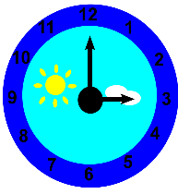



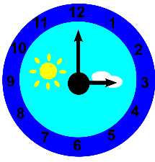


Usar para comunicarse
Producir de memoria
Producir con ayuda
Pronunciar
Comprender
Reconocer
Notes:
Students to ‘read’ the poem aloud from memory just from the visual prompts

Slide 20
Quiero ver una vaca
Quiero ver una vaca colorada
Quiero ver una vaca colorada
A las tres de la tarde
Quiero ver una vaca colorada
A las tres de la tarde
De un día de febrero
Quiero ver una vaca colorada
A las tres de la tarde
De un día de febrero
En un campo verde
Quiero ver una vaca colorada
A las tres de la tarde
De un día de febrero
En un campo verde
O amarillo
1
1+
1+
2
1+
2
3
1+
2
3
4
1+
2
3
4
5
Notes:
Students to analyse the structure of the poem.

Slide 21
Quiero ver una vaca
Quiero ver una vaca colorada
Quiero ver una vaca colorada
A las tres de la tarde
Quiero ver una vaca colorada
A las tres de la tarde
De un día de febrero
Quiero ver una vaca colorada
A las tres de la tarde
De un día de febrero
En un campo verde
Quiero ver una vaca colorada
A las tres de la tarde
De un día de febrero
En un campo verde
O amarillo
1
1+
1+
2
To write your own poem in this style there are several possibilities:
1. Just change the cow, time, month, colour of field
OR
2. Change the Quiero as well to Puedo (I can) / Debo (I must) / Tengo que (I have to) / Voy a (I’m going to) / Me gusta (I like) / Odio (I hate) /
OR
3. Change the VER as well
OR
4. Change everything except the essential structure
Notes:
Students to write their own poem with the same structure / style.
There are easy and more challenging ways to do these variations on a theme.
E.g.
Just change the cow, time, month, colour of field
OR
Change the Quiero as well to Puedo / Debo / Tengo que / Voy a / Me gusta / Odio / etc…
OR
Change the VER as well
OR
Change everything except the essential structure

Slide 22
Quiero ver una vaca
Quiero ver una vaca colorada
Quiero ver una vaca colorada
A las tres de la tarde
Quiero ver una vaca colorada
A las tres de la tarde
De un día de febrero
Quiero ver una vaca colorada
A las tres de la tarde
De un día de febrero
En un campo verde
Quiero ver una vaca colorada
A las tres de la tarde
De un día de febrero
En un campo verde
O amarillo
¿Qué?
¿Cómo?
¿Cuándo?
¿Qué fecha?
¿Dónde?
¿De qué color es…?
¿Cómo se llama?
¿Dónde vive?
¿De dónde es?
¿Cuál es su nacionalidad?
¿Qué idiomas habla?
¿Cuántos anos tiene?
¿Cuándo es su cumpleaños?
¿Qué tipo de vaca es?
¿Quién es su mejor amigo/a?
¿La vaca tiene mascotas?
Enrique Fierro (1942-). Poeta uruguayo
Notes:
Enrique Fierro nació en Montevideo, Uruguay en 1942 y vivió, entre 1974 y 1984, en la ciudad de México y, desde 1989 hasta hoy, es profesor de la Universidad de Texas en Austin. Entre 1985 y 1989 fue director de la Biblioteca Nacional del Uruguay.
Su primer título de poesía apareció en 1964 ("De la invención", Montevideo, Siete Poetas Hispanoamericanos), el último en 2002 ("Mutaciones, 2", México, Ediciones Sin Nombre).
Vintén Editor ha publicado cuatro de sus libros: "Quiero ver una vaca" (1989), "Homenajes" (1991), "La savia duda" (1996, Premio Nacional de Poesía del Ministerio de Educación y Cultura) y "Selección natural" (1999).

Slide 23


2 Students can initiate in the classroom as soon as they know the individual question words, so teach these with gestures asap!
http://www.youtube.com/watch?v=iqCvE258vY0

Slide 24

Kas?
Kaip?
Kodėl?
ką?
Kiek?
Kur?
Kiek?
Kada?
Kuris?
Notes:
These are Lithuanian question words. Let’s see how many we can learn?
Teach the key question words with gestures. See this video for suggested gestures.
http://www.youtube.com/watch?v=iqCvE258vY0

Slide 25

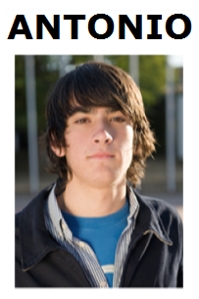
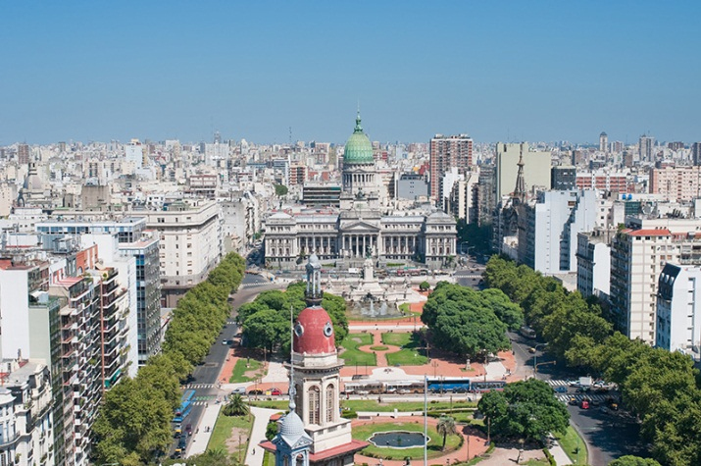
Hotseating
Argentina, el uno de enero, 2015
¡Hola! ¿Qué tal? Me llamo Antonio y vivo en Argentina, en Buenos Aires. Tengo trece años y mi cumpleaños es el quince de mayo.
Soy bastante sincero. También soy generoso, pero no soy tímido. Tengo una hermana que se llama Rosa. Tiene catorce años. En mi opinión, es un poco tonta.
Tengo un ratón y dos peces. Mi ratón es blanco y muy divertido.
Mis peces son azules y amarillos y son estupendos, pero no son muy listos. Mi color favorito es el amarillo.
Mi pasión es el rugby y mi héroe es Felipe Contepomi. ¡Es genial! Mi cantante favorita es Beyoncé porque es fenomenal.
Mi programa favorito es ‘Factor X’.
❶
❷
❸
❹

Slide 26
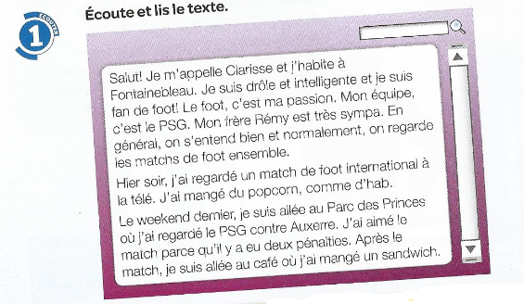
❶
Salut! Je m’appelle Clarisse et j’habite à Fonainebleau. Je suis drôle et intelligente et je suis fan de foot! Le foot, c’est ma passion. Mon équipe, c’est le PSG.
Mon frère Rény est très sympa. En genéral on s’entend bien et normalement on regarde les matches de foot ensemble.
Hier soir, j’ai regardé un match de foot international à la télé, J’ai mangé du popcorn, comme d’hab.
Le weekend dernier, je suis allée au Parc des Princes où j’ai regardé le PSG contre Auxerre. J’ai aimé le match parce qu’il y a eu deux pénalties. Après le match, je suis allée au café où j’ai mangé un sandwich.
❷
❸
❹
Notes:
Text taken from Studio 2 – Heinemann course. Module 3 unit 5. p.56

Slide 27
1 | Comment t’appelles tu?
2 | Où habites-tu?
3 | Tu es comment?
4 | Tu es drôle? Tu es intelligent?
5 | Quel est ton sport préféré?
6 | Quelle est ta passion?
7 | Quelle est ton équipe préférée?
8 | Qui est Rény?
9 | Tu as des frères ou des soeurs?
10 | Comment s’appelle ton frère?
11 | Ton frère, il est comment?
12 | On se dispute?
13 | Qu’est-ce qu’on fait ensemble?
14 | Qu’est-ce que tu aimes faire avec ton frère?

Slide 28
15 | Qu’est-ce que tu fais normalement avec ton frère?
16 | Qu’est-ce que tu as fait hier soir?
17 | Tu as mangé quelquechose?
18 | Qu’est-ce que tu as fait le weekend dernier?
19 | Le PSG, c’est quoi?
20 | C’était bien le match? Pourquoi?
21 | Le PSG a gagné?
22 | Qu’est-ce que tu as fait après le match?
We will return later to other tasks that maximise question asking.

Slide 29

Quelles sont les questions?
2. La capitale de la Tunisie, c’est Tunis.
4. Je vais en Espagne pour aller à la plage.
1. Il fait beau.
3. S’il fait du soleil, je fais du cyclisme.
5. Oui, bien sûr. Et toi?
6. Hier je suis resté à la maison.
8. Je vais visiter le château
7. On peut faire du ski
9. Peut-être

Slide 30
Was sind die Fragen?
4. Ich fahre nach Schottland, um Nessie zu sehen.
1. Es donnert und blitzt.
2. Die Hauptstadt von Österreich ist Wien.
3. Wenn es heiß ist, esse ich Eis.
5. Ja, sicher. Und du?
6. Gestern bin ich zu Hause geblieben.
8. Ich werde die Burg besichtigen
7. Man kann Skifahren
9.Vielleicht
Notes:
Pupils have just learnt um..zu… and wenn clauses in the context of learning about Austria. This exercise also revises all tenses and modals as well as question-forming.

Slide 31
¿Cuáles son las preguntas?
9. Si, por supesto. ¿Y tú?
1. Mi instituto es un colegio mixto con mil quinientos alumnos.
2. La asignatura que más me gusta es la música.
8. Tengo pensado hacer mi bachillerato. Quisiera estudiar ciencias.
3. Es muy amable y abierto y explica todo muy bien
7. Hice dos semanas de prácticas laborales en un taller mecánico.
4. Soy socio del club de baloncesto.
6. Mi escuela primaria era muy pequeña y no teníamos que llevar uniforme.
5.Quizás

Slide 32

3 Pictures and authentic texts can be a powerful stimulus for spontaneous talk in the foreign language classroom.

Slide 33
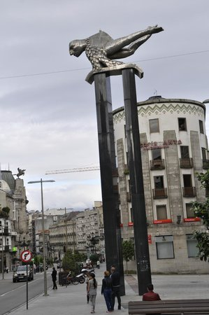
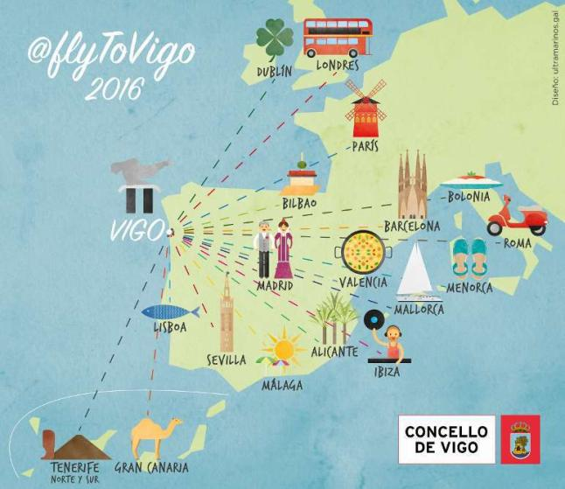

¿Dónde está Vigo?
¿Qué es esto?
me llamo
__ una escultura, que __ _____
‘El sireno’ o en inglés ‘Merman’
¡Hola! __ ______ Victor y ____ en Vigo, que _____ en el noroeste de España.
Es
vivo
se llama
está
Es el símbolo de Vigo.

Slide 34
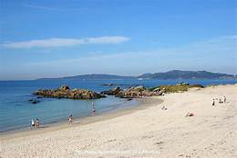
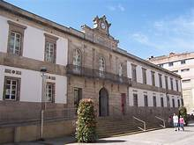
¿Qué hay en Vigo?
¿Dónde está Vigo?
Vigo _____ en el noroeste de España.
En Vigo _____ muchas playas y unos museos.
está
hay
Hoy vamos a…
- hablar de la familia

Slide 35
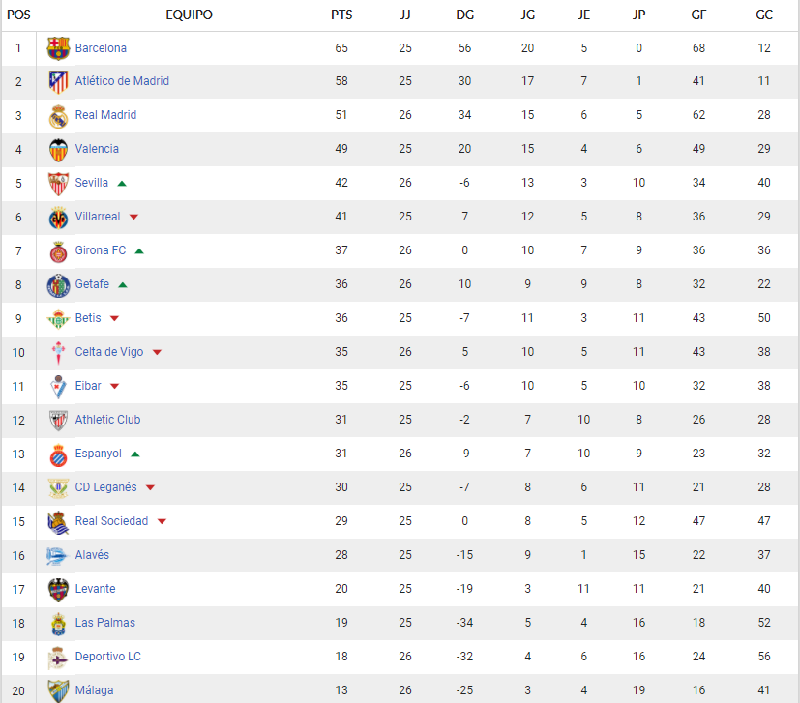


está
Vigo_______ en el noroeste de España.
tiene
Vigo __________un equipo de fútbol
se llama
que _________ Real Club Celta de Vigo (o Celta Vigo).

Slide 36
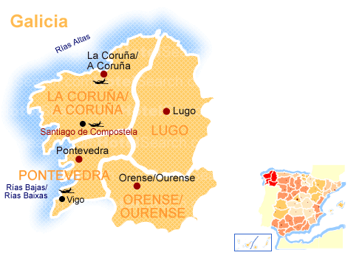
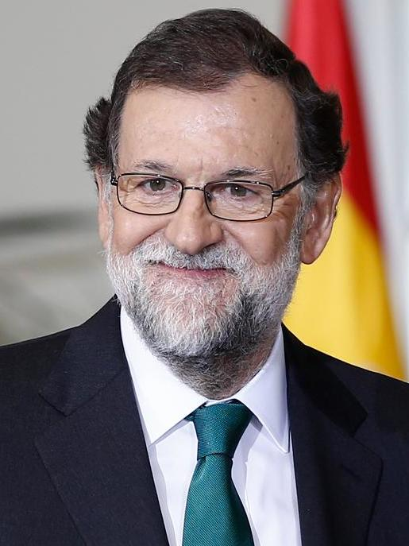
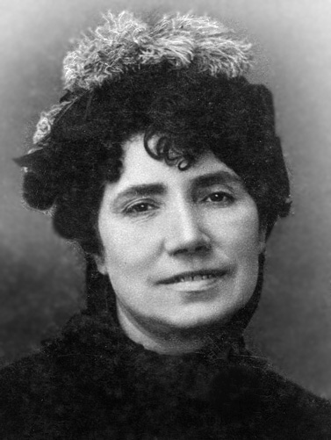
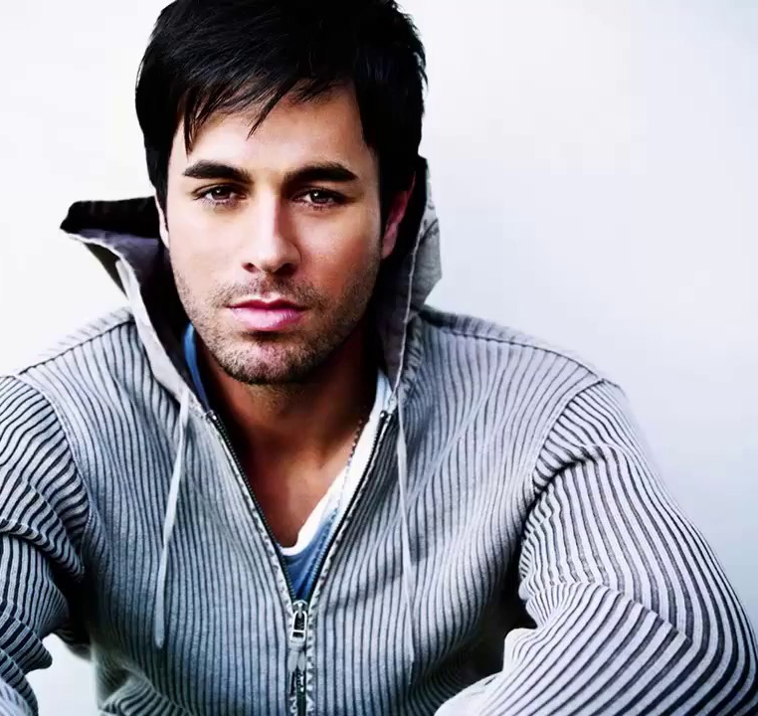
está
Vigo ________ en Galicia, una región de España.
Estas personas famosas _________ de Galicia.
son
Mariano Rajoy – Presidente del Gobierno de España
Rosalía de Castro - poeta
Enrique Iglesias - cantante
1837 - 1885
1975 -
1955-
tiene
Rosalía / Enrique / Mariano _______ el pelo … y los ojos …

Slide 37
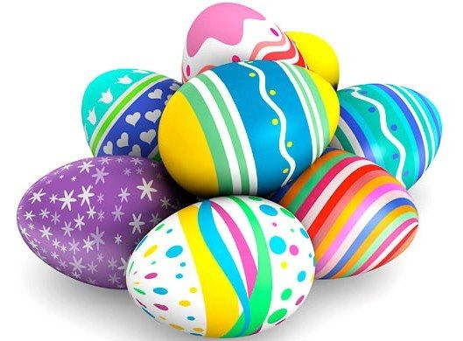
La búsqueda de los huevos de Pascua
An Easter egg is great.
Easter eggs are pretty.
I have an Easter egg.
The Easter egg is delicious.
My Easter egg is totally awesome.
But I like your Easter egg because it’s big.
My brother has two Easter eggs.
However, my sister doesn’t have an Easter egg.
Where is it? Do you have an Easter egg, please?
There are lots of Easter eggs in the classroom!
adapted from Greg Horton idea

Slide 38

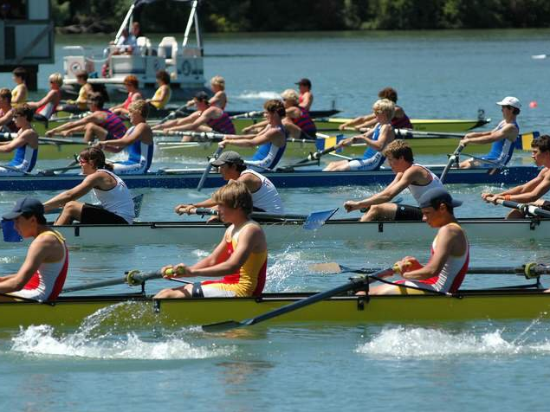
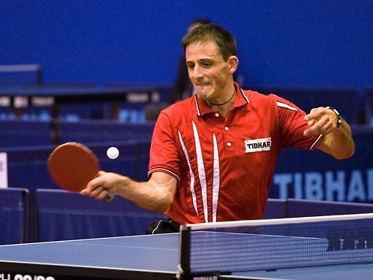
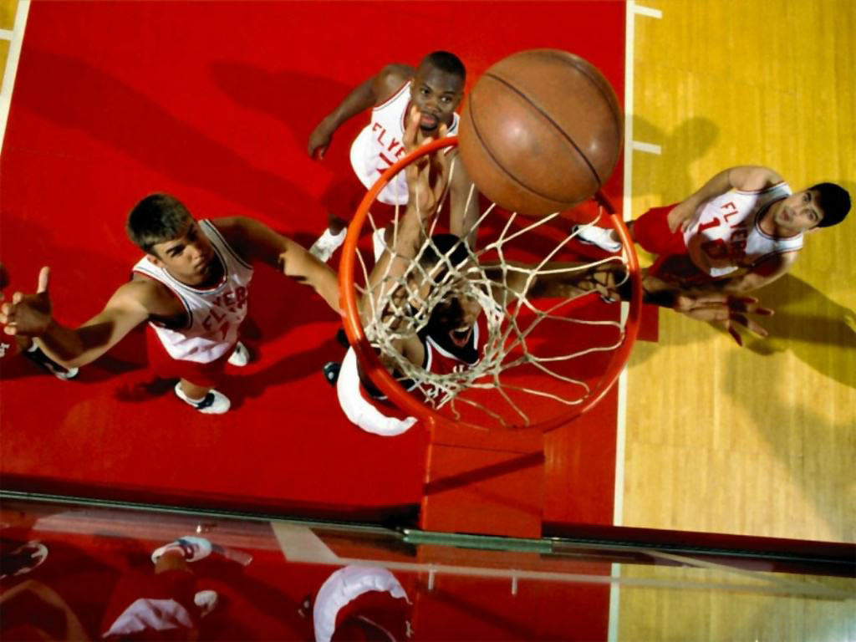
Notes:
This slide for delgates to suggest reasons (2-3 mins) and then share impressions (2-3 mins).
NB: Tell delegates that there is classroom footage of this activity in the toolkit.
Cherche l’intrus. The key with this task is that there must be several plausible answers. If there is topic specific language implicated in the task, then students should know this already. The language you need to do this type of task is very useful because it is essentially:
1) I think that the
2) 3rd persons (singular and plural) of the verb ‘to be’, …
3) ‘because’
4) 3rd persons (singular and plural) of the verb ‘to be’, …
5) complement (which can often be key grammatical words like noun, adjective, verb, masculine, feminine, singular, plural)
Hockey, rowing, table tennis and basketball.
A) Rowing because it’s the only water sport
B) Rowing because the other sports are ball sports
C) Table tennis because it’s the only individual sport
D) Hockey because it’s the only sport on grass
E) Hockey photo because it’s the only one without any people
F)…?

Slide 39
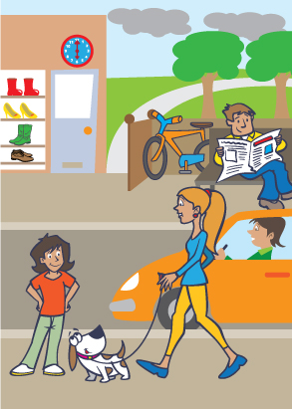
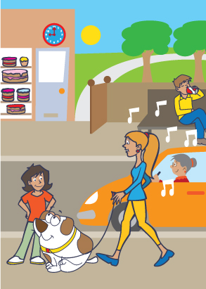
1) Menciona dos diferencias.
2) Responde a dos preguntas.
3) Haz dos preguntas.
B
Notes:
Get them to do this task as students (5 mins)
Pictures and task taken from ASSET Breakthrough speaking task – grade 3
1) Menciona dos diferencias.
2) Responde a dos preguntas.
3) Haz dos preguntas.

Slide 40
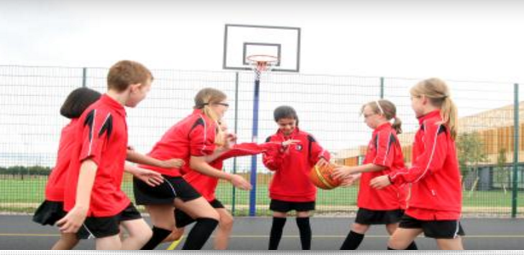
¿Est-ce que tu joues au basket?
Avec qui…?
Où?
Quand…?
Pourquoi…?

Slide 41
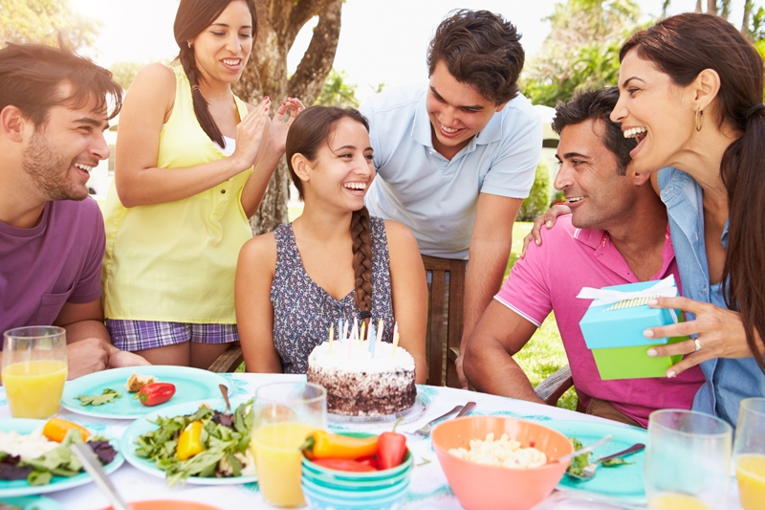

Escribe dos frases verdaderas y una frase falsa.
Luego haz ‘Quiz-Quiz-Trade’ en clase.
People
Action
Location
Mood
(Weather)

Slide 42
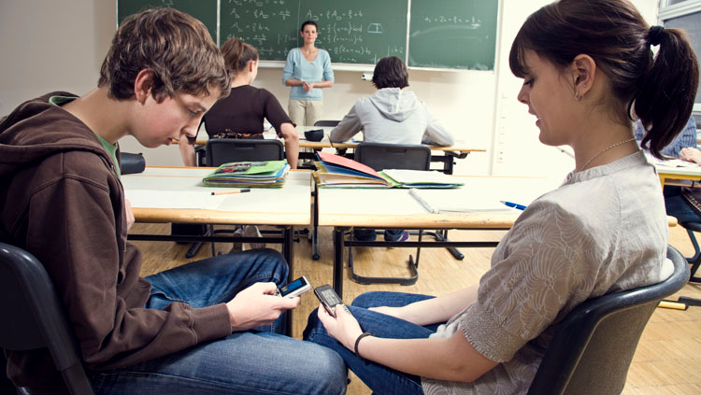
Vrai ou faux?
R
1. Il y a cinq personnes dans la photo.
F
2. Ils sont chez eux.
F
3. Les élèves portent un uniforme.
R
4. C’est un cours de mathématiques.
F
5. Tous les élèves travaillent bien .
Notes:
True/False

Slide 43
Vrai ou faux?
1. Il y a cinq personnes dans la photo.
2. Ils sont chez eux.
au collège.
3. Les élèves portent un uniforme.
4. C’est un cours de mathématiques.
5. Tous les élèves travaillent bien .
Notes:
True/False

Slide 44
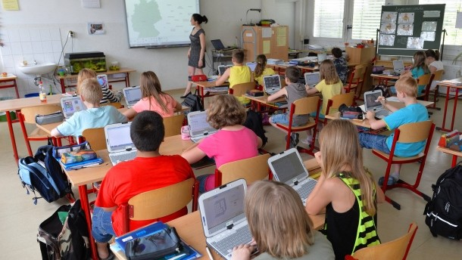
des infinitifs
to be*
to learn
to work
to write
to teach
to read
to speak
to wear
être
apprendre
travailler
écrire
enseigner
lire
parler
1. It is a school.
2. There are some pupils.
3. The teacher is teaching geography.
4. The pupils are working on computers.
5. They are not wearing a school uniform.
6. They are learning geography.
7. The teacher is speaking.
8. The pupils are not speaking.
porter
il y a
there is/are =
The teacher One boy One girl
The pupils The people
le/la prof
un garçon
une fille
les élèves
les gens
Notes:
Translate vocabulary, then sentences.
Focus on 3rd person singular and plural forms.

Slide 45
1. C’est un collège
1. It is a school.
2. There are some pupils.
3. The teacher is teaching geography.
4. The pupils are working on computers.
5. They are not wearing a school uniform.
6. They are learning geography.
7. The teacher is speaking.
8. The pupils are not speaking.
2. Il y a des élèves.
3. La prof enseigne la géo
4. Les élèves travaillent à l’ordinateur.
5. Ils ne portent pas d’uniforme.
6. Ils apprennent la géo
7. La prof parle.
8. Les élèves ne parlent pas.
Notes:
Whenever possible, use the 3rd person plural – it’s the same as the infinitive, and never irregular so much easier to get accurate!
Reminder that is/are + -ing in English is JUST THE PRESENT TENSE in GERMAN.

Slide 46
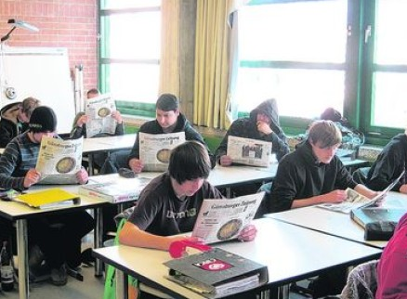
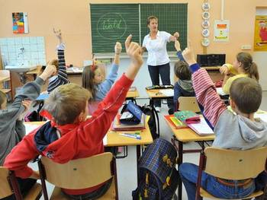
A
Ecris les phrases en français.
1. The pupils are in school.
2. They are reading the newspaper.
3. All the pupils are working.
4. It is a secondary school.
5. It is a primary school.
6. They are answering questions.
B
Photo A ou Photo B?

Slide 47
A
Schreib die Sätze auf Deutsch.
1. The pupils are in school.
2. They are reading the newspaper.
3. All the pupils are working.
4. It is a secondary school.
5. It is a primary school.
6. They are answering questions.
1. Les élèves sont au collège.
2. Ils lisent un journal.
3. Tous les élèves travaillent.
B
4. C’est une école secondaire.
5. C’est une école primaire.
6. Ils répondent aux questions.
Photo A ou Photo B?
le journal (the newspaper)
répondre (to answer)

Slide 48
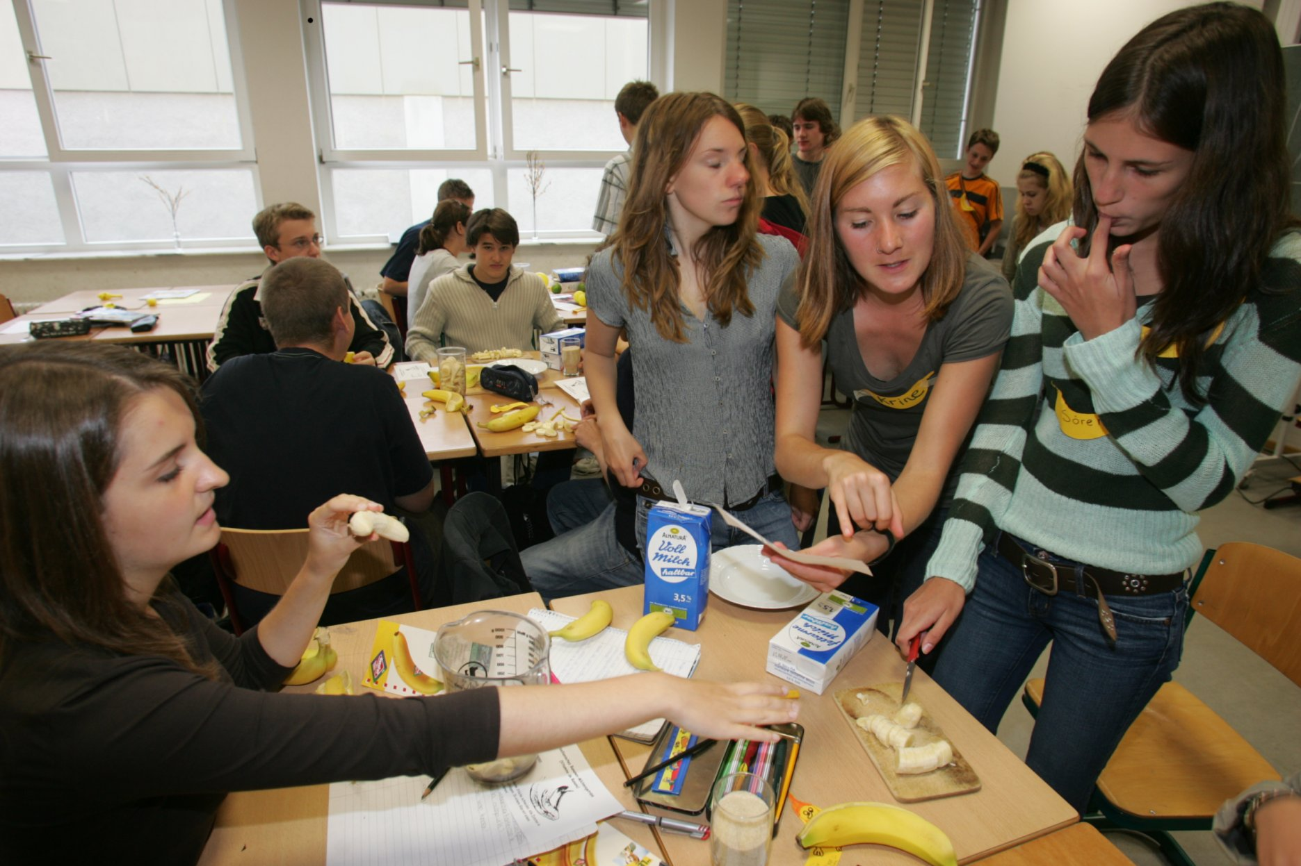
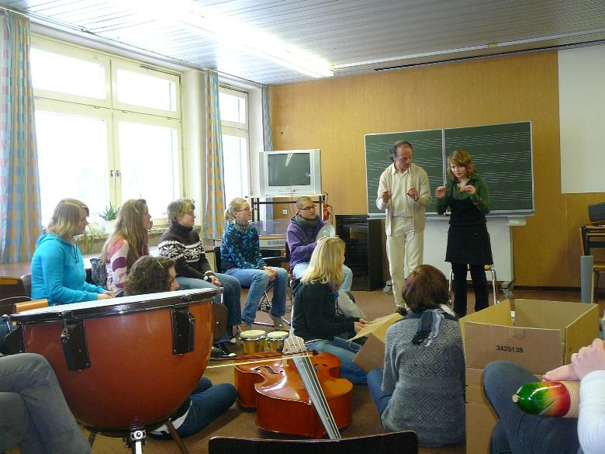
Ecris quatre phrases. Une phrase doit être fausse.
1
2
3
4
Ecris quatre phrases. Une phrase doit être fausse.
1
2
3
4

Slide 49
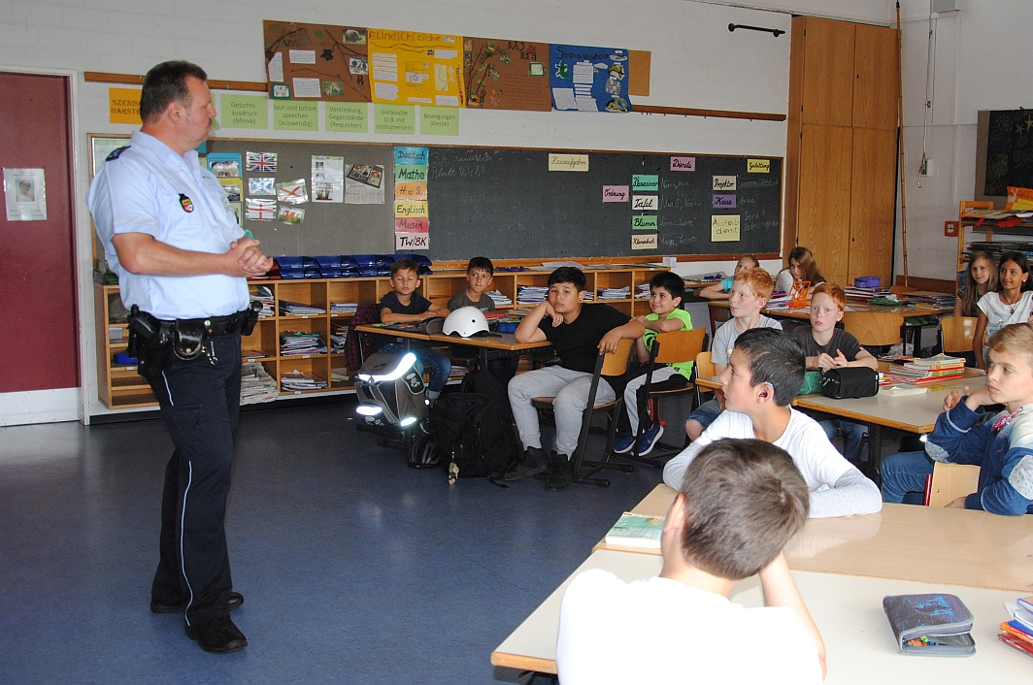
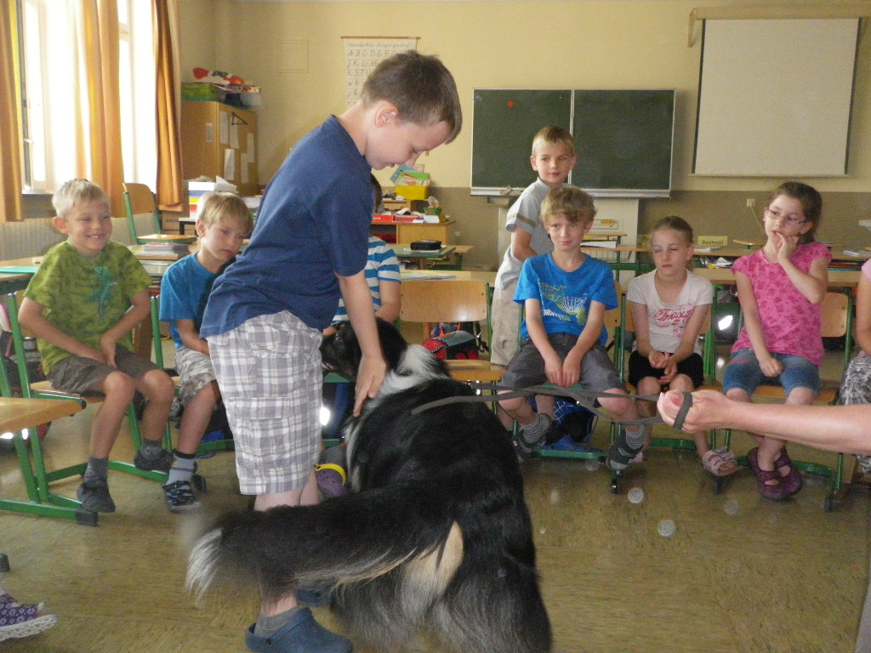
Ecris quatre phrases. Une phrase doit être fausse.
1
2
3
4
Ecris quatre phrases. Une phrase doit être fausse.
1
2
3
4

Slide 50
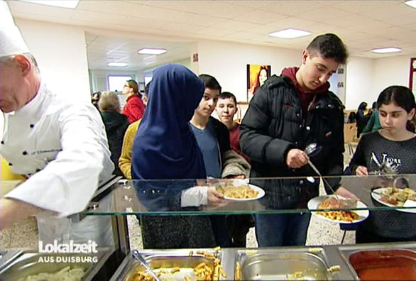
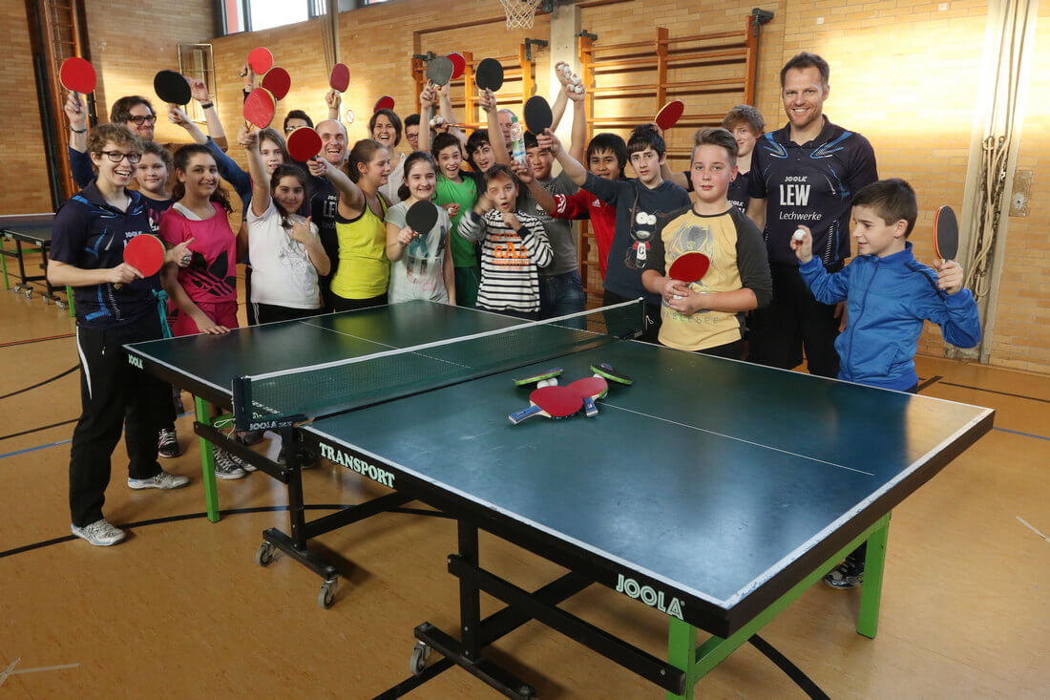
Ecris quatre phrases. Une phrase doit être fausse.
1
2
3
4
Ecris quatre phrases. Une phrase doit être fausse.
1
2
3
4

Slide 51
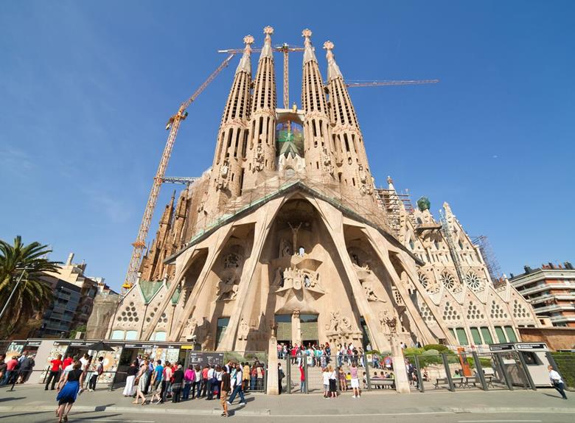
¿Qué hay en la foto?
¿Cómo es …?
¿Dónde está…?
¿Qué hacen?
People
Action
Location
Mood
(Weather)
Notes:
Aiming to elicit:
En la foto hay un edificio / un monumento / una iglesia (not exactly a catedral, it’s a basilica)
El edificio / la catedral es grande, enorme, bonito/a, histórico/a, antiguo/a – (started 1882 - ?? possible completion date - 2026?), impresionante, importante, alto/a
También hay unas personas (que visitan el monumento).
Las personas son turistas.
En mi opinión / Pienso que está en España.
También hay unos edificios modernos y una palmera, una grúa (crane).
NB: the greyed out questions are extension – additional for higher attaining students.

Slide 52
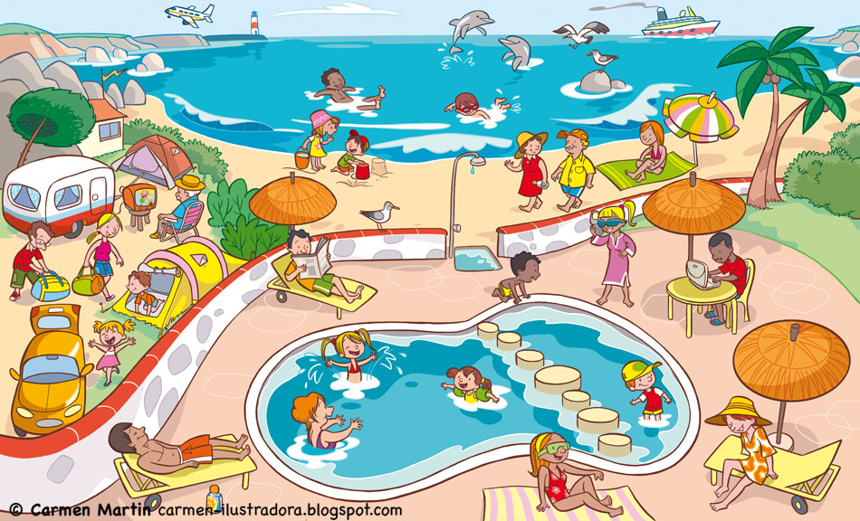
¿Qué hay en la foto?
¿Cómo es …?
¿Dónde está…?
¿Qué hacen?
People
Action
Location
Mood
(Weather)

Slide 53
¿Qué hay en la foto?
To say who is doing what, change the infinitive.
Remove –ar/-er/-ir and add:
I = -o
you = -as / -es
s/he = -a / -e
we = -amos / -emos / -imos
they = -an /-en
infinitivo
En la foto hay…
muchas personas / mucha gente
un camping / una playa / una piscina etc…
nadar
tomar el sol
escuchar
montar
tocar
descansar
comprar
bailar
usar
estar
jugar* (juego)
hacer* (hago)
ver
leer
salir* (salgo)
ir*
¿Qué tiempo hace?
Hace…
(No) llueve / nieva.
Más vocabulario:
en el mar / en la piscina
a caballo / en bici
la guitarra
un helado
el ordenador
al aire libre / de vacaciones
a los videojuegos / al voleibol / a la pelota
deportes acuáticos
submarinismo
la tele / una película
un libro / un periódico / una revista
con mis amigos
de compras / de excursión (en barco) / de paseo
¿Qué hace la gente?
Todas las personas…
Unas persons…
Otras personas…
Una persona … (un hombre / una mujer un chico / una chica)
Y tú, ¿Qué haces normalmente en verano / en invierno?

Slide 54
¿Qué hay en la foto?
To say who is doing what, change the infinitive.
Remove –ar/-er/-ir and add:
I = -o
you = -as / -es
s/he = -a / -e
we = -amos / -emos / -imos
they = -an /-en
infinitivo
En la foto hay…
muchas personas / mucha gente
un camping / una playa / una piscina etc…
nadar
tomar el sol
escuchar
montar
tocar
descansar
comprar
bailar
usar
estar
jugar* (juego)
hacer* (hago)
ver
leer
salir* (salgo)
ir*
¿Qué tiempo hace?
Hace…
(No) llueve / nieva.
Más vocabulario:
¿Qué hace la gente?
Todas las personas…
Unas persons…
Otras personas…
Una persona … (un hombre / una mujer un chico / una chica)
Y tú, ¿Qué haces normalmente en verano/ en invierno?

Slide 55


4 Interaction language needs teaching. Introduce key structures and encourage students to use and re-use them often.
http://www.tes.co.uk/teaching-resource/French-Classroom-Display-6336471/
http://www.tes.co.uk/teaching-resource/Spanish-Classroom-Display-6336470/
http://www.tes.co.uk/teaching-resource/German-Classroom-Display-6340641/

Slide 56






content(e)
fatigué(e)
le meilleur/
la meilleure!
Je suis…
triste
malade
perdu(e)

Slide 57







aller à mon cours de musique?
consulter mon vocabulaire?
m’asseoir là?
Je peux…
aller aux toilettes?
travailler avec…?
utiliser un dictionnaire?

Slide 58








travailler à deux?
parler?
écrire?
Il faut…
mémoriser?
coller?
vous donner nos cahiers?

Slide 59






répéter?
parler plus lentement?
donner un exemple?
Salut!
Salut!
Bonjour
ex: J’adore la musique!
Salut!
Ça va?
Pouvez-vous…
m’aider?
signer mon mérite?
lire ça?

Slide 60






facile
difficile
pas mal
assez
très
C’était…
un peu
rigolo!
affreux!
ennuyeux
Ha ha ha!

Slide 61






fini
oublié
gagné
J’ai / Je n’ai pas…
mon cahier
perdu
compris

Slide 62








un problème
tout bon!
une idée
J’ai…
Geburtstag
un chien
faim/soif
mal à la tête
einen Hund
perdido

Slide 63








Carte de points
Est-ce que je peux parler plus en français?
- Use the French talk mat to help you talk in French in the lesson.
- Over time try to use language from all categories.
- These are shown on your reward / punch card by these symbols/emojis:
- We will use the punch hole to punch the right category.
Qui?
Madame…
le/la responsable (this role will rotate every week).

Slide 64









































[3]
Je suis… le meilleur / la meilleure. content(e). perdu(e). fatigué(e). malade. triste. | J’ai… tout bon. un problème. une idée. faim. soif. mal à la tête. un chien. chaud / froid. | Comment? Qu’est-ce que? Où? (D’où?) Quand? Qui? Avec qui? Pourquoi? Combien? Quel(s)? Quelle(s)? À quelle heure? Est-ce que? | C’était comment? C’était…? facile. difficile. pas mal. rigolo. ennuyeux. affreux. (très, assez, un peu)
 |  | Vas-y! C’est à moi. C’est à toi. J’ai gagné. Tu as perdu. Je commence. Tu commences. Ne fais pas ça! Tu triches!
Pouvez-vous.? répéter? parler plus lentement? donner un exemple? m’aider? signer mon mérite? lire ça ? | Faut-il…? travailler à deux? écrire? parler? mémoriser? coller? vous donner nos cahiers? | Je peux m’asseoir là? aller à mon cours de musique? consulter mon vocabulaire? aller aux toilettes? travailler avec..? utiliser un dictionnaire? | Comment dit-on…? Comment s’écrit…? Que penses-tu…? Je pense que…c’est… Je suis d’accord. Je ne suis pas d’accord. Moi aussi. / Pas moi. Et toi? Je ne sais pas. Ça m’est égal. Aimes-tu…? T’es fou / folle! As-tus (un style/une gomme?) J’ai besoin d’(un papier, un cahier, etc.).
[1]
[2]
[4]
[5]
[6]
[7]
[8]
ex: J’adore la musique!

Slide 65
Name of student/class
Name of student/class
Name of student/class
Name of student/class

Slide 66
Tarjeta de puntos
¿Cuánto español uso en clase?
- Use the Spanish talk mat to help you talk in Spanish in the lesson.
- Over time try to use language from all categories.
- These are shown on your reward / punch card by these symbols/emojis:
- We will use the punch hole to punch the right category.
¿Quién?
Señorita Vázquez / Doctora Hawkes
El responsable (this role will rotate every week).

Slide 67






[3]
¿Cómo estás? Estoy… fenomenal. bien. confundido/a. cansado/a. enfermo/a. fatal. | Tengo… todo correcto. un problema. una idea. hambre. sed. dolor de cabeza. un perro. calor / frío | ¿Cómo? ¿Qué? ¿Dónde? ¿Cuándo? ¿Quién? ¿Con quién? ¿Por qué? ¿Cuánto? ¿Cuántos / as? ¿Cuál? ¿Qué tipo de? ¿A qué hora? | ¿Cómo fue? Fue… fácil. difícil. así así. divertido. aburrido. fatal. (muy, bastante, un poco)
 |  | En parejas Te toca a ti Has perdido Me toca a mí He ganado Tú empiezas ¡No hagas eso! Yo empiezo ¡Estás hacienda trampa!
¿Puede..? repetirlo? hablar más despacio? dar ejemplo? ayudarme? firmar mi mérito? leerlo ? | ¿Tenemos que…? trabajar en pareja? escribir? hablar? memorizarlo? pegarlo? entregar los cuadernos? | ¿Puedo..? sentarme allí? ir a mi clase de música? mirar en mi guía de vocabulario? ir al baño? trabajar con..? usar el diccionario? | ¿Cómo se dice..? ¿Cómo se escribe? ¿Qué piensas? Pienso que …es… Sí, es verdad / No, es mentira Yo también / Yo tampoco ¿Y tú? No lo sé. No estoy seguro /a Me da igual (=) ¿Te gusta…? ¿Estás loco/a?! ¿Tienes (un boli/una goma)? Necesito… (papel, un cuaderno nuevo, etc.).
[1]
[2]
[4]
[5]
[6]
[7]
[8]
Un animal
ej. Un perro

Slide 68
AÑADIR TEXTO AQUÍ
AÑADIR TEXTO AQUÍ
AÑADIR TEXTO AQUÍ
AÑADIR TEXTO AQUÍ

Slide 69
Belohnungskarte
Sprich Deutsch!
- Use the German talk mat to help you talk in German in the lesson.
- Over time try to use language from all categories.
- These are shown on your reward / punch card by these symbols/emojis:
- We will use the holepunch to punch the right category.
Wer?
Doktor Hawkes
der Klassensprecher (this role will rotate every week).

Slide 70










[3]
Wie geht’s? Mir… geht’s toll / gut. geht’s schlecht. ist kalt. ist heiβ. Ich bin krank. Ich bin müde. | Ich habe… es richtig. ein Problem. eine Idee. Hunger. Durst. Kopfschmerzen. einen Hund. vergessen. | Wie? Wo? Wann? Was? Wer? Mit wem? Warum? Wie viel? Wie viele? Welcher / welche / welches? Was für? Um wie viel Uhr? | Wie war es? Es war… einfach. schwierig. in Ordnung. lustig. langweilig. total schlecht. (sehr, ziemlich, ein bisschen)
Darf ich… einen Kuli haben? Papier/ein neues Heft haben? zu meiner Musikstude gehen? aufs Klo gehen? mit … arbeiten? ein Wörterbuch verwenden? | Müssen wir…? zu zweit arbeiten? schreiben? sprechen? das auswendig lernen? das einkleben? die Hefte abgeben? | Können Sie..? das wiederholen? langsamer sprechen? ein Beispiel geben? mir helfen? hier unterschreiben? das lesen? | Wie sagt man..? Wie schreibt man…? Was denkst du? Ich denke, …ist… Ja, das stimmt. Nein, das stimmt nicht. Ich auch. / Ich nicht. Ich weiß es nicht. Und du? Magst du…? Ich mag / Ich mag…nicht. Es ist mir egal. Spinnst du?! Ich verstehe (nicht).
[1]
[2]
[4]
Partnerarbeit
Los! | Ich bin dran.
Komm! | Du bist dran.
Du beginnst. | Du schummelst!
Würfle!. | Mach das nicht!
[5]
[6]
[7]
[8]
Guten
Tag!
Ich mag…
z.B. Popmusik!

Slide 71
8-Deutsch
HAMBURG
8-Deutsch
HAMBURG
8-Deutsch
HAMBURG
8-Deutsch
HAMBURG

Slide 72
Nivel 1 | How do you say…in German?
Nivel 2 | I think …is…
Nivel 3 | Yes, that’s right. Me, too!
Nivel 4 | No, that’s not right. Are you mad?!
Nivel 5 | I don’t know. What do you think?
Nivel 6 | I don’t care!
Wie sagt man…auf Deutsch?
Ich denke…ist…
Ja, das stimmt. Ich auch!
Nein, das stimmt nicht.
Spinnst du?!?!
Ich weiβ es nicht.
Was denkst du?.
Es ist mir egal!

Slide 73




2
3
1 Ask a question
2 Give an answer
3 Agreeing
4 Disagreeing
5 Uncertainty
6 Disinterest
7 Ask someone else
Ich denke, …ist…
Ja,das stimmt.
1
Ich auch.
Wie sagt man…?
7
Und du?
Was denkst du?
‘bee’ auf Deutsch?
4
Nein, das stimmt nicht.
6
Ich nicht.
Es ist mir egal.
5
Du spinnst!
Ich weiß es nicht.

Slide 74





Wer ist das?
Wie alt ist er / sie?
27
33
26
1
91
Notes:
1. Prince Harry – 33
2. Ed Sheeran - 26
Emma Watson – 27
David Attenborough – 91
Finding Dory – 1

Slide 75



5 Keep the language of pair and group tasks more straightforward than teacher – student talk. There can be a mixture of language ‘practice’ and ‘use’ tasks.

Slide 76

Use a variety of tasks, as appropriate to the age, ability and interest of the pair / group:
(i) tandem
(ii) speed-dating
(iii) speaking lines
(iv) brainstorming
(v) give one, get one / quiz-quiz-trade
(vi) target talk
(vii) telepathy
(viii) pair share
(ix) say something else
(x) spend the words

Slide 77

Pregunta-Pregunta-Intercambia
Take the flashcard I’ve given you.
Quiz-quiz-trade your cards.
Quiz: Say the Spanish. The other person tries to say the English for that word.
Quiz: The other person will say their card to you, you say the English.
Trade: Exchange cards and move on to someone else.

Slide 78
Sp → Eng
Eng → Sp
Sp → Eng
Eng → Sp
My name: _________________
I am testing: _________________
 |  | 1 | 2 | 3 | 4
hay | there is / there are
no hay nada | there is nothing
un museo | a museum
un polideportivo | a sports centre
un centro comercial | a shopping centre
una piscina | a swimming pool
una plaza | a square
una tienda | a shop
unos/unas | some
muchos/muchas | lots of

Slide 79

1
2
3
Rosa.
David.
Felipe.
regular.
fatal.
bien.
11 años.
13 años.
12 años.
Hola, me llamo
Estoy
Tengo
4
5
20 de diciembre.
3 de enero.
31 de julio.
un gato
tres peces
un perro
Mi cumpleaños es el
Tengo
y
6
7
dos conejillos de Indias.
una serpiente.
nada más.
Francia
Jamaica
México
mi familia.
mis padres.
mis animales.
Vivo en
con
8
9
francés/francesa.
inglés/ inglesa.
mexicano/a.
francés y alemán.
inglés y español.
solo español.
Soy
y hablo
10
los Estados Unidos.
Escocia.
el Perú.
En el futuro me gustaría vivir en
Notes:
Build up to spontaneous speaking. You can only use spontaneously what you really know well, so practice and automatization is important.
This telepathy task builds confidence with answers.

Slide 80
1
2
3
Hola, me llamo…
Estoy…
Tengo…
4
5
Mi cumpleaños es el…
Tengo…
y…
6
7
Vivo en…
con…
8
9
Soy…
y hablo…
10
En el futuro me gustaría vivir en…
Notes:
This leads learners to personalize answers with prompts.

Slide 81








Inicio
60 segundos
1 | ¿C_____ t_ l________ ?
2 | ¿C____ e_____?
3 | ¿C______ a____ t______?
4 | ¿C_______ e_ t_ c__________?
5 | ¿T________ a________?
6 | ¿D_______ v_______?
7 | ¿C__ q_______ v_______?
8 | ¿C____ e__ t__ n______________?
9 | ¿Q__ i_______ h______?
10 | ¿D____ t_ g_______ v_____ e_ e_ f______?
60
45
30
15
0
Notes:
Pairs – Q&A with a time limit!

Slide 82
Queen Mary’s High School, Walsall
Motivating talk in the languages classroom
Wednesday 9 May
Notes:
Language learning at its best is cumulative and gently yet powerfully progressive. Successful outcomes at GCSE have their source in strategic planning, careful teaching and motivational learning at KS3. This session explores how we can achieve this in practice!
Rachel works across the seven schools in the CAM Academy Trust. Director of International Education and Research, and SLE for languages, she is also a former President of ALL, the Association for Language Learning. Co-author of several textbooks, including the new Pearson textbook for GCSE Spanish (¡Viva!), she has a PhD from Cambridge University, focusing on teacher and learner interaction in the secondary languages classroom.

Slide 83
References
Hawkes, R. (2012) Learning to talk and talking to learn: how spontaneous teacher–learner interaction in the secondary foreign languages classroom provides greater opportunities for L2 learning, unpublished PhD thesis, University of Cambridge.
Lantolf, J.P. (2000) ‘Second language learning as a mediated process’, in Language Teaching 33: 79–96.
Long, M.H. (1985) ‘Input and second language acquisition theory’ in S. Gass and C. Madden (eds) Input in second language acquisition (377–393), Rowley, MA:
Office for Standards in Education (Ofsted) (2008) The changing landscape of languages: an evaluation of language learning 2004/2007, London: HMSO.
Office for Standards in Education (Ofsted) (2011) Modern languages: achievement and challenge 2007–2010, London: HMSO.
Salter, M.V. (1989) Languages for communication: the next stage: recommendations for action, London: DES and CILT.
Swain, M. (2000) ‘The output hypothesis and beyond: mediating acquisition through collaborative dialogue’ in J.P. Lantolf (ed.) Sociocultural Theory and Second Language Learning (97–114), Oxford: Oxford University Press.

