Slide 1
Get the best grade you can in GCSE German speaking
Anglia Ruskin University Tuesday 22 January 2013

Slide 2
Spot the difference
Are these true for speaking or writing or both?
1. You have time to plan before you produce the language 2. You communicate your opinions through words only 3. You have a lot of time to think
Communicating a lot of information is important
Accuracy is one factor, but others are equally important
Your performance depends largely on listening comprehension
Notes:
To introduce students to the objectives of the day. Begin by pointing out that there are 2 x productive skills (i.e. when they are actually producing language themselves, rather than working to understand language that they are on the receiving end of, as in listening and reading). These are speaking and writing. They have similarites but they are also different from each other, especially when it comes to how they are assessed/graded at GCSE. How so?
Is this speaking or writing or both? 1. You have time to plan before you produce the language 2. You communicate your opinions through words only 3. You have a lot of time to think
Communicating a lot of information is important
Accuracy is one factor, but others are equally important
Your performance depends largely on listening comprehension
Give the students time to discuss this for a few minutes and take answers from the floor. The statements are deliberately open with elements of ambiguity and the idea is to draw out some of the following thoughts: 1. In GCSE you have some time to plan for both speaking and writing. In the actual exam itself, the moment of production is more immediate/spontaneous in speaking whereas in writing, you can stop/start/revise/cross out/start again and it’s only at the end of the hour that you actually ‘produce’ the piece of language which is marked. in speaking, once you start speaking everything you say is part of the assessment. In real life, of course, there can be planned speaking e.g. presentations / talk / assembly etc.. but there is a lot more talking that is unplanned
In writing – this is more true, although we want to introduce the idea that using punctution helps convey mood as well. In speaking, the words are important of course, but we have many non-verbal aspects too, such as tone of voice / intonation, pronunciation, facial expression, hesitations/fillers for thinking time, body language / gesture 3. Relatively – this applies more to writing of course. in speaking, though, we should not forget that we can buy ourselves time with fillers to get a few seconds thinking time and that this is perfectly acceptable, normal, as it happens in usual conversations in the mother tongue too! 4. Yes, important to both. Ultimately, it the quantity of information that we communicate in both speaking and writing that counts. 5. Can apply to both, of course. In writing – accuracy is one factor but complexity is another important aspect. In speaking, accuracy is also important, but the other factors that are equally important are sounding confident, saying it like you mean it, responding readily to what is said to you, in short, being able to interact with others It is hard to quantify this exactly, but over the years as an examiner it has been proven to me time and time again that this counts for an awful lot, and certainly is more important than grammatical mistakes, even quite serious ones, as long as the meaning is clear. 6. This is of course only true of speaking, and underlies the most fundamental difference. Whatever exam board you do, your speaking performance starts with you understanding the questions / comments that are put to you by the other person, then knowing how to repsond readily to them. This is why this afternoon we will work on listening skills. The more quickly you can process / understand questions the more confidently you will be able to respond to them.

Slide 3
Zum Anfangen…
Person 1: Eins Person 2: Zwei Person 1: Drei
1. Statt das Wort zu ‘eins’ sagen, klatsche einmal.
2. Statt das Wort ‘drei’ zu sagen, spring.
Notes:
At this point we have explored some of the similarities and differences between writing and speaking, the 2 ways you are learning to produce language. We’ve identified a couple of key differences. As our focus is on speaking today, it follows that we need to spend time on these. 1. Using tone of voice to express emotion 2. Responding readily 3. Sounding confident (saying it like you mean it!)
It’s often easiest to start doing this by beginning with the simplest language. Like in a scientific experiment, where, to focus on one element you keep everything else the same. So, we’re going to start with language you don’t even have to think too hard about producing! Numbers 1 – 2 – 3. Don’t be fooled into thinking this is going to be easy though. We’re working on tone of voice, ready responses, sounding confident. In pairs, have this conversation. First, just get a rhythm going. I’ll give you 30 seconds to do that. When I call ‘ drei– zwei– eins’ I want you to stop. Now, I want you to try putting some mood/emotion into it. You may include questions – responses – exclamations. Don’t try to do this too fast or you won’t be really responding to what you hear. Try to think about the emotion you’re conveying and use an appropriate gesture or facial expression. You’ve all done drama at KS3 so use all your strategies from there. (useful to have another teacher there to demo this with)
Off you go!

Slide 4
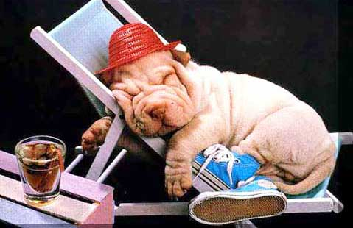
Urlaube
Notes:
OK – that’s great. But limiting in terms of what we’re communicating. Let’s try transferring this to a more realistic scenario for a short conversation.
Obviously you’re all on different topics at the moment, but what we do today will use language from topics you’ve most likely covered in y9, and not too much that’s brand new, because the focus of the day, and particularly this session, is to speak better using the resources we already have in our heads. so this first conversation is about holidays, just what is most important to you in a good holiday.

Slide 5
__ __ __ __________ __ ___?
W__ __ __ W__________ __ d__?
W__ i__ d__ W__________ f__ d__?
Was ist das Wichtigste für dich?
Notes:
Here’s the question you’re all going to need to be able to ask. What’s the most important thing for you? Let’s practise this a few times, and reduce the prompt on the screen as we do so, so that we’ve got it in our heads nearly as well as ‘uno – dos – tres’
(Teacher to click to remove more and more of the words until there are just the spaces) This whole practice phase just to take a 2-3 minutes

Slide 6
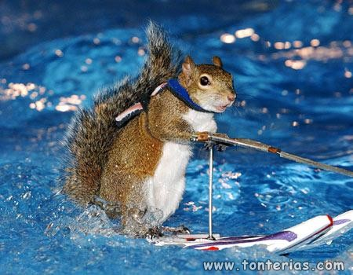
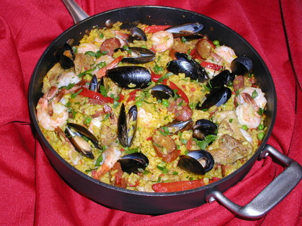
die Sonne (das Wetter)
der Strand
die Geschäfte
der Wassersport
das Schwimmbad
die Leute
die Unterkunft
das Meer
das Essen
Notes:
Whole group pronunciation activity. Go through each of the words, saying them with the group, rather than teacher say – students repeat. If any seem hesitant, pick up on those words and reinforce/model the pronunciation.
In the booklets, students will have these words. They will be doing the speaking activity without looking at their booklets, but we can give them a minute or so to select 3-4 items that they are confident to say from memory.

Slide 7
¿___ __ __ ___ _______________ ____ __ wenn du im Urlaub bist?
Was ist das Wichtigste für dich, wenn du im Urlaub bist?
Person 1: Also, das Wichtigste für mich ist der Strand. Person 2: Der Strand! Also, für mich ist es das Essen. Was meinst du? Person 1: Ja das Essen ist auch wichtig. (und auch denke ich, dass .... / und du?)
Notes:
Introduce the scenario
The question disappears to be replaced by blanks and just the end part? First, they can just doing the dialogue as written, with feeling.
Next, they can do it, changing the underlined words.
Then they can do it with all the words blocked out. Finally, they can do it again from memory, trying to continue the conversation, giving opinions about other holidays features they haven’t mentioned.
This could be worth modelling with another teacher/student (need 2 x microphones active)
Ok. This beginning has been about highlighting the importance of tone of voice, intonation and ready responses to questions. I hope that you all feel that you could hear in your own voices how much more convincing it is when you inject emotion into your voice. That was the first ‘game changer’ or perhaps we should say ‘grade changer’ of the day. Now, we’re going to look at the other grade changers that we are going to master during the day today. Everything else we do this morning will be about these.

Slide 8
Grade changers
Vary your adjectives (don’t repeat ‘interessant/ langweilig’!)
Extend and justify opinions with ‘weil’
Refer to others (s/he – we – they)
Compare then and now
Describe things with 5 details
Use 5 different verbs in the past (Ich habe viel gemacht, zum Beispiel ......)
Link and narrate (Erstens…später…ein bißchen später…zuletzt…)
Use ‘um .... zu’ to extend (ich bin nach London gefahren, um einkaufen zu gehen)
Use ‘I wanted but I couldn’t, so I…’ (Ich wollte ins Kino gehen, aber ich konnte nicht, also habe ich fergesehen)
Refer to the future (Ich werde…/Ich will…/ich möchte…/Ich habe die Absicht ...../Ich hoffe…)
Notes:
You will have heard your teachers talk about these already I’m imagining. They may not have displayed them in a list quite like this, but these are 10 essential things that, once you’ve learnt to do them with confidence, will make you a better speaker of the language and will also change your grade in speaking
Some core grade changers from D → C and C→ B. If students manage all of these with confidence, good pronunciation and intonation their performance will most likely be at B grade, if ½ to ¾ then a secure C. It is fine to tell them this.
Session 1 – we are going to work on the first 5 of these and Session 2 we will improve on the other 5.
To do these, it will be best to work in smaller groups, so we’re going to break out now into our groups.

