Slide 1
Comberton Village College
Using PowerPoint 2010 in whole class languages teaching
Rachel Hawkes
Lesson planning and writing using PowerPoint 2010
Rachel Hawkes

Slide 2
Contents
Introduction – Getting started
Section 1 – Presenting new language
Section 2 – Practising language orally
Section 3 – Practising language aurally
Section 4 – Practising reading comprehension
Section 5 – Practising written language
p.3-4
p.5-14
p.15-17
p.18-24
p.25-28
p.29-30

Slide 3
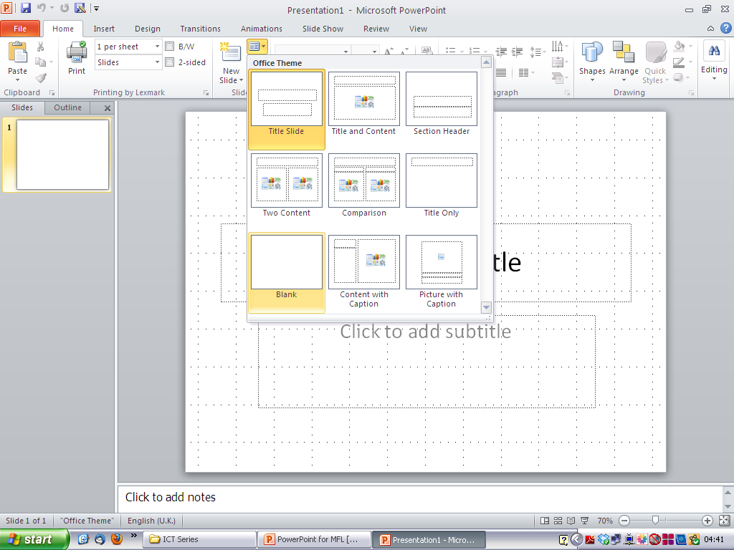
Introduction: Getting started on a new lesson
1. Open Microsoft PowerPoint and you will see the screen below. (diagram 1) If you haven’t got the menu shown on the right you can open this up by clicking on Format and selecting Slide Layout. (diagram 2) I prefer to start with a blank page so I choose this by clicking on this option. (diagram 1)
Diagram 1
Diagram 2

Slide 4
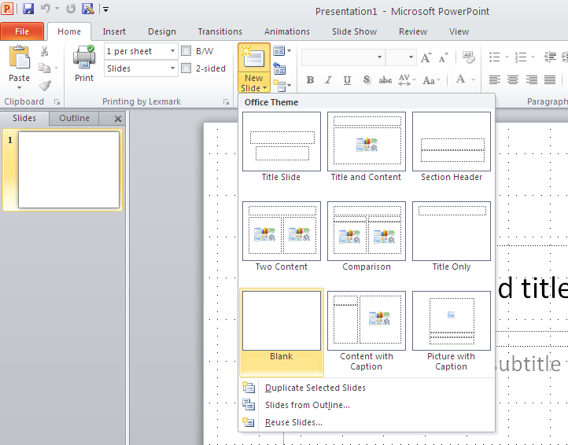
2. To add a new blank slide to your presentation, click on Insert and choose the New Slide option. (Diagram 3) From the same menu you can also choose insert Duplicate Slide which can be very useful for making similar, yet progressive staged activities in the presentation of new language phase of a lesson.
Diagram 3
3. As you can see, from the Insert tab, you can see the option to insert a text box, a picture, a table, a shape, video or audio. We will look at the most relevant functions as they occur in the making of a languages lesson. Different to previous versions of PPT, each insert step triggers a new set of options that apply to that item.
Diagram 4
Insert WordArt
Insert video
Insert picture
Insert table
Insert text box
Insert audio

Slide 5
Diagram 5
Show grid (to help guide positioning of pictures & text)
Some features are now in different places. The option to see the grid lines on your slides for guidance is now found from the View tab.

Slide 6
Section 1: Presenting new language
1. The presentation of new language can involve many different activities and it would not be desirable to follow exactly the same formula in every lesson. That said, there are a number of staged presentation activities that are in the repertoire of all languages teachers and that lend themselves particularly well to PowerPoint. I list them separately here and then detail how to make each type of activity in this section:
Students hear the new language presented by the teacher linked to a visual image and on a coloured background to reinforce the gender (if nouns).
Students hear the new language presented by the teacher, linked to the same visual image and indicate their comprehension by identifying the number or the letter of the language item.
Students see the visual image and hear two alternatives presented by the teacher, indicating their comprehension and practising production by recalling the correct option. (This can be made more challenging by presenting more options to choose from and/or varying the speed of presentation)
Students repeat the language items after the teacher, seeing the visual image once more.
Students respond chorally ‘C’est vrai’ or ‘C’est faux’ to the teacher’s presentation of the language items in response to the visual stimulus. (The speed of appearance/disappearance of the visual image can be increased to increase the demand in terms of language recognition in this activity.)
Students respond to the question ‘Qu’est-ce qui manque?’ and produce the language for the visual image that has disappeared.
Students identify the item as it appears or requested by the teacher by number.

Slide 7
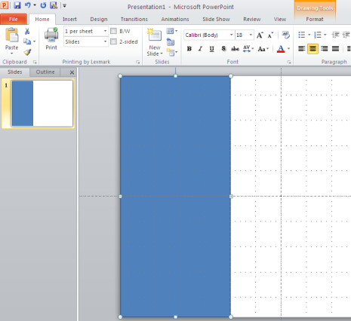
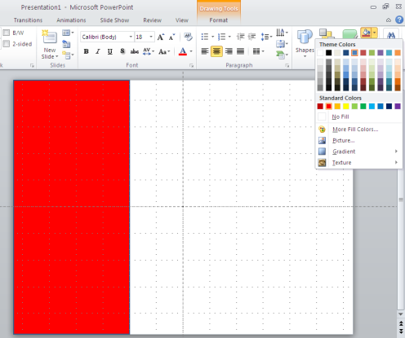
Students hear the new language presented by the teacher linked to a visual image and on a coloured background to reinforce the gender (if nouns).
1. I aim to introduce 6, 9 or 12 new vocabulary items in a lesson. These numbers of items work well visually and spatially as well as being challenging if the objective is independent production and retention of new language plus its combination with existing language by the end of the lesson.
2. I count up the number of items of each gender and plan to divide my slide up into blocks of colour accordingly. If I have 9 items, 3 masculine, 3 feminine and 3 neuter (in Gm) I will draw 3 rectangles of the same size. (diagram 6)
Diagram 6
Click in the top left hand corner and drag the cursor down to make a rectangle shape that fills about a 1/3 of the slide. When you click off, your shape is automatically shaded in blue. (Diagram 7). To change the colour fill, make sure it is selected and then choose a different colour by clicking to the right of the paint tin icon on the tool bar at the top right of the screen. (Diagrams 8)
Diagram 8
Diagram 7

Slide 8
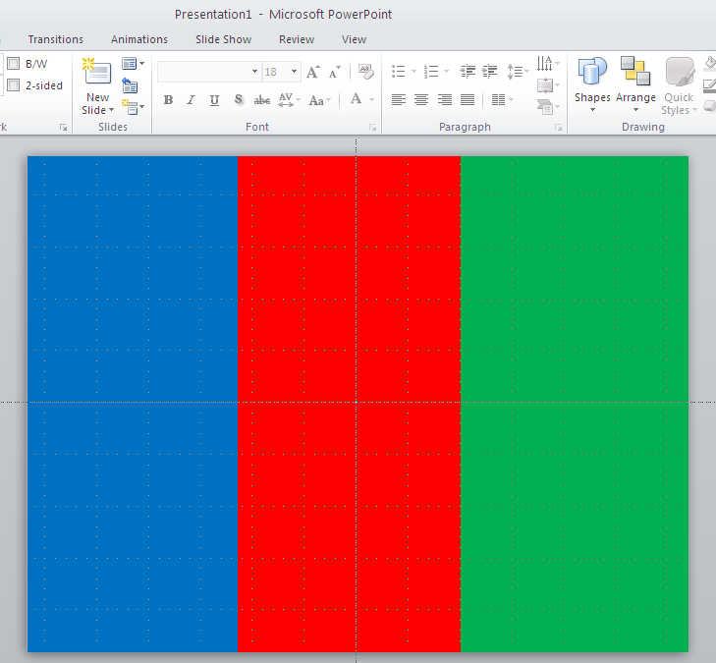
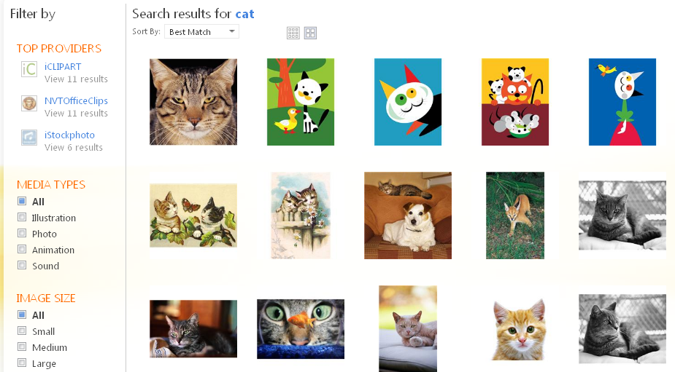
3. Next just copy and paste the existing rectangle to make the other two (or however many you need). If the shape is selected (has white round dots at the corners) then you can simply do Ctrl C to copy the shape and Ctrl V to paste. (Ctrl X deletes the item selected). Use the same method as before to colour fill the shapes. (Diagram 9)
Diagram 9
4. Now you need to insert the visual images you want to represent your new language. You can get these from a variety of sources. Some clip art images are stored on most computers and you can search for those whilst working within PowerPoint. Click on Insert → clip art icon on the menu bar type in a search word. If you have internet access you can search clip art online http://office.microsoft.com/en-us/images/ , which is much improved.
Diagram 10

Slide 9
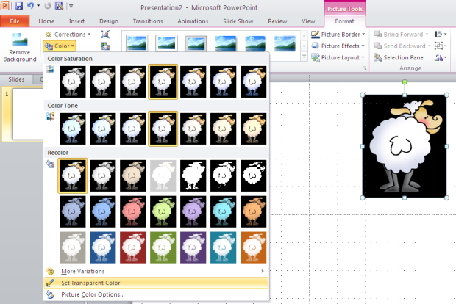
There are other royalty free images for use within education too. Here are 3 possibilities.
http://openclipart.org/
http://www.wpclipart.com/
http://www.phillipmartin.info/clipart/homepage.htm
Or you can use www.google.co.uk and select Images before you search – this gives a lot of images BUT be careful about copyright, particularly if you might share your work more widely. Alternatively you can cull images from existing PowerPoints or Word documents. If I am doing this, I open up the document containing the pictures and use Ctrl C and Ctrl V to insert the pictures into my new PowerPoint lesson.
TIP! If you copy and paste the picture and it has an unwanted background colour, select Format → Colour → Set transparent colour and then click onto a section of the background.
Diagram 11

Slide 10
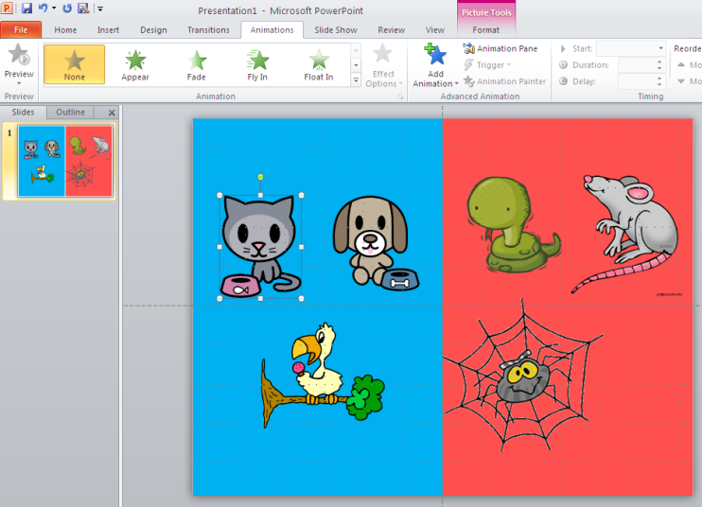
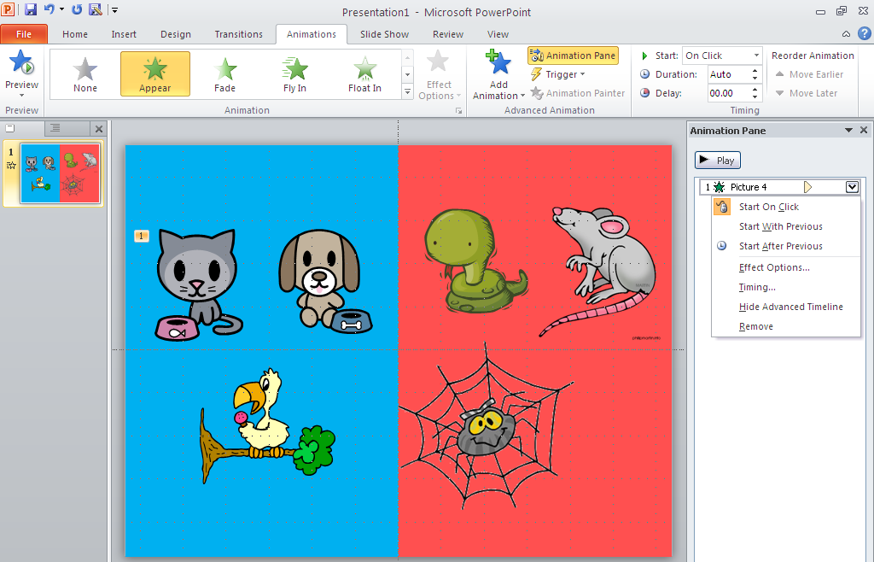
Diagram 12
Move the images into the appropriate positions according to their gender and the order in which you want to present them. It is useful to present a few easier words (cognates) first but not to leave all the most difficult language to the end.
NB: if copying and pasting straight into the PPT from the internet results in a grainy image, you can often improve the quality by saving first to your computer and then importing.
5. Now you can choose how you want the pictures to appear. To begin this process, select the Animations tab. When you click on a picture, the greyed out options turn green and you can select an appearance animation effect.
Diagram 13
Diagram 14
All animation options are available across the top. If you prefer the old format, you can choose to see them in Animation Pane.

Slide 11
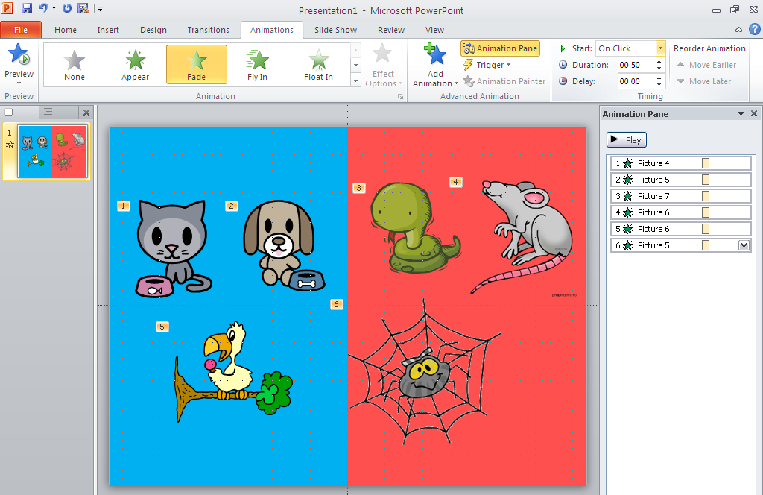
6. With this first presentation activity, you probably want each image to appear separately on your mouse click. I think that a multitude of whizzy effects adds nothing to the learning at this point (if ever!) and it saves time to have a couple of favourites that you use for this activity. I use Fade for pictures Wipe (left to right) most often r text. The quickest way to animate all the pictures using the same effect but appearing one by one is to select them all on the slide (click and draw round them with the arrow so that they all show the white dots). Click on the effect you want, then go to the Start option (top right) and choose ‘on click’. This means that the pictures will appear one by one. NB: You need to check the order of appearance at this point and you can easily adjust the order of individual pictures by clicking on them in the Animation Pane menu and dragging them up or down. (see diagram 15)
Diagram 15

Slide 12
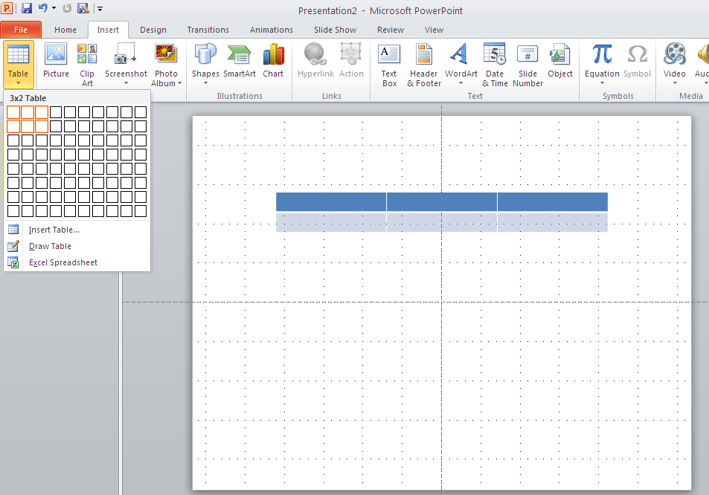
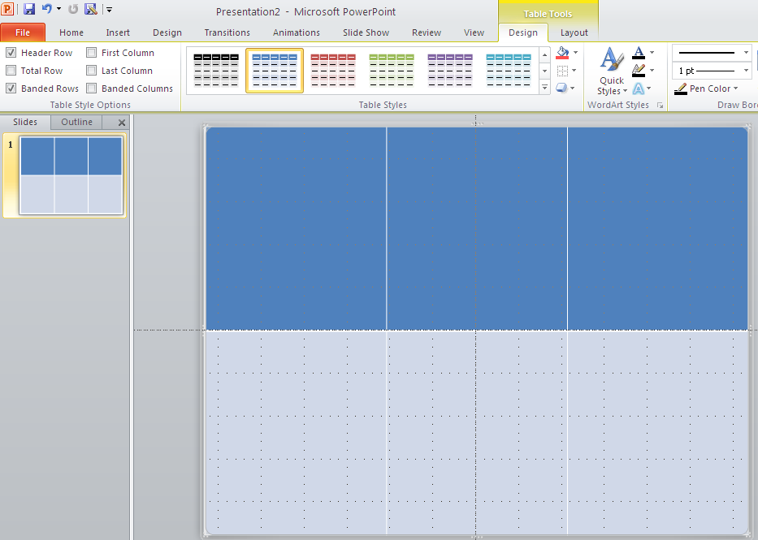
At this point your first slide is finished. But more importantly
you have most of what you need to make all the other presentation slides very much more quickly than this first slide.
Students hear the new language presented by the teacher, linked to the same visual image and indicate their comprehension by identifying the number or the letter of the language item.
To create this
activity, begin with a new blank slide. Then insert a table (either 2 x 3, 3 x 3 or 4 x 3) either by clicking on the insert table icon.
Diagram 16
Resize the table by
clicking and holding on a white dot in the corner and dragging it out to fill the whole screen.
Diagram 17
NB: Notice that a new set of menu options has appeared above the slide. Often you will want the table to be clear. Click the down arrow and all the format options will appear.

Slide 13
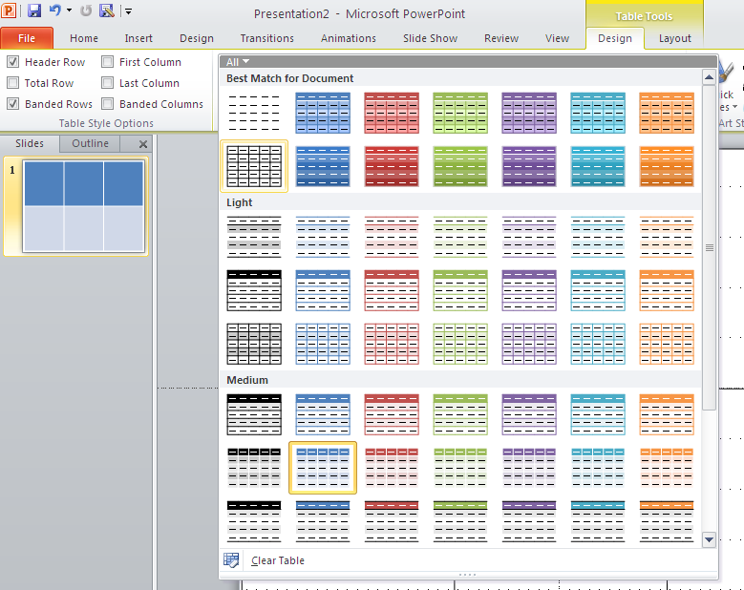
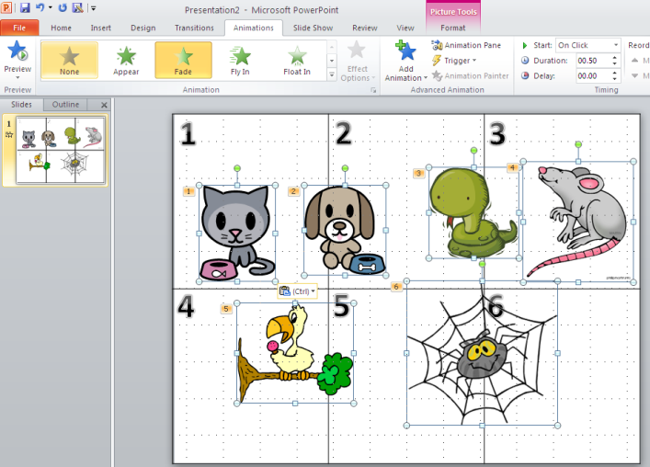
Diagram 18
I usually choose this option.
To number/letter the boxes either just type into them or
select the WordArt symbol from the tool bar and make numbers or letters in this way. The most efficient way to replicate is to format one as you want it (style, colour, size) and then Ctrl C and Ctrl V to create a copy.
Select, copy and paste all the pictures from your first slide
into this new one. Whilst still selected, go to the Animation tab and click ‘None’ to remove the animation from all the images all at once. Then adjust the positions of the images so that they fit nicely in the boxes.
Diagram 19
Diagram 20

Slide 14
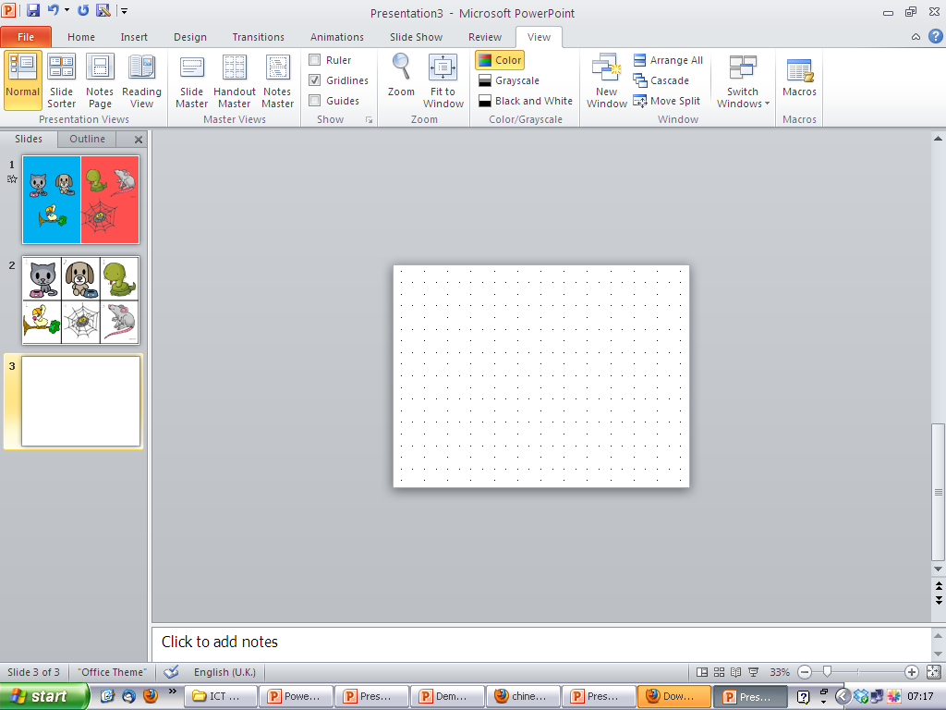
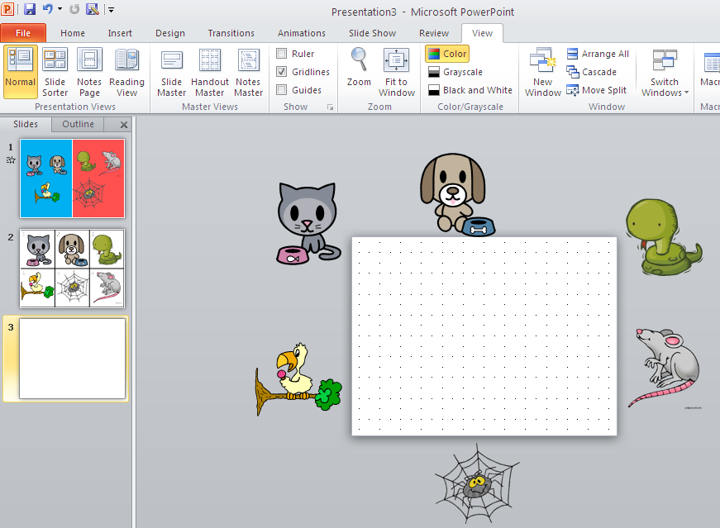
TIP: It can work really well to use numbers and letters other than the first 12 in the alphabet. The function of the activity is thereby broadened to include the revision of other essential language. Even KS4 classes sometimes need this consolidation.
Students see the visual image and hear two alternatives presented by the teacher, indicating their comprehension and practising production by recalling the correct option. (This can be made more challenging by presenting more options to choose from and/or varying the speed of presentation)
Insert a new slide and
choose blank presentation as the format. To create this type of activity, it is most useful to be able to see lots of space around the slide, so choose 33% using the sliding bar on the bottom right shown in diagram 21.
Diagram 21
Diagram 22
Now copy and paste
the same pictures in from a previous slide and remove any animations that are already attached to them. (see previous instructions for how to do this.) Move the pictures to positions just off the edge of the slide. See diagram 22.

Slide 15
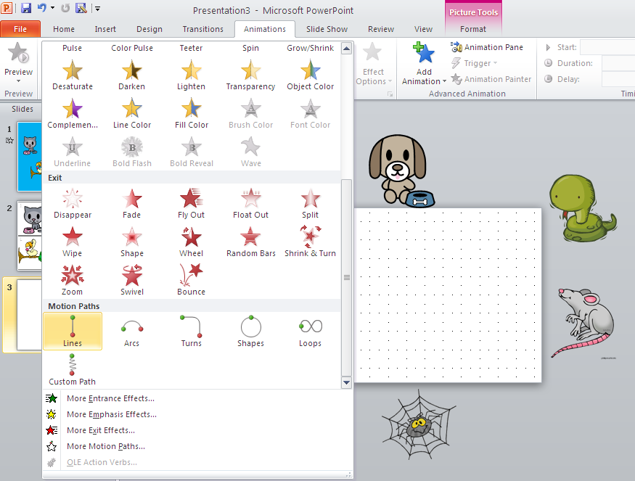
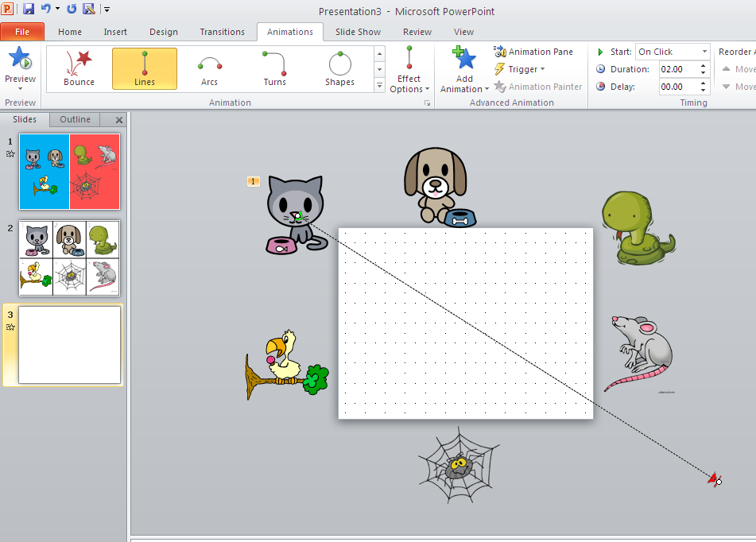
The idea here is to animate each picture to come on and
off the screen using a motion path. This is obviously not the only way to present the ‘alternatives’ activity but it does provide visual variety and keeps students’ attention and their concentration levels high.
Diagram 23
Begin by clicking on one image to select it. Then select Animation. Scroll down to Motion Paths. And select an option. Line is the easiest to use.
Select Line option and click and drag a line down from your
selected picture to a position off the edge of the slide. If you want to check the effect, select Preview on the top let of your screen. Repeat for all other images, choosing the order you wish them to appear.
Diagram 24

Slide 16
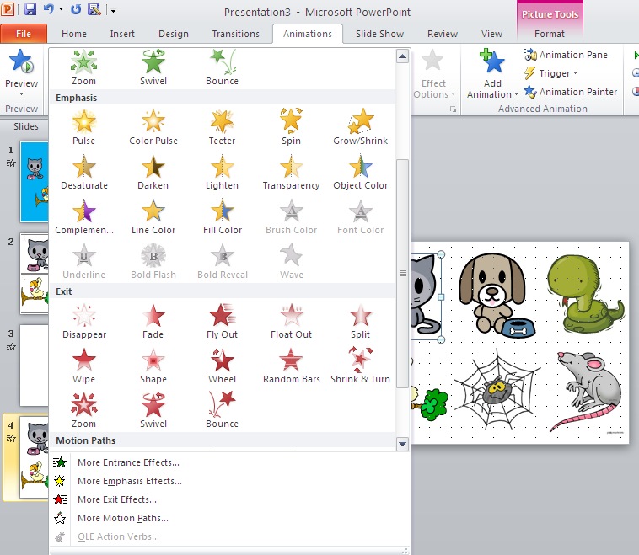
Students repeat the language items after the teacher, seeing the visual image once more.
For this activity simply make a new slide, copy and paste the images in again and animate to appear in a different order this time for variety.
e. Students respond chorally ‘C’est vrai’ or ‘C’est faux’ to the teacher’s presentation of the language items in response to the visual stimulus. (The speed of appearance/disappearance of the visual image can be increased to increase the demand in terms of language recognition in this activity.)
1. Create a new slide, blank presentation format and copy and paste the pictures onto it again, removing any existing animation. The idea of this activity is to reinforce comprehension, involving the whole class at once. It is not always necessary with higher ability students, but for lower ability groups, it provides a further opportunity for consolidation whilst maintaining their interest and involvement. In terms of animation, the idea is to animate each picture to appear and then disappear.
2. To animate, select a picture by clicking on it, choose Animation select the green entrance effect you want. Then scroll down to the red exit effects and choose Add Animation from the task bar. The result will be two animations, an entrance and exit for the same image, on two different mouse clicks. Animate the remaining images in the same way.
Diagram 25

Slide 17
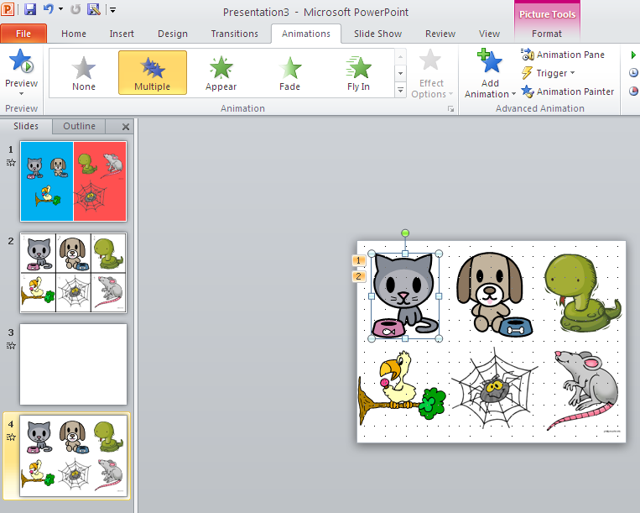
Diagram 26
You can see that you have done this when you see 2 animation boxes appear next to the image.
f. Students respond to the question ‘Qu’est-ce qui manque?’ and produce the language for the visual image that has disappeared.
For (f) you can simply make a duplicate slide from (e) and then remove all the entrance effects leaving only the exit effects. You can alter the order of animation to keep variety.
g. Students identify the item as it appears or requested by the teacher by number.
For (g) you can use either an earlier slide again or make a similar one, either within a numbered grid or on a plain background. Depending on how much support students need with gender, it may be useful to present the images again on the coloured backgrounds.

Slide 18
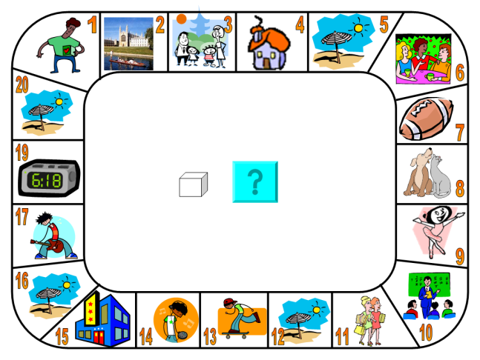
Section 2: Practising new language orally
You can use PowerPoint to present a variety of different activities ranging from whole class to pair work activities. The method for creating the activity slides is the same as for the presentation activities detailed above. (a) and (b) below are examples of both whole class practice activities and pair work slides.
a1. Students practise pronunciation and speed of recognition
further by a game, e.g. ‘Si c’est vrai, répétez, si c’est faux, silence.’
All pictures visible, the teacher points to one image and if s/he
says the TL for what it is, students repeat, if s/he says a different
item, students remain silent. This is played as a contest between
the whole class and the teacher (first to 5 points).
a2. Students at KS4 use this set of prompts and visual images
to practise speaking about their daily routine in German.
Diagram 27
Diagram 28
a3. Students at KS4 use this
game board to practise speaking
for at least a minute on whichever
topic box they land on. The die in
the centre looks like it’s being
rolled when you click it.

Slide 19
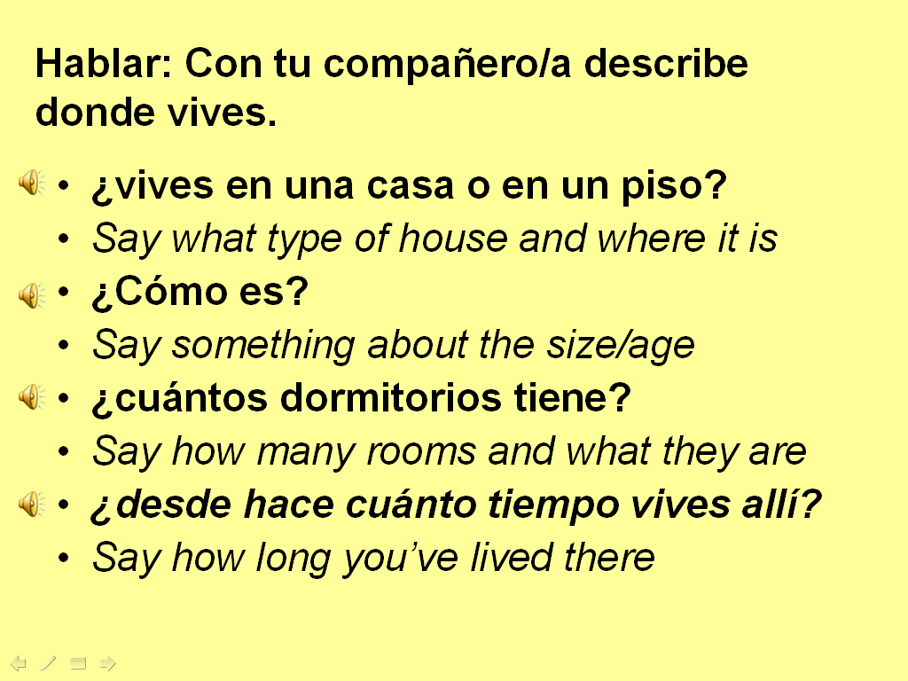
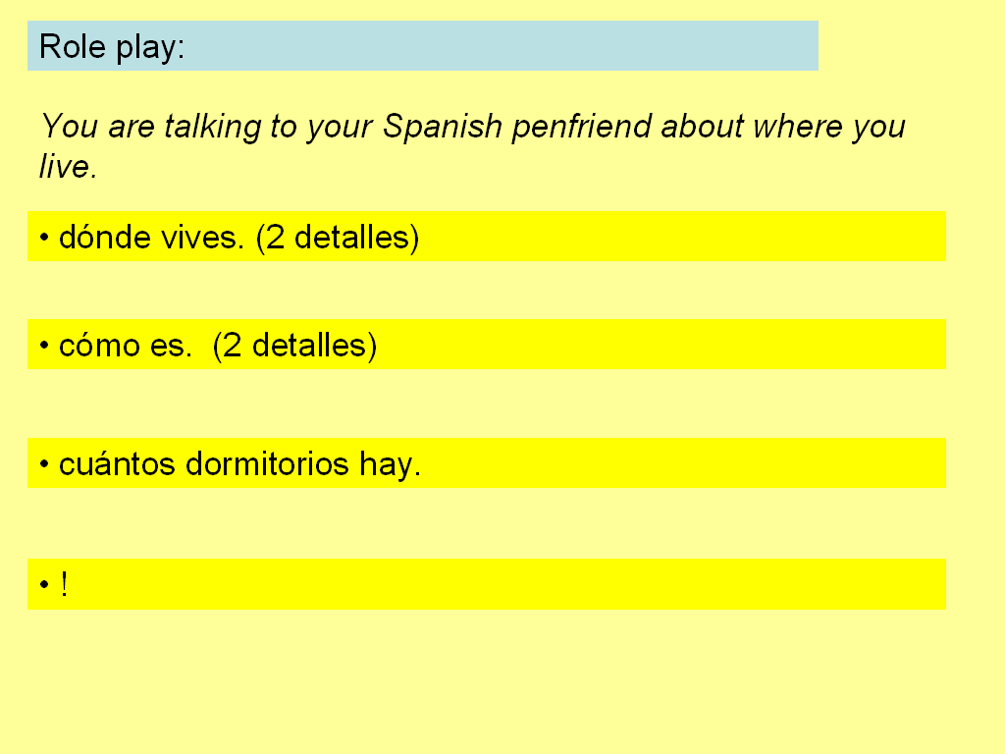
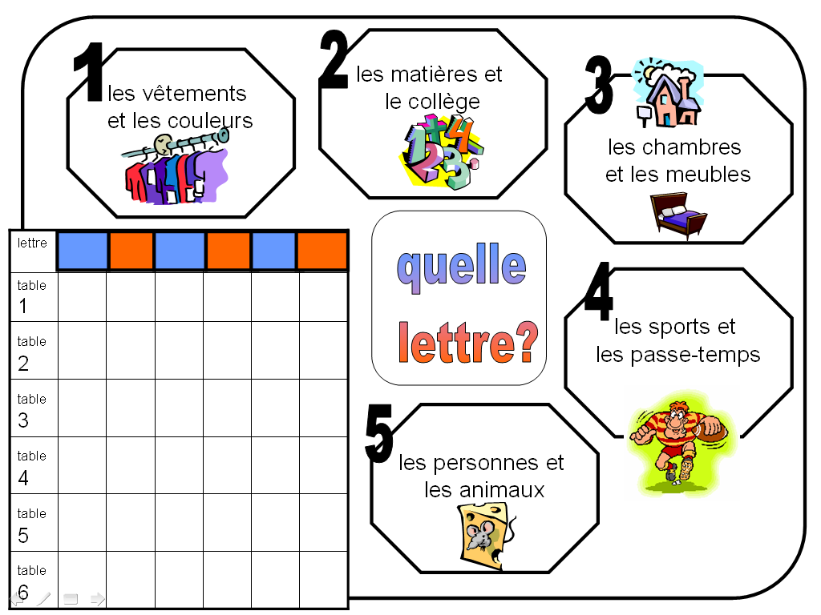
a4. It is very straightforward to create role play activities in
PowerPoint. The first slide on the left is more structured and has
the questions inserted as sounds (covered later in the listening
section) with the English instruction given. The second is
progression to a GCSE Higher Role play layout with prompts in the
TL only.
Diagram 29
a5. This is just a PowerPoint
version of the alphabet
game, in which students
work in groups, are given a
letter of the alphabet and 2
minutes and have to come
up with a word for each of
the 5 categories, gaining one
point for each..
Diagram 30
The advantage of this as a PowerPoint slide is the clarity of the pre-prepared scoring grid and the letters that appear automatically when you click in the coloured boxes. Once you have a master like this, you can easily change the categories and letters to make different versions for different topics and classes

Slide 20
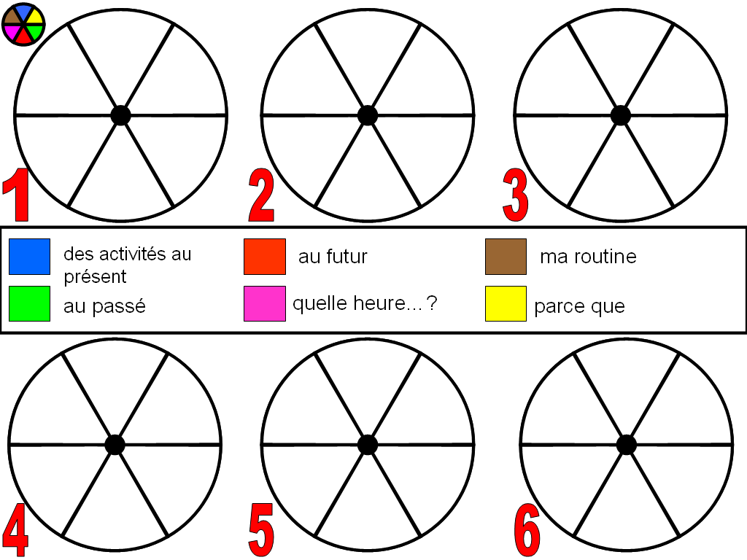
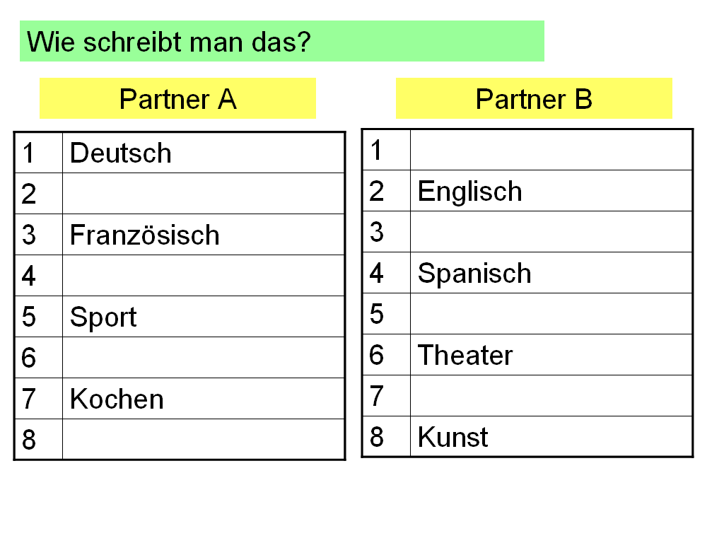
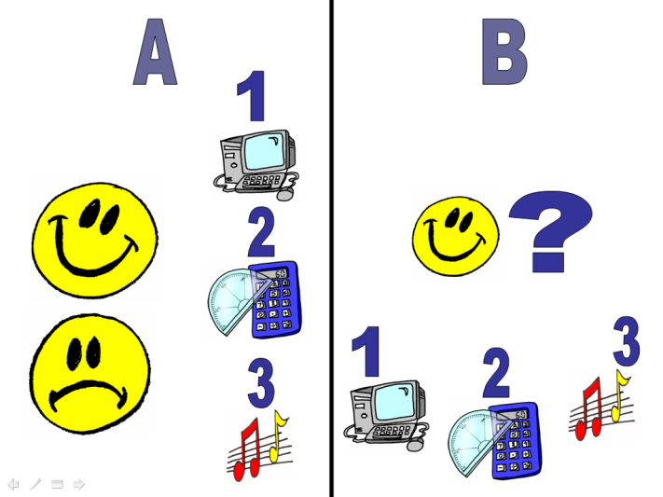
a6. This is a PowerPoint
version of Trivial Pursuit.
This is the master game
slide. The 6 wheels
represent the class divided
into 6 groups and their
progress through the game
is shown by clicking on a
triangle according to the
colour key (top left) to fill in
the coloured piece once
they have answered
correctly in that category.
(This effect is created using
triggers in the PowerPoint
program.) It also works well
as an FLA activity with up to
6 students.
Diagram 31
The coloured boxes can be hyperlinked to other slides with picture prompts to aid students to say an appropriate answer. The categories and supporting slides can be easily changed to make new games.
b1. These two slides show two different ways to model a pair
work activity. Clearly with the slide on the left, this is just the
model – the one for the students to carry out has different
information to retain the information gap!
Diagram 32

Slide 21
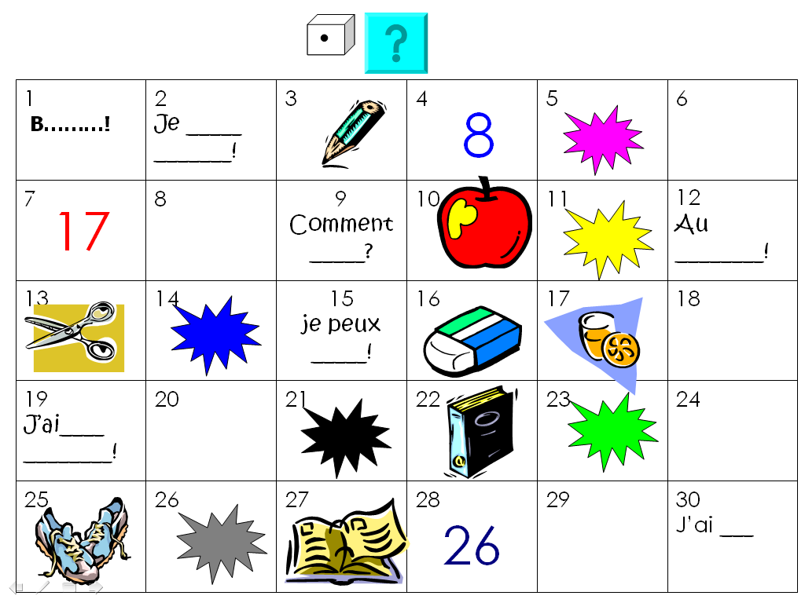
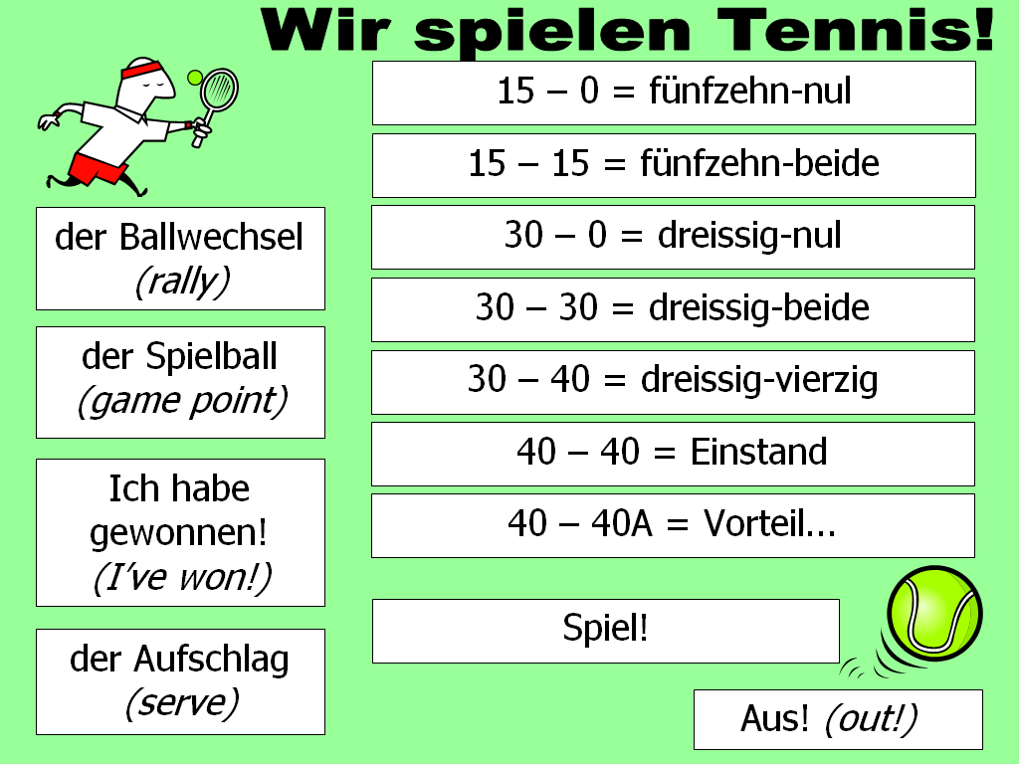
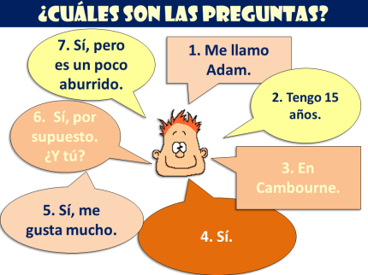
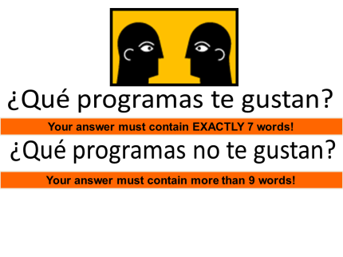
Diagram 33
b2. This is a game that works
best in pairs once
demonstrated as a whole class.
Students have their own dice
and work in pairs to come up
with either an individual item
of vocabulary or a sentence
containing that item (can be
easily differentiated within one
class in the same lesson).
b3. This is just a fun way to
structure any pair work that
you want to introduce into
your lesson. Students play in
pairs against each other and
can either practise ‘batting’
individual items of
vocabulary to and fro until
one can’t think of any, or
they can be practising a
conversation or interview
with several exchanges.
Diagram 34
Diagram 35
There are a lot of different speaking activities that can be built from one PPT slide. Here are a few more examples.

Slide 22
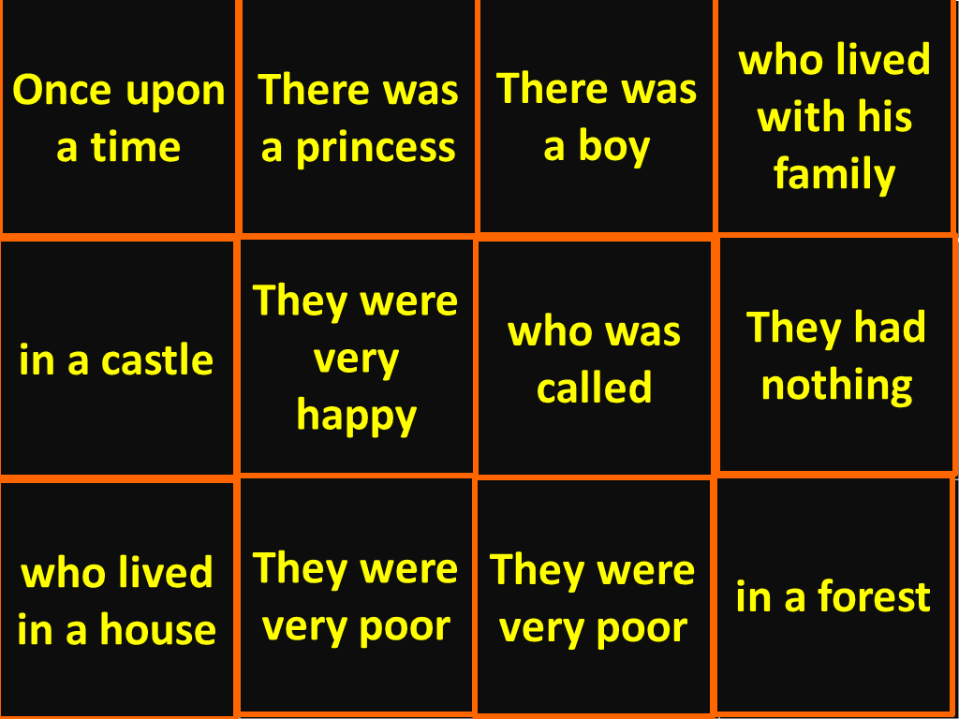
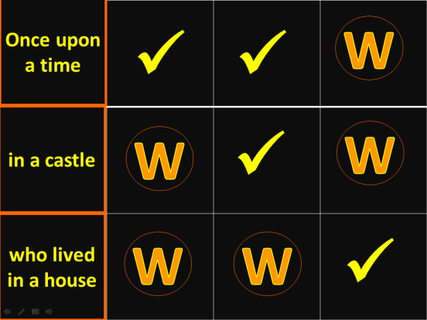
Creating triggers in PowerPoint 2010
Triggers are very useful when you want to have more flexibility in responding to students’ contributions. With animation effects that are triggered in presentation mode rather than pre-set as a sequence, you can take answers in the order in which students present them. One example of an activity type using triggers is a spontaneous talk activity, in which a photo is hidden behind several triggered boxes, each showing a statement. To reveal part of the photo beneath, students need to create a question in the language that would generate the statement as an appropriate answer. When they do this, the teacher clicks on that square, which disappears to reveal what is beneath.
Diagram 36
This one is a Wipe Out game slide. Students have to produce the TL for the story narration phrases given in English. When they do, the teacher reveals what is underneath by clicking on the square. This square is triggered to disappear revealing either a tick or a W beneath.
A tick is a point for the team and they continue playing. A W means no point and play passes to the other team. The team with the most ticks wins.

Slide 23
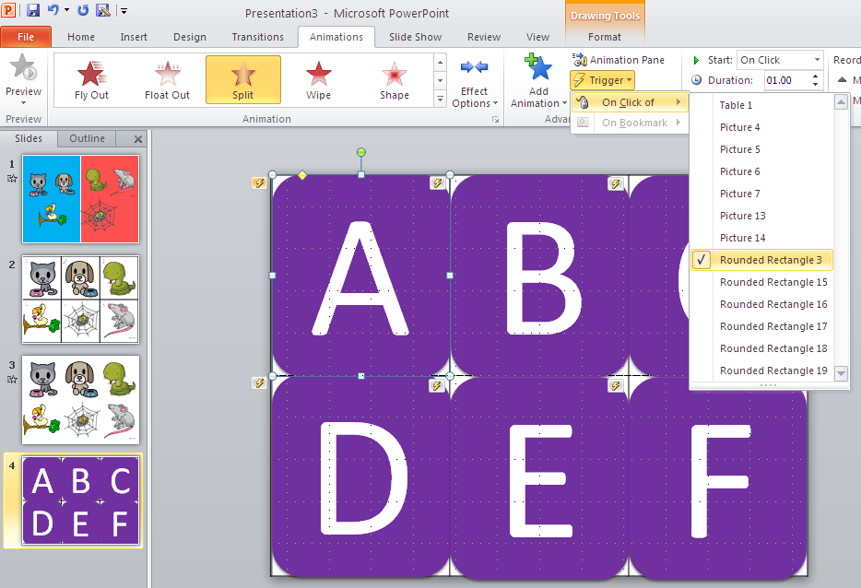
Triggers can be applied to make most language elicitation activities more responsive and interactive. This slide uses 6 triggered shapes covering the 6 animals that were part of the language introduction activities earlier in this guide. Students have the option to guess what is behind any of the shapes each time rather than work through in a particular order.
Diagram 37
1. Draw a shape (Insert → Shapes) 2. Colour the shape (top right) 3. Right click on the shape and select ‘Edit text’ to label the shape with a letter/number. 4. Go to Animations. Select an exit effect. 5. In the Advanced Animation box choose Trigger. Pull down the tab to ‘on click of’ and select from the list of possibilities. Most often you want the effect to be triggered by clicking the shape itself. 6. Copy/paste the shape – edit the text – use Animation Painter to add the trigger effects to all of the shapes.

Slide 24
Section 3: Practising new language aurally
One of the most useful features of PowerPoint is that you can insert sounds into your presentation and control their playback within your presentation. This has several advantages:
You can achieve a very quick transition between activities.
You can trim the audio creating smaller sections to differentiate for the ability of your class.
You can repeat effortlessly and without having to exit the presentation.
Using the cordless mouse in the classroom, you can play the listening material from wherever you are in the room – you are not tied to the CD player at the front.
You can pre-prepare slides with the answers so that after the activity it is very simple to mark and students have a visual reference and will not ask you to repeat answers.
If students find the activity difficult, you can easily do an example with them first, showing the answers and how to record them in the table.
Previously, if you wanted to divide the audio, you needed some additional software to edit the listening material e.g. Audacity, before inserting into PowerPoint. However, PowerPoint 2010 (unlike 2003) allows you to insert both WAV and MP3 audio, and automatically adds a playback bar. This allows you to control start, stop and volume whilst within presentation mode. There is now therefore much less of a need to edit the audio. There is also the facility to trim the audio within PowerPoint itself.

Slide 25
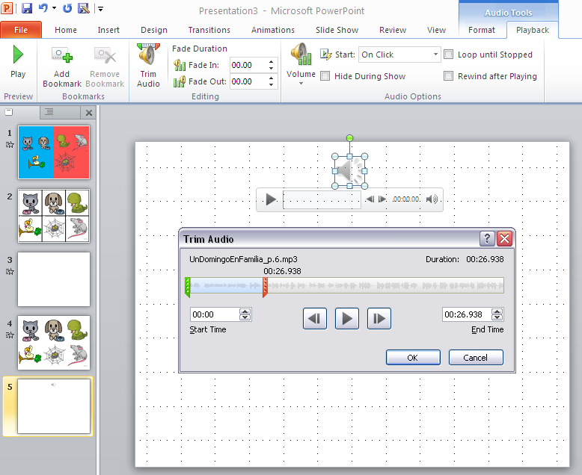
NB: If you do want to cue your listening by clicking action buttons, you can still only do this with WAV format. WAV audio takes up a lot more memory than MP3 and so will increase the overall size of your PowerPoint file. I no longer do this with my lesson writing as I think it is no longer a good use of time, given the new features of 2010, including the option to trim the audio within the PPT itself. This is how to do a simple audio file insert (either WAV or MP3).
Diagram 38
From the Insert menu, choose Audio and then Audio from File. Then you browse on your computer for the audio file and select insert in that dialogue box. The playback bar that appears will disappear in presentation mode, until you hover over the speaker icon, at which point it reappears to give you control over the playback.
You can isolate the part of the listening file you want to play. Click on the speaker icon and Audio Tools appears. Choose the Playback tab. From this menu/ribbon choose Trim Audio. Move either the start (green) or end (red) sliders to select the portion you want to play and then click ok. NB: It still plays all of it until you are in presentation mode.
Diagram 39

Slide 26
Advanced options for audio files
You can now choose to have your audio playing across more than one slide too.
Select the icon for the sound file on your slide.
From the Animations tab, locate the Effect Options button and click the More Arrow below it to Show Additional Effect Options. The Play Audio dialog box will appear.
Ensure the Effect tab is selected, and from the Stop playing section, select After and then use the up and down arrows in the slides field to indicate for how many slides the audio should play.
You can also decide how to start playing the audio file.
Follow steps 1 and 2 above.
Select the Timing tab.
From the Start drop-down menu select On Click.
From here you have two options. If you would like the sound to play by clicking anywhere on the screen, say after a title appears, then select Animate as part of click sequence. Just be sure if you select this option, that you properly arrange the sound on the Custom Animation pane so that it begins in the desired order. If you do not want the sound to start at a specific time, but rather by clicking a specific object, select Start effect on click of and then choose the object that will trigger the sound from the drop-down menu. NB: If you would like to be able to click the sound icon on your slide during the presentation to start the audio, select the Audio Settings tab and ensure that Hide audio icon during slide show is not selected.

Slide 27
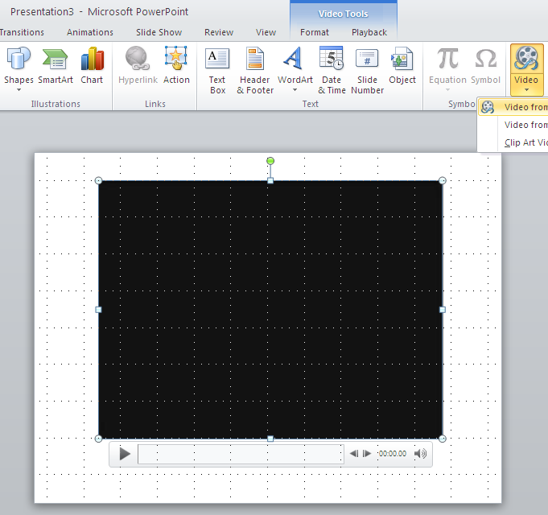
Inserting video into PowerPoint 2010
There are two ways to include video in your PowerPoint resources. You can embed or link to the video file. If you embed the video, your file size increases (a lot) but the video clip becomes part of the PowerPoint and cannot be lost. If you link to the video clip, the file size remains small but the link can be broken, (and if you email the PPT the video clip does not go too).
Diagram 40
To embed a video clip
There are 2 methods here. Either go from the Insert menu, choose Video and then Video from File. Then browse on your computer for the video file and select insert in that dialogue box. The playback bar that appears will disappear in presentation mode but reappear when you hover over the clip. You can then control playback in the same way as audio files.
You will often want to re-size the video. Use the corner handles to do this and position the video image where you want it on the slide.
Diagram 41
Alternatively, use a slide format like this and click the ‘insert media clip’ button. In this case the video is usually already the correct display size.

Slide 28
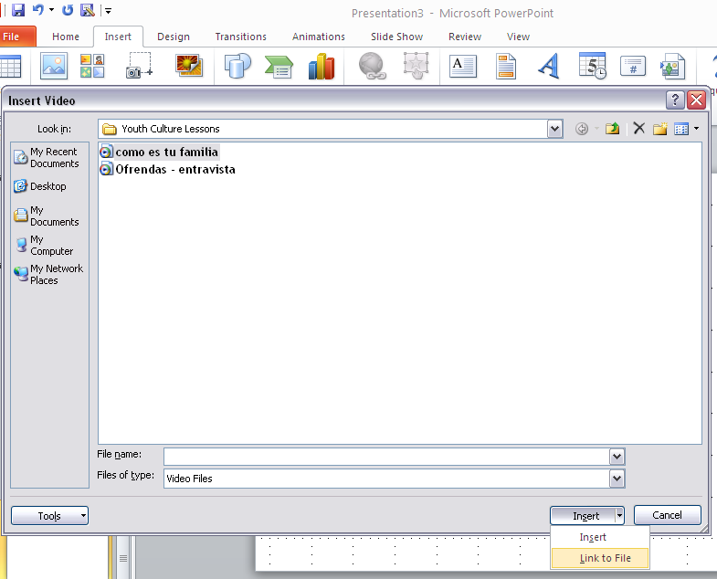
Diagram 42
To link to a media clip
Use either of the methods described already for embedding a video clip. In the dialogue box that appears when you locate your video file, instead of selecting ‘insert’ pull down the tab and choose ‘link to file’ instead. This gives you the same playback possibilities as embedding.
NB: To check your file size, go to Fill → Info → Properties
Playback / editing options
1. Trim Video
You can isolate the part of the listening file you want to play. Click on the video clip and Video Tools appears. Choose the Playback tab. From this menu/ribbon choose Trim Video. Move either the start (green) or end (red) sliders to select the portion you want to play and then click ok.
2. Start video
The default setting is to start playback ‘on click’ but you can select ‘start automatically’ if you click on the video clip, go to Video Tools, select Playback, then from video options pull down the tab next to ‘on click’ and select instead ‘start automatically’.
3. Play ‘full screen’
Just below the ‘on click’ tab is a box that you can check for ‘full screen’ playback.
Link to training video on inserting video into PowerPoint.
Notes:
http://office.microsoft.com/en-gb/powerpoint-help/introduction-2-59-RZ102673174.aspx?CTT=1&section=2 Training video on inserting video.

Slide 29
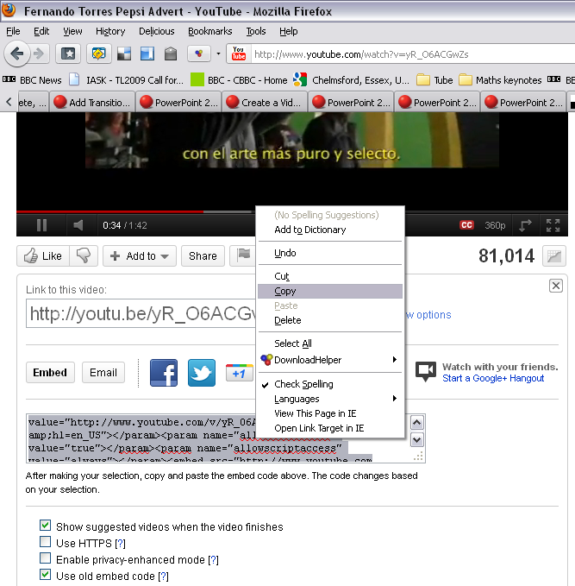
To insert a video from the internet e.g. YouTube
Diagram 43
Choose Insert and then Video. Pull down the tab and select Video from website. A dialogue box appears, into which you need to insert code. To get the code you need to go to the location where the video is stored.
NB: This does not embed the video, it links to it, to play directly from the website.
Diagram 44
Underneath the video clip on the website, select the Share button. Go down to the Embed option and check the ‘use old embed code’ box. Select and copy all of the code and paste it into the dialogue box in your PPT presentation. You will be able to control playback in the same way as all of the other options to insert media clips.
NB: You may still find it useful to download video from websites and for this I recommend RealPlayer or StreamTransport.

Slide 30
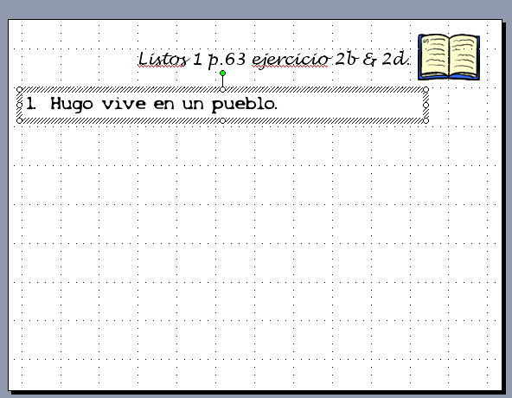
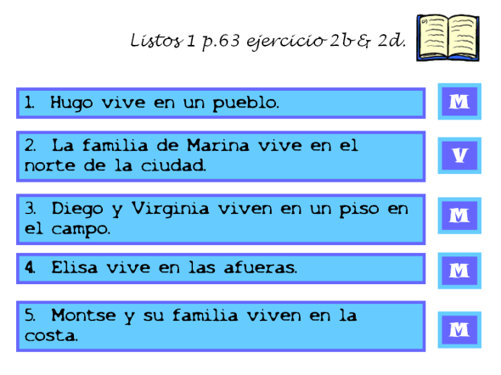
Section 4: Practising new language in reading
Reading activities can be presented using PowerPoint too. The advantages to this are that the whole text can be displayed for whole class work first, or to illustrate the activity or begin with an example. Various literacy or grammar focused activities can benefit from having a whole class large version of the text on display. In addition, the benefits to be gained from having the answers and marking scheme appear visually for the class are obvious. There are no particular new skills to learn for the making of reading activities, although as we have concentrated so far on inserting pictures and sound, it seems like a useful point to include some general pointers about inserting and animating text in PowerPoint.
1. Using a new slide with blank format, draw a text box by selecting Insert then Text Box and then clicking and dragging it out on your slide.
Diagram 45
Write the text of the question or statement into the box and select the font and size that you want. To add a colour fill to the box, select the text box and then click on the paint tin (top right) and select a colour in the usual way. If you want a coloured outline to your box, select the colour from the pen icon. Then copy and paste this text box, editing the text to create all the questions you want
As you can see, you do not have to type out the text, students can refer to the text book, it may be just the answers you want to focus their attention on using PowerPoint. The second slide shows you the finished activity. To make the True/False answer boxes appear, create them using a small text box, format them and then animate their appearance in the same way as you did for the pictures.
Diagram 46

Slide 31
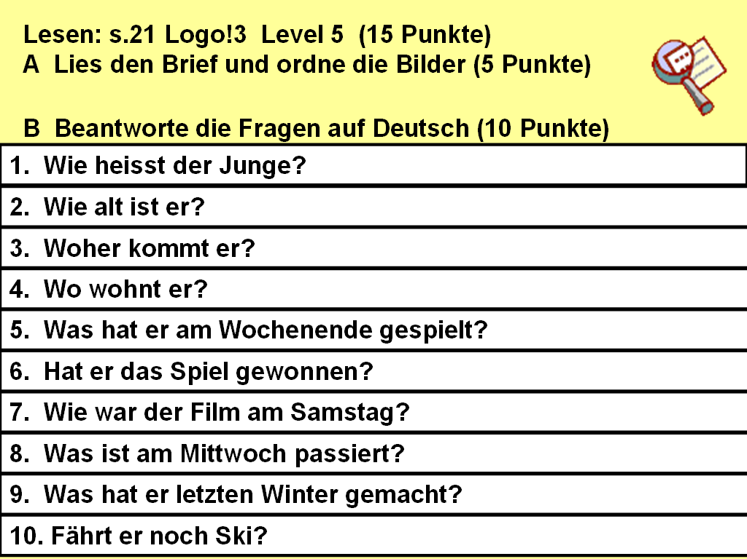
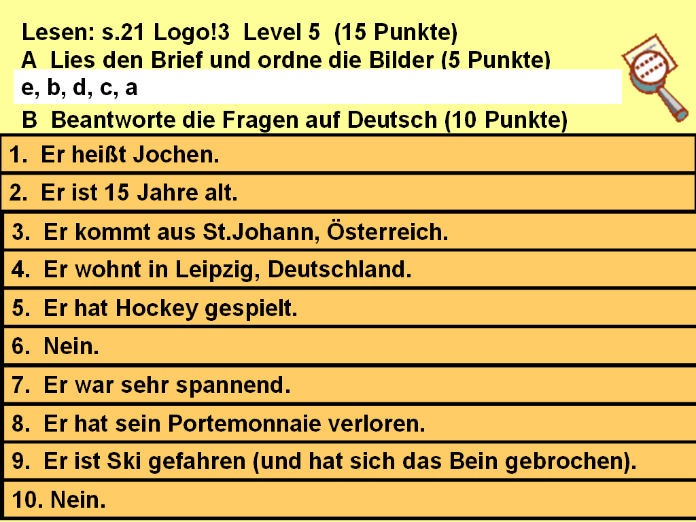
2. If you have questions in the TL (or English) that students need to answer, one neat way to present them is to have the answers appear over the top of the questions.
To do this, create the questions slide first. It is a good idea to save this slide as it is and make a duplicate to put the answers on as you may want to print the question sheet out and reduce to A5 size for the students.
Then on your duplicate slide, make a copy of the first text box and colour fill it a different colour. Type the answer in and animate it to appear. Then position the answer text box over the question one so that it fits exactly. Now do the same with the other boxes so that all the questions are covered by answers.
Diagram 47
Diagram 48
When you play the presentation, the questions will be on the slide and the answers will reveal themselves over the top on your mouse click.

Slide 32
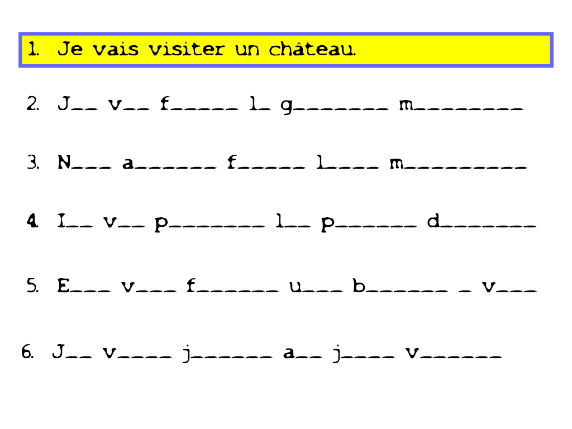
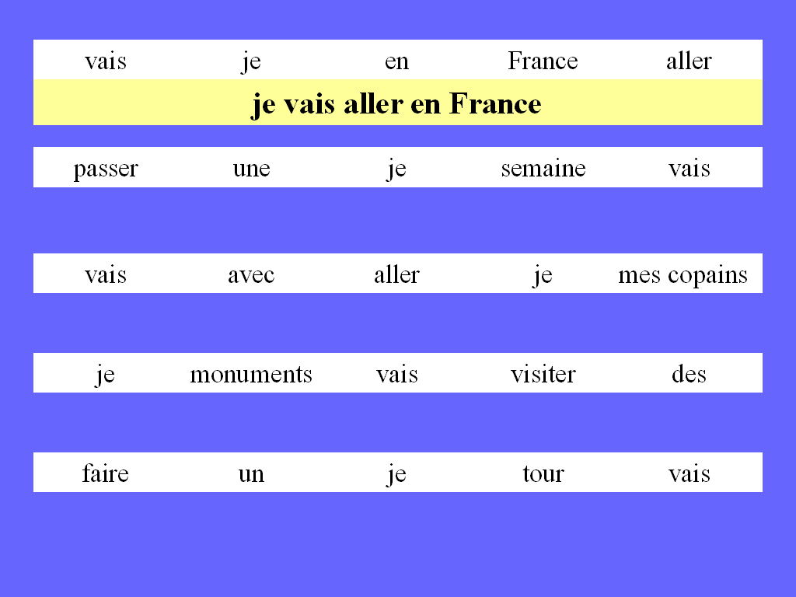
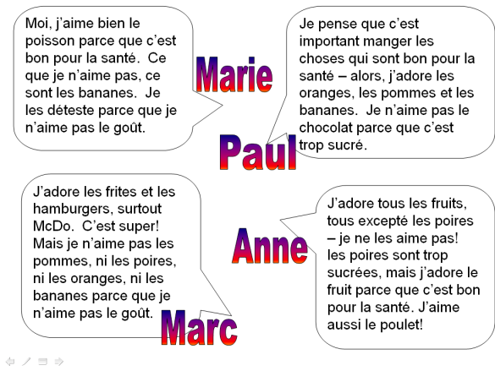
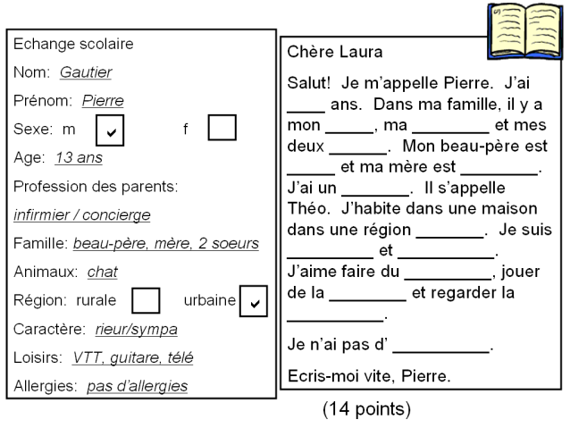
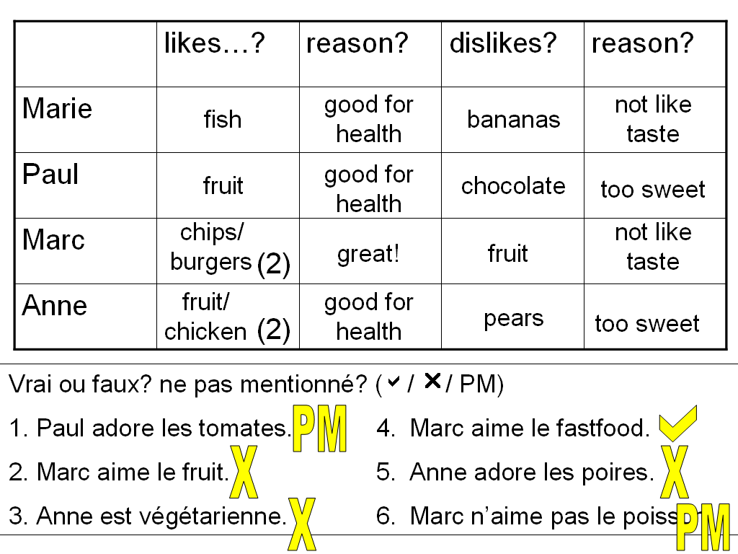
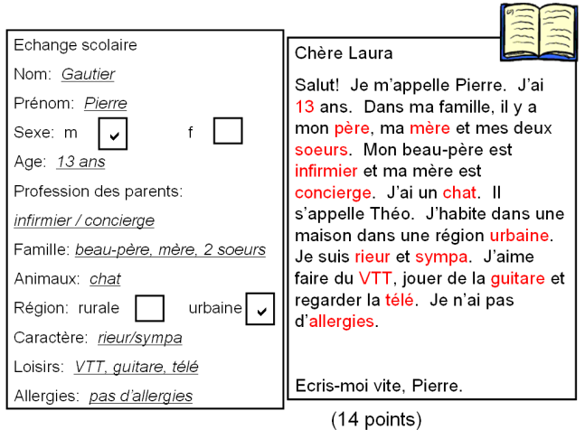
Diagram 49
3. These techniques can also be used to good effect for eliciting language orally from students, either by presenting the sentences mixed up, or just with the first letter of each word, and then having the full sentence appear over the top.
Diagram 50
Here are a few more examples of using reading slides in PowerPoint presentations. Where individual work is desired, these slides can be printed off and reduced to A5 size. If point 20 font size is used in the presentation, reduction to A5 works well for students to read.

Slide 33
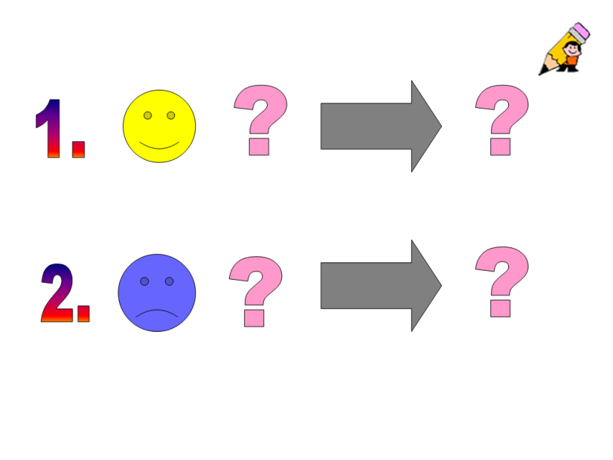
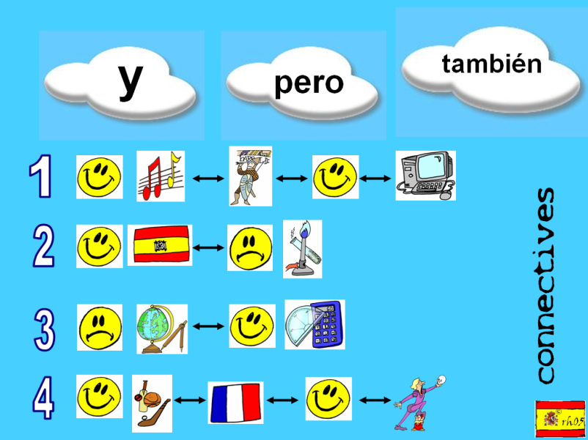
Section 5: Practising new language in writing
Finally, I have a few examples of how PowerPoint can be used to present, explain and shape writing activities to improve pupil achievement in and engagement with writing tasks.
Plenaries
Diagram 51
Here is one example of a slide used to elicit written opinions about food at the end of a lesson introducing and practising the new language. I sometimes do these plenaries using mini whiteboards, although they work equally well in exercise books. Students write something like:
1. J’aime l’ananas parce que c’est bon pour la santé.
2. Je déteste le lard parce que c’est trop gras.
Diagram 52
A further example of a plenary from a lesson practising opinions and school subjects. students had previously encountered these three connectives and were encouraged explicitly to use them to form longer sentences using the new opinions structures and school subjects.

Slide 34
2. Assessment for Learning
Diagram 53
Once per half-term, students complete a writing activity that is set up carefully and explained using a ‘tick grid’ of quality of language items that are appropriate for each level during each year of each key stage. The tick grid is used with students prior to completing the task to make explicit the aspects of language that would make an excellent answer.
We then use the tick grid to mark the first draft of the work. students complete a second draft of the piece, paying attention to those elements that they have not included or included unsuccessfully. Their second draft is then awarded a NC level or GCSE grade depending on the Key Stage.
This can be done with writing questions at all levels from beginners to A level.
Diagram 54
3. Showing pupil work
A further way to increase levels of engagement and improve performance in writing is to show scanned examples of pupil work, either from students within the class, or from a bank of excellent pupil work from the same year group or level that has been saved in a portfolio.
Diagram 55

Slide 35
1
Best new features
The Animation Painter is one of the new features in PowerPoint 2010. The Animation Painter allows you o copy the animation effects of one object (and all the settings applied to that animated object), to another object (or many objects) with a single click of the mouse on each new object. This feature is a real time saver . Select the slide which contains the animation you wish to copy.
Click on the Animations tab. Copy animation to ONE Object
1. Click on the object that contains the desired animation. 2. In the Advanced Animation section, click on the Animation Painter button. Note that the mouse cursor now changes to an arrow with a paint brush.
3. Click on the object to which you wish to apply this same animation.
This animation and all its settings has now been applied to the new object.
Copy animation to SEVERAL Objects
1. Click on the object that contains the desired animation. 2. In the Advanced Animation section of the ribbon, double click on the Animation Painter button. Note that the mouse cursor now changes to an arrow with a paint brush.
3. Click on the first object to which you wish to apply this same animation.
4. Continue to click on all objects that require the animation.
To turn the animation painter feature off, click the Animation Painter button once again.

Slide 36
2
Best new features
Convert your PowerPoint presentation to a video.
Why would you want to do this?
1. The WMV video file format can be read by most computers.
2. Any transitions, animations, sounds and narration will be embedded into the video.
3. The video can be published to a website or emailed. It is not editable, so the entire presentation will always remain as the author intended.
4. You can control the file size of the video by selecting appropriate options.
5. The targeted audience does not need to have PowerPoint installed on their computer in order to view the video.
How do you do it? 1. Choose File → Save & send→ Create a Video 2. Then choose your settings:
a. Computer & HD Displays - Use this default setting if you are going to display this slide show with a projector on a screen for an audience. b. Use Recorded Timings & Narrations - Either retain any timings you have added or the default settings will be assigned. c. Seconds to spend on each slide - By default this setting is 5:00 seconds. You may make a change the timing. d. To accept these settings click on the Create Video button.

