Slide 1


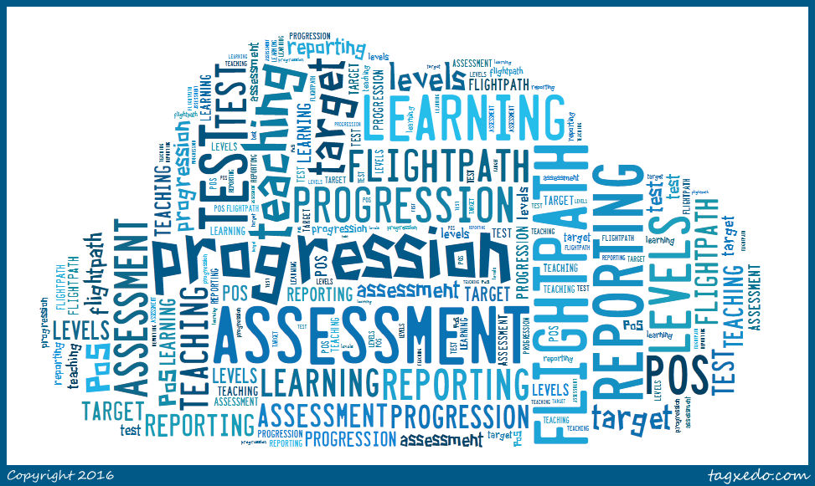
No more levels!
The opportunities for languages at KS2 and KS3
Notes:
No more levels! The opportunities for languages at KS2 and KS3
The combination of the new programmes of study at KS2 and KS3 and the removal of the previous NC KS3 assessment framework presents us with the ideal opportunity (and necessity!) to think carefully and critically about what we teach when, and how we will know what learners know at every stage along the way. This session sets out the main issues facing all languages teachers as we design a new assessment framework for languages in our own schools, and looks practically at how we might join up our thinking cross-phase provide progression wherever possible over the first seven years of compulsory language learning.
Starting from the key government messages about assessment, and outlining the range of possible approaches to life after levels, this workshop focuses on one specific example for languages, which measures progression from KS2 to KS4, whilst maintaining an emphasis on assessment for learning.
Timings and overview
Background
KS2 → KS3? (Speaking examples / Grammar examples) - Activity
Basis for my framework
Pupil-friendly versions of statements
Additional strands (Verbs / Vocabulary)
Sample tasks to level – Activity
Joining up practice - Transition

Slide 2
No more levels…
In May 2013, the Secretary of State announced: ‘as part of our reforms to the national curriculum, the current system of ‘levels’ used to report children’s attainment and progress will be removed. It will not be replaced.’

Slide 3
KS3: Assessment without NC Levels
All change…!
KS2: Languages statutory Y3 to Y6
KS4: New GCSE- new grading system / new level challenge
Notes:
When everything changes at once, it’s fairly interesting!
What is the constant that we can cling to in the face of this uncertainty?
We need some sort of anchor….

Slide 4
Aims for this session
Why we need a joined up approach
Examples (Grammar / Speaking)
Basis for the Steps framework
Pupil-friendly statements
Additional strands (Verbs and Vocabulary)
Sample tasks
Transition

Slide 5
New GCSE:
new grading system / new challenge
Notes:
The GCSE is getting harder. And for current Y9!
I think we are already working as hard as we can (and as smart as we can) at KS3/KS4.
We can’t just put all our hope on the fact that Controlled Assessments are going and we’ll get some teaching time back (nice as this will be!)
So we do need a longer road to GCSE. Yes, it will help if we see Years 7 – 11 as more joined up but If only we had a way of introducing language learning 4 years earlier so that they build up knowledge and skills earlier and for longer?!!!

Slide 6
Task 1
Sort the cards, putting the KS2 statements of attainment on the left and their matching KS3 statement to the right.
Use the order: listening, speaking, reading, writing, grammar
Notes:
There are 8 cards for KS2 (slide 1) and 8 for KS3 (slide 2).
Copy and cut onto card (use same colour for both sets or the task will not be worth doing).
Ask teachers to put the KS2 cards on the LHS and their matching KS3 statement on the RHS.
Use the standard order of
listening
speaking
reading
writing
grammar

Slide 7
Listening listen attentively to spoken language and show understanding by joining in and responding explore the patterns and sounds of language through songs and rhymes and link the spelling, sound and meaning of words Speaking engage in conversations; ask and answer questions; express opinions and respond to those of others; seek clarification and help* speak in sentences, using familiar vocabulary, phrases and basic language structures develop accurate pronunciation and intonation so that others understand when they are reading aloud or using familiar words and phrases* present ideas and information orally to a range of audiences* Reading read carefully and show understanding of words, phrases and simple writing appreciate stories, songs, poems and rhymes in the language broaden their vocabulary and develop their ability to understand new words that are introduced into familiar written material, including through using a dictionary Writing write phrases from memory, and adapt these to create new sentences, to express ideas clearly describe people, places, things and actions orally* and in writing Grammar understand basic grammar appropriate to the language being studied, such as (where relevant): feminine, masculine and neuter forms and the conjugation of high-frequency verbs; key features and patterns of the language; how to apply these, for instance, to build sentences; and how these differ from or are similar to English. | Listening listen to a variety of forms of spoken language to obtain information and respond appropriately transcribe words and short sentences that they hear with increasing accuracy Speaking initiate and develop conversations, coping with unfamiliar language and unexpected responses, making use of important social conventions such as formal modes of address express and develop ideas clearly and with increasing accuracy, both orally and in writing speak coherently and confidently, with increasingly accurate pronunciation and intonation Reading read and show comprehension of original and adapted materials from a range of different sources, understanding the purpose, important ideas and details, and provide an accurate English translation of short, suitable material read literary texts in the language, such as stories, songs, poems and letters, to stimulate ideas, develop creative expression and expand understanding of the language and culture Writing write prose using an increasingly wide range of grammar and vocabulary, write creatively to express their own ideas and opinions, and translate short written text accurately into the foreign language. Grammar identify and use tenses or other structures which convey the present, past, and future as appropriate to the language being studied use and manipulate a variety of key grammatical structures and patterns, including voices and moods, as appropriate develop and use a wide-ranging and deepening vocabulary that goes beyond their immediate needs and interests, allowing them to give and justify opinions and take part in discussion about wider issues use accurate grammar, spelling and punctuation.
KS2
KS3
Notes:
KS2 on the left and KS3 on the right
Adapted to show more clearly the continuity between KS2 and KS3.
NB: the text is exactly the same as the PoS.

Slide 8
Listening
1) Listen and show understanding by joining in and responding
2) Link the sound, spelling and meaning of words
Speaking
1) Ask and answer questions
2) Express opinions
3) Ask for clarification and help
4) Speak in sentences
5) Describe people, places, things
Grammar
1) Gender of nouns
2) Singular and plural forms
3) Adjectives (place and agreement)
4) Conjugation of key verbs
Reading
1) Read and show understanding of phrases and simple texts
2) Read aloud with accurate pronunciation
3) Use a dictionary
Writing
1) Write phrases from memory
2) Adapt phrases to create new sentences.
3) Describe people, places, things
Notes:
KS2 PoS
Despite (or actually because of) its brevity, the PoS document is very dense.
Here I’ve extracted the key elements further and categorised to achieve greater clarity.
Let’s imagine that students actually arrived with this knowledge for a moment…

Slide 9
Linguistic knowledge
 | French | Spanish | German
Gender Awareness of gender as a concept which will be new to most pupils as well as explicit teaching of definite and indefinite articles. | le (m), la (f), les (plural), L’ (before a vowel). un (m), une (f), des (some) | el (m), la (f), los (m plural), las (f plural) un (m), una (f), unos (m some), unas (f some) | der/ den* (m), die (f), das (n), die (plural) ein/ einen* (m), ein (n), einige (some) used in the accusative / object (row 2) case e.g Ich habe einen Hund.
Nouns Recognition of nouns in the target language. | - | - | Nouns in German have capital letters.
Plurals An ability to recognise nouns in the plural, both by the article and the noun ending. | Most plurals are formed by adding an –s. For example, une vache>des vaches "cows" However, the final –s in French plural nouns is not usually pronounced. | Most plurals are formed by adding an –s. Sometimes there is a spelling change, e.g. pez > peces. | The words der/das/die all become ‘die’ in the plural. For words that end in –i or –o, or are French or English in origin, add a final –s, e.g. Kulis, Kinos, Restaurants, Tickets. der/das words that end in -el or -en or -er do NOT change spelling in the plural, e.g. Spiegel, Mädchen, Manager. Exceptions have just to be learnt!
Notes:
This is an extract from Section 3 of the ALL Connect Transition Toolkit, shortly to be available to all, on the ALL website. This section looks at Key linguistic knowledge at KS2.
Within the toolkit there are links to online resources on different wikis, that help to support the teaching of specific elements.
For example, on this page there’s a link to several resources on the Grammar wiki, one of which is a KS2 Spanish resource on pencil case items.
Give out Handout: Task 2 KS2 Spanish Pencil Case Indefinite Articles and Task 2b Linguistic knowledge analysis sheet

Slide 10
Task 2
Look at the 3 activity sheets A, B, and C.
For each one, discuss and note down:
a) what the task involves, and
b) the prior learning needed before completing it.
Then discuss what the next learning steps might be.
Look at the PoS statements for KS2 and decide which are being covered here.
Finally, discuss the implications for teachers at KS3 if pupils have the linguistic knowledge to:
a) complete these tasks, and
b) apply the learning to other topic areas (e.g. family, pets, food, clothes, shapes etc.)

Slide 11
Task 2: Linguistic analysis
 | Description of task | Necessary prior learning | Points for clarification?
A
B
C
What might the next learning steps be?
What are the implications for KS3 teachers?

Slide 12
Task 2: Linguistic analysis
 | Description of task | Necessary prior learning | Points for clarification?
A
B
C
What might the next learning steps be?
What are the implications for KS3 teachers?
Word level reading task - match written noun + indefinite article to picture.
Pupils will need to be familiar with: a) the sound-meaning relationship of all these words
b) the written form of these words
c) how these specific words are pronounced
d) the key sound-writing links in Spanish (i.e. phonics)
e) the fact that there are two words for ‘a’ and two words for ‘some’
Q: Could this be the 1st time pupils see the words in writing? A: Possibly but more usually they would see the written word as part of the presentation and practice phase.
Simple sentence level reading task – pick out and draw 3 nouns from each text. Guided writing – adapting the model sentence.
It would make sense if pupils had practised speaking in sentences, too, i.e. orally producing ‘In my pencil case I have a …, a… and a … (It is good if they do the punctuation physically – saying ‘coma’ and drawing one in the air, using index fingers to make a + sign for ‘y’ and gesturing a point for full stop (punto). There are no pictures to prompt them now, so they need to know the words more securely. They don’t need to know spelling for this task, as all the words needed for writing are on the page, except for ‘lápices’ (plural of lápiz).
Simple sentence level writing task, following a model sentence.
Pupils need to know how to spell the individual pencil case items, and they need to know the correct work for ‘a’ or ‘some’.
This task would follow lots of writing practice (on sleeves, in the air, on mini-whiteboards, as well as other speaking, listening and reading activities).
1. Colours to describe the items / 2. The definite articles / 3. Work on pluralising nouns
4. new topic areas with other nouns, in sentences using tengo / no tengo and later with other verbs (como / llevo / veo)
1. If we don’t know, we could teach these exact same nouns again from scratch as though for the first time
2. Even if individual words have been forgotten, the awareness that there are two genders, two words for ‘a’ and ‘some’, same word order in simple sentences Subject – Verb – Object etc.. Is very significant
3. If we wanted to do work on pencil case nouns (or other familiar KS2 nouns), how might we do it differently now at KS3?
Notes:
Feedback: 5 minutes
This slide is to support feedback and discussion on Task 2.

Slide 13

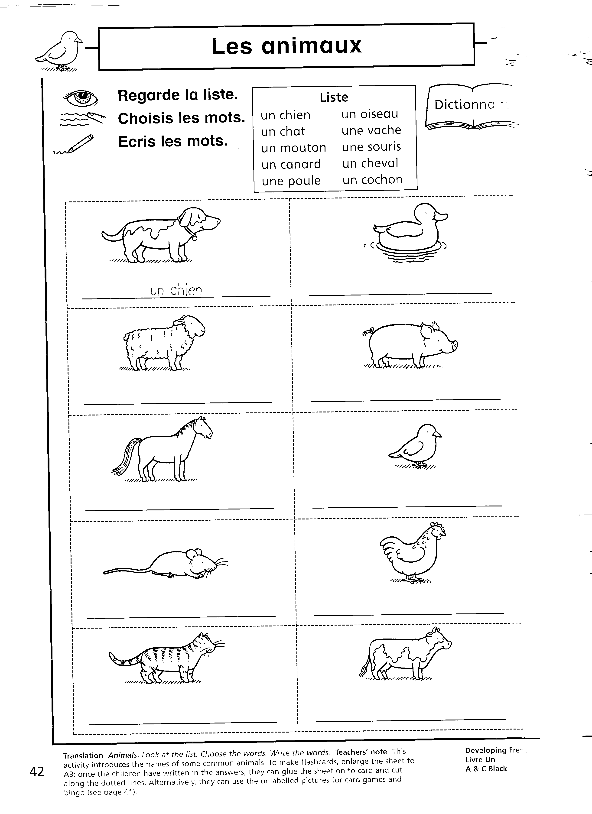

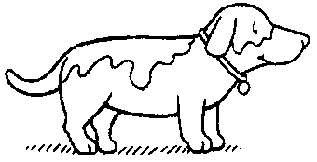


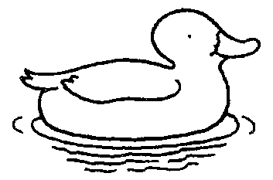


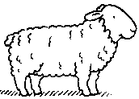

Nouns → Verbs
Fui a la tienda de animales y compré …
Notes:
Let’s continue to think about the implications for KS3 teaching for a moment.
For example, if we imagine that this is the sort of activity that pupils do at KS2 to build up a series of nouns in their memory, at KS3 we could consider putting much more of a focus on verb structures in our oral practice.
As the toolkit suggestion: “Instead we would ask pupils how many sentences they can make with the word “banane”. “J’aime les bananes.” “J’ai une banane.” “Les bananes sont jaunes”, “Je n’ai pas de banane aujourd’hui.” “J’ai mangé une banane.” “Voici une banane.” “J’ai mangé ta banane.”

Slide 14

Task 3
KS3 speaking
Think about language you know:
  Questions
  Statements (past, present, future, conditional)
  Negative statements
  Opinions
You have 60 seconds
In the target language…
Take it in turns
Say as many sentences about an apple, or apples as you can – from any of the categories - to your neighbour
E.g. I like .. , How much is ..?
Notes:
Something like this, focused much more on the verbs.
Look at the KS3 grammar PoS statement - it is very verb / tense oriented.

Slide 15
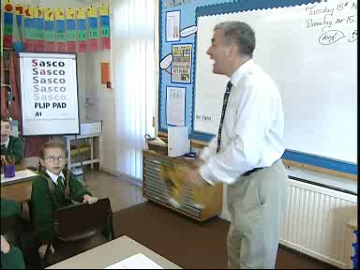
Conversations at KS2
Notes:
Video = 40 seconds
Questions (and answers)
engage in conversations; ask and answer questions; express opinions and respond to those of others; seek clarification and help*

Slide 16

Conversations at Y7
Video extract from Pearson KS3 Toolkit http://www.rachelhawkes.com/
Notes:
Play from the beginning up until 4 mins.
One very useful thing to bring out here is the swapping in and out of task to real interaction, ensuring that the students know what the questions mean and can answer them.
The teacher also puts in some useful follow up questions to develop spontaneity and speed of response.

Slide 17
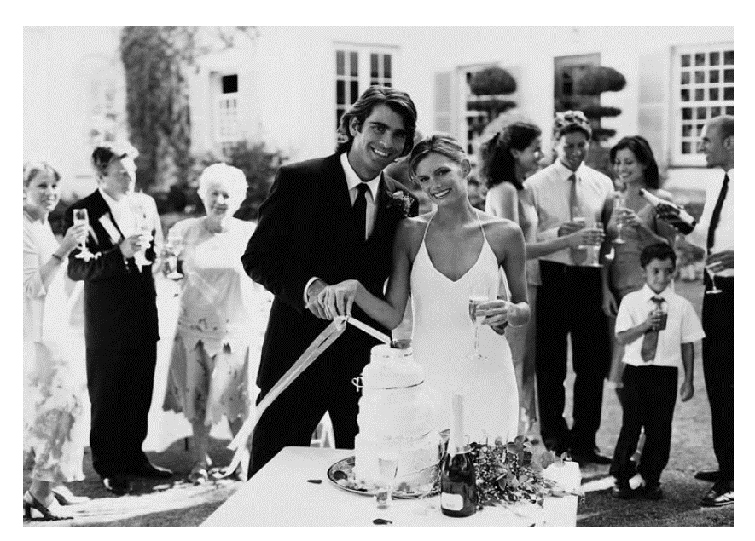

Conversations at Y11
¿Qué hay en la foto?
¿Qué tiempo hace?
Da detalles físicos
¿Están contentos? ¿Cómo lo sabes?
¿Dónde está(n)?
¿Qué están haciendo?
¿Por qué crees esto?
S-H-E
P-A-L-M-(W)
Notes:
Point – Evidence/Explanation
or
SHE – Statement / Hypothesis / Evidence/Explanation
Physical description
Action
Location
(Weather)
Mood
For students
AQA French SAMS DRAFT 1
Your teacher will ask you the following three questions and then two more questions which you have not prepared.
• Qu’est-ce qu’il y a sur la photo ?
• Tu veux te marier un jour ? Pourquoi/pourquoi pas ?
• Tu t’entends bien avec ta famille ? Pourquoi/pourquoi pas ?
For teachers
The maximum time for this part of the test is three minutes but may well be less than that for some students. ( = maximum 36 seconds to answer each bullet)
Students may use any notes they have made during the preparation time.
You begin the conversation by asking the student the first question ‘Qu’est-ce qu’il y a sur la photo ?’ You then ask the remaining four questions in order. You may paraphrase the questions provided the same meaning is maintained, and you may repeat or paraphrase a question that the student does not understand. You should allow the students to develop their responses as well as they are able. However, do not go over the maximum time of two minutes for the questions and answers on the Photo card.
Qu’est-ce qu’il y a sur la photo ?
• Tu veux te marier un jour ? Pourquoi/pourquoi pas ?
• Tu t’entends bien avec ta famille ? Pourquoi/pourquoi pas ?
• Décris ton/ta meilleur(e) ami(e).
• Qu’est-ce que tu fais avec tes amis le week-end ?

Slide 18

Aims for this session
Why we need a joined up approach
Examples (Grammar / Speaking)
Basis for the Steps framework
Pupil-friendly statements
Additional strands (Verbs and Vocabulary)
Sample tasks
Transition

Slide 19
Expected Progress and Guided Learning Hours
Year | Hours of tuition | Cumulative hours | CEFR Level
3 | 19* | 19
4 | 19* | 38
5 | 38* | 76
6 | 38* | 114 | A1
7 | 95 | 209 | A2
8 | 95 | 304 | A2+
9 | 95 | 399
10 | 95 | 494 | B1
11 | 95 | 589
12 | 190 | 779 | B2
13 | 190 | 969 | C1
*Figures based on 30 minutes per week at Y3 and Y4, 60 minutes at Y5 and Y6
Notes:
The first thing I looked at was the Common European Framework. All other European countries use this to measure language learning over time.
There are some stable guided learning hours indicators which are useful in terms of setting out what is reasonable and likely from school-based language learning.
I set these hours up against the language learning allocations in two of the schools I work in, to get an idea.
We’ll come back to how I used this later, but one thing I want us to take from this slide: We are going to find it much easier to get students to the new GCSE if the statutory learning is in place at KS2…
The GLH were helpful in deciding the approximate progress we can expect during each key stage. All primary and secondary schools vary in their allocation of curriculum time for language learning, but here I have taken as a starting point 30 minutes per week in Years 3 and 4, 60 minutes in Years 5 & 6, and 150 minutes per week across KS3 and KS4. (This equates to 3 x 50 minute lessons across KS3 and KS4. This is a rough average. In fact, our dual linguists have less and our single linguist classes have slightly more than this.)
We can see from the table that, with this number of GLH, we might reasonably expect learners to achieve at least A1 competence by the end of KS2, and at least A2 by the end of Y8 (assuming the curriculum allocation hours given), making significant progress towards B1 but not reaching it by the end of Y9. I used this information to peg the key progression points A1 and A2 within the new framework.
A1 = Step 4 on my framework

Slide 20
KS3 Assessment
Life after levels …..
Challenges for languages assessment:
Accurate description of progression within the subject
Joined up approach across KS2,3 and 4
Assess knowledge (conceptual / content) and skills
Consistent with whole school approach

Slide 21
Whole school approach
schools are free to determine their own approach to assessment, data collection, achievement monitoring and reporting to parents
AND:
must publish their assessment policy for KS3 on their own school websites by September 2015?
individual subject specialists to describe progression within our own subjects

Slide 22

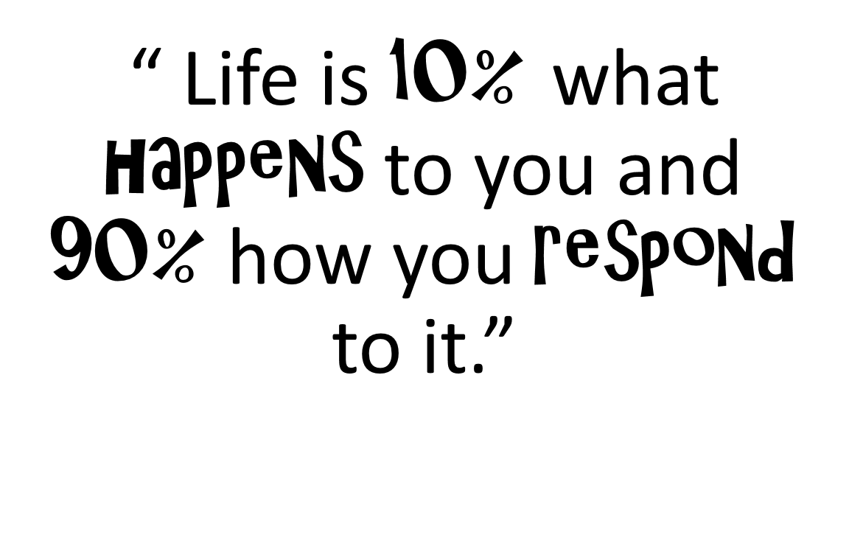

Slide 23
A new assessment framework
based on the requirements of the new Programmes of Study at KS2 and KS3
drawing also on
the CEFR
the Languages Ladder
the KS2 and KS3 Frameworks
attempting to avoid some of the pitfalls of the old NC Levels

Slide 24
A new assessment framework
provides descriptors of emerging linguistic competence, as evidenced through
performance in each of the 4 skills
applied use of grammatical structures
supporting vocabulary strand which describes a repertoire of knowledge

Slide 25
One thing I have tried to avoid is providing descriptors that can be reduced to a list of ‘things to do to reach the next level’.
There is a fine line between description and prescription.
That is not to say that teachers and learners should not look at the descriptors for the next step to help inform their target-setting, but that the descriptors do not provide an itemised checklist of things learners need to ‘do’ to move up to the next level.

Slide 26
Framework structure
10 language learning steps
Spaced out over the 7 years of KS2 and KS3
Year | 3 | 4 | 5 | 6 | 7 | 8 | 9
Steps range KS2 & KS3 | 1-2 | 1-3 | 2-4 | 2-4(+) | 3-6 | 5-8 | 6-10

Slide 27
Expected Grades at GCSE
Predicted range of future performance in the new GCSE exams (first teaching September 2016 to current Y9).
Year 9 Step | 6 | 7 | 8 | 9 | 10
new GCSE predicted grade range | 1-4 | 4-6 | 6-8 | 7-9 | 8-9

Slide 28
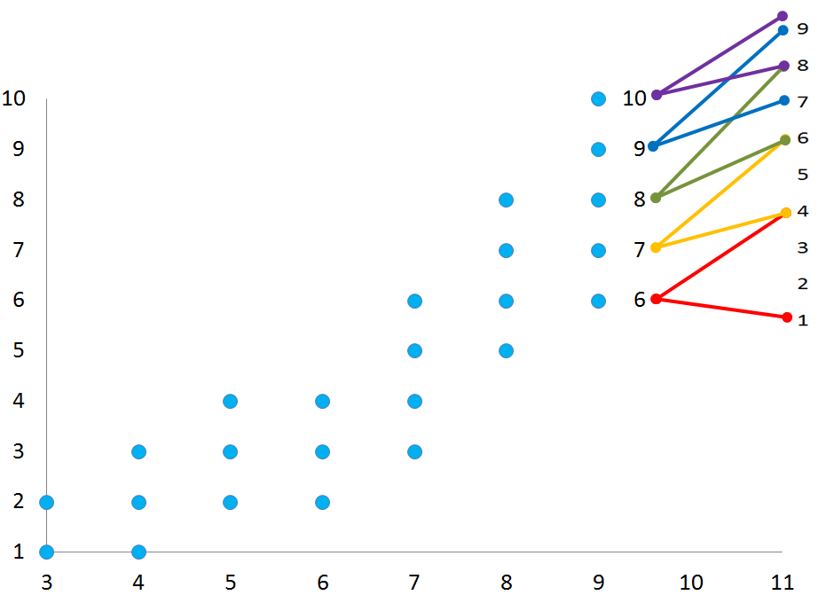
A realistic flightpath…
GCSE grades
STEPS
Academic year

Slide 29
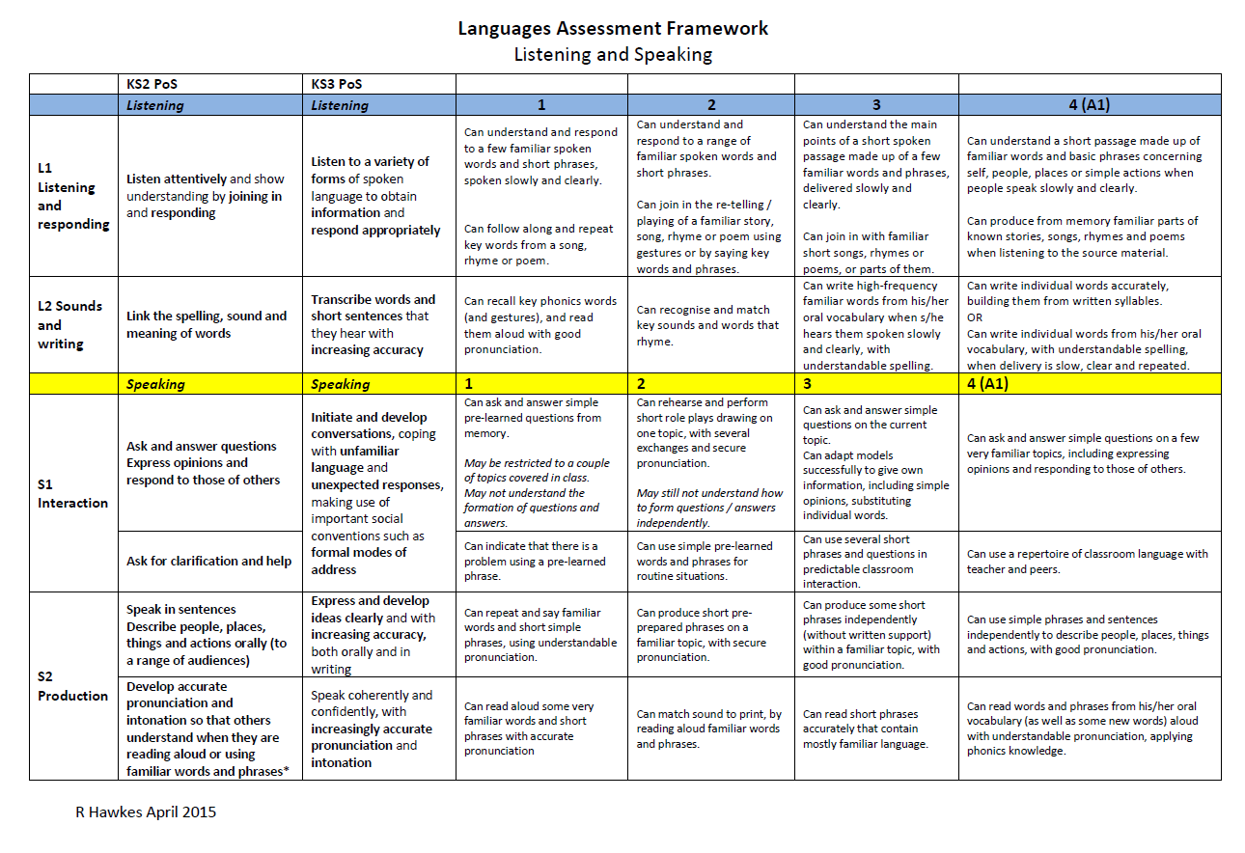
Notes:
Direct people to Handout 2

Slide 30
Aims for this session
Why we need a joined up approach
Examples (Grammar / Speaking)
Basis for the Steps framework
Pupil-friendly statements
Additional strands (Verbs and Vocabulary)
Sample tasks
Transition

Slide 31
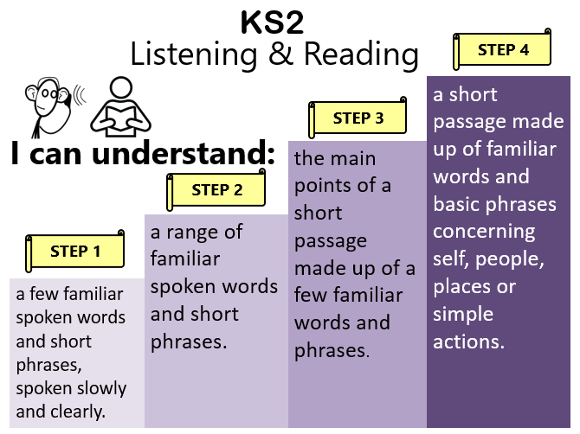
Reporting
Notes:
Assessment and reporting : 10 minutes maximum
These simplified assessment posters have been created using the KS2 PoS attainment statements, the KS2 Framework for Languages, and the Common European Framework of Reference (CEFR). Step 4 has been aligned with A1 on the CEFR, which anchors progression within an already existing, well-respected and widely-used model of language competence. The skills of reading and listening have been combined, as have the grammar and vocabulary strands, whilst speaking remains separate from writing. The idea is for pupils to recognise what they can already do, as well as what they will be able to do next. If pupils are able to do securely what is described for Step 4 in each strand, they will have fulfilled the expectations of the KS2 Programme of Study. These posters are available on the Transition and Progression wiki and are fully editable

Slide 32

KS2
Speaking
STEP 4
STEP 3
ask and answer simple questions on a few familiar topics and in classroom talk, giving opinions, using simple phrases and sentences independently, with good pronunciation, expressing opinions and responding to those of others.
I can:
STEP 2
ask and answer simple questions on the current topic and for classroom talk, producing short phrases, including opinions, from memory, with good pronunciation.
STEP 1
rehearse and perform short role plays drawing on one topic, with several exchanges and secure pronunciation, and use simple pre-learned words and phrases for routine situations.
ask and answer simple pre-learned questions from memory.

Slide 33
Year 7
Speaking
STEP 6
STEP 5
interact across three-four topics and in classroom talk, adapting and re-combining pre-learnt language to produce spontaneous exchanges, including forming some questions, with some pauses for thinking.
I can:
STEP 4
ask and answer an increasing range of questions in topic-based and classroom interaction, adapting familiar questions, and can give information confidently from two-three recent topics.
STEP 3
ask and answer simple questions on a few familiar topics and in classroom talk, giving opinions, using simple phrases and sentences independently, with good pronunciation, expressing opinions and responding to those of others.
ask and answer simple questions on the current topic and for classroom talk, producing short phrases, including opinions, from memory, with good pronunciation.

Slide 34
Year 8
Speaking
STEP 8
take part in multi-exchange conversations on familiar topics, including those covered in previous years, constructing questions independently and using a variety of structures, with more frequent pauses with less predictable interactions.
STEP 7
I can:
interact confidently within familiar topics and in classroom talk, asking questions independently, and can express information in more than one time frame, without reference to notes, with some hesitation and/or inaccuracy.
STEP 6
STEP 5
interact across three-four topics and in classroom talk, adapting and re-combining pre-learnt language to produce spontaneous exchanges, including forming some questions, with some pauses for thinking.
ask and answer an increasing range of questions in topic-based and classroom interaction, adapting familiar questions, and can give information confidently from two-three recent topics.

Slide 35
Year 9
Speaking
STEP 10
STEP 9
STEP 8
engage in longer stretches of unplanned conversation on the full range of KS3 topics, showing the ability to cope with unexpected questions or responses, whilst still pausing and/or making errors when trying out more ambitious language.
I can:
initiate and ask a range of questions confidently and appropriately to extend conversations (2-3 minutes) and can give more developed responses on a range of topics, which go beyond personal, everyday issues.
STEP 7
take part in multi-exchange conversations on familiar topics, including those covered in previous years, constructing questions independently and using a variety of structures, with more frequent pauses with less predictable interactions.
STEP 6
interact confidently within familiar topics and in classroom talk, asking questions independently, and can express information in more than one time frame, without reference to notes, with some hesitation and/or inaccuracy.
interact across three-four topics and in classroom talk, adapting and re-combining pre-learnt language to produce spontaneous exchanges, including forming some questions, with some pauses for thinking.

Slide 36
Aims for this session
Why we need a joined up approach
Examples (Grammar / Speaking)
Basis for the Steps framework
Pupil-friendly statements
Additional strands (Verbs and Vocabulary)
Sample tasks
Transition

Slide 37
Customising the framework
From the SOW:
1) a list of 200 non-cognate words for each language taught
2) an overview list of the main topics and sub-topics to be learnt throughout the key stage
3) a list of the types of text to be included in listening and reading tasks

Slide 38
Customising the framework
From the SOW:
4) a list of the grammatical structures to be learnt, including when they are first introduced, subsequently re-used, and when independent use is expected.
(grammar strand included within the framework itself is not as generic as it might at first sight appear, being informed by the KS2 and KS3 Spanish schemes of work in use in our schools).

Slide 39
Checklist
Described progression in my subject (from KS2 – KS4)
Cross-referenced with a recognised progression framework that has guided learning hours
Integrated that progression map into the new whole school assessment framework, which could involve:
Breaking down overall progression into equal ‘steps’ with a notion of progress expected for the ‘more able, average and less able’ student over each year
Designing regular assessments that ‘test’ whether students have made (more / less than) expected progress
Setting assessments that rank students by percentiles that in turn generate an assessment of + = - (or verbal equivalent)
Generating targets and flight paths??!!

Slide 40
Aims for this session
Why we need a joined up approach
Examples (Grammar / Speaking)
Basis for the Steps framework
Pupil-friendly statements
Additional strands (Verbs and Vocabulary)
Sample tasks
Transition

Slide 41
Task 4
Look at the KS2 writing portfolio, then the baseline assessments (October Y7), the linguistic challenge and the spring term writing tasks.
Discuss in groups.

Slide 42
Aims for this session
Why we need a joined up approach
Examples (Grammar / Speaking)
Basis for the Steps framework
Pupil-friendly statements
Additional strands (Verbs and Vocabulary)
Sample tasks
Transition

Slide 43
Transition
“the introduction of compulsory language learning has not yet stimulated increased contact between language teachers in state primary and secondary schools.”
p.69, Language Trends Survey 2015

Slide 44

It’s good to talk!
It’s bad not to talk!
Notes:
Just rephrasing ‘It ‘s good to talk’ to ‘It’s bad not to talk’ can subtly alter the way we think about this.
There’s no doubt that there are both elements of carrot (reward) and stick (negative consequences) to the issue of KS2 – KS3 languages transition.
It seems clear that, at the moment, the factors compelling us to focus our energies on transition in a concerted and consistent way are not sufficient.
So, perhaps we need to consider a little more carefully what happens if we don’t talk…

Slide 45
Transition
How do we (best) assess on transition going forward?
A piece of writing produced in the summer term sent up to the Y7 teacher
A language specific baseline assessment in September of Y7
A non-language specific assessment in September of Y7

Slide 46
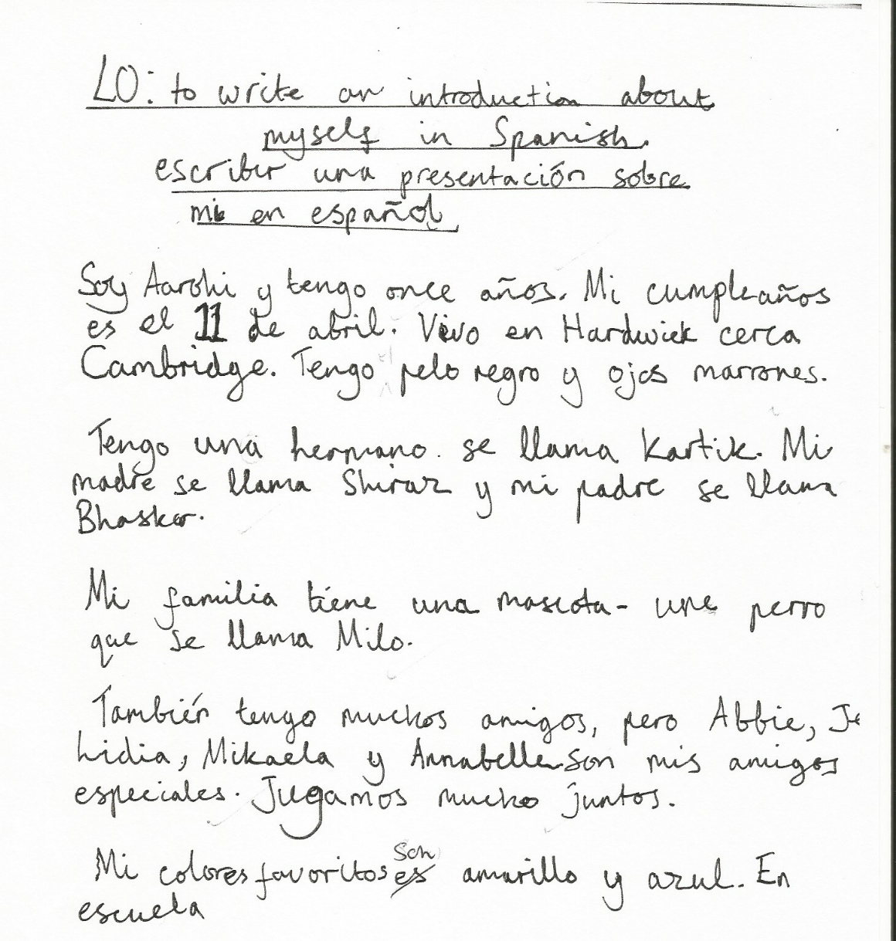
Y6 writing
Notes:
Give out the KS2 Transition Writing assessment handout.

Slide 47
Aims for this session
Why we need a joined up approach
Examples (Grammar / Speaking)
Basis for the Steps framework
Pupil-friendly statements
Additional strands (Verbs and Vocabulary)
Sample tasks
Transition

Slide 48
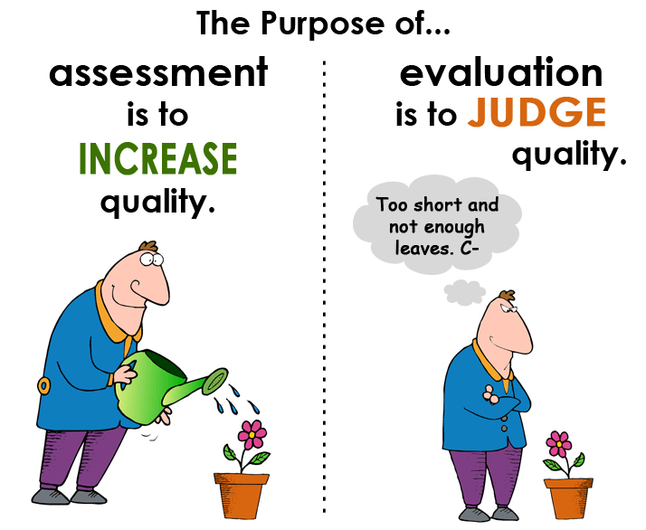
Let’s not forget…
http://www.rachelhawkes.com/PandT/Assessment_2015/Assess2015.php

Slide 49
What next?
Visit the ALL Connect Blog: allconnectblog.wordpress.com
KS2 modules: on Grammar, Speaking, Writing & Progression
KS2/3 module: on Transition, and
KS3 modules: on Literature, Spontaneous Speaking, Grammar & Translation
To these, in year 2 have been added:
KS2/3 module: Transition Toolkit
KS2 module: Coordinator’s Handbook.
ALL Connect has also created new interactive wikis, allowing teachers to upload examples of their own resources, and download further support materials:
Literature Wiki: all-literature.wikidot.com
Speaking Wiki: all-speaking.wikidot.com
Grammar Wiki: all-grammar.wikidot.com
Writing & Translation Wiki: all-writingtranslation.wikidot.com
Progression & Transition Wiki: all-progressiontransition.wikidot.com
Notes:
Access the material online for yourself and/or for your department

Slide 50
No more levels!
The opportunities for languages at KS2 and KS3
Notes:
No more levels! The opportunities for languages at KS2 and KS3
The combination of the new programmes of study at KS2 and KS3 and the removal of the previous NC KS3 assessment framework presents us with the ideal opportunity (and necessity!) to think carefully and critically about what we teach when, and how we will know what learners know at every stage along the way. This session sets out the main issues facing all languages teachers as we design a new assessment framework for languages in our own schools, and looks practically at how we might join up our thinking cross-phase provide progression wherever possible over the first seven years of compulsory language learning.
Starting from the key government messages about assessment, and outlining the range of possible approaches to life after levels, this workshop focuses on one specific example for languages, which measures progression from KS2 to KS4, whilst maintaining an emphasis on assessment for learning.
Timings and overview
Background
KS2 → KS3? (Speaking examples / Grammar examples) - Activity
Basis for my framework
Pupil-friendly versions of statements
Additional strands (Verbs / Vocabulary)
Sample tasks to level – Activity
Joining up practice - Transition

Slide 51


Year 7
Listening & Reading
STEP 6
passages of approx. 50 words, containing predictable information drawn from several familiar topics, and can infer meaning of some unfamiliar language, translating individual words and short phrases into English.
STEP 5
I can understand:
the details in a short passage on a few familiar topics with predictable information contained in simple sentences with mostly familiar language, and can pick out and translate from written text individual words into English.
STEP 4
a short passage made up of familiar words and basic phrases concerning self, people, places or simple actions.
STEP 3
the main points of a short passage made up of a few familiar words and phrases.

Slide 52
Year 8
Listening & Reading
STEP 8
longer passages of approx. 100 words, which may contain a few unpredictable elements, including a range of structures, and drawn from several topics including those less recently studied, and can cope with some unfamiliar language in a variety of text types.
STEP 7
I can understand:
passages of approx. 80 words, containing predictable information from four-five topics including a range of structures, and can infer meaning in some authentic and/or adapted texts, translating short phrases into English.
STEP 6
STEP 5
passages of approx. 50 words, containing predictable information drawn from several familiar topics, and can infer meaning of some unfamiliar language, translating individual words and short phrases into English.
the details in a short passage on a few familiar topics with predictable information contained in simple sentences with mostly familiar language, and can pick out and translate from written text individual words into English.

Slide 53
Year 9
STEP 10
Listening & Reading
STEP 9
STEP 8
extended, varied passages of approx. 200 words, which contain unpredictable elements, time frames, a range of structures, and drawn from any topics previously studied, and can translate short passages into English.
I can understand:
longer, varied texts of approx. 150 words, which may contain some unpredictable elements, different time frames and a range of structures, and can translate shorts extracts into English.
STEP 7
longer passages of approx. 100 words, which may contain a few unpredictable elements, including a range of structures, and drawn from several topics including those less recently studied, and can cope with some unfamiliar language in a variety of text types.
STEP 6
passages of approx. 80 words, containing predictable information from four-five topics including a range of structures, and can infer meaning in some authentic and/or adapted texts, translating short phrases into English.
passages of approx. 50 words, containing predictable information drawn from several familiar topics, and can infer meaning of some unfamiliar language, translating individual words and short phrases into English.

Slide 54

Year 7
Writing
STEP 6
STEP 5
write short paragraphs from memory on two-three topics with good accuracy, and adapt known structures (with some inaccuracy) and add new, researched language with some success, as well as translate short sentences from English across two-three topics.
I can:
STEP 4
write a paragraph from memory made up of short sentences using taught language on a few topics, (which may have some mistakes), and can translate short phrases from English containing all familiar language from the most recent topic.
STEP 3
write a short, simple text from memory, using simple sentences from one familiar topic with reasonable spelling, and can write sentences on a few topics using a model, e.g. a writing frame.
write words, phrases and short, simple sentences from memory with understandable spelling, and change some elements in sentences to create new ones.

Slide 55
Year 8
Writing
STEP 8
write text of several paragraphs from memory, using a variety of structures, manipulating known structures and combining with new elements to produce new meanings, which are almost always clear, and translate a short paragraph from English, drawing on language from four-five topic areas.
STEP 7
I can:
write from memory at greater length (e.g. 60-75 words) on one topic, using more than one time frame and a logical structure, recycling learnt language and combining with new elements to express own ideas, as well as translate a short paragraph from English.
STEP 6
STEP 5
write short paragraphs from memory on two-three topics with good accuracy, and adapt known structures (with some inaccuracy) and add new, researched language with some success, as well as translate short sentences from English across two-three topics.
write a paragraph from memory made up of short sentences using taught language on a few topics, (which may have some mistakes), and can translate short phrases from English containing all familiar language from the most recent topic.

Slide 56
Year 9
Writing
STEP 10
STEP 9
STEP 8
write a coherent piece of prose of several paragraphs from memory, using appropriate links between paragraphs, using a range of vocabulary and structures, showing a growing awareness of FL syntax, and how this differs to English, and can translate a paragraph from English drawn from all KS3 topics covered.
I can:
write extended pieces of several paragraphs from memory, drawn from a variety of current and previous topics, using a range of more complex structures (with some errors), and accurate straightforward language, and can translate a paragraph from English from previous and current topics.
STEP 7
STEP 6
write text of several paragraphs from memory, using a variety of structures, manipulating known structures and combining with new elements to produce new meanings, which are almost always clear, and and translate a short paragraph from English, drawing on language from four-five topic areas.
write from memory at greater length (e.g. 60-75 words) on one topic, using more than one time frame and a logical structure, recycling learnt language and combining with new elements to express own ideas, as well as translate a short paragraph from English.
write short paragraphs from memory on two-three topics with good accuracy, and adapt known structures (with some inaccuracy) and add new, researched language with some success, as well as translate short sentences from English across two-three topics.

Slide 57
Year 7
Grammar & Vocabulary
STEP 6
STEP 5
recall and use 30 verbs in the present tense and the simple future, use question words with more confidence to frame spontaneous questions, and use the relative pronoun ‘which’ in a variety of contexts to extend sentences, and use 80 cognate and 50 non-cognate words.
I can:
STEP 4
use nouns and adjectives, subject pronouns and present tense verbs (regular and key irregular) to generate positive and simple negative sentences independently, recalling at least 20 verbs, and use 50 cognate and 30 non-cognate words.
STEP 3
use high-frequency verb forms, nouns, articles and adjectives to form simple sentences independently, and has a basic repertoire of words and phrases related to people, places, things and simple actions.
use definite and indefinite articles, agree adjectives for number and gender, use all persons of several regular verbs in the present tense (with a writing frame) and use days of the week in simple sentence formation.

Slide 58
Year 8
Grammar & Vocabulary
STEP 8
recall and use 50 verbs, selecting and forming the correct time frame, albeit with some errors, and can use several modal verb + infinitive constructions, a variety of negative forms, and superlatives, and use 100 cognate and 100 non-cognate words.
STEP 7
I can:
recall and use 40 verbs, form the past tense with regular and key irregular verbs, use some modal verbs in combination with infinitives, use reflexive verbs in limited contexts and use comparative forms, and use 100 cognate and 80 non-cognate words.
STEP 6
STEP 5
recall and use 30 verbs in the present tense and the simple future, use question words with more confidence to frame spontaneous questions, and use the relative pronoun ‘which’ in a variety of contexts to extend sentences, and use 80 cognate and 50 non-cognate words.
use nouns and adjectives, subject pronouns and present tense verbs (regular and key irregular) to generate positive and simple negative sentences independently, recalling at least 20 verbs, and use 50 cognate and 30 non-cognate words.

Slide 59
Year 9
Grammar & Vocabulary
STEP 10
STEP 9
STEP 8
recall and use 75 verbs with reasonable accuracy in all tenses covered, can use direct object pronouns, a range of conjunctions, demonstrative adjectives and pronouns, and relative pronouns, and use 200 cognate and 150 non-cognate words.
I can:
recall and use 60 verbs, selecting and forming the correct tense with familiar and researched language, with some errors, and can form the imperative, use direct object pronouns and some conjunctions, and use 150 cognate and 125 non-cognate words.
STEP 7
STEP 6
recall and use 50 verbs, selecting and forming the correct time frame, albeit with some errors, and can use several modal verb + infinitive constructions, a variety of negative forms, and superlatives, and use 100 cognate and 100 non-cognate words.
recall and use 40 verbs, form the past tense with regular and key irregular verbs, use some modal verbs in combination with infinitives, use reflexive verbs in limited contexts and use comparative forms, and use 100 cognate and 80 non-cognate words.
recall and use 30 verbs in the present tense and the simple future, use question words with more confidence to frame spontaneous questions, and use the relative pronoun ‘which’ in a variety of contexts to extend sentences, , and use 80 cognate and 50 non-cognate words.

Slide 60
KS2
Listening & Reading
STEP 4
a short passage made up of familiar words and basic phrases concerning self, people, places or simple actions.
STEP 3
I can understand:
the main points of a short passage made up of a few familiar words and phrases.
STEP 2
a range of familiar spoken words and short phrases.
STEP 1
a few familiar spoken words and short phrases, spoken slowly and clearly.

Slide 61
KS2
Writing
STEP 4
STEP 5
write a short, simple text from memory, using simple sentences from one familiar topic with reasonable spelling, and can write sentences on a few topics using a model, e.g. a writing frame.
I can:
STEP 4
write words, phrases and short, simple sentences from memory with understandable spelling, and change some elements in sentences to create new ones.
STEP 3
write simple words and several short phrases from memory with understandable spelling, and substitute one element in a simple phrase or sentence to vary the meaning.
write some single words from memory, with plausible spelling, and with support substitute one element in a simple phrase to vary the meaning.

Slide 62
KS2
Grammar & Vocabulary
STEP 4
STEP 3
use high-frequency verb forms, nouns, articles and adjectives to form simple sentences independently, and has a basic repertoire of words and phrases related to people, places, things and simple actions.
I can:
STEP 2
use definite and indefinite articles, agree adjectives for number and gender, use all persons of several regular verbs in the present tense (with a writing frame) and use days of the week in simple sentence formation.
STEP 1
use indefinite and definite articles with a variety of nouns and adjectives, create a greater variety of sentences using key verbs (has, is, and some regular –AR verbs) and sequencers and/or prepositions of place.
use singular indefinite articles, form regular plural nouns, show awareness of adjective and noun position and agreement, use high frequency verb forms (I have, it is, they are, there is/are), and the connectives and, but, and also.

