Slide 1


Making the weather and creating the climate
strategies for generating and sustaining engagement in
language learning.

Slide 2
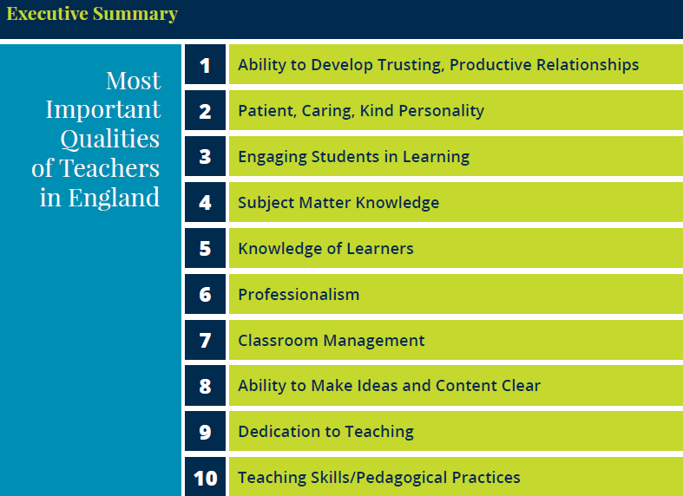
England: What makes an effective teacher?
Inicio
60 segundos
60
45
30
15
0
Katherine McKnight, PhD, Pearson
Lacey Graybeal, Jessica Yarbro, & John Graybeal, George Mason University
Notes:
https://www.pearson.com/content/dam/one-dot-com/one-dot-com/global/Files/efficacy-and-research/schools/global-survey/reports/RINVN9283_UK_July_ExecSum.pdf

Slide 3
Summary of key theoretical model
Motivation concerns the fundamental question of why people behave as they do, that is, the choice of a particular action, the persistence with it, and the effort expended on it.
With a long-term learning process such as the mastery of a second language, learners' ultimate success will depend heavily on their level of motivation.
Because motivation always manifests itself in a dynamic interplay with other personal and contextual factors, a particularly fruitful approach to conceptualizing motivation is by focusing on motivational conglomerates of various motivational, cognitive, and emotional variables that form coherent patterns and, as such, act as wholes.
One motivational conglomerate that offers a particularly useful framework for language educators is the learners' future vision of themselves.
Language-specific vision is operationalized within the broader construct of the L2 motivational self system, which highlights three primary sources of L2 motivation: the learners' vision of themselves as effective L2 speakers (ideal L2 self); the social pressure coining from the learner's environment (ought-to L2 self); and the learners’ positive learning experiences.
Skills in motivating learners are central to effective teaching; relevant motivational strategies can be divided into three main clusters. focusing on: (I) the learner's future vision; (2) the individual's learning experience; and (3) the group's learning experience.
Taken from: Dörnyei, Z. (2014). Motivation in second language learning. In M. Celce-Murcia, D. M. Brinton & M. A. Snow (Eds.), Teaching English as a second or foreign language (4th ed., pp. 518-531). Boston, MA: National Geographic Learning/Cengage Learning.

Slide 4

Planning
Prior learning
Priming (or creating the climate)
Promoting participation
Defining progress

Slide 5


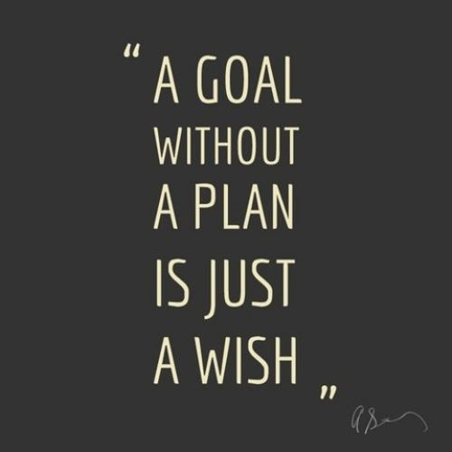
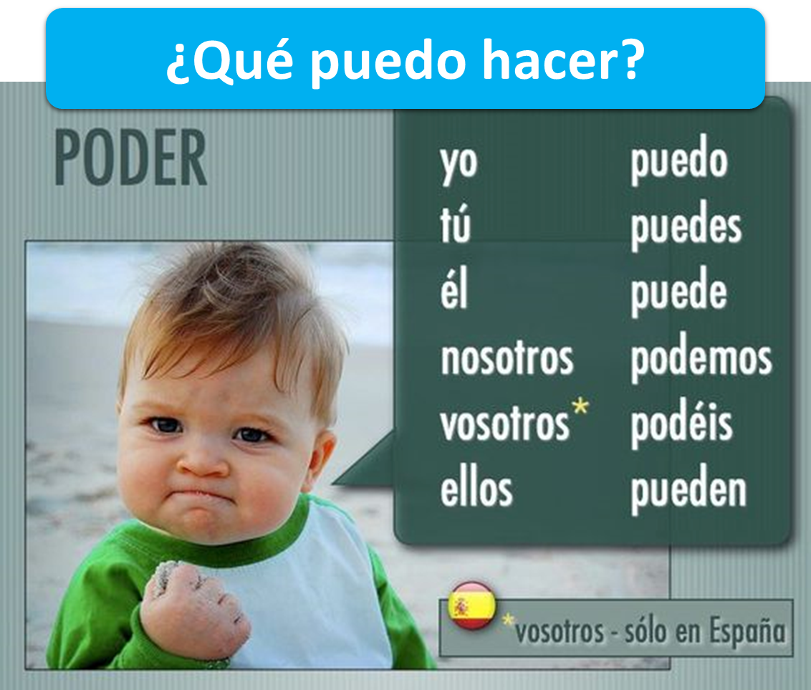

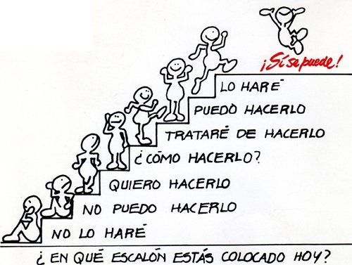
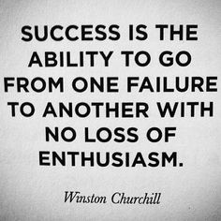
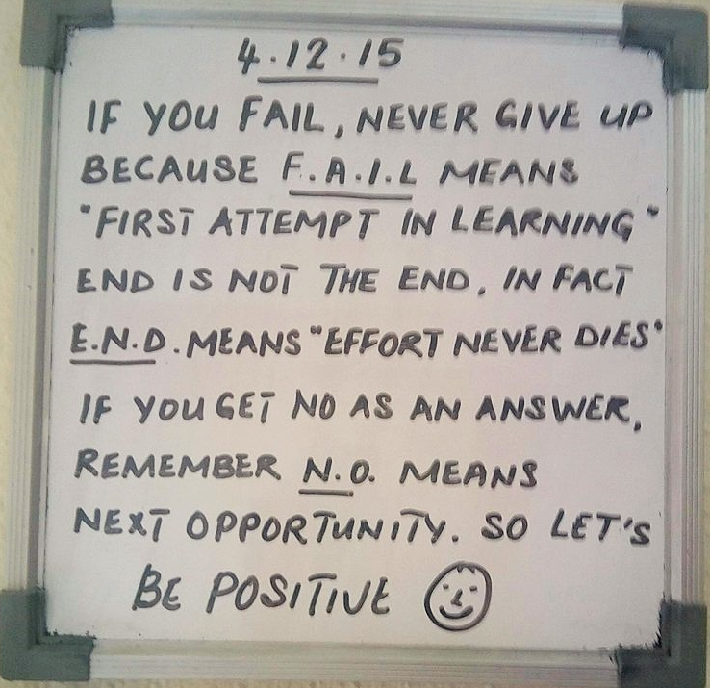


Slide 6


Creating the climate for learning
DOs
take risks
have a go
show good ‘audience’ skills
respond to others’ contributions
ask questions
make links
Co-teachers
Two rules for the classroom
1) Do everything to help yourself learn as much as you can
2) Do everything to help others learn
DONTs
think everyone else knows the answer
keep quiet when you’re not sure
get cross if you know the answer but don’t get to contribute

Slide 7





¿Tienes un problema??
Cerebro
Cuaderno
Compañero
Notes:
all images copyright free for non for profit use from www.clker.com

Slide 8



Hoy vamos a…
pensar
leer
cantar
conversar
osar

Slide 9

Promoting participation
Consistently high expectations
Frequent reminders
Recognition and rewards
Randomised selection

Slide 10

Progress: learning stages
Recognise (in sound / writing)
Understand (in sound / writing)
Pronounce (independently)
Produce (in speech / writing) with support
Produce (in speech / writing) from memory
Use (in speech / writing) in free communication
The main curriculum content in language learning is grammar and vocabulary.
Apply these stages in your planning whether the learning focus is grammar or vocabulary, or both.

Slide 11
Usar para comunicarse
Producir de memoria
Producir con ayuda
Pronunciar
Comprender
Reconocer
¿Cómo se dice en español?
1 What do you like doing?
2 I like listening to music.
3 I also like playing video games.
4 I really like going out with my friends, of course.
5 But I don’t like writing emails and…
6 I don’t like singing karaoke at all. And you? Do you sing karaoke?
la escalera del saber

